Slide 1
Henry V: A linear time algorithm for solving the N-Queens Problem using only 5 patterns
Ali Dehghani, Reza Namvar, Abdullah Khalili
28th International Computer Conference, Computer Society of Iran (CSICC), Tehran, Iran, 25-26 Jan. 2023
Presenter: Hsin-Chang Yu
Date: Nov. 21, 2023

Slide 2
Abstract
It has been known that the time complexity of solving the N-Queens problem, a classic problem with many applications in computer science is Nondeterministic Polynomial (NP). Many different approaches have been proposed for solving the problem since its first presentation in 1848 including genetic algorithms, brute force search and propositional logic statements.

Slide 3
Abstract
In this paper, a novel idea called Layouts have been proposed to solve this problem in θ(n) time complexity. Layouts are patterns for placing queens on the chessboard. Correctness of the proposed approach has been proven for all natural numbers using proof by contradiction and exhaustion.

Slide 4
Abstract
It is shown that by using only 5 layouts, N-Queens with any size can be solved in linear time. The proposed approach has been verified by being applied to 60 different sizes of the N-Queens problem where the size has been chosen by randomly selecting a number between 1000 and 10000.

Slide 5
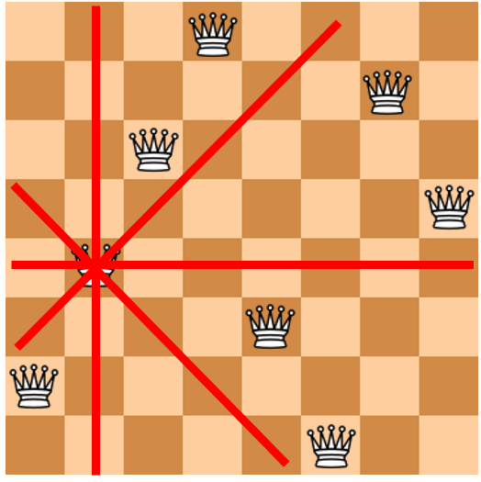
N-Queens Problem

Slide 6
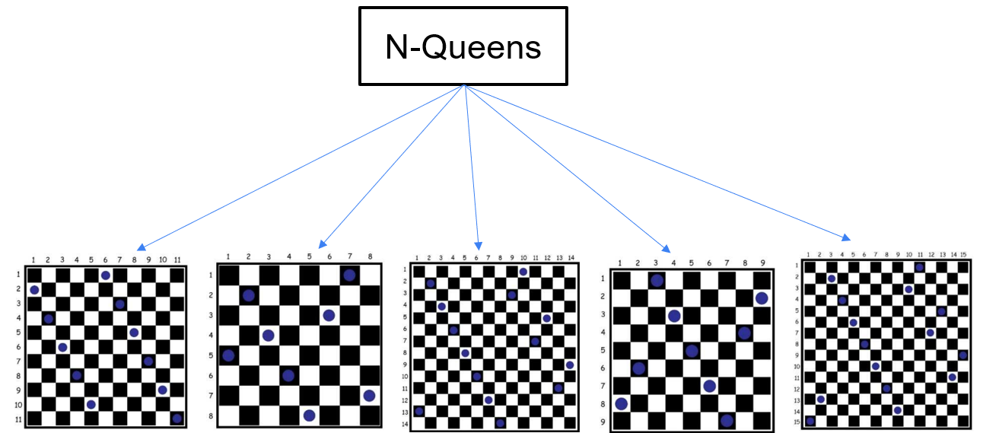
5 Layouts

Slide 7
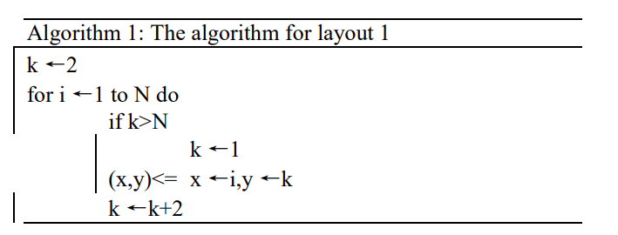
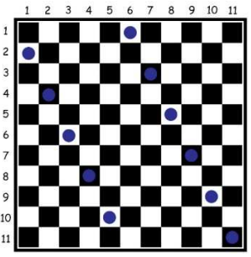
Layout 1
N is in the form of
6i, 6i+1, 6i+4, 6i+5

Slide 8
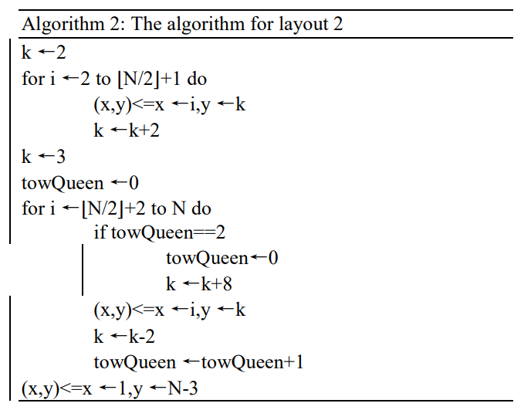
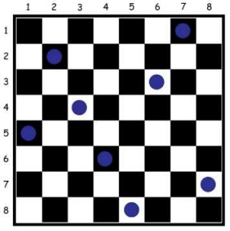
Layout 2
N is in the form of
12i+8

Slide 9
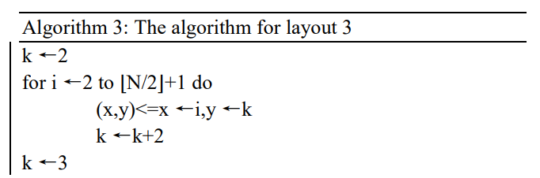
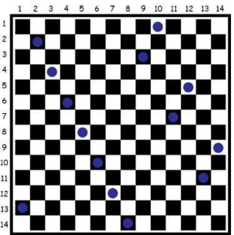
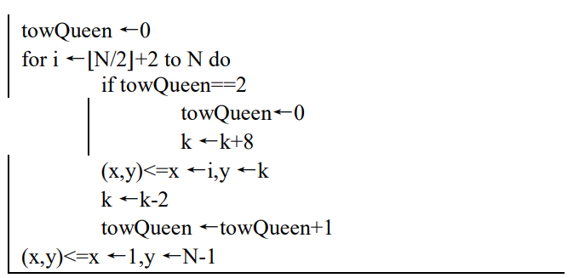
Layout 3
N is in the form of
12i+2

Slide 10
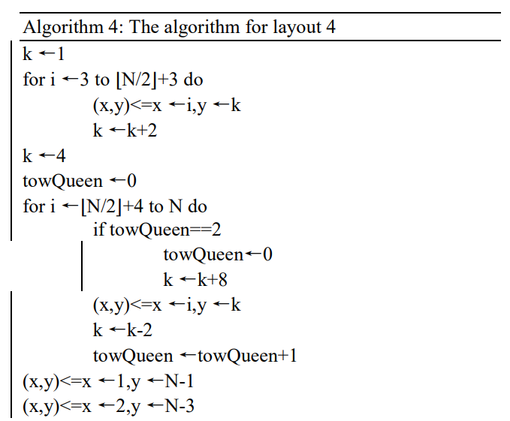
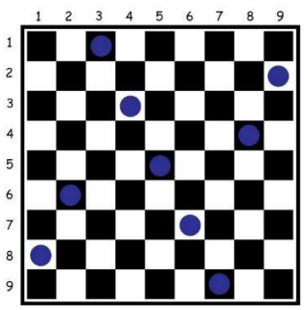
Layout 4
N is in the form of
12i+9

Slide 11

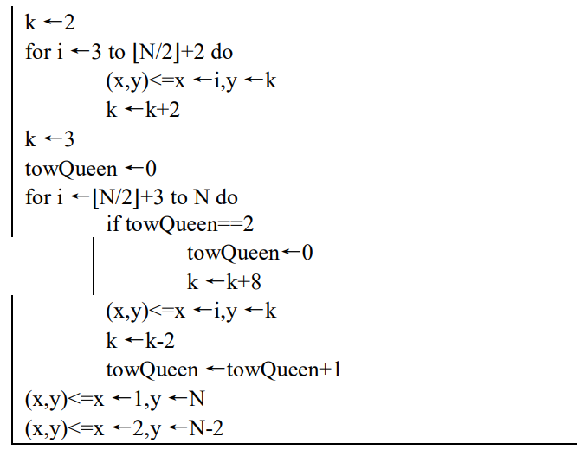
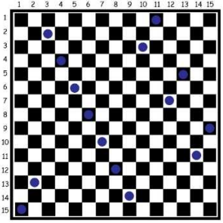
Layout 5
N is in the form of
12i+3

Slide 12
Correctness Proof
Proving that these five layouts can solve any case of the N-Queens problem.
Proving that when considering an N × N chessboard as an N × N matrix, each layout is producing a correct solution for its associated number set.

Slide 13
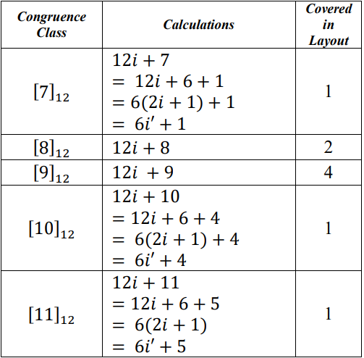
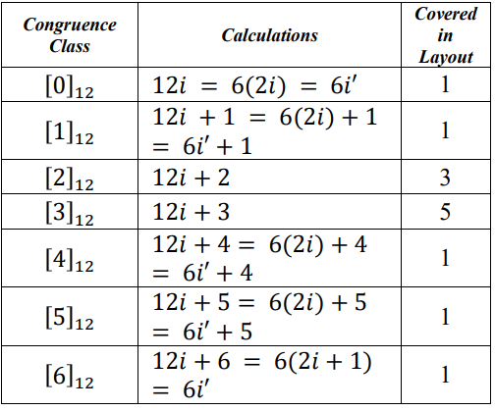
Proof (i)

Slide 14
Proof (ii). Skip

Slide 15

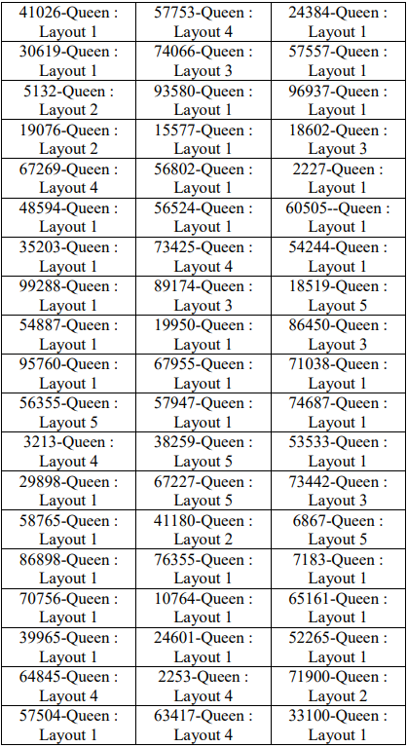
Result

Slide 16
Thanks
Notes:
Given a string S of length n, an integer p ∈ [1..n] is a period of S if S[i] = S[i + p] for all i ∈ [1..n − p].
S[|S| − p + 1] = c

