Slide 1
Combining Probabilities
Kevin Leyton-Brown. University of British Columbia.
Probability and Combinatorics. (Apr. 22, 2019)
Presenter: Yu-Chen Lin
Date: Dec. 26, 2023

Slide 2
Abstract
This article delves into the problem of determining the probability of an event occurring when two predictors make conflicting predictions. The author utilizes a system of linear equations to represent the probabilities of various outcomes and discusses the uncertainty and underspecification inherent in the problem. Throughout the discussion, the author introduces prior assumptions regarding the reliability of the predictors and the a priori probability of the event, elucidating their impact on the final probability calculation. The discourse extends to scenarios involving multiple predictors, outlining a method to calculate the probability of an event based on the predictions of several individuals under the assumptions of pairwise independence and symmetry between "yes" and "no." The article concludes by proposing how to estimate event probabilities under reasonable assumptions in the absence of additional information.

Slide 3
Problem Description
Correct : 0.75
Mr. Smith, who is correct 75% of the time.
Mr. Jones, who is correct 60% of the time.
Mr. Smith
Wrong : 0.25
Correct : 0.6
If Mr. Jones claims that X will occur and Mr. Smith claims that X will not occur, what’s the probability of X occur?
Mr. Jones
Wrong : 0.4

Slide 4
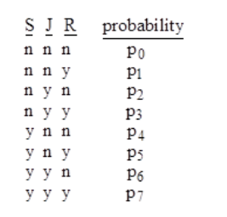


Slide 5
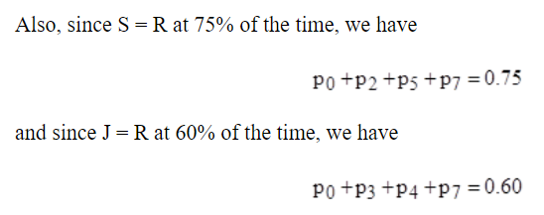

Slide 6


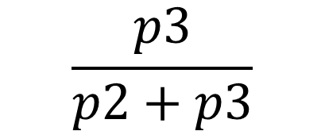
We want to determine the probability that R = y given that S = n and J = y, which is the probability of [n y y] divided by the probability of [n y *].
$$\frac{p3}{p2+p3}$$
?

Slide 7

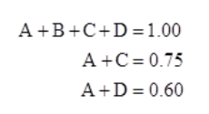


Setting A = p₀ + p₇, B = p₁ + p₆, C = p₂ + p₅, and D = p₃ + p₄

Slide 8
Three linear equations in four unknowns.
For example, we can set
A = 0.5, B = 0.25, C = 0.15, and D = 0.10
OR
A = 0.6, B = 0.25, C = 0.15, and D = 0.00
∞ solutions

Slide 9
Nevertheless, in real life the problems we confront are often (always?) underspecified, but we must still make decisions.
We can make "reasonable" assumptions.
One approach would be to estimate (guess) how much correlation exists between the correctness of J and S.

Slide 10
For example, since S seems to be smarter than J, we might assume that S is correct whenever J is correct, as well as being correct on some experiments when J is incorrect.
This would imply that p₃ = p₄ = 0 and p₂ > 0, so the probability of X occur is 0.

Slide 11
Another approach would be to assume that the correctness of S and J's predictions are statistically independent, in the sense that they are each just as likely to be right regardless of whether the other is right or wrong.

Slide 12
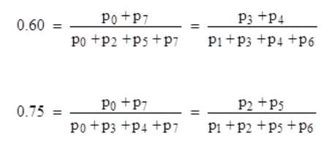





Slide 13








Slide 14







Slide 15








Slide 16
Letting u = 0.6 and v = 0.75

Slide 17
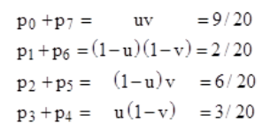

Slide 18














But this still doesn't uniquely determine the value of p₃/(p₂ + p₃).
We need at least one more assumption.
We assume symmetry between "y" and "n".
In other words, assume that probability of any combination is equal to the probability of the complementary combination, given by changing each "y" to an "n" and vice versa.

Slide 19




Slide 20
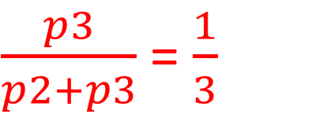
p₂ = 6/40, p₃ = 3/40
Therefore
$\frac{p3}{p2+p3}$ = $\frac{1}{3}$

Slide 21
Notice that our resulting value for the probability of X is not equal to the a priori value of 1/2 that we assumed by imposing symmetry between "y" and "n".
If we have some a priori reason to believe the probability of X is something different than 1/2, we could re-do the calculation using this value.

Slide 22
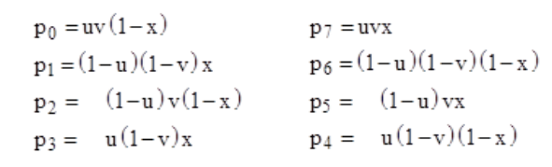

To account for this additional information (if we have it), we can let x denote the a priori probability of X, and then write the individual state probabilities as follow:

Slide 23
We suppose Mr. Red's ability to correctly identify the outcome of a TRUE/FALSE experiment is 75%, Mr. Green's is 60% and Mr. Blue's is 55%.
If all of them agree that the outcome of the experiment is TRUE, is the resulting probability of "TRUE" 75% or is it weighted somewhere between 75% and 55% ?
75% ?
55% < x < 75% ?

Slide 24
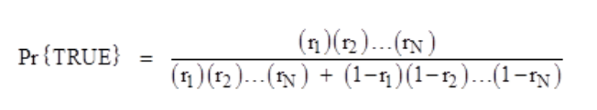

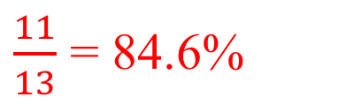
This is underspecified, but if we impose the assumptions of (1) pairwise independence and (2) "y"/"n" symmetry, then in the general case of N prognosticators these two assumptions are sufficient to uniquely determine the answer.
$\frac{11}{13}$ = 84.6%

Slide 25
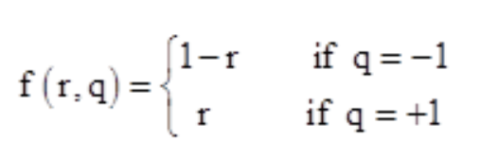
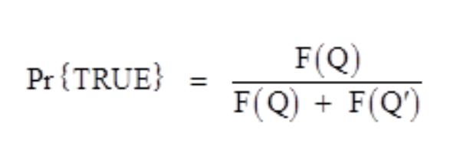
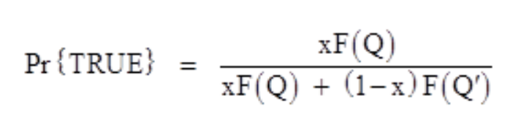

Slide 26
Conclusion
It present a reasonable way to combine the predictions of the occurrence of an event.
It assumes that the correctness of Smith's predictions is totally uncorrelated with the correctness of Jones's predictions, which would almost certainly not be the case in any realistic situation.

