Slide 1
Finding top-k longest palindromes in substrings
Kazuki Mitani, Takuya Mieno, Kazuhisa Seto, Takashi Horiyama
Theoretical Computer Science 979 (2023) 114183
Presenter: Shih-Hong Li
Date: Dec. 26, 2023

Slide 2
Abstract
Palindromes are strings that read the same forward and backward. Problems of computing palindromic structures in strings have been studied for many years with the motivation of their application to biology. The longest palindrome problem is one of the most important and classical problems regarding palindromic structures, that is, to compute the longest palindrome appearing in a string T of length n. The problem can be solved in O(n) time by the famous algorithm of Manacher (1975). This paper generalizes the longest palindrome problem to the problem of finding the top-k longest palindromes in an arbitrary substring, including the input string T itself. The internal top-k longest palindrome query is, given a substring T [i.. j] of T and a positive integer k as a query, to compute the top-k longest palindromes appearing in T [i.. j]. This paper proposes a linear-size data structure that can answer internal top-k longest palindromes query in optimal O(k) time. Also, given the input string T , our data structure can be constructed in O(n logn) time. For k = 1, the construction time is reduced to O(n).

Slide 3
Manacher’s algorithm(1/2)
Let T = abba
Preprocess
T = #a#b#b#a#
P[1…2n-1] = 0
Time complexity = O(n)

Slide 4
Manacher’s algorithm(2/2)
T = #a#b#b#a#
Traverse T:
Expand centered on position 1 (character ‘#‘)，longest palidrom radius is 0，update P[1] = 0
Expand centered on position 1 (character ‘a‘)，longest palidrom radius is 1，update P[2] = 1
Expand centered on position 1 (character ‘#‘)，longest palidrom radius is 0，update P[3] = 0
Expand centered on position 1 (character ‘b‘)，longest palidrom radius is 1，update P[4] = 1
……..

Slide 5
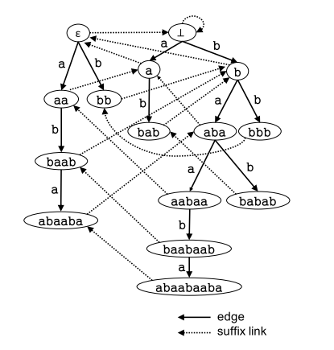
Palindromic trees
T = abaabaabababbb
Solid Line = Edges
Dashed Line = Suffix Link

Slide 6
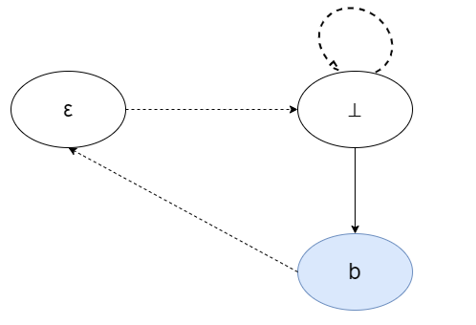
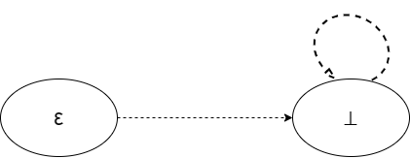
Construct tree
Initial
T = abaabaabababbb

Slide 7
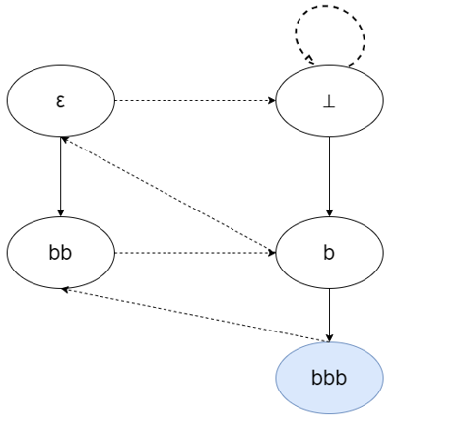
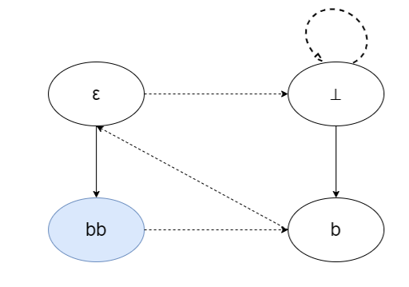
Construct tree
T = abaabaabababbb
T = abaabaabababbb

Slide 8
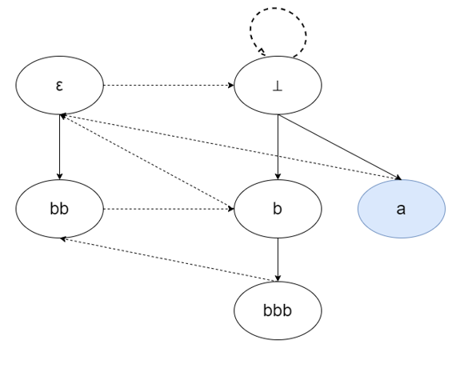
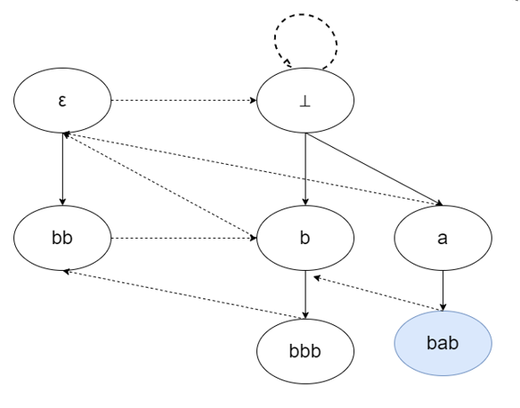
Construct tree
T = abaabaabababbb
T = abaabaabababbb

Slide 9
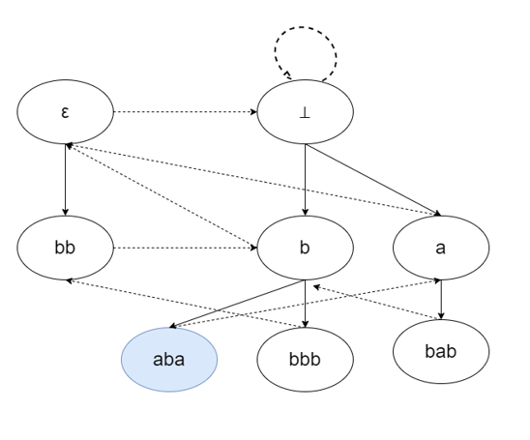
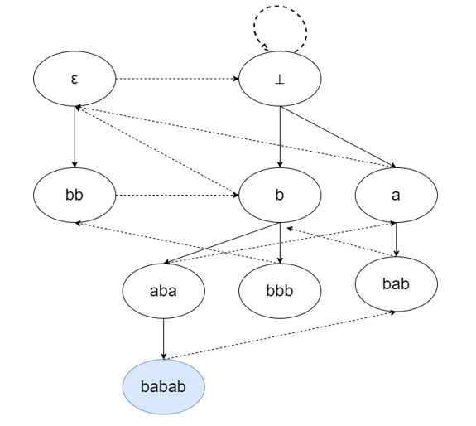
Construct tree
T = abaabaabababbb
T = abaabaabababbb

Slide 10
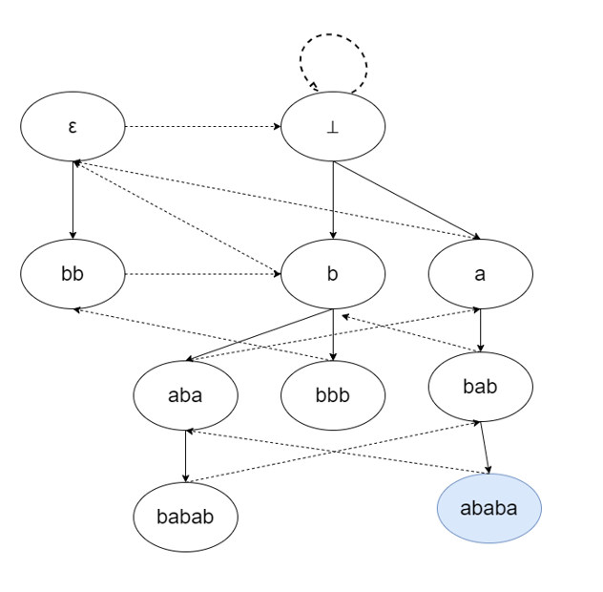
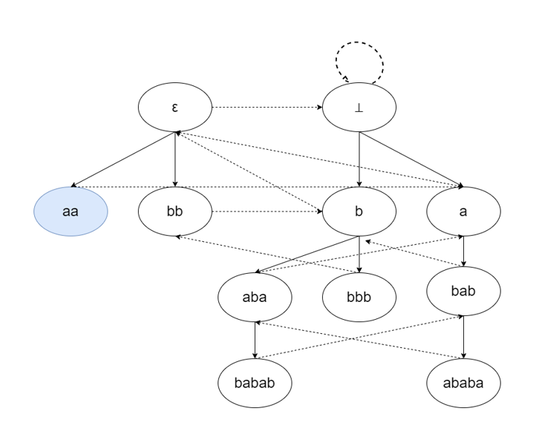
Construct tree
T = abaabaabababbb
T = abaabaabababbb

Slide 11
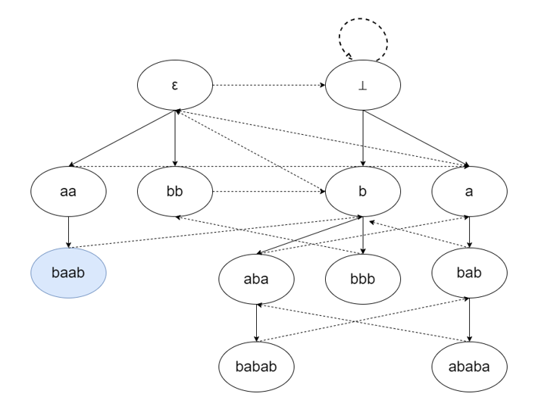
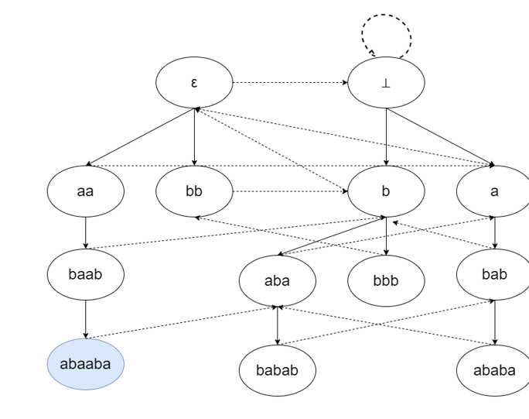
Construct tree
T = abaabaabababbb
T = abaabaabababbb

Slide 12
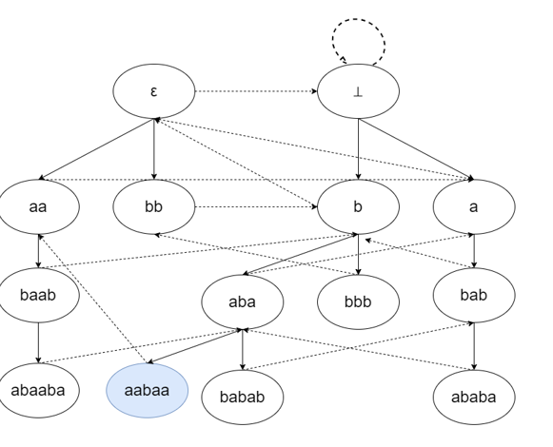
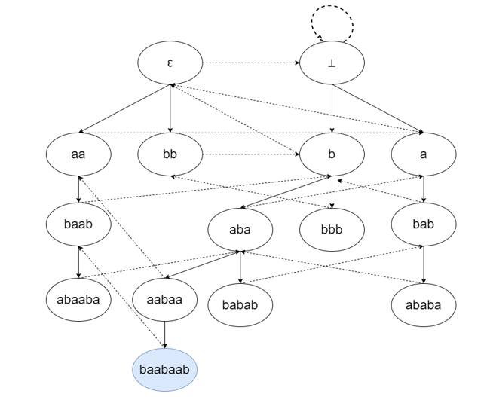
Construct tree
T = abaabaabababbb
T = abaabaabababbb

Slide 13
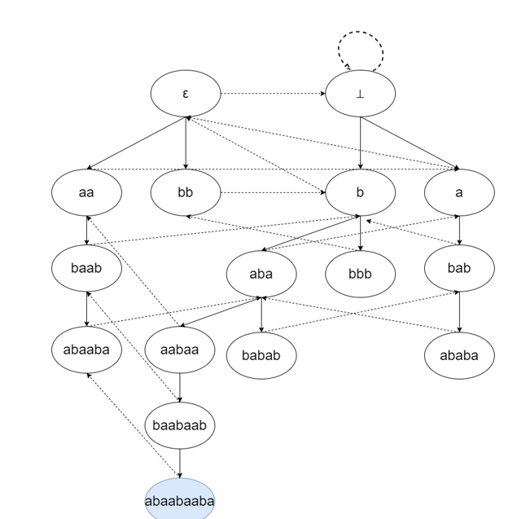
Construct tree
T = abaabaabababbb
LSufPa[1..n] :
stores a pointer to the node in paltree(T) corresponding to the longest palindromic suffix of T [1.. j]
for each 1 ≤ j ≤ n
And so as LSufPa[1..n](the longest palindromic suffix)
Time Complexity = O(n)

Slide 14
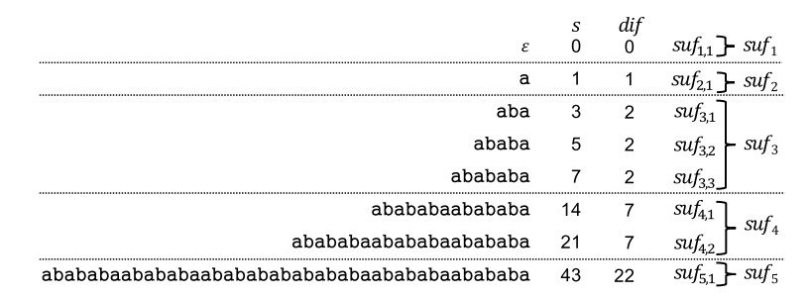
Palindromic suffixes of a string and the partition
Notes:
Palindromic suffixes of a string and the partition (suf 1,..., suf 5) of their lengths. Three integers s3 = 3, s4 = 5, and s5 = 7 are represented by a single arithmetic progression suf 3 since dif 3 = dif 4 = dif 5 = 2. Since s4 is the second smallest term in suf 3, suf 3,2 = s4.

Slide 15
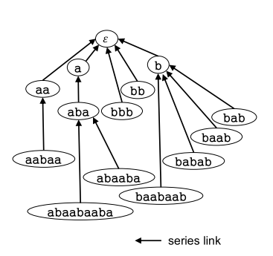
Seriestree tree
E.g. : node (abaabaaba)
| abaabaaba | - | abaaba | = 3
| abaaba | - | aba | = 3
| aba | - |a| = 2
The serieslink(abaabaaba) = aba
Time complexity = O(n)

Slide 16
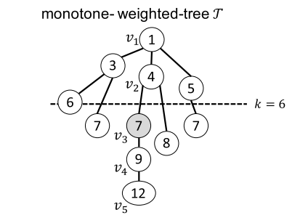
Monotone-weightedtree
WAQT (v,k)
E.g : WAQT (v₅,6) = V₃
The query time : O(loglog n)

Slide 17
The Range Minimal Query (RMQ)
A = [1,3,7,4,10,2]
RMQ_{max}(A,1,3)= 7
Use Cartesian tree of array A :O(1) answering time

Slide 18
Internal longest palindrome query
Query input : Two indices i and j with 1 ≤ i ≤ j ≤ n
Query output: The longest palindromic substring in T [i.. j]
Idea : the longest palindromic substring will apper at the longest palindromic prefix,suffix,infix
Internal longest palindrome query = MAX(prefix,suffix,infix)

Slide 19

Step 1: Obtain the longest palindromic suffix of T [1.. j]
The longest palindromic suffix v of T[1..j] is stored in LSufPal[j]
If |v|$≤$ | T[i..j]| : answer，return T[j-|v|+1...j]
Else: goto step 2

Slide 20
Step 2: Determine the group to which the desired length belongs
u= WAQseriestree(T)(v, j − i)
Let suf _{α} be the group such that |u| ∈ suf _{α}. If the smallest element
suf _{α,1} in suf _{α} is at most |T [i.. j]|, the length belongs to the same group suf _{α} as |u|. Otherwise, the length l belongs to the previous group suf _{α−1}

Slide 21
Step 3: Calculate the desired length
Let suf _{β} be the group to which the length l belongs, which is determined in Step 2. Since suf _{β} is an arithmetic progression
i.e., suf _{β,γ} = suf _{β,1} + (γ − 1)dif _{β} for 1 ≤ γ ≤ |suf _{β} |, the desired length can be computed by using a constant number of arithmetic operations. Then, we return T [j − l+ 1.. j]
Compute the longest palindromic prefix of T [i.. j] in a symmetric way using LPrePal instead of LSufPal.

Slide 22
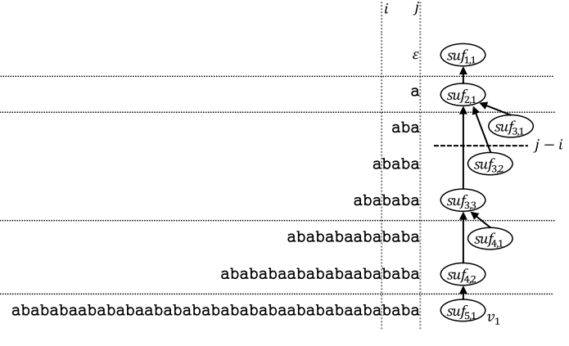
Example
T[1..j] = abababaabababaabababababababaabababaabababa
Compute the longest palindromic suffix if T[i..j]
Step 1 : v1 is the longest palindromic suffix in T[1..j]
Step 2 : WAQseriestree(T )(v1, j − i) = suf_{3,3}
Step 3 : suf _{3,3} = suf _{3,1} + (3 − 1)*2
suf _{3,1} is the longest palindromic suffix of T[i..j]

Slide 23
Palindromic infixes
Let w be a palindromic substring of T
Let c be the center of w
The longest Palindromic infixes center must be located at (i+t)/2<c<(s+j)/2
MP[1..2c-1] : stores the length of the maximal palindrome whose center is c
By using Manacher’s algorithm construct MP in O(n)

Slide 24
Palindromic infixes
The longest palindromic suffix : T[s..j]
The longest palindromic prefix : T[i..t]
The Center of the longest Palindromic infixes is in (i+t)/2<c<(s+j)/2
Palindromic infixes = MP[RMQMP(i + t, s + j − 2)]
Time complexity : O(n)

Slide 25
Top-k longest palindromes problem
A maximal palindrome in T
the shrink of the q-th longest palindrome for some q with 1 ≤ q ≤ r − 1
By using Manacher’s algorithm construct M[1..2n-1] in O(n)
M[p]: stores the p-th longest maximal palindrome in T
R[1..n] : R[l] stores the set of palindromes of length l

Slide 26
Top-k longest palindromes problem
E.g. :
The longest palindrome is M[1]=[s,t] , than update R[t-s+1] ={[s,t]}
then second,third…. : the length r of the r-th longest palindrome is in {R[l_{r−1}], R[l_{r−1} −1], R[l_{r−1} −2]}
Time complexity :
Manacher’s algorithm construct M[1..2n-1] : O(n)
Answering Top-k palindromes : O(k)
Total : O(n+k)

Slide 27
Internal Top-k longest palindromes query
Query input: An interval [i, j] and an integer k
Query output: An array TopLPalT ([i, j],k)

Slide 28
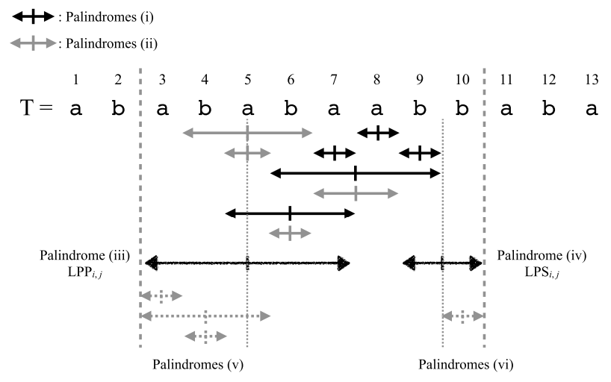
The r-th longest palindrome in a string T[i.. j] is one of the followings

Slide 29
Example
TopLPalT ([3, 10],5),given a string T = abababaabbaba
Preprocess:
M[1..27]
R[1..13]
1 | 2 | 3 | 4 | 5 | 6 | 7 | 8 | 9 | 10 | 11 | 12 | 13 | 14 | 15 | 16 | 17 | 18 | 19 | 20 | 21 | 22 | 23 | 24 | 25 | 26 | 27
# | a | # | b | # | a | # | b | # | a | # | b | # | a | # | a | # | b | # | b | # | a | # | b | # | a | #
0 | 1 | 0 | 3 | 0 | 5 | 0 | 7 | 0 | 5 | 0 | 3 | 0 | 1 | 4 | 1 | 0 | 1 | 4 | 1 | 0 | 3 | 0 | 3 | 0 | 1 | 0
1 | 2 | 3 | 4 | 5 | 6 | 7 | 8 | 9 | 10 | 11 | 12 | 13
[1][7] | Nil | [1..3] | [6..9] | [3..7] | Nil | [1..7] | Nil | Nil | Nil | Nil | Nil | Nil
[8][9] [10][13] |  | [5..7] [10..12] [11..13] | [8..11]

Slide 30
Example
Find the first palindrome : like Internal longest palindrome query
Longest palindrome prefix = T[3..7]
Longest palindrome suffix = T[9..10]
Longest palindrome infix = M[RMQM(3+ 7, 9 + 10 − 2)] = M[RMQM(10,17)] =T[3..7] but c=5 not satisfy，next[6..9] satisfy
MAX(| T[3..7] |,| T[9..10] |,| T[6..9] |) = T[3..7]
Update R[5]={[3..7]}
1 | 2 | 3 | 4 | 5 | 6 | 7 | 8 | 9 | 10 | 11 | 12 | 13 | 14 | 15 | 16 | 17 | 18 | 19 | 20 | 21 | 22 | 23 | 24 | 25 | 26 | 27
# | a | # | b | # | a | # | b | # | a | # | b | # | a | # | a | # | b | # | b | # | a | # | b | # | a | #
0 | 1 | 0 | 3 | 0 | 5 | 0 | 7 | 0 | 5 | 0 | 3 | 0 | 1 | 4 | 1 | 0 | 1 | 4 | 1 | 0 | 3 | 0 | 3 | 0 | 1 | 0
 | 1 |  | 2 |  | 3 |  | 4 |  | 5 |  | 6 |  | 7 |  | 8 |  | 9 |  | 10 |  | 11 |  | 12 |  | 13

Slide 31
Example
The second-longest palindrome is in :
Longest palindrome infix = T[6..9]
Longest palindrome suffix = T[9..10]
Shrink of Longest palindrome prefix = T[4..6]
Update R[4] = {[6..9]}
The second Longest palindrome infix = T[5..7]
1 | 2 | 3 | 4 | 5 | 6 | 7 | 8 | 9 | 10 | 11 | 12 | 13 | 14 | 15 | 16 | 17 | 18 | 19 | 20 | 21 | 22 | 23 | 24 | 25 | 26 | 27
# | a | # | b | # | a | # | b | # | a | # | b | # | a | # | a | # | b | # | b | # | a | # | b | # | a | #
0 | 1 | 0 | 3 | 0 | 5 | 0 | 7 | 0 | 5 | 0 | 0 | 0 | 1 | 4 | 1 | 0 | 1 | 4 | 1 | 0 | 3 | 0 | 3 | 0 | 1 | 0
 | 1 |  | 2 |  | 3 |  | 4 |  | 5 |  | 6 |  | 7 |  | 8 |  | 9 |  | 10 |  | 11 |  | 12 |  | 13

Slide 32
Example
The third longest palindrome is in:
The second Longest palindrome infix = T[5..7]
Longest palindrome suffix = T[9..10]
Shrink of Longest palindrome prefix = T[4..6]
T[5..7] and T[4..6] both length 3
Since infix is a palindromic substring of LPP_{3,10} that has been choice the mirror T[3..5] also a palidrom
Update P[3] = {[3..5],[5..7],[4..6]}
New Longest palindrome prefix = T[4..6]

Slide 33
Example
The top-5 palidroms R={[3, 7],[6, 9],[5, 7],[4, 6],[3, 5]}
Tome complexity :
construct a data structure : O(n logn)
Answer the any interal top-k longest palindrome query : O(k) time
1 | 2 | 3 | 4 | 5 | 6 | 7 | 8 | 9 | 10 | 11 | 12 | 13
[1][7] | Nil | [5..7] | [6..9] | [3..7] | Nil | [1..7] | Nil | Nil | Nil | Nil | Nil | Nil
[8][9] [10][13] |  | [4..6] [3..5]

Slide 34
Thanks

