Slide 1
A Real Linear and Parallel Multiple Longest Common Subsequences (MLCS) Algorithm
Yanni Li, Hui Li, Tihua Duan,
Sheng Wang, Zhi Wang, Yang Cheng
KDD '16 Proceedings of the 22nd ACM SIGKDD International Conference on Knowledge Discovery and Data Mining
Pages 1725-1734
San Francisco, California, USA — August 13 - 17, 2016
Presenter: Shou-Fu Lo
Date:2017/07/11

Slide 2
Abstract(1/2)
Information in various applications is often expressed as
character sequences over a ﬁnite alphabet (e.g., DNA or
protein sequences). In Big Data era, the lengths and sizes
of these sequences are growing explosively, leading to grand
challenges for the classical NP-hard problem, namely search-
ing for the Multiple Longest Common Subsequences (MLC-
S ) from multiple sequences. In this paper, we ﬁrst unveil the
fact that the state-of-the-art MLCS algorithms are unable
to be applied to long and large-scale sequences alignments.

Slide 3
Abstract(2/2)
To overcome their defects and tackle the longer and large-
scale or even big sequences alignments, based on the pro-
posed novel problem-solving model and various strategies,
e.g., parallel topological sorting, optimal calculating, reuse
of intermediate results, subsection calculation and serializa-
tion, etc., we present a novel parallel MLCS algorithm. Ex-
haustive experiments on the datasets of both synthetic and
real-world biological sequences demonstrate that both the
time and space of the proposed algorithm are only linear in
the number of dominants from aligned sequences, and the
proposed algorithm signiﬁcantly outperforms the state-of-
the-art MLCS algorithms, being applicable to longer and
large-scale sequences alignments.

Slide 4
LCS/MLCS
In the past forty years, in order to eﬃciently tackle the
LCS/MLCS problem, various types of LCS/MLCS algo-
rithms and tools (e.g., SAMtools1 , BLAST2 , Clustal
Omega3 , etc.) have been proposed, which can be divided into
two categories: classical dynamic programming and dominant-
point-based algorithms.
S1 = TGACGATC ,
S2 = ATGCTCAG and
S3 = CTAGTACG over Σ = {A, C, G, T },
there are 4 MLCSs with length 4, namely MLCS₁ = AGTC,
MLCS₂ = TGTC , MLCS₃ = TGAG and MLCS₄ = TGCG.

Slide 5
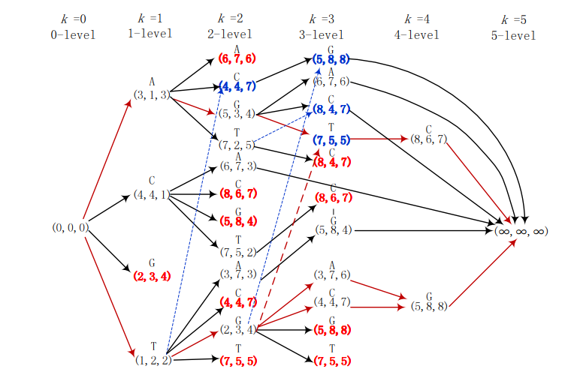
MLCS-DAG(Directed Acyclic Graph)
S1 = TGACGATC ,S2 = ATGCTCAG and S3 = CTAGTACG

Slide 6
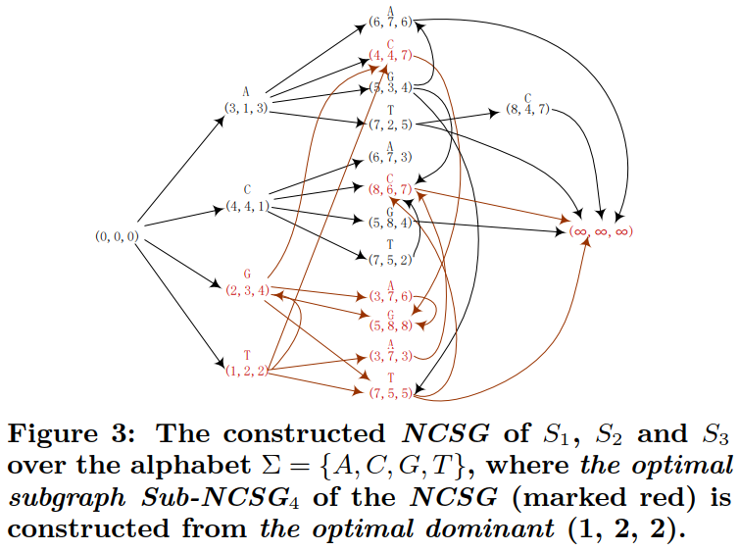
A Novel Problem-Solving Model: NCSG
S1 = TGACGATC ,S2 = ATGCTCAG and S3 = CTAGTACG

Slide 7
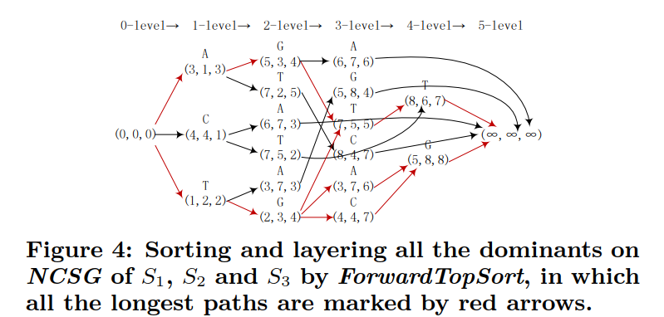
A Strategy to Mine MLCSs: Forward/ Back- ward Topological Sorting on NCSG
S1 = TGACGATC ,S2 = ATGCTCAG and S3 = CTAGTACG

Slide 8
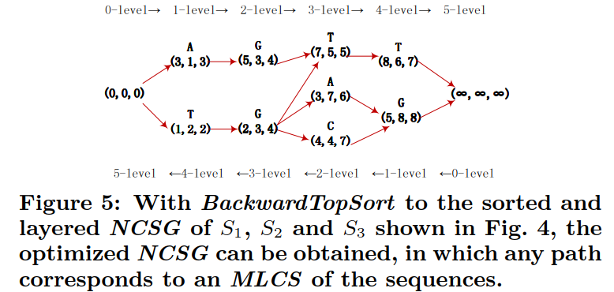
A Strategy to Mine MLCSs: Forward/ Back- ward Topological Sorting on NCSG
S1 = TGACGATC ,S2 = ATGCTCAG and S3 = CTAGTACG
All the non-critical points in the NCSG are now identiﬁed and
can be easily removed.

Slide 9
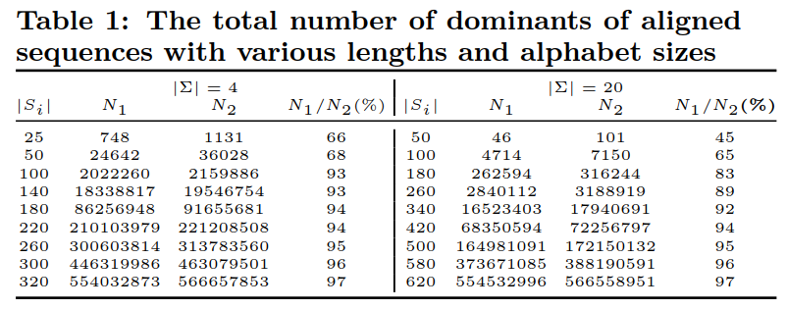
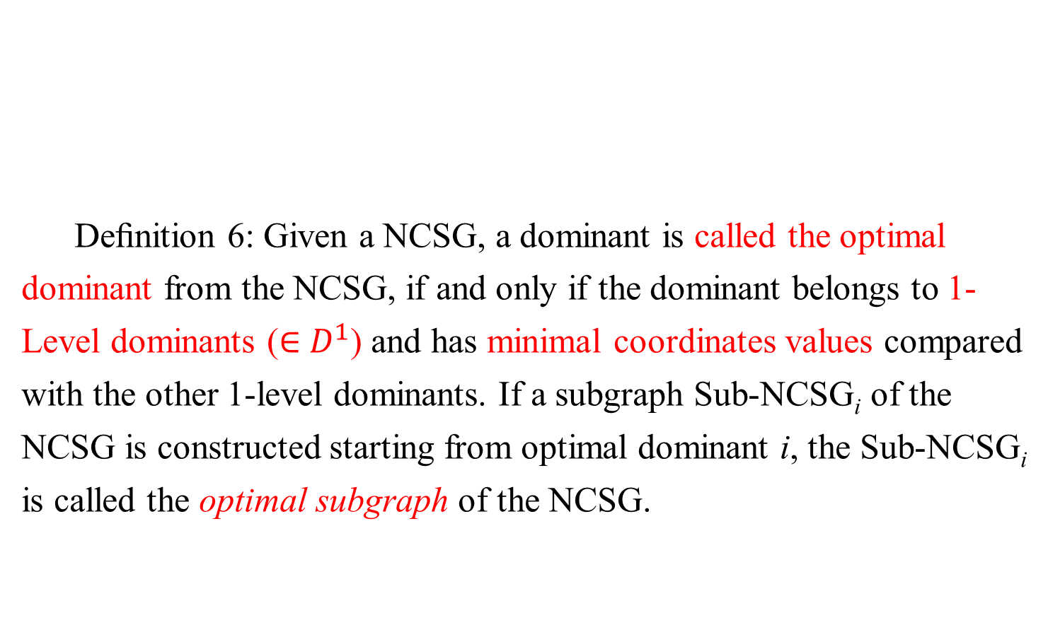
Strategies against the Challenges
Deﬁnition 6: Given a NCSG, a dominant is called the optimal
dominant from the NCSG, if and only if the dominant belongs to 1-
Level dominants (∈ $D^{1}$) and has minimal coordinates values compared
with the other 1-level dominants. If a subgraph Sub-NCSG_{i} of the
NCSG is constructed starting from optimal dominant i, the Sub-NCSG_{i}
is called the optimal subgraph of the NCSG.

Slide 10
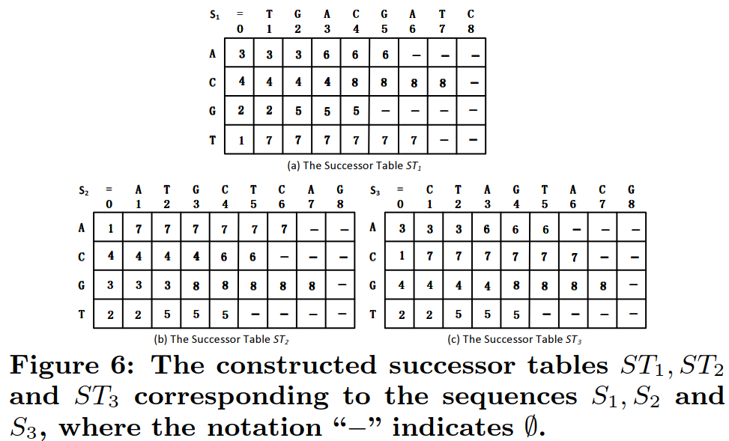
A Parallel Algorithm RLP_MLCS
Strategy 1: Successor Table

Slide 11
A Parallel Algorithm RLP_MLCS
Strategy 2: DM(Index, Point)
We present a bidirectional hash table DM(Index, Point),
wherein the Point represents a d-dimensional coordinates
of a dominant and Index is a serial number corresponding
to the dominant.
DM ={〈0, (0, 0, 0)〉, 〈 1, (3, 1, 3) 〉, 〈 2, (4, 4, 1) 〉,
〈3, (2, 3, 4)〉,〈4,(1, 2, 2)〉, 〈 5,(3, 7, 3) 〉, 6,(4, 4,
7)〉, 〈7,(7, 5, 5)〉, 〈8,(5, 8, 4) 〉,〈9, (5, 8, 8) 〉, 〈 10,
(3, 7, 6)〉, 〈11, (8, 6, 7) 〉, 〈12, (∞, ∞, ∞)〉,〈13, (5, 3,
4)〉, 〈14, (7, 2, 5)〉, 〈15, (6, 7, 6)〉, 〈 16, (8, 4, 7)〉,
〈17, (6, 7, 3)〉, 〈18, (7, 5, 2)〉, }.

Slide 12
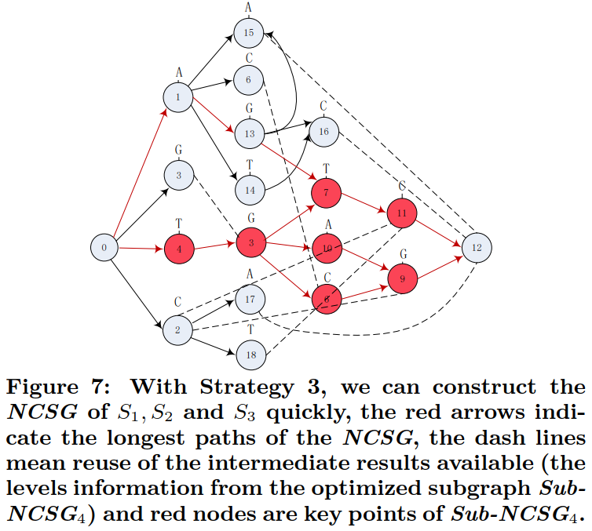
A Parallel Algorithm RLP_MLCS
Strategy 2:
DM(Index, Point)

Slide 13
A Parallel Algorithm RLP_MLCS
Strategy 3: The Optimal Calculation and Reuse of Intermediate
Results.
Our extensive experiments and analysis reveal the fact that the
optimal subgraph Sub-NCSG_{i} of NCSG not only contains most
of the dominants of the NCSG (45%-97%, average 88%, see
Table 1), but also contributes to most of the MLCSs (75%-100%,
average 85%).
For example, the optimal dominant (1, 2, 2) shown in Fig. 3
contributes to three MLCSs of the sequences S1 , S2 and S3 ,
which is 3 out of 4 MLCSs, accounting for 75%.

Slide 14
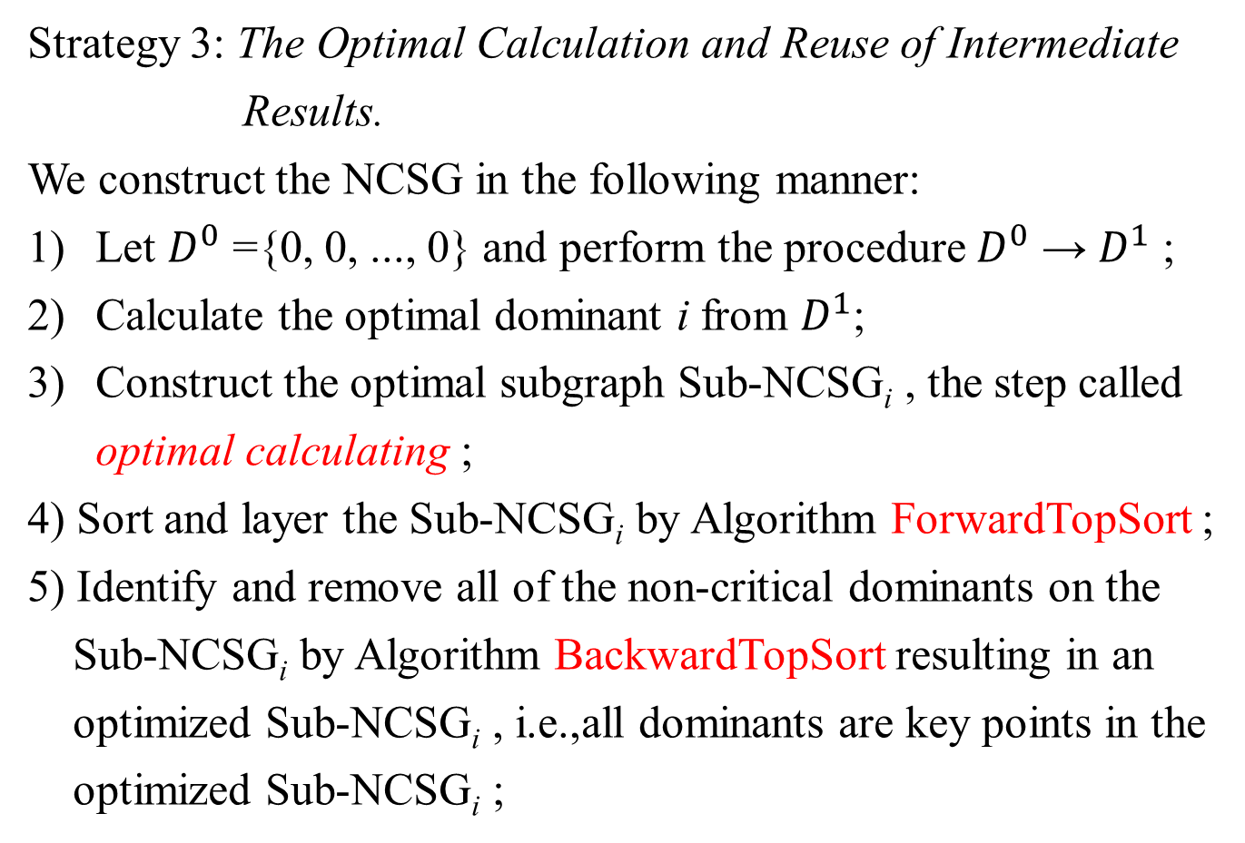
A Parallel Algorithm RLP_MLCS
Strategy 3: The Optimal Calculation and Reuse of Intermediate
Results.
We construct the NCSG in the following manner:
Let $D^{0}$ ={0, 0, ..., 0} and perform the procedure $D^{0}$ → $D^{1}$ ;
Calculate the optimal dominant i from $D^{1}$;
Construct the optimal subgraph Sub-NCSG_{i} , the step called
optimal calculating ;
4) Sort and layer the Sub-NCSG_{i} by Algorithm ForwardTopSort ;
5) Identify and remove all of the non-critical dominants on the
Sub-NCSG_{i} by Algorithm BackwardTopSort resulting in an
optimized Sub-NCSG_{i} , i.e.,all dominants are key points in the
optimized Sub-NCSG_{i} ;

Slide 15
A Parallel Algorithm RLP_MLCS
Strategy 3: The Optimal Calculation and Reuse of Intermediate
Results.
6) Construct another subgraph of Sub-NCSG_{j} using the levels
information of the dominants from the optimal subgraph Sub-
NCSG_{i} ,which have already been computed in previous steps,
thus this step is called reuse of intermediate results.
For convenient of further discussion, the above steps 1) - 6)
in Strategy 3 are denoted as Function OptCalReusing1 (), while
the above steps 1) - 4) and 6) in Strategy 3 (not including step 5))
are denoted as Function OptCalReusing2 ().

Slide 16
A Parallel Algorithm RLP_MLCS
Strategy 4: Subsection Calculation and Serialization
For example, we split the sequences
S₄ = TGACGATC and S₅ = ATCGTCAG into two subsections
S₄₁ = TGAC and S₅₁ = ATCG with S₄₂ = GATC and S₅₂ =TCAG
in their subscripts 4. (X)
物件序列化簡單來說就是將物件變成資料流，可以將物件
存成檔案，可以儲存在硬碟中。
物件反序列化就是將檔案還原成物件，並拿來使用。
當物件需要封包的傳送、遠端服務甚至是網路資料流都
運用了序列化的技術。

Slide 17
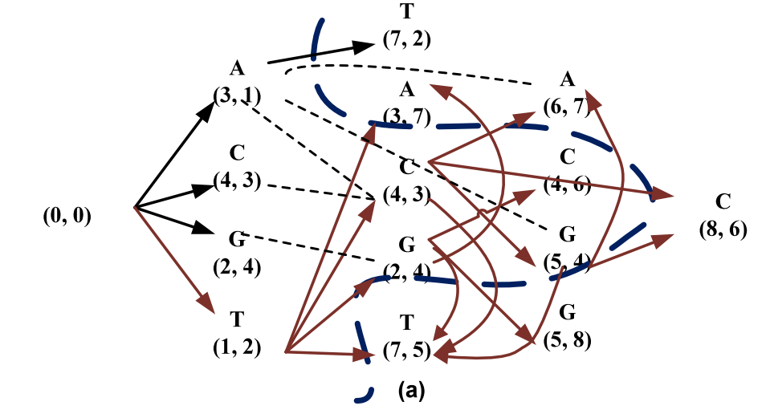
A Parallel Algorithm RLP_MLCS
Strategy 4: Subsection Calculation and Serialization
S₄ = TGACGATC and S₅ = ATCGTCAG
Therefore, call function OptCalReusing2 () (not function OptCalReusing1 (), as no dominant is lost from the ﬁrst subsection), we can construct the ﬁrst subsection sub-graph of the NCSG, denoted as Sub-NCSG_{s1} (Fig. 8(a)), and then serialize the constructed Sub-NCSG_{s1} (left part shown in Fig. 8(b)) to the disk.

Slide 18
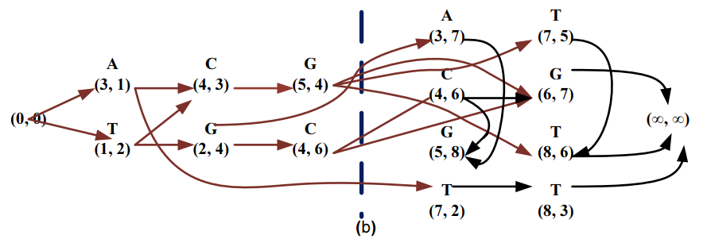
A Parallel Algorithm RLP_MLCS
Strategy 4: Subsection Calculation and Serialization
S₄ = TGACGATC and S₅ = ATCGTCAG
(b) Next, we continue constructing the second subsection subgraph Sub-NCSG_{s2} by calling function OptCalReusing1 () (right part shown in Fig. 8(b)).

Slide 19
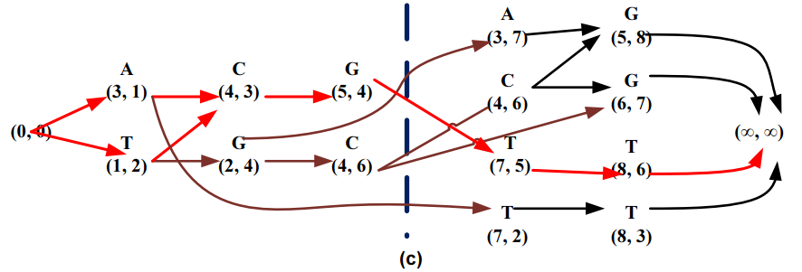
A Parallel Algorithm RLP_MLCS
Strategy 4: Subsection Calculation and Serialization
S₄ = TGACGATC and S₅ = ATCGTCAG
(b) Secondly, we deserialize the Sub-NCSG_{s1} and perform Sub-NCSG_{s1} = Sub-NCSG_{s1} ∪ the optimized Sub-NCSG_{s2} shown in Fig. 8(c) ,and then continue backward sorting the Sub-NCSG_{s1} by Algorithm BackwardSortTop.

Slide 20
A Parallel Algorithm RLP_MLCS
Strategy 5: The Multiple Concurrent Execution
Since the optimal subgraph NCSG_{i} of the aligned sequences
always contributes to most of the MLCSs, ranging from 75%
to 100%, we can concurrently construct the non-optimal
subgraph NCSG_{j} of the non-optimal dominants with the reuse
of intermediate results of the optimal subgraph NCSG_{i}
available (called multiple concurrent execution ) so as to
further improve the eﬃciency of the proposed algorithm.

Slide 21
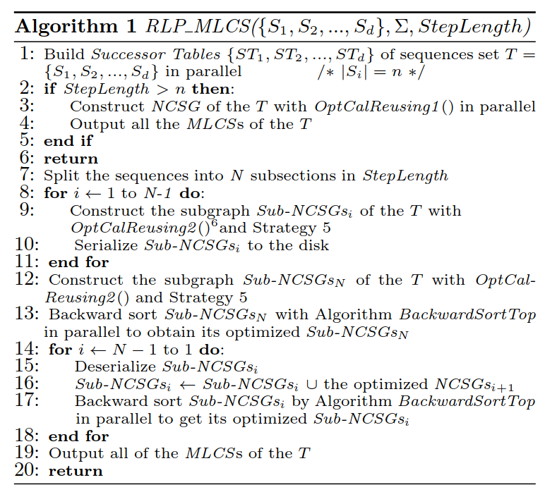
A Novel Parallel MLCS Algorithm

Slide 22
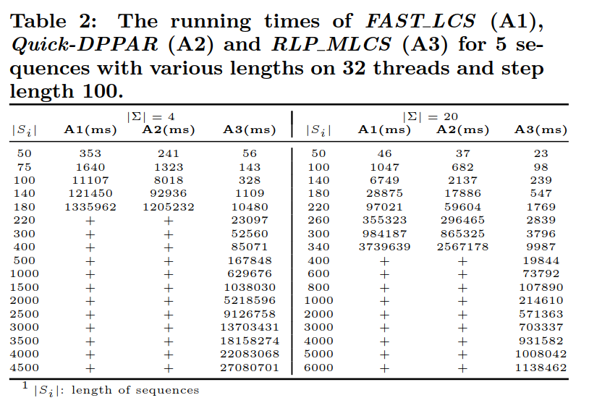
Experimental Results

Slide 23
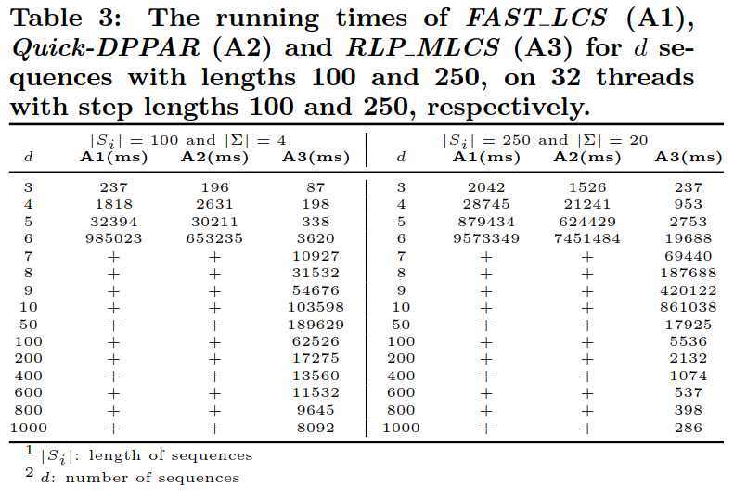
Experimental Results

