Slide 1
Prediction of Stock Market Price Using Hybrid of Wavelet Transform and Artificial Neural Network
S. Kumar Chandar, M. Sumathi and S. N. Sivanandam
Indian Journal of Science and Technology, Vol. 9(8) ,
February 2016
Presenter: Shou-Fu Lo
Date: 2017/08/29

Slide 2
Abstract(1/2)
Background/Objectives: Accurate prediction of stock market is
highly challenging. This paper presents a forecasting model
based on Discrete Wavelet Transform (DWT) and Artificial
Neural Network (ANN) for predicting financial time series.
Methods/Statistical analysis: The idea of forecasting stock
market prices with discrete wavelet transform is the central
element of this paper. The proposed forecasting model uses the
Discrete Wavelet Transform to decompose the financial time
series data. The obtained approximation and detail coefficients
after decomposition of the original time series data are used as
input variables of back propagation neural network to forecast

Slide 3
Abstract(2/2)
future stock prices. Approximation coefficients can characterize
the coarse structure of the data and detail coefficients capture
ruptures, discontinuities and singularities in the original data, to
recognize the long-term trends in the original data. Findings:
The proposed model was applied to five datasets. For all of the
datasets, accuracy measures showed that the presented model
outperforms a conventional model. It also proved that the hybrid
forecasting technique has achieved better results compared with
the approach which is not using the wavelet transform.
Applications/Improvements: The accuracy of the proposed hybrid
method can also be improved by developing a model using
artificial neural network with Adaptive Neuro Fuzzy Interference
System.

Slide 4
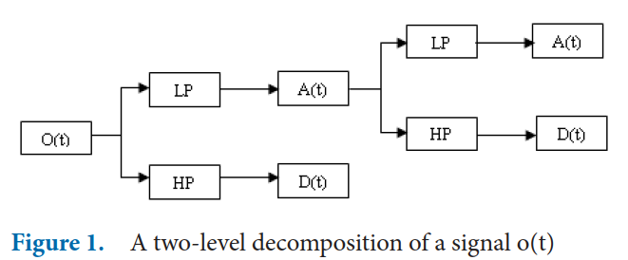
Discrete Wavelet Transform
定義一些需要用到的訊號及濾波器。
O(t)：離散的輸入訊號，長度為N。
A(t)：low pass filter低通濾波器，可以將輸入訊號的高頻部份濾掉而輸出低頻部份。
D(t)：high pass filter高通濾波器，與低通濾波器相反，濾掉低頻部份而輸出高頻部份。

Slide 5
Discrete Wavelet Transform
The fundamental and novel contribution of the paper is to use
Discrete Wavelet Transform (DWT) to decompose the
historical data series into a set of well-behaved coefficients
(AC and DC).
Approximation coefficients (low frequency) used to
characterize the coarse structure of data to identify long term
trends.
Detail coefficients (high frequency) used to capture rupture,
singularities and discontinuities.

Slide 6
Discrete Wavelet Transform
小波轉換的基底，是由一組既代表頻率又代表位置的基底所
構成，這些基底之間彼此互相存在著放大、縮小和平移的關
係。
而任意的一個信號亦皆可由小波轉換的基底的線性組合所合
成。
小波轉換即是算出此信號所含有每一個基底的分量。
小波轉換的基底在一維時，具有時間與頻率的資訊，在二維
時，具有空間位置和頻率的資訊。

Slide 7
Discrete Wavelet Transform
常見的小波基底: Haar, Daubechies, Biorthogonal, Coiflets,
Symlets, Morlet, Mexican Hat, Meyer, Gaus, Dmeyer,
ReverseBior, Cgau, Cmor, Fbsp, Shan.

Slide 8
Discrete Wavelet Transform
以 Ψ(t) 代表小波信號的母函數，利用此函數，可以產生小波
轉換的所有基底，以 Ψ(t-T / a) 表示函數 Ψ(t) 在時間軸上放
大或縮小 a 倍，平移 T 時間的信號，這些信號將構成小波轉
換的基底。
若 a > 1，此函數在時間軸放大，即此信號的頻率變低。
若 a < 1，此函數在時間軸縮小，即此信號的頻率變高。
Haar 小波定義為 Ψ_{H}((t-T) / a)，其中：
Ψ_{H}(k) = 1, if 0 < k < 1/2
Ψ_{H}(k) = -1, if 1/2 <= k < 1
Ψ_{H}(k) = 0, others

Slide 9
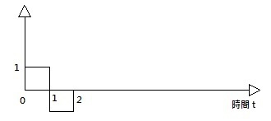
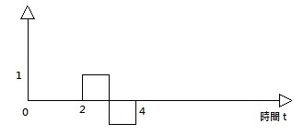
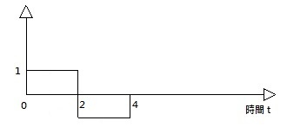
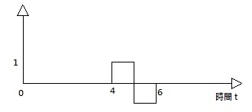
Discrete Wavelet Transform
a = 2, T = 2
a = 2, T = 0
a = 4, T = 0
a = 2, T = 4
由圖可以發現 Haar 小波的特性：
這些小波在時間的延展上有一定的範圍
這些小波的頻率並非完全相同
這些小波兩兩正交

Slide 10
Discrete Wavelet Transform
以 Haar 小波而言，Ψ_{H}(t/2) 可視為離散信號能表示的
最高頻率成為的一個 Haar 小波信號，因為在 Ψ_{H}((t-T) / a) 中， 1/a 的最大值是 1/2，可以 2 的次方值，將此頻率變小，即 1/a 可以取 1/2, 1/4, 1/8 …，同理，T 的值可取 0, 2, 4, 8 ...，
如此，可重新定義一組離散 Haar 小波基底，這些基底之間彼此兩兩正交： Ψ_{i,m}(k) = Ψ_{H}(2^{i}t - m); i = -1, ..., -∞; m = 0, ..., ∞

Slide 11
Discrete Wavelet Transform
設 o(t) 為一維信號，則此信號可以 Ψ_{i,m}(k) 線性組合表示成：
o(t) = ΣΣ D_{i,m} * Ψ_{i,m}(t), 其中 i = -1, ..., -∞; m = 0, ..., ∞
D_{i,m} 為 o(t) 之一維小波轉換之係數， 接著將上式的兩邊信號和 Ψ_{i,m}(t) 作內積： ∫ o(t) * Ψ_{i,m}(t) dt = ΣΣ D_{i,m} * Ψ_{i,m}(t) * Ψ_{i,m}(t) 由於 Ψ_{i,m}(t) 中的基底彼此正交的關係 (內積為 0)，接著會變成： =>∫ o(t) * Ψ_{i,m}(t) dt = D_{i,m} * Ψ_{i,m}(t) * Ψ_{i,m}(t) =>∫ o(t) * Ψ_{i,m}(t) dt = D_{i,m} * 2 ^{-i} 所以： =>D_{i,m} = 2 ^{i} * ∫o(t) * Ψ_{i,m}(t) dt

Slide 12
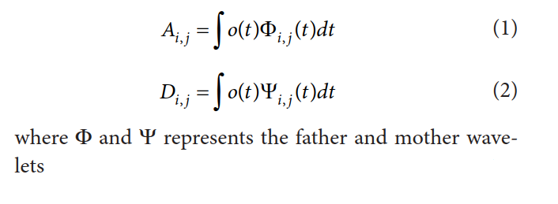
Discrete Wavelet Transform

Slide 13
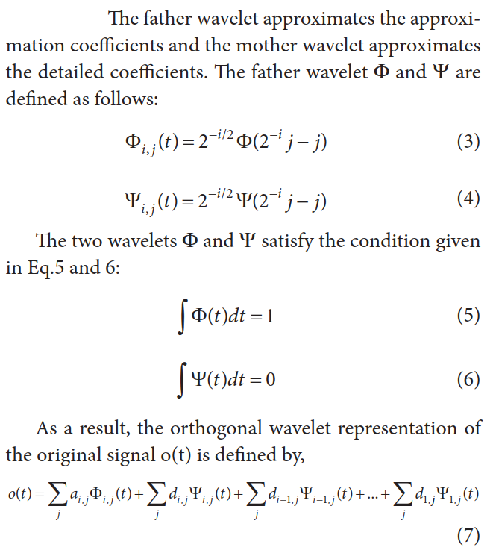
Discrete Wavelet Transform

Slide 14
Discrete Wavelet Transform
Step 1: Data collection: Historical data of stock market are collected from authorized source.
Step 2: Decomposition: The original data series is
decomposed using Haar wavelet transform up to
2 levels.
Step 3: Developing prediction system using BPNN to predict the closing price.
Step 4: Measure the performance of the proposed
method

Slide 15
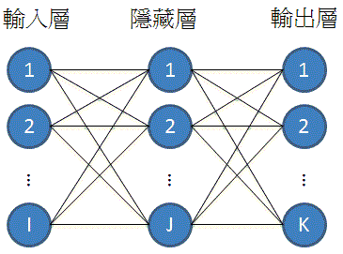
Back Propagation Neural Networks
The BPNN consists of three layers. The first
layer is an input layer and corresponds to the problem’s input variables. The second layer is the hidden layer is used to capture the non-linear relationships among the variables. The third layer is the output layer used to provide the forecasted values.屬於「監督式學習」

Slide 16
Experimental Results
The proposed technique considers the data for
the time period from January 1, 2010 to June, 2015 with a total of 1414 observations. The first 80% of the total data points are used as the training sample, while the remaining 20% of the total sample data points are used as the testing sample.

Slide 17
Experimental Results

Slide 18
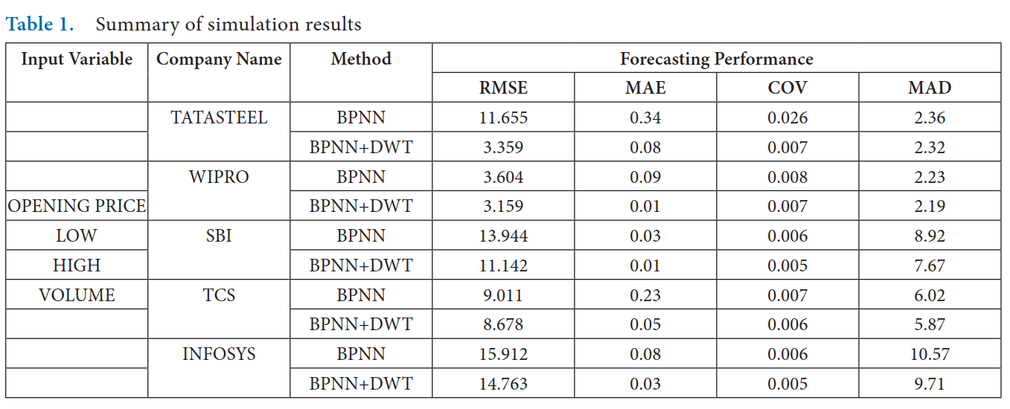
Experimental Results

