Slide 1
Proceedings of the 17th International Conference on Pattern Recognition (ICPR), 2004, Cambridge, UK, Takeshi Saitoh,Kimiya Aoki, and Toyohisa kaneko
Automatic Recognition of Blooming Flowers
Presenter：Wei-Hao Fu
Date：2017/11/07
Notes:
1
Saito Takeshi 齊藤武
Aoki Kimiya 青木公也
Kaneko Toyohisa 金子豐久

Slide 2
Abstract (1/2)
This paper describes an automatic method for recognizing a blooming flower based on a photograph taken with a digital camera in natural scene. The problem of identifying an object against the background is known to be difficult. In this paper, we employ a photograph where the object (a blooming flower) is focused but the background is defocused. For extracting a flower region, we propose a new method that extracts a boundary by selecting a route with minimizing a sum of the local cost divided by the route length. Experiments were conducted for 600 pictures (20 pictures each for 30 species). A successful boundary extraction rate of 97% and a flower recognition rate of 90% were obtained.

Slide 3
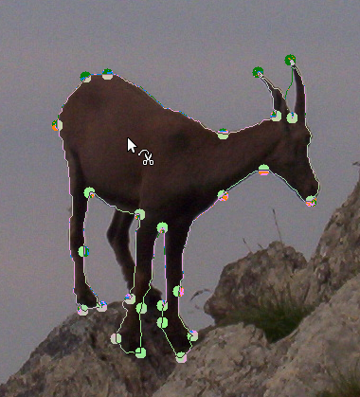
Extraction method
Intelligent Scissors (IS)
Reference: https://docs.gimp.org/en/gimp-tool-iscissors.html

Slide 4
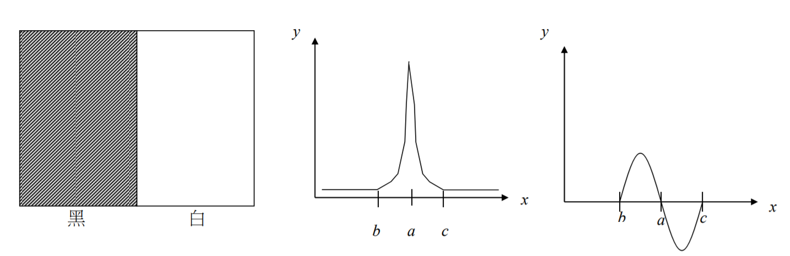
Extraction method
Intelligent Scissors (IS)
Laplacian Zero-Crossing
Gradient Magnitude
Gradient Direction
Reference: http://140.117.156.238/course/CSSV/2011/%E7%9B%A3%E6%8E%A7%E8%A6%96%E8%A8%8A_ch3.pdf
40.117.156.238/course/CSSV/2011/監控視訊_ch3.pdf

Slide 5
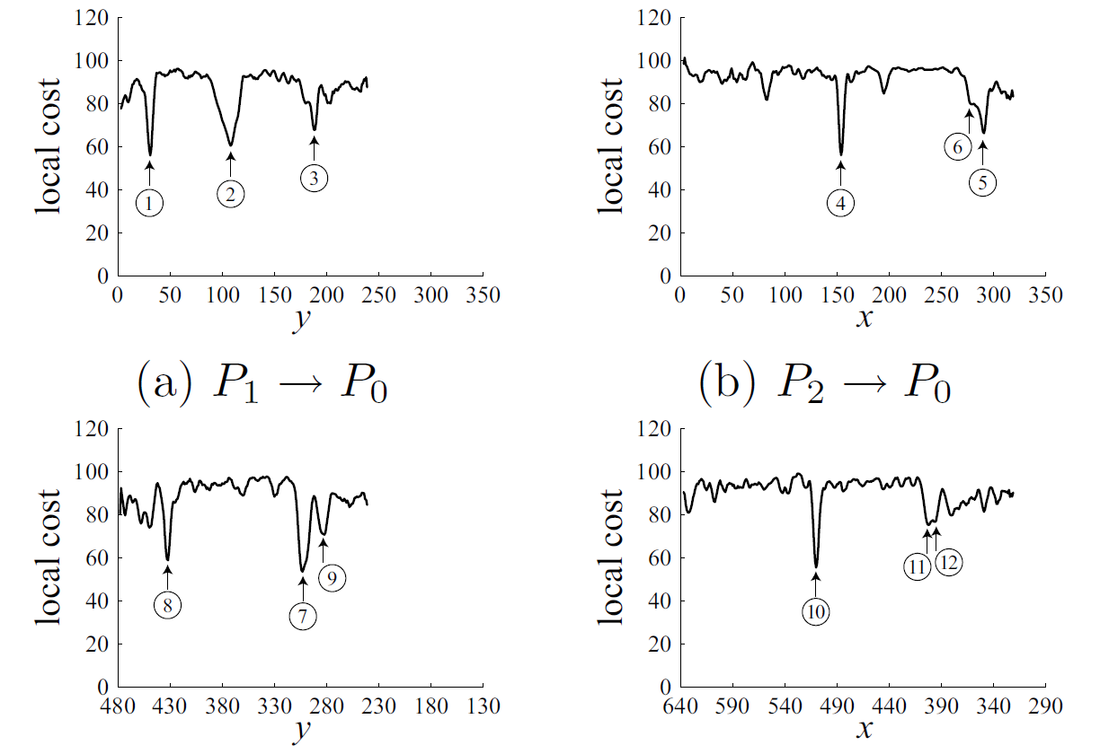
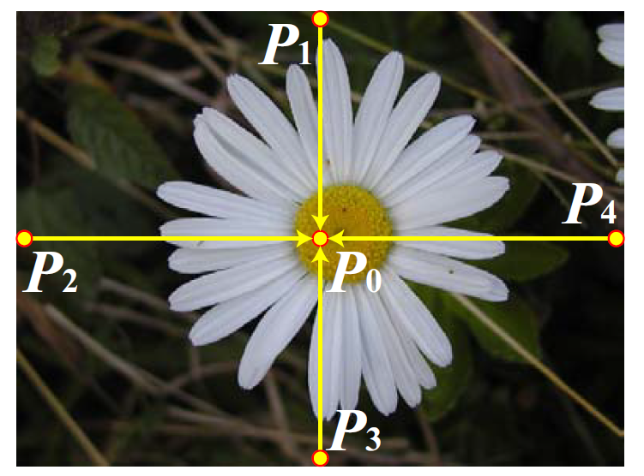
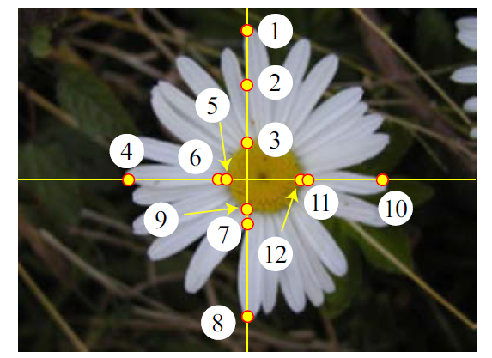
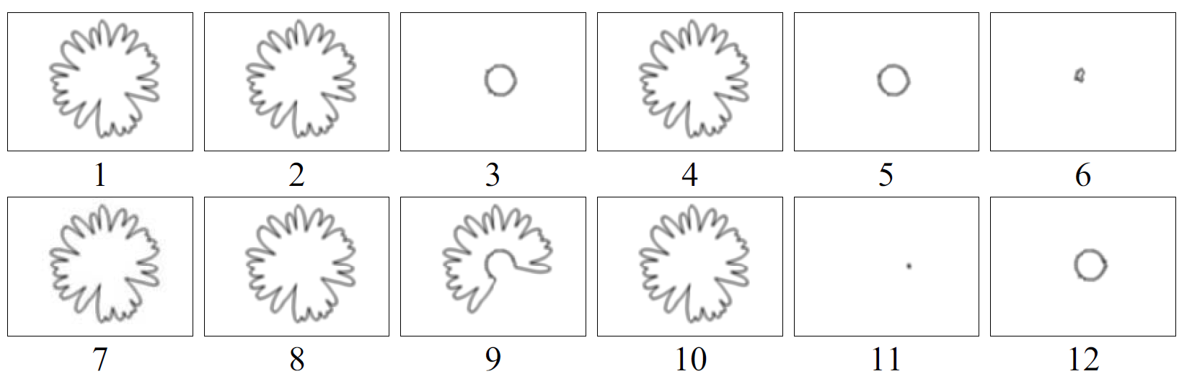
Extraction method
Normalized cost (NC)

Slide 6
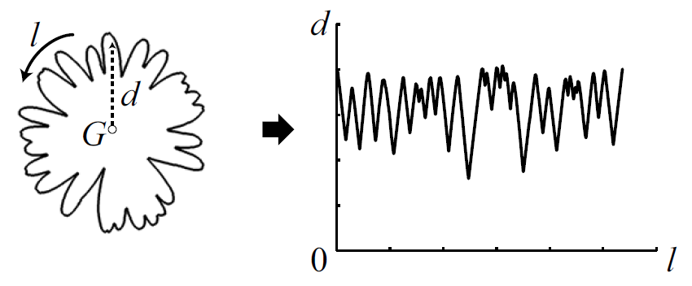
Feature selection
Shape features
The ratio of the average width over the average height.
The number of petals.
The central moment.
The roundness
Notes:
Central moment?

Slide 7
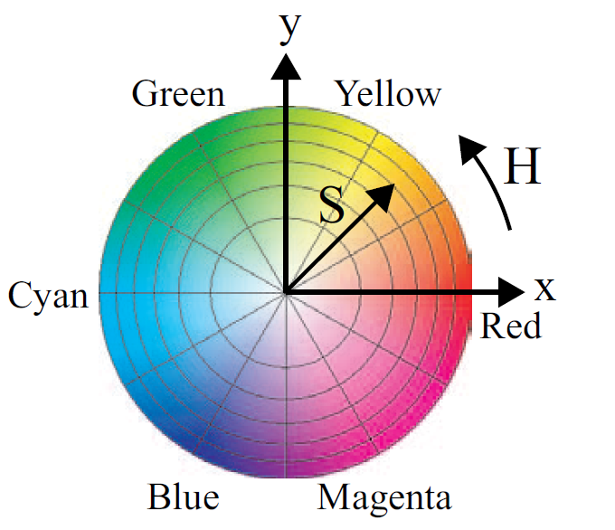
Feature selection
Color features
The x coordinate of the largest color cell.
The y coordinate of the largest color cell.
The ratio of the largest color cell.
The x coordinate of the second largest color cell.
The y coordinate of the second largest color cell.
The ratio of the second largest color cell.

Slide 8
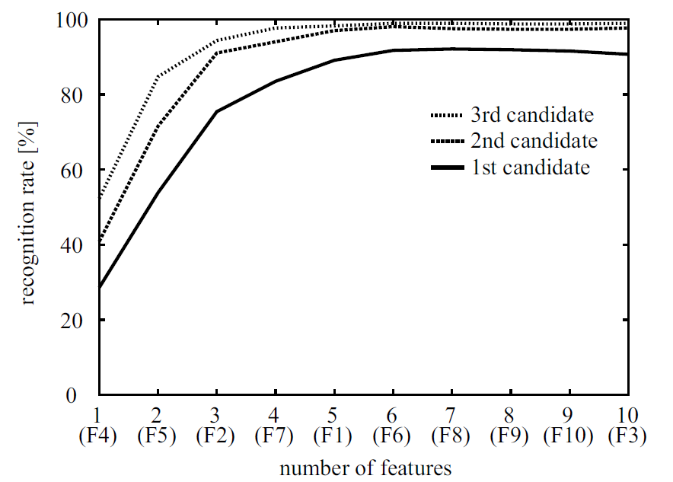
Experiment
Dataset: 20 pictures each for 30 species.

