Slide 1
Mastering the game of Go without human knowledge
David Silver, Julian Schrittwieser, Karen Simonyan, ioannis Antonoglou, Aja Huang, Arthur Guez, Thomas Hubert, Lucas baker, Matthew Lai, Adrian bolton, Yutian chen, Timothy Lillicrap, Fan Hui, Laurent Sifre, George van den Driessche, Thore Graepel & Demis Hassabis
Nature 550, 354–359 (19 October 2017)
Presenter：Jia-Hong Liu
Date：2017/11/7

Slide 2
Abstract(1/3)
A long-standing goal of artificial intelligence is an algorithm that learns, tabula rasa, superhuman proficiency in challenging domains. Recently, AlphaGo became the first program to defeat a world champion in the game of Go. The tree search in AlphaGo evaluated positions and selected moves using deep neural networks.

Slide 3
Abstract(2/3)
These neural networks were trained by supervised learning from human expert moves, and by reinforcement learning from self-play. Here we introduce an algorithm based solely on reinforcement learning, without human data, guidance or domain knowledge beyond game rules. AlphaGo becomes its own teacher: a neural network is trained to predict AlphaGo’s own move selections and also the winner of AlphaGo’s games.

Slide 4
Abstract(3/3)
This neural network improves the strength of the tree search, resulting in higher quality move selection and stronger self-play in the next iteration. Starting tabula rasa, our new program AlphaGo Zero achieved superhuman performance, winning 100–0 against the previously published, champion-defeating AlphaGo.

Slide 5
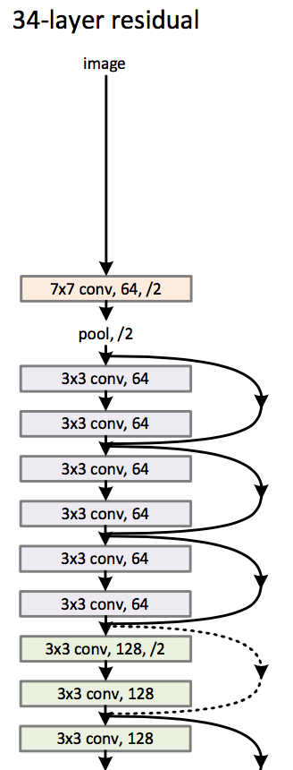





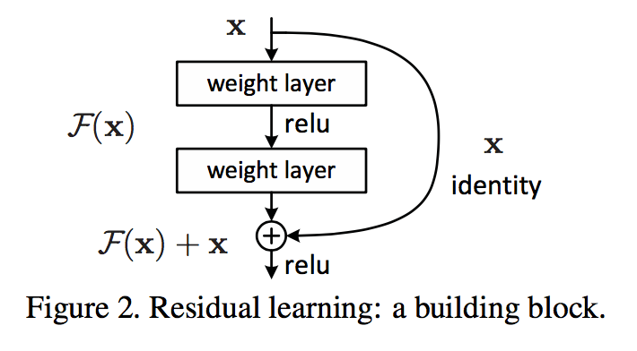
Residual Neural Network

Slide 6

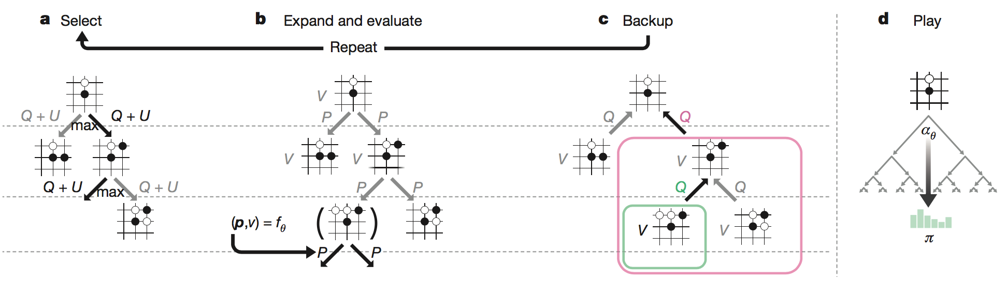



Monte Carlo tree search in AlphaGo Zero

Slide 7
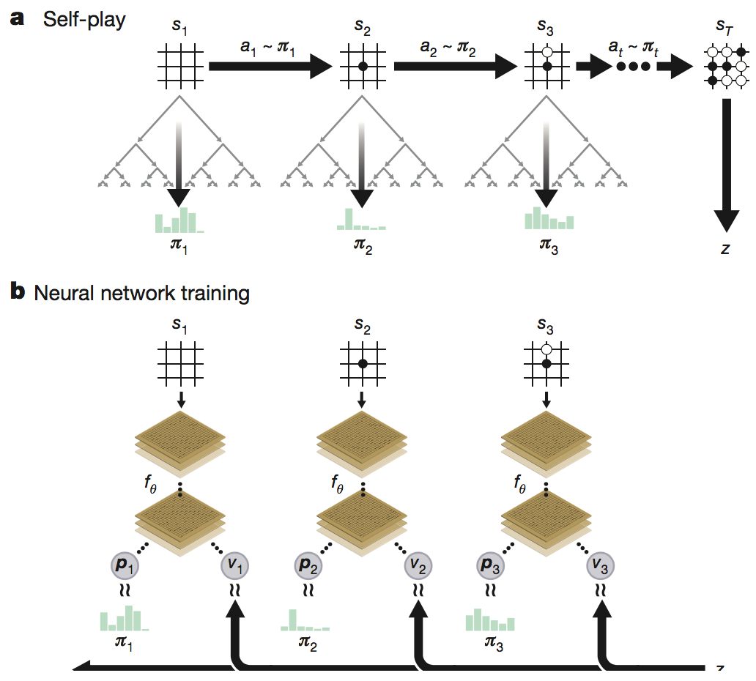

Slide 8
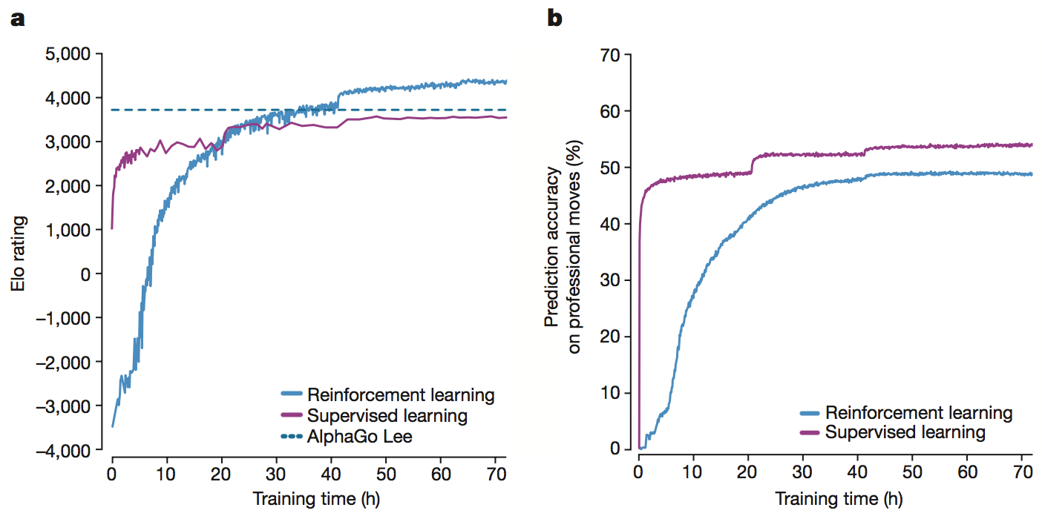
ELO等級分制度是指由匈牙利裔美國物理學家Arpad Elo創建的一個衡量各類對弈活動水準的評價方法，是當今對弈水準評估的公認的權威方法。被廣泛用於西洋棋、圍棋、足球、籃球等運動。線上遊戲英雄聯盟、魔獸世界內的競技對戰系統也採用此分級制度。

Slide 9
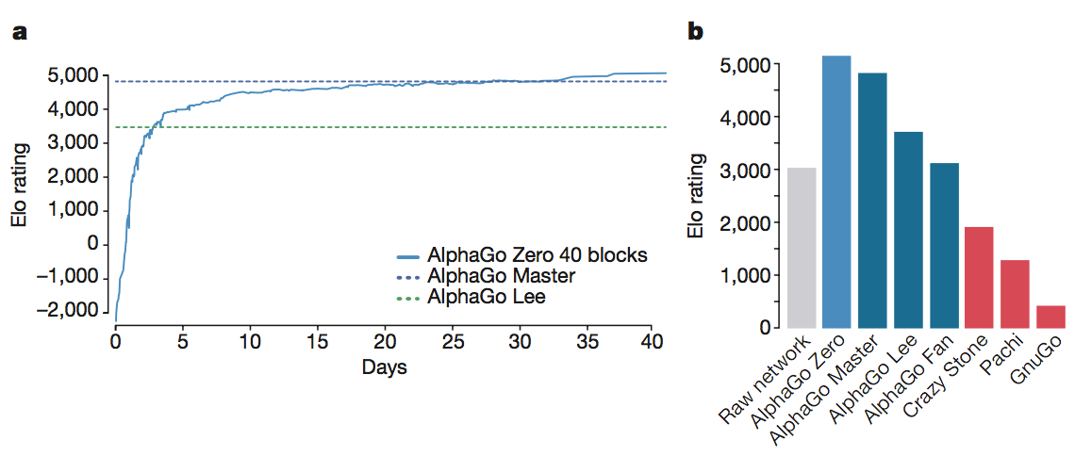
result

