Slide 1
A dynamic programming solution to a generalized LCS problem
Lei Wang, Xiaodong Wang, YingJie Wu, Daxin Zhu
Information Processing Letters 113 (2013) 723–728
Speaker: Kuan-Chih Chen
Date: 2017.11.28
Notes:
作者:王晓东吴英杰
Lei Wang : Microsoft AdCenter
Fuzhou University/Quanzhou Normal University
Xiaodong Wang : YingJie Wu : Fuzhou University
Daxin Zhu : Quanzhou Normal University

Slide 2
Abstract
In this paper, we consider a generalized longest common subsequence problem, the string-excluding constrained LCS problem. For the two input sequences X and Y of lengths n and m, and a constraint string P of length r, the problem is to find a common subsequence Z of X and Y excluding P as a substring and the length of Z is maximized. The problem and its solution were first proposed by Chen and Chao(2011), but we found that their algorithm cannot solve the problem correctly. A new dynamic programming solution for the STR-EC-LCS problem is then presented in this paper. The correctness of the new algorithm is proved. The time complexity of the new algorithm is O(nmr).

Slide 3



The generalized constrained LCS problems
$$X=x_{1}x_{2}…X_{n}$$
$$Y=y_{1}y_{2}…y_{m}$$
$$P=p_{1}p_{2}…p_{r}$$
SEQ-IC-LCS
STR-IC-LCS
SEQ-EC-LCS
STR-EC-LCS
X和Y的LCS，包含序列P
X和Y的LCS，包含字串P
X和Y的LCS，不包含序列P
X和Y的LCS，不包含字串P
LCS = aba
SEQ-IC-LCS = aba
STR-IC-LCS = aa
SEQ-EC-LCS = ab/ba
STR-EC-LCS = aba
LCS = ab
SEQ-IC-LCS = ab
STR-IC-LCS = ab
SEQ-EC-LCS = a/b
STR-EC-LCS = a/b
X = abbba
Y = aaba
P = aa
X = abbb
Y = aab
P = ab

Slide 4
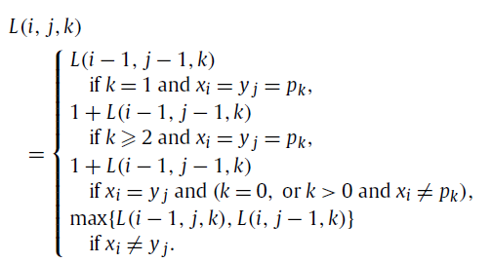
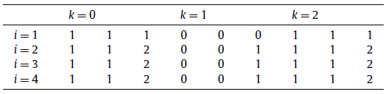


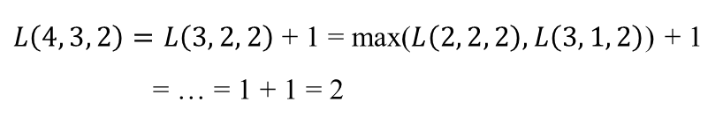
A proposed dynamic programming algorithm
*By Chao & Chen in 2011
for any $1≤i≤n$, $1≤j≤m$, $0≤k<r$
*Boundary: L(i, 0, k) = L(0, j, k) = 0
X = abbb
Y = aab
P = ab
STR-EC-LCS = a or b
$$j= 1 2 3$$
$L\left(4, 3, 2\right)=L\left(3, 2, 2\right)$ + 1 = max($L\left(2, 2, 2\right),L\left(3, 1, 2\right)$) + 1
= … = 1 + 1 = 2

Slide 5
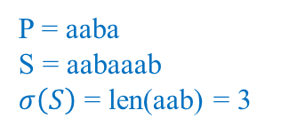


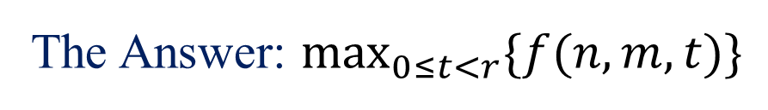
Their dynamic programming solution - Purposal
P = aaba
S = aabaaab
$σ\left(S\right)$ = len(aab) = 3
$$X[i : j] =x_{i}x_{i+1}…x_{j}$$
$$\text{z}\text{: }\text{the} \text{LC}\text{S} \text{of} X\left[1 : i\right] and Y\left[1 :j\right] \text{excluding} \text{P} \text{as} \text{a} \text{substring}$$
$$σ\left(S\right): \text{the} \text{length} \text{of} \text{the} \text{longest} \text{suffix} \text{of} \text{S} \text{that} \text{is} \text{also} \text{a} \text{prefix} \text{of} \text{P}$$
$$f\left(i, j, k\right):\text{the} \text{length} \text{of} \text{z} \text{and} σ\left(z\right)=k$$
The Answer: $\max_{0≤t<r}{\{f(n, m, t)\}}$
for any
$1≤i≤$n, 1 $≤j≤$m, 0 $≤$k<r

Slide 6
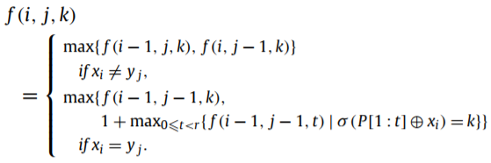






Their dynamic programming solution - Theorem
$$f\left(i, j, k\right)$$
for any $1≤i≤n$, $1≤j≤m$, $0≤k<r$
$$max⁡\{f\left(i−1, j, k\right), f(i, j−1, k)\}$$
$$if x_{i}≠y_{j}$$
$$max⁡\{f\left(i−1,j−1,k\right),$$
$$1+\max_{0≤t<r}\left\{f\left(i−1, j−1, t\right) \right| σ\left(P\left[1:t\right]⨁x_{i}\right)=k\} \}$$
$$if x_{i}=y_{j}$$
*Boundary: f(i, 0, k) = f(0, j, k) = 0

Slide 7



When $x_{i}≠y_{j}$
if $x_{i}≠z_{t}$
$$z\left[1:t\right]= a Common Subsequence of X\left[1:i−1\right] \& Y[1:j]$$
$$f\left(i, j, k\right)=f\left(i−1,j,k\right)$$
if $y_{j}≠z_{t}$
$$z\left[1:t\right]= a Common Subsequence of X\left[1:i\right] \& Y[1:j−1]$$
$$f\left(i, j, k\right)=f\left(i,j−1,k\right)$$
$$f\left(i, j, k\right)=max(f\left(i−1,j,k\right), f\left(i,j−1,k\right))$$
X = abba
Y = aab
P = ab
f(4, 3, 1) = f(3, 3, 1) =1

Slide 8


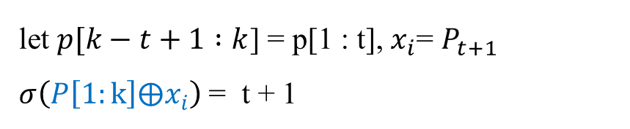


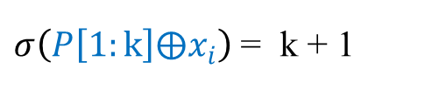

When $x_{i}=y_{j}$, about $σ\left(P\left[1:k\right]⨁x_{i}\right)$
$$if x_{i}=P_{k+1}$$
$P\left[1:k\right]⨁x_{i}$=$P\left[1:k+1\right]$
$σ\left(P\left[1:k\right]⨁x_{i}\right)$ = k + 1
$$if x_{i}≠P_{k+1}$$
let $p[k−t+1 :k$] = p[1 : t], $x_{i}$= $P_{t+1}$
$σ\left(P\left[1:k\right]⨁x_{i}\right)$ = t + 1
X = abbb
Y = aab
P = ab
if k = 1, $x_{i}=y_{j}$= $P_{k+1}$
$σ\left(P\left[1:k\right]⨁x_{i}\right)$ = $σ\left(P\right)=len(P)$ = 2
Notes:
當$x_{i}=P_{k+1}$，$σ\left(P\left[1:k\right]⨁x_{i}\right)$ = 求參數(P)的長度(他同時符合P跟S)

Slide 9
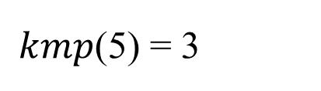
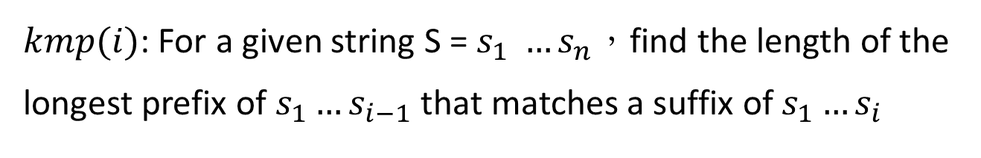
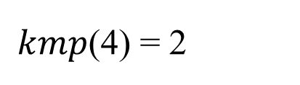
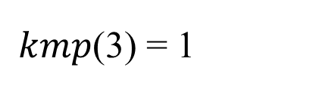
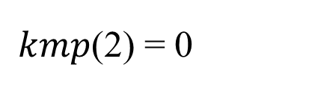
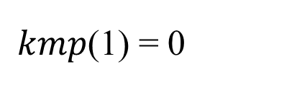
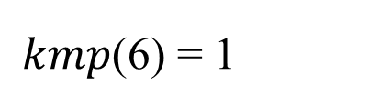
KMP Algorithm – string matching problem(1/2)
*Knuth-Morris-Pratt
$kmp(i)$: For a given string S = $s_{1} …s_{n}，$find the length of the longest prefix of $s_{1}…s_{i−1}$ that matches a suffix of $s_{1}…s_{i}$
S =ａｂａｂａａ
$kmp$(1) = 0
$kmp$(2) = 0
$kmp$(3) = 1
ａ ｂａｂａａ
ａｂ ａｂａａ
ａｂａ ｂａａ
ａｂａｂａａ
ａｂａｂａａ
ａ ｂａｂａａ
$kmp$(4) = 2
$kmp$(5) = 3
$kmp$(6) = 1
ａｂａｂ ａａ
ａｂａｂａ ａ
ａｂａｂａａ
ａｂ ａｂａａ
ａｂａ ｂａａ
ａｂａｂａａ
Notes:
從index(i)最多往前幾個位置，使得往前的那些成為s的prefix

Slide 10


KMP Algorithm – string matching problem(2/2)
Set T = ａｂａｂｂｂａ…
S =ａｂａｂａａ
ａｂａｂｂｂａ…
$kmp$(3)＝1
ａｂａｂａａ
ａｂａｂｂｂａ…
ａｂａｂａａ
ａｂａｂｂｂａ…
ａｂａｂａａ
ａｂａｂｂｂａ…
ａｂａｂａａ
$kmp$(5)＝3
ａｂａｂｂｂａ…
ａｂａｂａａ
…

Slide 11


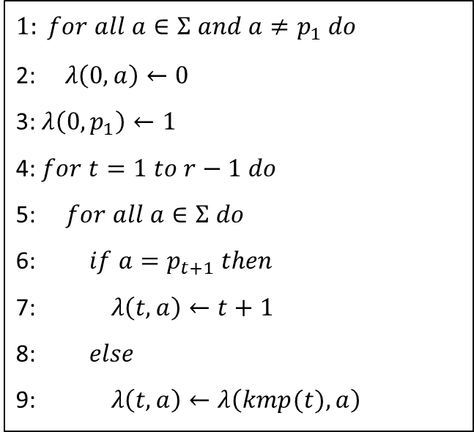
Pre-compute for $σ\left(P\left[1:k\right]⨁x_{i}\right)$
$Input:$String $P=p_{1}p_{2}…p_{r}$, alphabet $Σ$
$Output:$A table $λ$
$$1: for all a∈Σ and a≠p_{1} do$$
2:$λ\left(0, a\right)←0$
3:$λ\left(0, p_{1}\right)←1$
4: $for t=1 to r−1 do$
5: $for all a∈Σ do$
6: $if a=p_{t+1} then$
7:$λ\left(t, a\right)←t+1$
8: $else$
9:$λ\left(t, a\right)←λ\left(kmp(t), a\right)$
cost: O(r|Σ|)

Slide 12
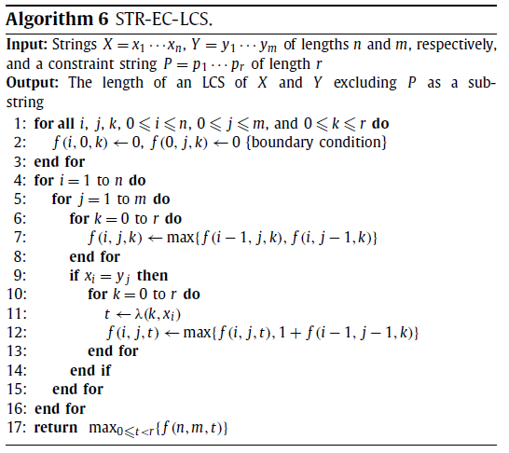

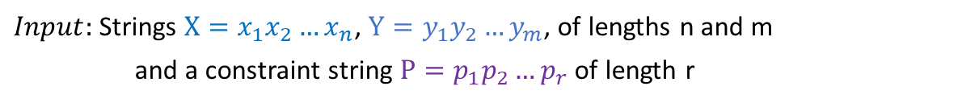
The whole algorithm(for STR-EC-LCS)
$Input:$Strings $X=x_{1}x_{2}…x_{n}$, $Y=y_{1}y_{2}…y_{m}$, of lengths n and m
and a constraint string $P=p_{1}p_{2}…p_{r}$ of length r
$$Output:The length of an LCS of X and Y excluding P as a substring$$
$$t ←λ\left(k, x_{i}\right)$$
$f\left(i, j, t\right)←max⁡\{f\left(i, j, t\right), 1+f(i−1,j−1, k)\}$

Slide 13
Time & Space Complexity
O(nmr) time, with preprocessing time O(r|Σ|)
O(nmr) space
n
m
r
r|Σ|

