Slide 1
Fish Classification in Context of Noisy Images
Adamu Ali-Gombe , Eyad Elyan, and Chrisina Jayne
International Conference on Engineering Applications of Neural Networks Engineering Applications of Neural Networks, Athens, Greece, August 25-27, 2017
pp 216-226
Presenter: Kuo-Feng Huang
Date: 2017/11/28

Slide 2
Abstract
In this paper, we analysed the performance of deep convolutional neural networks on noisy images of fish species. Thorough experiments using four variants of noisy and challenging dataset was carried out. Different deep convolutional models were evaluated. Firstly, we trained models on noisy dataset of fishing boat images. Our second approach trained the models on a new dataset generated by annotating fish instances only from the initial set of images. Lastly, we trained the models by synthesizing more data through the application of affine transforms and random noise. Results indicate that deep convolutional network performance deteriorate in the absence of well annotated training set. This opens direction for future research in automatic image annotation.

Slide 3
Dataset
In this paper we used a dataset of images provided by kaggle.
It contains 3777 images of fish. The fish categories include Albacore tuna(長鰭鮪魚), Bigeye tuna(短鮪), Yellowfin tuna(黃鰭金槍魚), Dolphin, Lampris guttatus(月魚), Sharks, other categories and images with no Fish, labelled as ALB, BET, YFT, LAG, DOL, SHARK, OTHER and NoF.

Slide 4
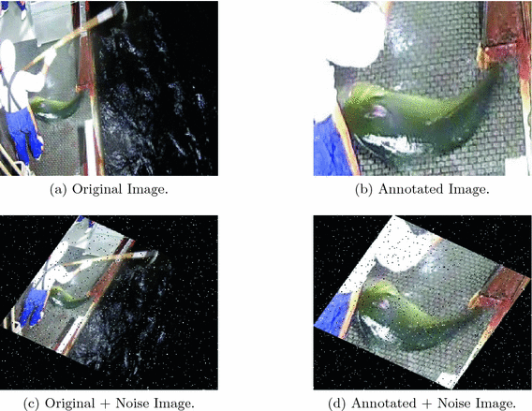
Dataset

Slide 5
Dataset
Dataset | Number of images | Noise | Affine
Original | 3777 | - | -
Annotated | 3777 | - | -
Original+Noise | 12275 | X | X
Annotated+Noise | 12275 | X | X

Slide 6
Before training
All images were resized to 224 by 224.
Images were shuffled, then split into test and trainwith 75% of data used for training and the remaining 25% of data for testing.

Slide 7
Methods
VGG Network : VGG-16為牛津大學的視覺幾何研究團隊(Visual Geometry Group)預先以ImageNet資料集大約120萬張圖片訓練而成的卷積神經網路(Convolutional Neural Network，或稱作CNN)模型。
Transfer Learning : a pre-trained network on ImageNet dataset

Slide 8
Convolution

Slide 9
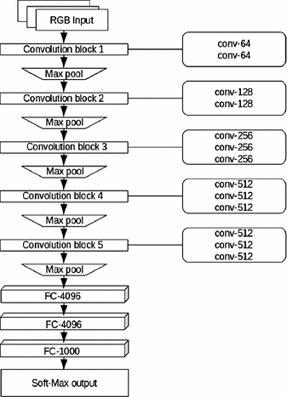
VGG-16

Slide 10
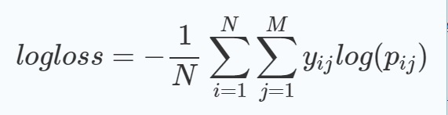

Results
Log loss and accuracy metrics were used to evaluate the models.

Slide 11
Results
Models log loss
Model | Original | Annotated | Original+Noise | Annotated+Noise
VGG-16 | 0.54 | 1.20 | 0.12 | 0.38
VGG-16 (transfer) | 18.45 | 27.88 | 0.10 | 30.61
Test accuracy of models
Model | Original | Annotated | Original+Noise | Annotated+Noise
VGG-16 | 97.20% | 90.17% | 99.38% | 98.00%
VGG-16 (transfer) | 86.60% | 79.81% | 99.54% | 77.80%

Slide 12
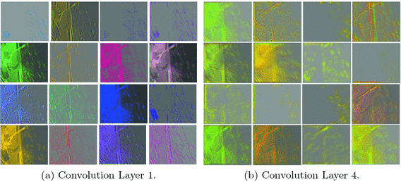
Results
Feature maps from original image

Slide 13
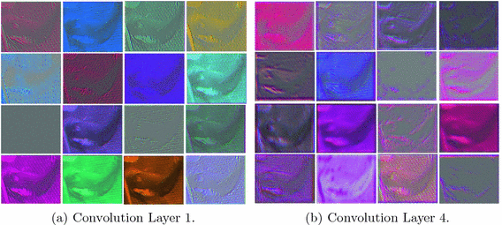
Results
Feature maps from annotated image

Slide 14
Results
A summary of sensitivity analysis of VGG-16 model
Dataset | Precision | Recall | F1-score
Original | 0.82 | 0.82 | 0.81
Annotated | 0.43 | 0.54 | 0.47
Original+Noise | 0.92 | 0.91 | 0.91
Annotated+Noise | 0.96 | 0.96 | 0.96

Slide 15
Conclusion
Features from these noisy prominent objects becomes more dominant as we go deeper into the network. As such, they prevent the network from learning specific fish features required for category classification.
With well annotated images, the network learns deep features that are category specific and for correct classification.
Learned features are transferable but a closely related dataset could have produced better results.

