Slide 1
Dynamic Time Warping under limited warping path length
Zheng Zhang, Romain Tavenard, Adeline Bailly, Xiaotong Tang, Ping Tang, Thmoas Corpetti
Information Sciences
Volume 393, July, 2017, Pages 91-107
Presenter: Shan-Ru Liu
Date: 2017/11/28

Slide 2
Abstract (1/2)
Dynamic Time Warping (DTW) is probably the most popular distance measure for time series data, because it captures flexible similarities under time distortions. However, DTW has long been suffering from the pathological alignment problem, and most existing solutions, which essentially impose rigid constraints on the warping path, are likely to miss the correct alignments. A crucial observation on pathological alignment is that it always leads to an abnormally large number of links between two sequences.

Slide 3
Abstract (2/2)
LDTW not only oppresses the pathological alignment effectively, but also allows more flexibilities when measuring similarities. It is a softer constraint because we still let the optimization process of DTW decide how many links to allocate to each data point and where to put these links. In this paper, we introduce the motivation and algorithm of LDTW and we conduct a nearest neighbor classification experiment on UCR time series archive to show its performance.

Slide 4
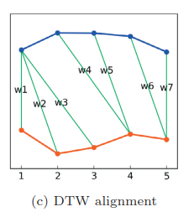
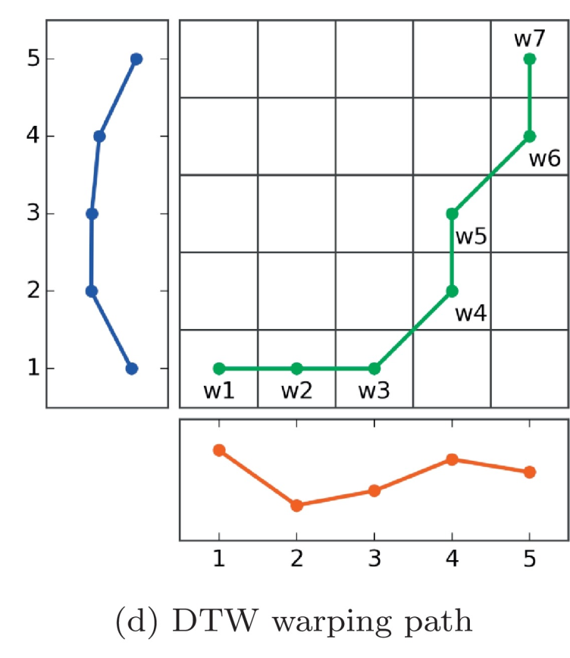
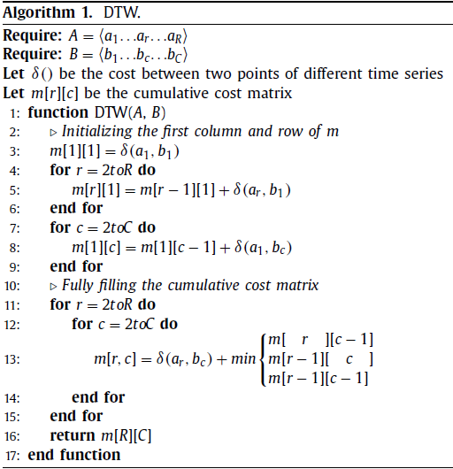
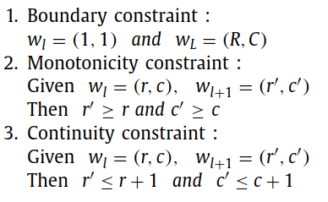
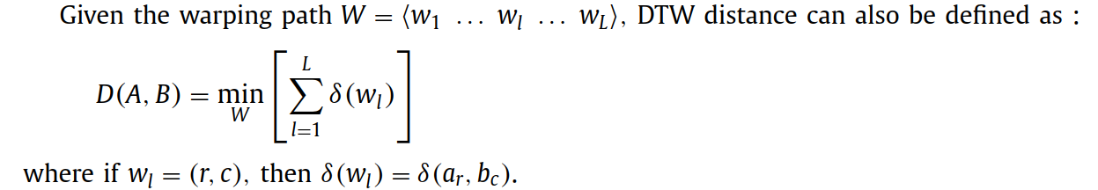
Naive DTW
DTW distance

Slide 5
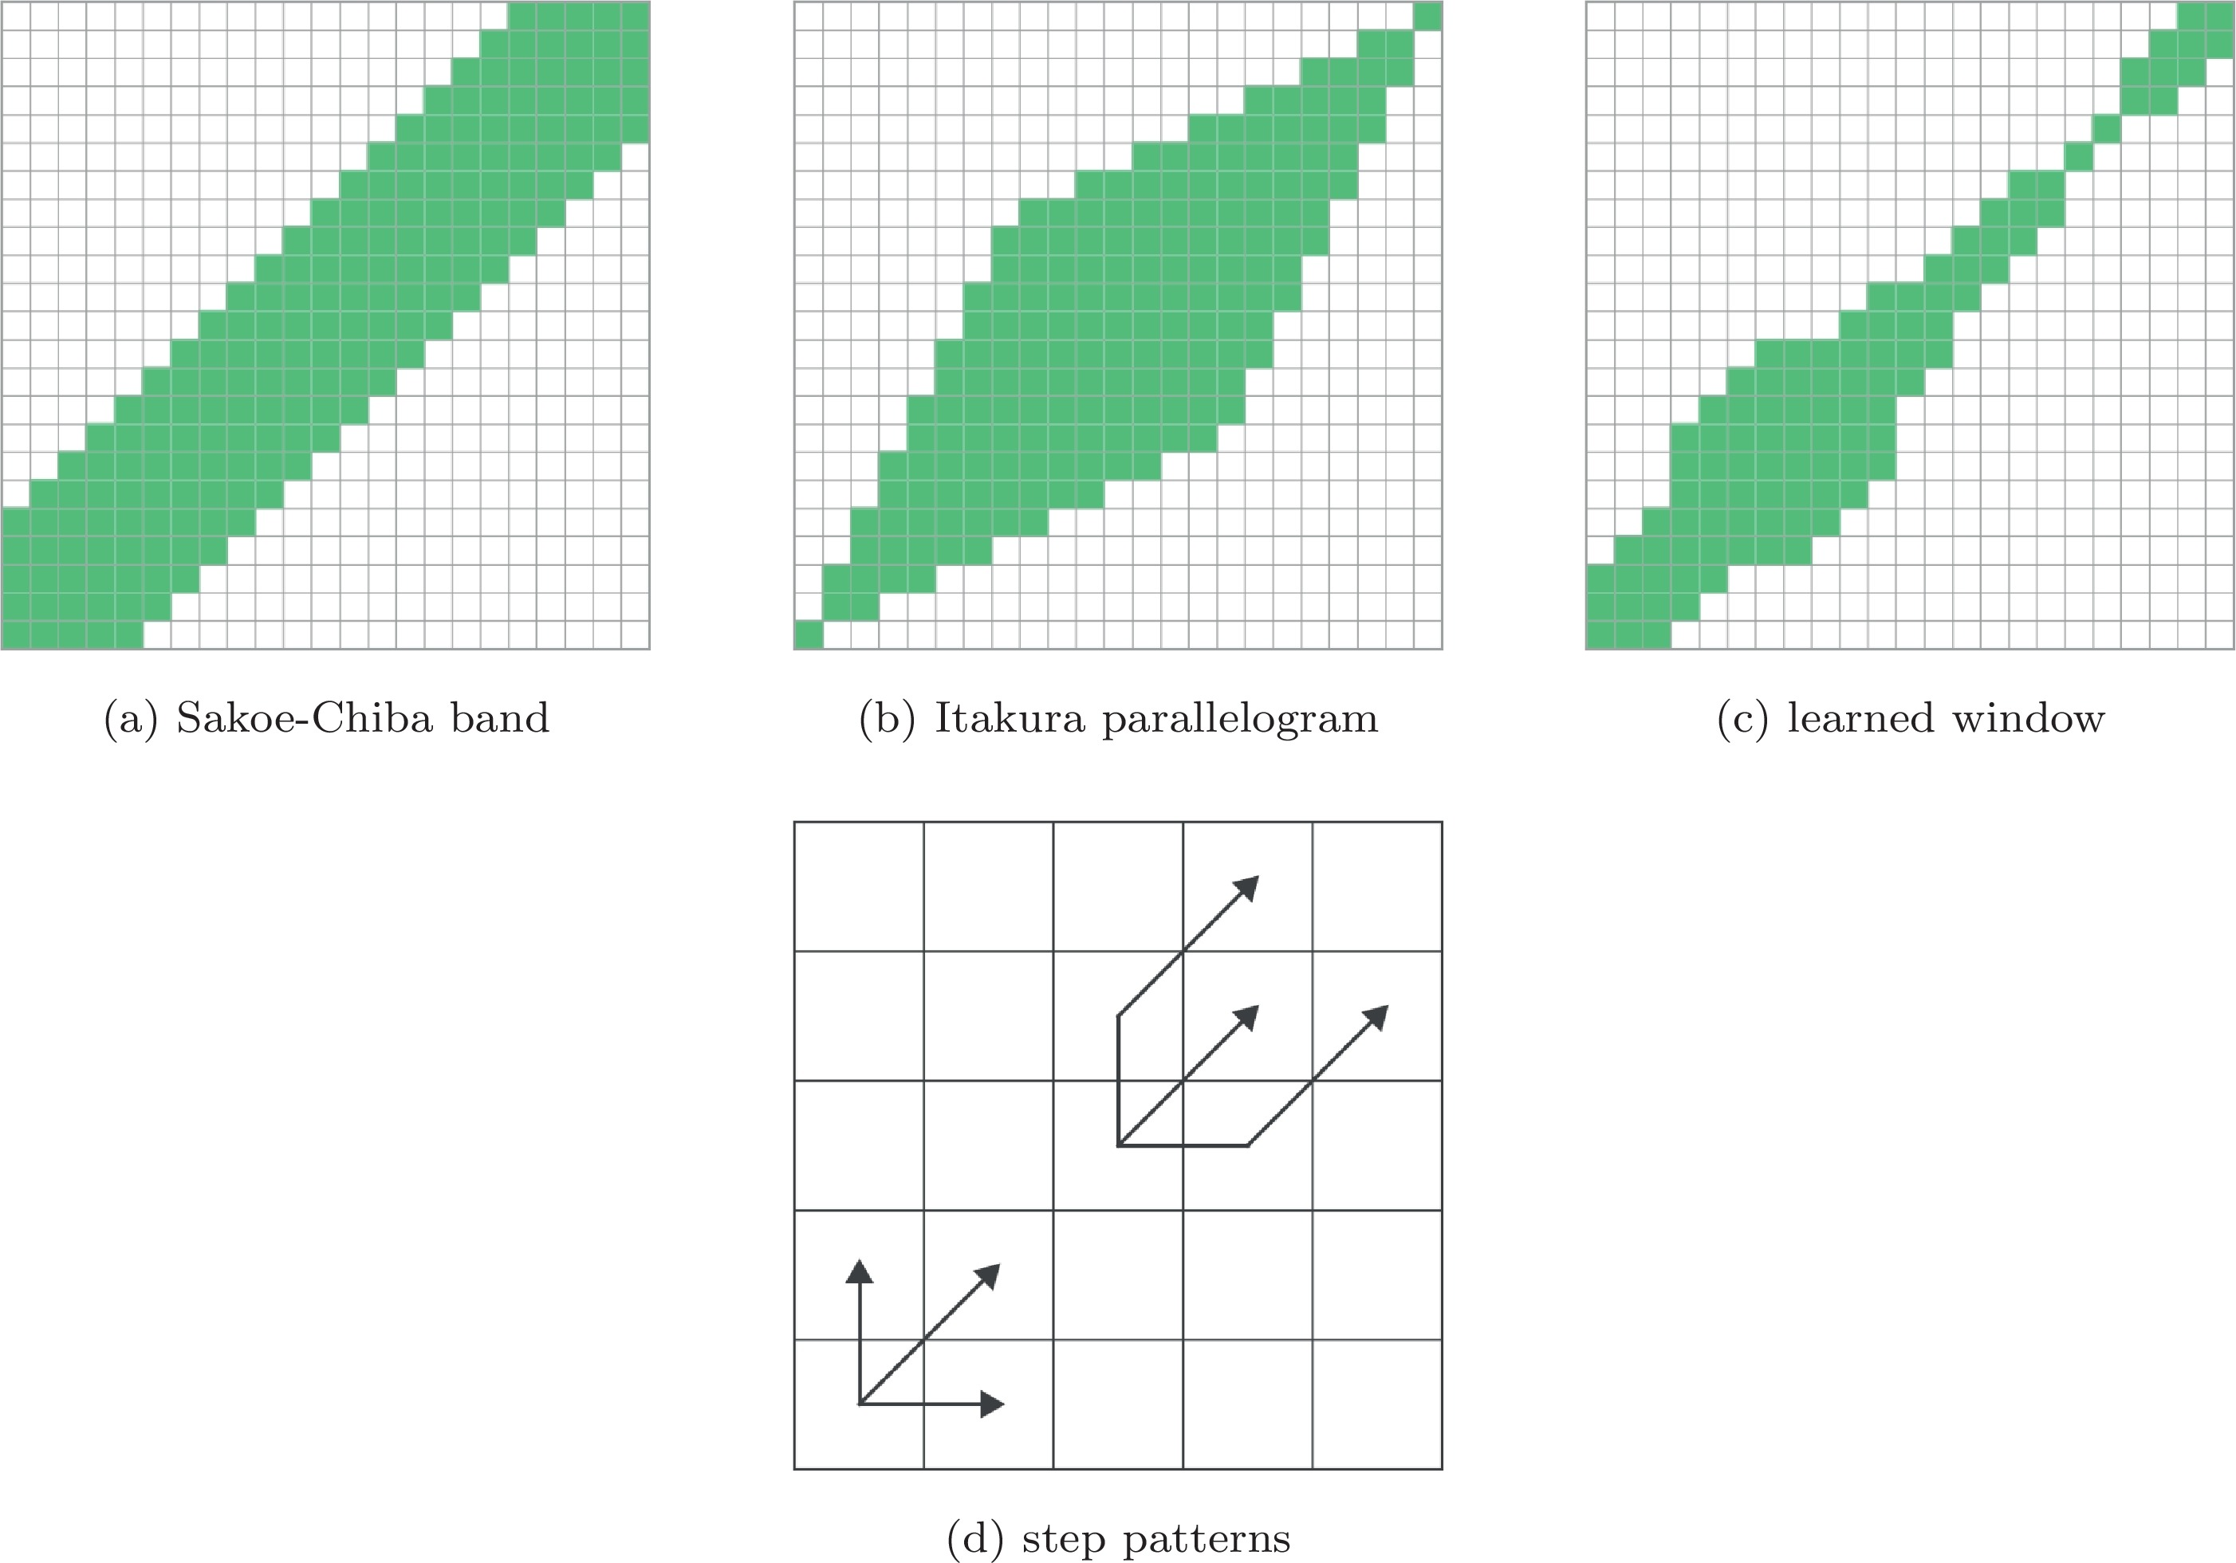
Variants of DTW

Slide 6
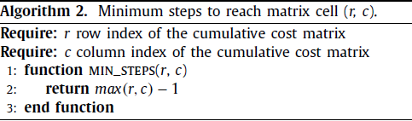
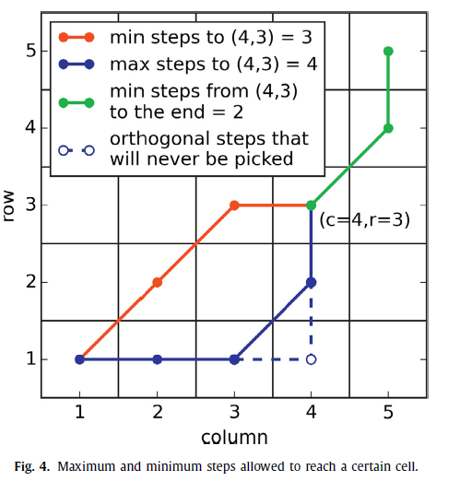
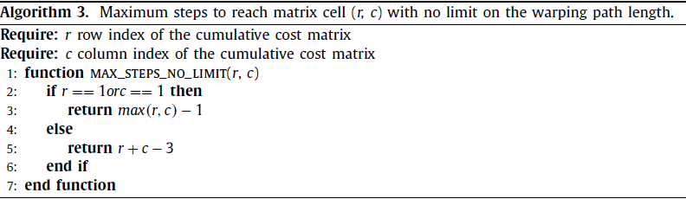
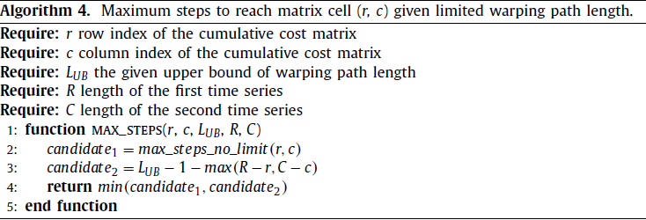
LDTW: DTW with limited warping path length(1/2)
max(r-1,c-1)
max(r-1,c-1)
(r-2)+1+(c-2)

Slide 7
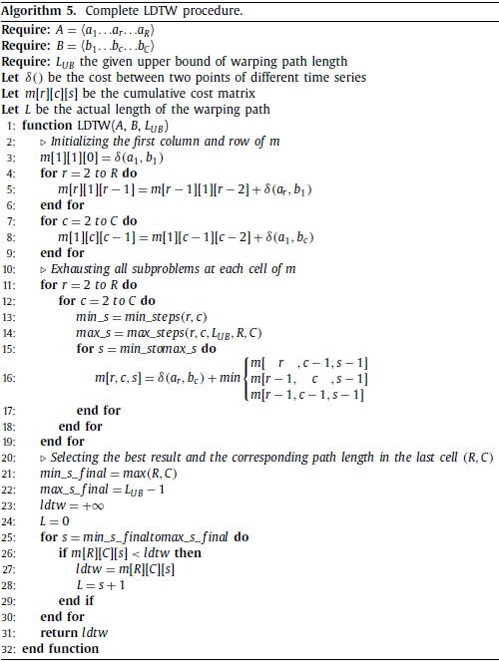
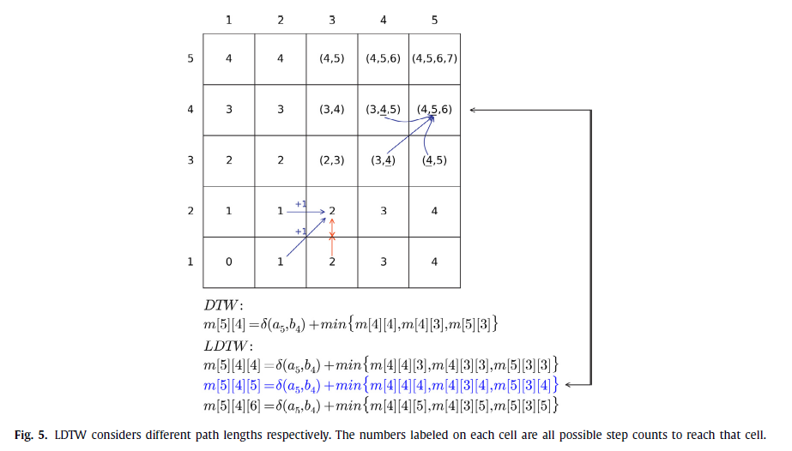
LDTW: DTW with limited warping path length(2/2)
$$m\left[3\right]\left[2\right]\left[2\right]=δ\left(a3,b2\right)+min⁡\{m\left[2\right]\left[2\right]\left[1\right],m\left[2\right]\left[1\right]\left[1\right],m[3][1][1]\}$$

Slide 8
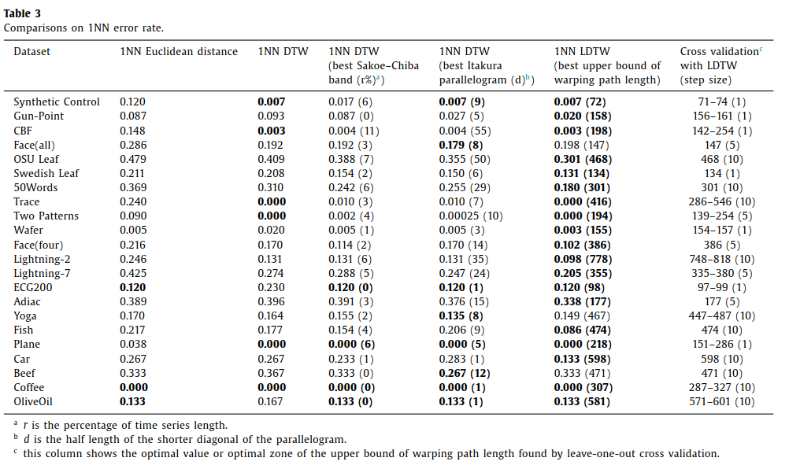
Experimental Result (1/2)

Slide 9
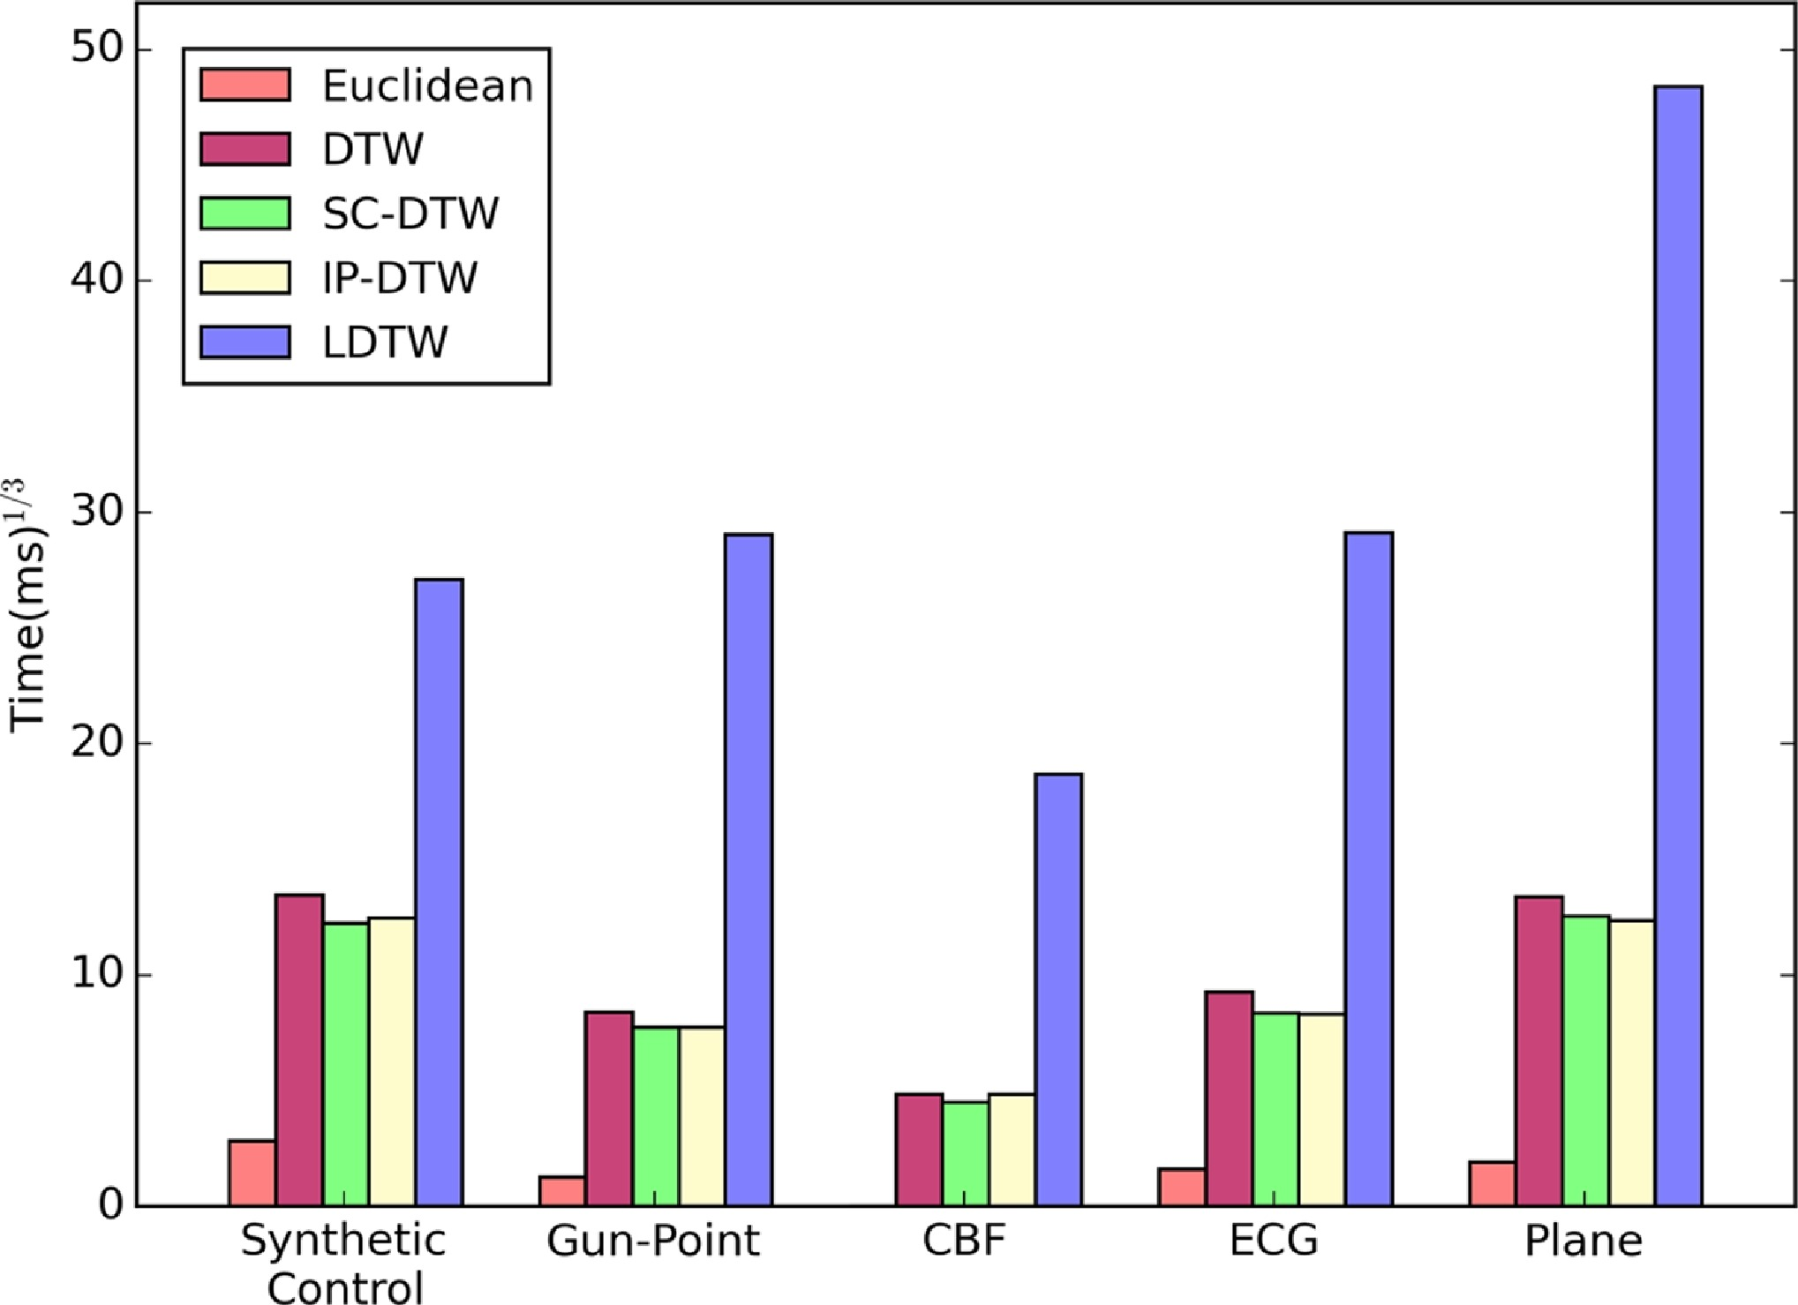
Experimental Result (2/2)

