Slide 1
Sparse Dynamic Programming for Longest Common Subsequence from Fragments
Brenda S. Baker, Raffaele Giancarlo
Journal of Algorithms, Vol. 42, 2002, pp. 231-254
Date : Feb. 25, 2005
Created by : Hsing-Yen Ann

Slide 2
Abstract
Sparse Dynamic Programming has emerged as an essential tool for the design of efficient algorithms for optimization problems coming from such diverse areas as computer science, computational biology, and speech recognition. We provide a new sparse dynamic programming technique that extends the Hunt–Szymanski paradigm for the computation of the longest common subsequence (LCS) and apply it to solve the LCS from Fragments problem: given a pair of strings X and Y (of length n and m, respectively) and a set M of matching substrings of X and Y, find the longest common subsequence based only on the symbol correspondences induced by the substrings.

Slide 3




Abstract (cont’d)
This problem arises in an application to analysis of software systems. Our algorithm solves the problem in time using balanced trees, or time using Johnson's version of Flat Trees. These bounds apply for two cost measures. The algorithm can also be adapted to finding the usual LCS in time using balanced trees or time using Johnson's version of Flat Trees, where M is the set of maximal matches between substrings of X and Y and is the alphabet. These bounds improve on those of the original Hunt–Szymanski algorithm while retaining the overall approach.

Slide 4
Sparse Dynamic Programming
The DP matrix is a sparse matrix. (Or, after adding some restrictions, only a sparse set of the entries of the DP matrix is meaningful.)
Consider only the matches rather than all matrix entries.
n
m
Usual DP: O(nm)
Sparse DP: O(|M| log |M|)

Slide 5
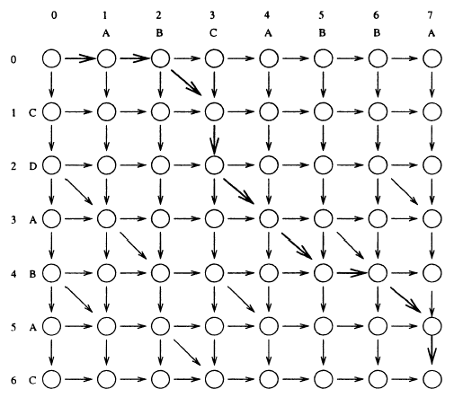
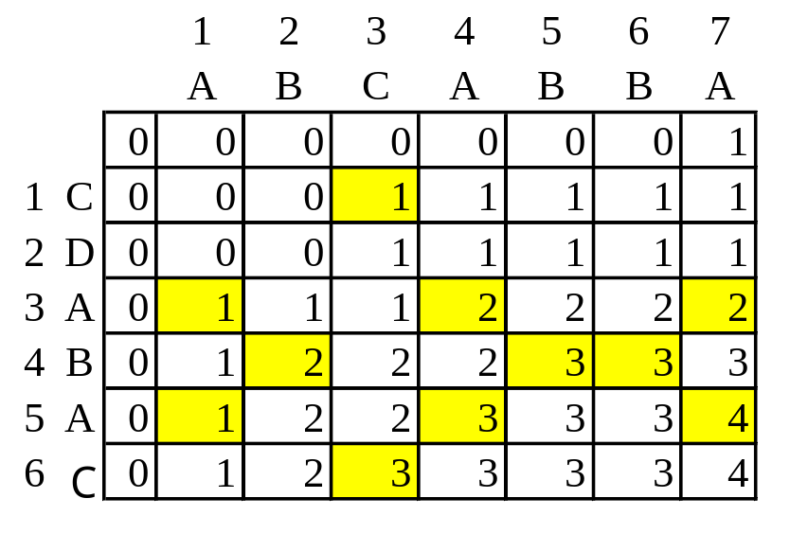
Transform LCS to Edit Graph
Find the shortest path in the edit graph for X and Y.
Match: a incident diagonal edge

Slide 6

LCS from Fragments Problem
Input:
  Strings X and Y (of length n and m, respectively).
  A set M of fragments (matching substrings of X and Y).
Output:
  A shortest path in the edit graph.
Usual LCS problem:
  Transformed to LCS from fragments problem by finding all maximal matches M in time [3,4].
Fragment: a triple (i, j, k)
  Edges which start at (i-1, j-1) and end at (i+k-1, j+k-1).

Slide 7
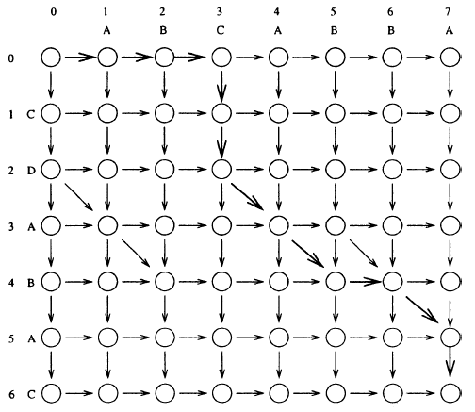
An Example of LCS from Fragments
Restriction: at least 2 diagonal edges.
Fragments: M={ (1,3,2), (4,3,2), (6,4,2) }.

Slide 8
Definitions for Lemmas
Two cost measures
  Levenshtein cost measure:
    all diagonal edge=0, otherwise=1
  Another:
    fragment segment cost=1 (for any length)
Let fragment f=(i, j, k), then
  start(f) = (i-1, j-1)
  end(f) = (i+k-1, j+k-1)
  x(p), y(p): x- and y-coordinates of a point p
  mincost₀(p): minimum Levenshtein cost from (0,0) to p

Slide 9
Lemma 2.1
Consider the specific cost measure. For any point p in the edit graph, there is a min-cost path from (0, 0) to p such that every fragment segment traversed is a prefix.
prefix
not prefix

Slide 10
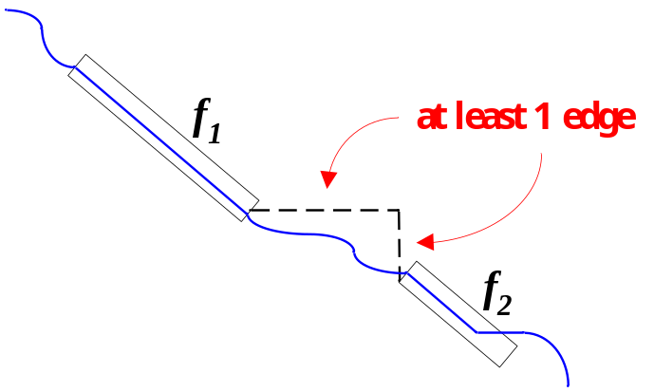
Lemma 2.2
Consider a min-cost path that satisfies Lemma 2.1, i.e., every fragment segment traversed is a prefix. If there are at least one horizontal edge and at least one vertical edge between two successive fragment segments in the path, the earlier fragment segment is the entire fragment.
If f₁ and f₂ are both in the min-cost path, then
f₂ could be a prefix, but
f₁ must be an entire fragment.

Slide 11
Corollary 3.1
For any fragment f and any point p on f,
mincost₀(p) = mincost₀ (start(f)).
Then we can define mincost₀(f) = mincost₀ (start(f)).
By Lemma 2.1, 2.2 and Corollary 3.1, the min-cost path can be determined by the fragments and their relationship.
A new recurrence formula based on fragments can be defined.

Slide 12
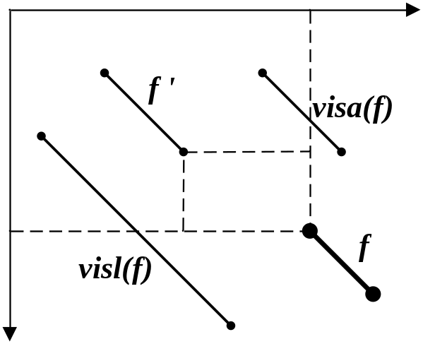
Relationship between Fragments
visl(f) : the first fragment that to the left of f.
visa(f) : the first fragment that to the above of f.
f ' precedes f :
  x(end(f ')) < x(end(f)) and y(end(f ')) < y(end(f))
If no diagonal edges between end(f')
and start(f), the min-cost from end(f')
to start(f) is:
x(start(f)) - x(end(f '))
+ y(start(f)) - y(end(f '))

Slide 13
New Recurrence Formula
d(f) = y(start(f)) - x(start(f)): diagonal number of f
Z(f) = mincost0(f) - x(end(f)) - y(end(f)):
  How much cost saved, a negative integer
Lemma 3.1:
For a fragment f,
mincost₀(f) = min{x(start(f))+y(start(f)), c_{p}, c_{l}, c_{a}}, where
  c_{p} = x(start(f)) + y(start(f)) + min{Z(f'): f‘ precedes f}
  c_{l} = mincost₀(visl(f)) - d(f) + d(visl(f))
  c_{a} = mincost₀(visa(f)) - d(visl(f)) + d(f)

Slide 14
The Algorithm
Store and sort all fragments on (x,y)-values. It can be done by using:
  balanced trees: O(log d)
  Emde Boas Flat Trees: O(log log u)
  Johnson’s version of Flat Trees: O(log log G)
Compute the all the visibility information by applying the new recurrence formula.
Extract the shortest path from the information in the selected data structure.

Slide 15
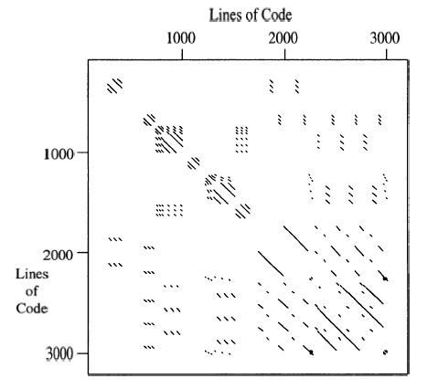
An Application
Find the duplication between two software system. (parameterized match of at least 10 lines)

