Slide 1
Finding the Most Vital Node of a Shortest Path
Enrico Nardelli, Guido Proietti, Peter Widmayer
Theoretical Computer Science, Vol. 296, pp. 167-177, 2003
Date : April 12, 2005
Created by : Hsing-Yen Ann

Slide 2
Abstract
In an undirected, 2-node connected graph G = (V, E) with positive real edge lengths, the distance between any two nodes r and s is the length of a shortest path between r and s in G. The removal of a node and its incident edges from G may increase the distance from r to s. A most vital node of a given shortest path from r to s is a node (other than r and s) whose removal from G results in the largest increase of the distance from r to s. In the past, the problem of finding a most vital node of a given shortest path has been studied because of its implications in network management, where

Slide 3
Abstract (cont’d)
it is important to know in advance which component failure will affect network efficiency the most. In this paper, we show that this problem can be solved in O(m + n log n) time and O(m) space, where m and n denote the number of edges and the number of nodes in G.

Slide 4

Problem Definition
Given:
  Undirected 2-node connected graph G = (V, E)
  Start node r, end node s
  A shortest path P_{G}(r, s)=<v₀, ..., v_{k}> from r to s
Find the most vital node such that
(removing v* will cause the shortest replacement path longest among all {v₁, ..., v_{k-1}})
The k-most vital nodes problem is NP-hard.
A naive algorithm needs O(mn + n² log n) time and O(m) space.

Slide 5
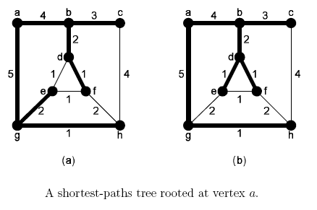
Single-Source Shortest Paths Tree
SPT SG(r) in G:
  A spanning tree of G rooted in r
  Union of all shortest paths from r
  Rather than consider all nodes and edges in G, we can consider only the shortest path P_{G}(r, s) and the SPT SG(r)

Slide 6
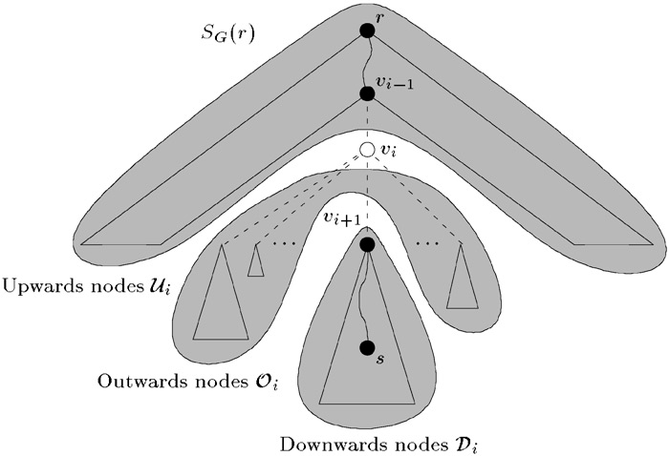
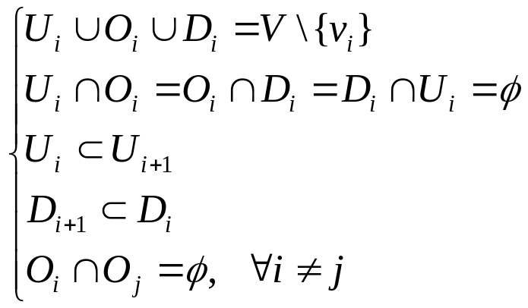
Structural Properties of Replacement Shortest Paths
Removing v_{i} will partition SG(r) into a set of subtrees: Ui, Oi, Di
Properties:

Slide 7






Some Lemmas
  : crossing edges associated with v_{i}
  but computing all corresponding to all v_{i} is not a good idea…
For each node
For each node
(subpaths of shortest paths are also shortest paths)
For each node , the shortest path from r to x must be concatenated by P_{G}(r,u) for some , one E(Ui, Oi) and some E(Oi, Oi).

Slide 8

The Algorithm and Its Time Analysis
The algorithm is consisted with computing and combining the components of distances.
Using Fibonnacci Heap to store nodes:
  1 MakeHeap
  O(n) Insert
  O(n) FindMin
  O(n) Delete
  O(m) DecreaseKey
O(m + n log n) for Computing SPT S_{G}(r) and S_{G}(s)
O(n) for managing sets O_{i} , i = 1, …, k-1
Total: O(m + n log n)

Slide 9




Computing Components of Distances
Compute a SPT S_{G}(r) rooted in r.
Then we know
Compute a SPT S_{G}(s) rooted in s.
Then we know
For i=1,…k-1, compute heaps H_{i} for all nodes with key:
By applying Dijkstra’s algorithm, then we know

Slide 10





Combining Components of Distances
Beginning: , put y in heap H with key:
At the i-th stage:
Remove v_{i} from H and associated nodes in O_{i}.
For all removed node , consider its crossing edges to D_{i}, compute
For all , consider its crossing edges to D_{i}, compute
Set min(key(y), k', k'') to be new key of y in H.

Slide 11

Combining Components of Distances (con’t)
The minimum key in H at the i-th stage is the length of the replacement shortest path of G-v_{i}.
When all stages have been completed, a most vital node can be determined as a node v_{i} on P_{G} (r, s) such that

