Slide 1
Aligning Alignments Exactly
John Kececioglu and Dean Starrett
Proceedings of the eighth annual international conference on Computational molecular biology
pp. 85 - 96 , 2004

Slide 2
Abstract
A basic computational problem that arises in both the construction and local-search phases of the best heuristics for multiple sequence alignment is that of aligning the columns of two multiple alignments. When the scoring function is the sum-of-pairs objective and induced pairwise alignments are evaluated using linear gap-costs, we call this problem Aligning Alignments. While seemingly a straightforward extension of two-sequence alignment, we prove it is actually NP-complete.

Slide 3
Abstract (cont.)
As explained in the paper, this provides the first demonstration that minimizing linear gap-costs, in the context of multiple sequence alignment, is inherently hard. We also develop an exact algorithm for Aligning Alignments that is remarkably efficient in practice, both in time and space. Even though the problem is NP-complete, computational experiments on both biological and simulated data show we can compute optimal alignments for all benchmark instances in two standard datasets, and solve very large random instances with highly-gapped sequences.

Slide 4
Definition:
Input:
  multiple alignments A and B
  substitution cost function δ
  gap initiation cost γ, and gap extension cost λ
Output
  An alignment of the columns of A versus the columns of B that minimizes the sum-of-pairs objective with linear gap costs.

Slide 5
The alignments A and B are viewed as two sequences. The problem is to align these two sequences by inserting, deleting, and substituting columns.
The cost for a gap of length x is γ+ λx
  Whenλ=0, it can be solved in polynomial time.
  Whenλ>0, it is NP-complete.

Slide 6
Shape
To evaluate the cost of an alignment with linear gap-costs we need to determine the number of gaps initiated by a column.
A shape s for an alignment with k rows is an ordered partition s = (s₁, s₂, s₃, … , s_{p} ) where 1 ≦ p ≦ k.

Slide 7
Example
ＡＣ－ＴＴＣ－－
ＡＣＧＴＴ－－－
－ＣＡＴＴＣ－－
Ａ－ＡＣＴＣＧＧ
s = ( {2}, {1, 3}, {4} )
Furthermore we denote the flat shape by
φ= ({1, 2, 3, … , k})

Slide 8
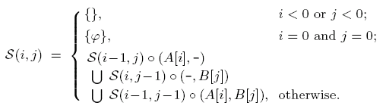
Recurrence
S(i, j) is the set of shapes of all alignments of a prefix of the input.
For a shape s and a column c, the shape obtained by concatenating c onto any alignment ending in s is denoted s ◦ c.

Slide 9
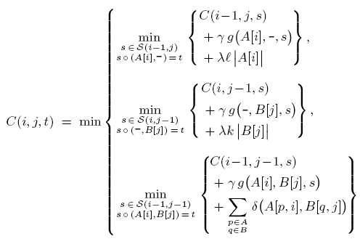

Slide 10
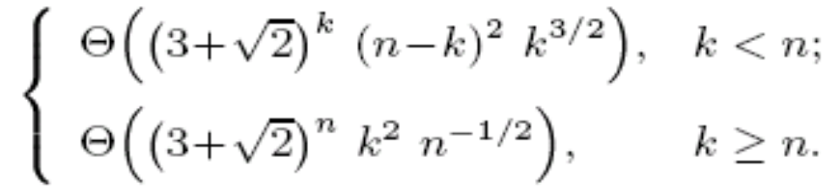
Time Complexity
To align two alignments,each having k sequences and n columns, the exact algorithm takes worst-case time

