Slide 1
CATH — a hierarchic classification of protein domain structures
CA Orengo, AD Michie and JM Thornton
Structure, vol.5, pp.1093–1108, 1997

Slide 2
Abstract
Protein evolution gives rise to families of structurally related
proteins, within which sequence identities can be extremely low.
As a result, structure-based classifications can be effective at
identifying unanticipated relationships in known structures and in
optimal cases function can also be assigned. The ever increasing
number of known protein structures is too large to classify all
proteins manually, therefore, automatic methods are needed for
fast evaluation of protein structures.

Slide 3
Abstract
We present a semi-automatic procedure for deriving a novel
hierarchical classification of protein domain structures (CATH).
The four main levels of our classification are protein class (C),
architecture (A), topology (T) and homologous superfamily (H).

Slide 4
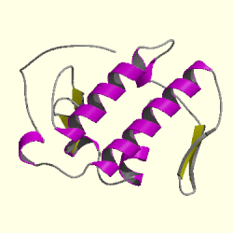
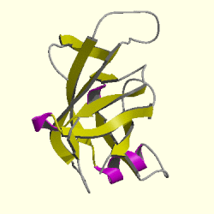
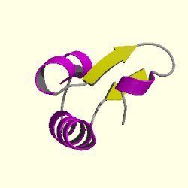
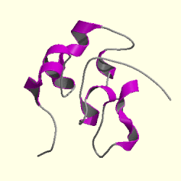
CATH Hierarchy
Class (C-level) : secondary structure composition and contacts
  Class1 : Mainly Alpha
  Class2 : Mainly Beta
  Class3 : Mixed Alpha- Beta
  Class4 : Few Secondary Structures
  Class1 Class2 Class3 Class4

Slide 5
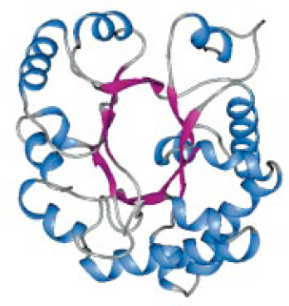
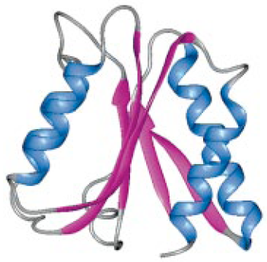
CATH Hierarchy
Architecture (A-level) : description of the gross arrangement of secondary structures, independent of connectivity
  Barrel
  Sandwich
  Barrel Sandwich

Slide 6
CATH Hierarchy
Topology (T-level) :depending on both the overall shape and connectivity of the secondary structures
  Structures which have a SSAP score of 70 and at least 60%
Homologous superfamily (H-level) : highly similar structures and functional similarity
  may have evolved from a common ancestor

Slide 7
CATH hierarchy
Sequence family (S-level) : significant sequence similarity and thus a high probability of having similar structure/function
  sequence identities >35%
Near-Identical(S95) : have a sequence identity of >=95%
Identity(S100) : share 100% sequence identity
Domain : the final node

Slide 8
Methods
Step 1 : selection of structures for CATH database
  well-resolved crystal structures(3.0 Å resolution or better)
  from PDB : 1, native (X-ray); 2, mutant (X-ray); 3, native (NMR); 4 mutant (NMR)
Step 2 : sequence comparisons (S-level)
  Pairwise comparisons between the sequences of all the proteins selected for CATH are performed using a standard Needleman and Wunsch algorithm, scoring 1 for matching identical residues, 0 otherwise and charging a gap penalty of 4.
  selected the best resolved crystal structure as a representative for the family

Slide 9
Methods
Step 3 : assignment of domain boundaries for multi-domain proteins
  DETECTIVE, PUU, DOMAK algorithm
Step 4 : automatic assignment of class
  Using an automated class assignment protocol to analysis domain structural class.
  preventing any cross class comparisons
Step 5 : structure comparisons (H- and T-levels)
  use fast and sensitive version of the program SSAP
  the SSAP score 70 to generate the T-levels and 80 the H-level
  Functions are determined by reference to SWISSPROT entries, using information from the PDB file or the literature.

Slide 10
Methods
Step 6 : assigning architecture
  The architecture (A-level) is determined manually using the classification of Richardson.
  Complex arrangements which cannot easily be described are placed in a general ‘complex’ architecture.
Step 7 : data on individual structures
  A number of graphical representations or information can be displayed.
Step 8 : assigning CATH numbers

Slide 11
Result
CATH

