Slide 1
Protein Side Chain Packing Problem: A Maximum Edge-Weight Clique Algorithmic Approach
Dukka Bahadur K.C, Tatsuya Akutsu and Tomokazu Seki
Proceedings of the second conference on Asia-Pacific bioinformatics - Volume 29, pages 191–200, 2004
Date: November 3, 2005
Created by Jing-Liang Hsin

Slide 2
Abstract
Protein side-chain packing has an important application in homology
modeling, protein structure prediction, protein design, protein docking
problems and many more. Protein side-chain packing problem is
computationally known to be NP-hard (Akutsu, 1997) (Chazelle,
Kingsford & Singh, 2003) (Pierce & Winfree, 2002). In the field of
computer science, the of reduction of a problem to other problems
is quite often used to design algorithms and to prove the complexity of a
certain problem. In this work, we have used this notion of reduction to
solve protein side-chain packing problem.We have developed a
deterministic algorithm based approach to solve protein side-chain
packing problem based on clique-based algorithms.

Slide 3
Abstract (cont.)
For this, we reduced this problem to the maximum clique finding problem
(SPMCQ). Moreover, in order to incorporate the interaction preferences
between the atoms, we have then extended this approach to maximum
edge-weight clique finding problem (SPWCQ) by assigning weights based
on probability discriminatory function.We have tested this approach to
predict the side-chain conformations of a set of proteins and have
compared the results with other existing methods. We have found
considerable improvement in terms of the size of the proteins and in terms
of the efficiency and accuracy of the prediction.

Slide 4
Protein side chain packing problem
Given a protein main chain conformation, constructing side chains by exploring all possible rotamer conformations simultaneously is called protein side chain packing problem.
  The representation of the side chain search space.
  The searching step to search through the represented search space.
  An energy function is introduced in order to refine the model.

Slide 5
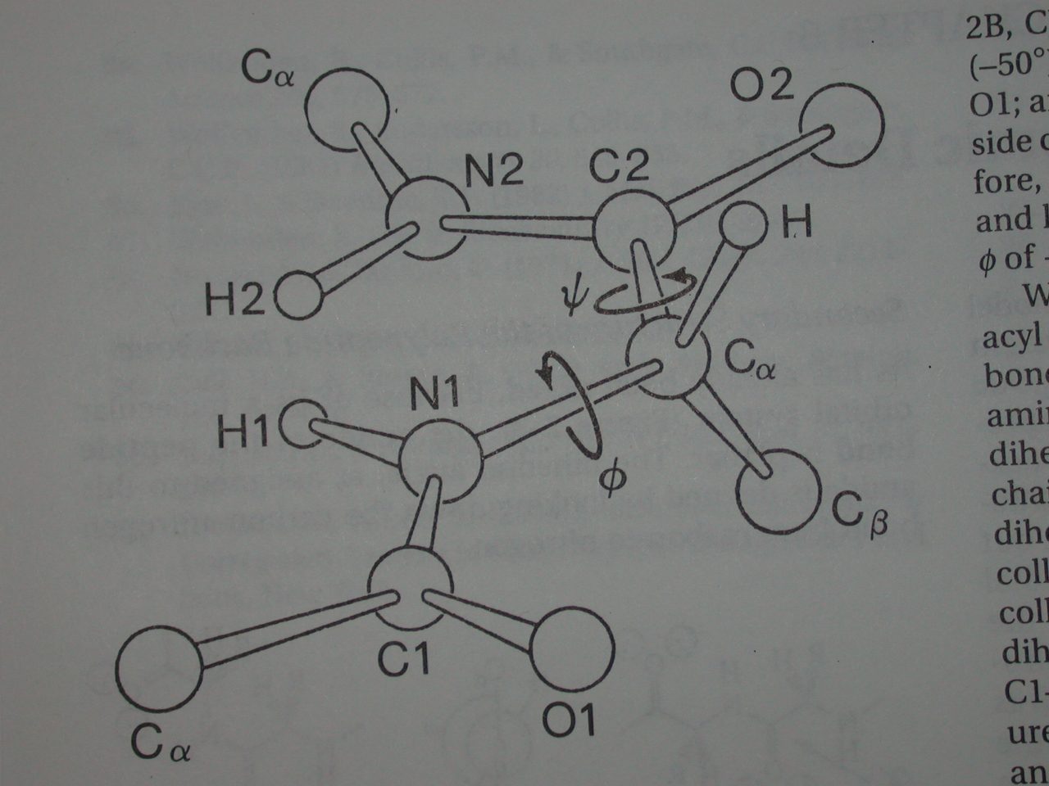
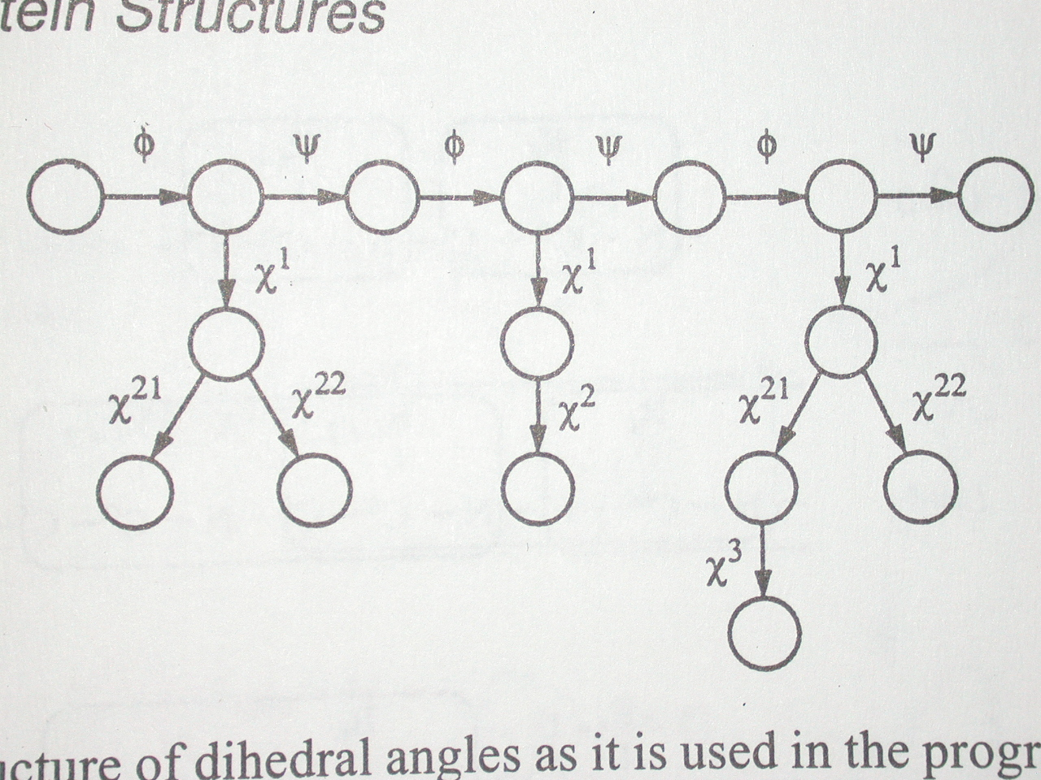
Dihedral angles
The φ-ψ angles which determine the main chain of the structure.
The x torsion angles which determine the side chain packing.
Jack Kyte, 1995 David G. Reid, 1997

Slide 6
Sampling of the graph
The set of rotation angles is defined by
(2πk) / K || k = 0, …, K-1.
Each side chain was rotated by an interval of (2πk/K) angle along the x₁ axis, generating (2π/K) conformations for a single side chain.
Using 20 rotamers for each side chain position (K=18).

Slide 7
Generation of the graph
Every possible conformation of a side chain residue is represented as a node and then edges are drawn between these nodes if these nodes satisfy some criteria.
Let R={r₁, …, r_{n}} be the set of residues of the given protein whose side chain conformations has to be calculated.
Let r_{i,k} be the i-th residue whose side chain atoms are rotated by (2πk) / K radian and the minimum distance between the atoms in r_{i,k} and the atom in the main chain is large than L₁ Å.

Slide 8
Generation of the graph (cont.)
The edge is drawn between two conformations if the minimum distance between the atoms in the pairs of nodes under consideration is large than L₂ Å .
In this work, L₁=1.5Å and L₂=4.0Å are used.

Slide 9
Maximum clique finding problem
Let us call this version of the algorithm for side chain packing as SPMCQ.
We solve this clique finding problem by using the clique finding algorithm developed by two authors (Tomita & Seki, 2003).

Slide 10
Clique algorithm
Let us call this version of the algorithm to find the maximum clique as MCQ.
Let G=(V,E) be an undirected graph, where V is the set of vertices and E is the set of edges.
For each v ∈V, Γ(v) denotes the set of vertices adjacent to v and deg(v) denotes the degree of v.
It maintains variables Q, Q_{max} and R.
In order to avoid enumerating all maximum cliques, approximate coloring of vertice is used. A number (color) No(p) is assigned to each vertex p in candidate set R.

Slide 11
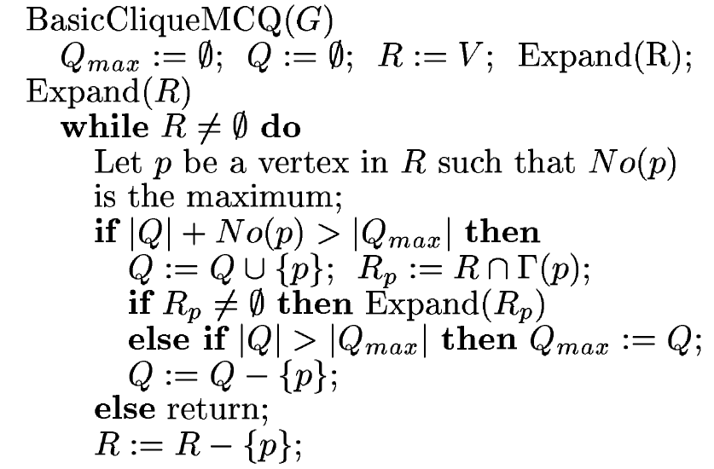
Clique algorithm (cont.)

Slide 12
Maximum edges weight clique
Our objective here is to assign weights to edges of a graph by determining the strength of interactions of a side chain to the local main chain and between two side chain.
The function based on residue-specific all-atom probability discriminatory function proposed by Samudarala et al. to best fit our purpose.

Slide 13
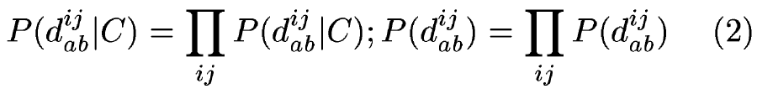
Weight function
The possible conformation of a structure is divided into two types viz. the set of correct conformations C and the set of incorrect conformations I.
A set of inter-atomic distance within a structure d^{ij}_{ab}, where d^{ij}_{ab} is the distance between atoms i and j, of type a and b respectively.

Slide 14
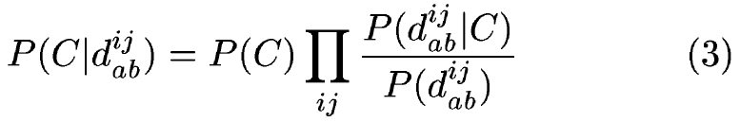
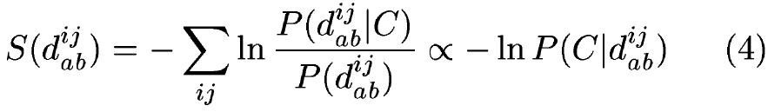
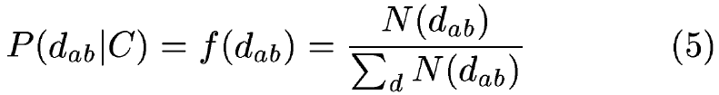
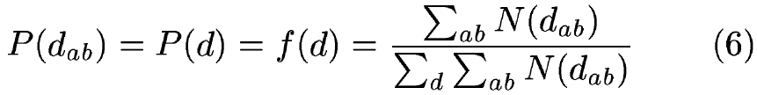
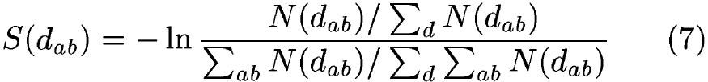
Weight function (cont.)

Slide 15
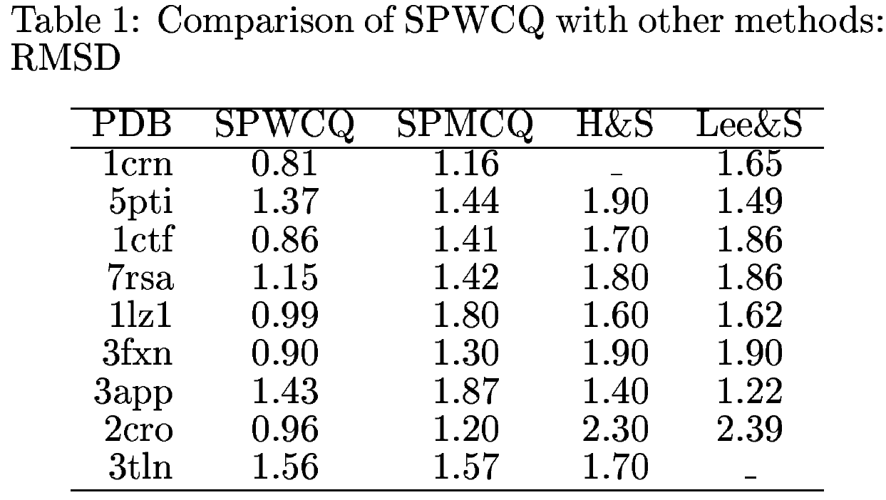
Results

Slide 16
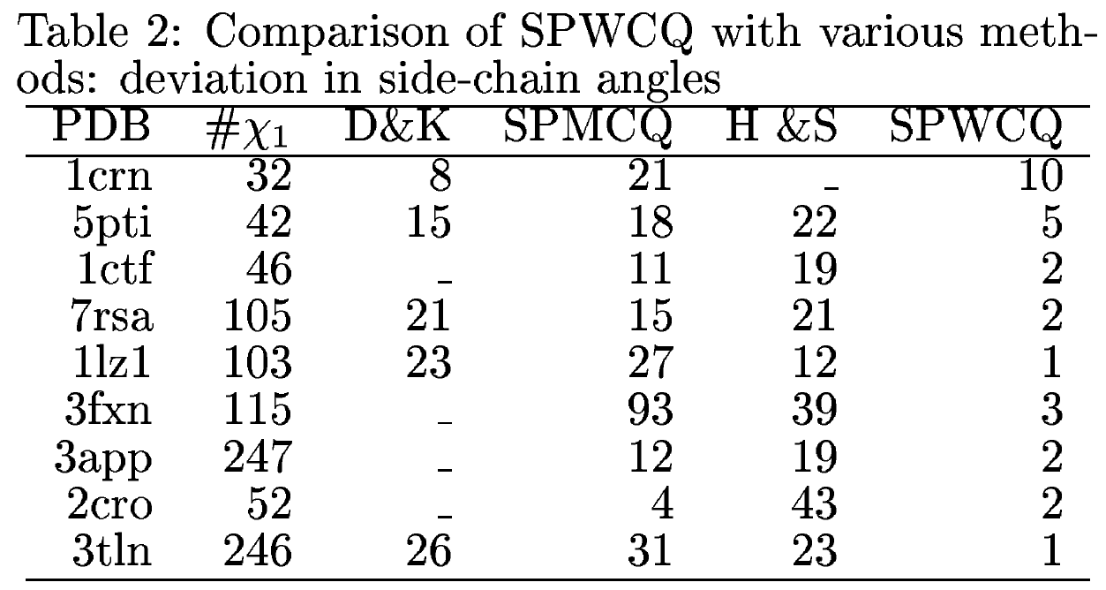
Results (cont.)

Slide 17
Conclusion
The value mentioned in the case of SPWCQ are not the optimal ones, in the sense that we restricted the number of maximum cliques to be analyzed due to computational reasoned.
Unlike the most branch and bound based methods we were able apply our algorithm to a protein of upto 323 residues long.
The main goal of this research was to develop a deterministic algorithm for protein side chain packing problem, we did not focus more on designing our own potential functions.

