Slide 1
Extending the Accuracy Limits of
Prediction for Side-chain Conformations
Zhexin Xiang and Barry Honig
J. Mol. Biol. Vol. 311, pp.421–430, 2001
Date: December 1, 2005
Created by Jing-Liang Hsin

Slide 2
Abstract
Current techniques for the prediction of side-chain conformations on a
fixed backbone have an accuracy limit of about 1.0-1.5 Å rmsd for core
residues. We have carried out a detailed and systematic analysis of the
factors that influence the prediction of side-chain conformation and, on
this basis, have succeeded in extending the limits of side-chain prediction
for core residues to about 0.7 Å rmsd from native, and 94% and 89% of
x₁ and x₁₊₂ dihedral angles correctly predicted to within 20° of native,
respectively. These results are obtained using a force-field that accounts
for only van der Waals interactions and torsional potentials. Prediction
accuracy is strongly dependent on the rotamer library used. That is, a
complete and detailed rotamer library is essential.

Slide 3
Selection and preparation of rotamer libraries
Test set of proteins:
  The first set included 15 proteins selected randomly from the culled PDB list with resolution between 0.83-1.4 Å and had a pair-wise sequence identity of less than 20%.
  The second set included 18 proteins which deposited in the PDB in 1999 with resolution better than 1.2 Å and that contained more than 40 residues.
Creation of rotamer library:
  We created three (10, 20, 40 ) rotamer libraries.
  Generally, a small portion of a complete rotamer library can represent a large fraction of the side-chain conformations.

Slide 4
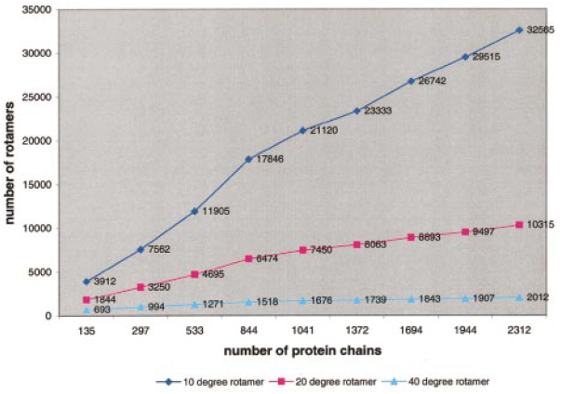
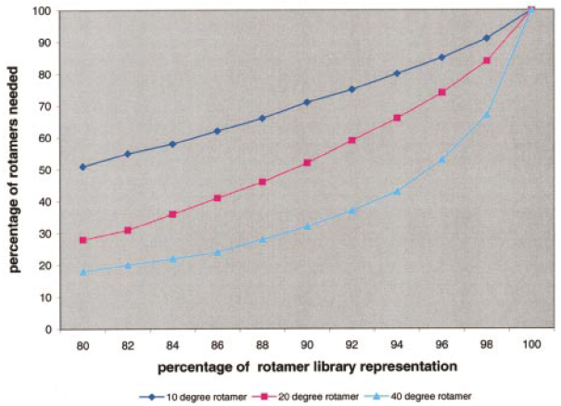
Selection and preparation of rotamer libraries (cont.)

Slide 5
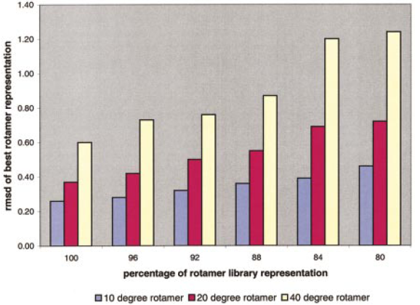
Selection and preparation of rotamer libraries (cont.)

Slide 6
Side-chain prediction method
Side-chain predictions were carried out on fixed poly-peptide backbones, which includes N, C^{α}, C, O and C^{β} atoms.
For each residue, all possible side-chain conformations are generated either from the dihedral angle rotamer library using bond angles and lengths from CHARMM, or from their coordinate rotamer library.
Using SCAP to predict side-chain conformation.

Slide 7
Accuracy analysis
RMSD values from the native conformation:
  We considered only side-chain heavy atoms, excluding C^{β} atoms.
Dihedral angle deviations from native:
  Only x₁ and x₁₊₂ dihedral angles were considered.
  A dihedral angle was considered to be predicted correctly if its value was within 20° of that of the minimized native structure.
  Protein core residues are defined as residues that are more than 90% buried

Slide 8
Effect of force-field
The bond lengths and angles were set to their experimental values.
The combinatorial problem was eliminated by predicting side-chain conformations, one residue at a time, while all others were held fixed in their native conformation.
The native conformation was added to the rotamer library for each residue.
The only remaining factor is the quality of the force-field, van der Waals forces and electrostatic interactions.

Slide 9
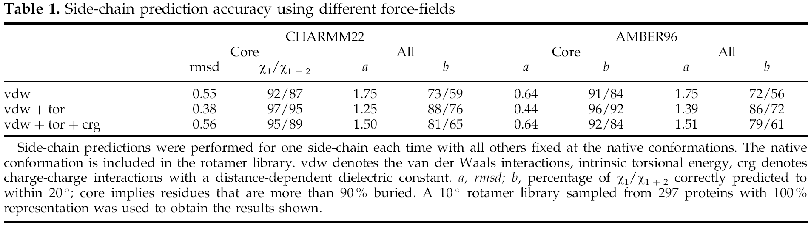
Effect of force-field (cont.)

Slide 10
Effect of the combinatorial problem
The bond lengths and angles were set to their experimental values.
The CHARMM31 force-field was used.
The initial conformation chosen for each residue was the closest rotamer to native rather than the native conformation itself.
We predicted side-chain conformations in two ways, one residue at a time until convergence is obtained and using 120 different initial conformations.

Slide 11
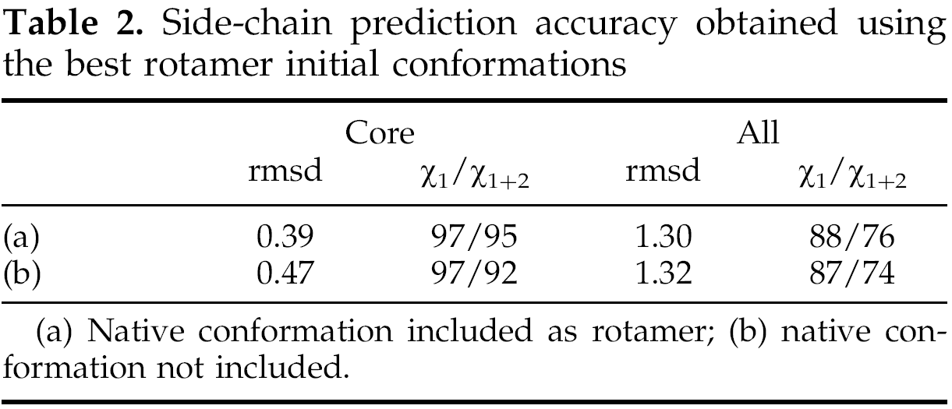
Effect of the combinatorial problem
(cont.)

Slide 12
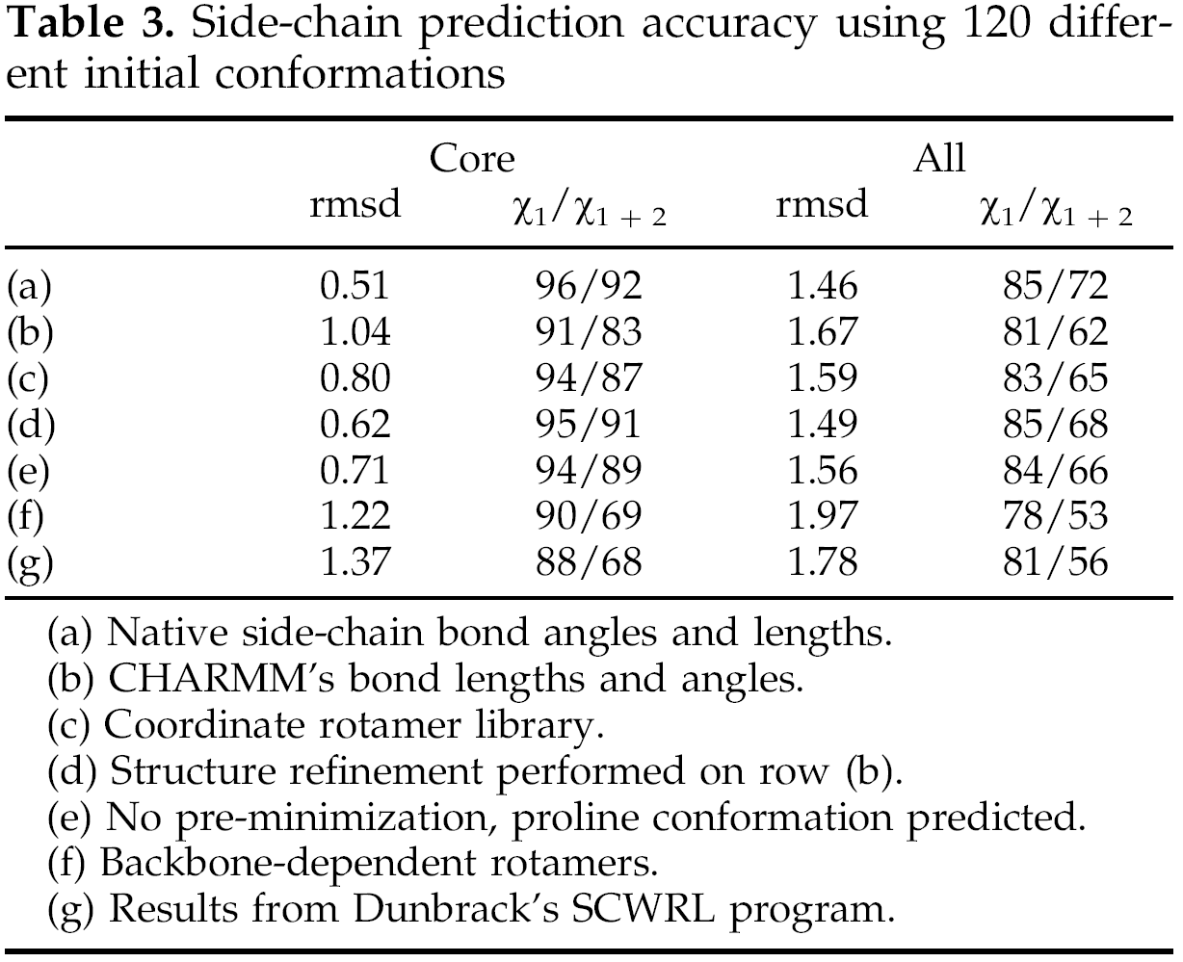
Effect of the side-chain bond angle and bond lengths

Slide 13
Structure refinement
The refinement simply involved sampling conformations that involved ±2 rotations of each dihedral angle for each residue.
The procedure was carried out, one residue at a time, with all other residues kept fixed.
The entire process was terminated when further iterations produced no change in conformation.

Slide 14
Effects of rotamer library
We repeated our calculations using the same energy function, search scheme, and definition of core residues but using Dunbrack's backbone-dependent rotamer library.
Under the same evaluation criteria, we also repeated predictions with Dunbrack's SCWRL program.

Slide 15
Conclusion
A central result is that prediction accuracy depends primarily on the quality of the rotamer library that is used.
There does not appear to be a significant combinatorial problem in side-chain prediction. However, side-chain predictions based on main chain alone are less accurate than those that address the full combinatorial problem.
For real applications, we have found that a prediction accuracy of 0.7 Å for core residues is easily obtainable.

