Slide 1
An Algorithm for the Distance between Two Finite Sequences
PETER H. SELLERS
JOURNAL OF COMBINATORIAL THEORY (A) 16, 253-258 (1974)
Presenter: Che-Jui Hsu (許哲睿)
Date: 2014/1/14
Notes:
http://www.researchgate.net/publication/220075789_An_Algorithm_for_the_Distance_Between_Two_Finite_Sequences

Slide 2
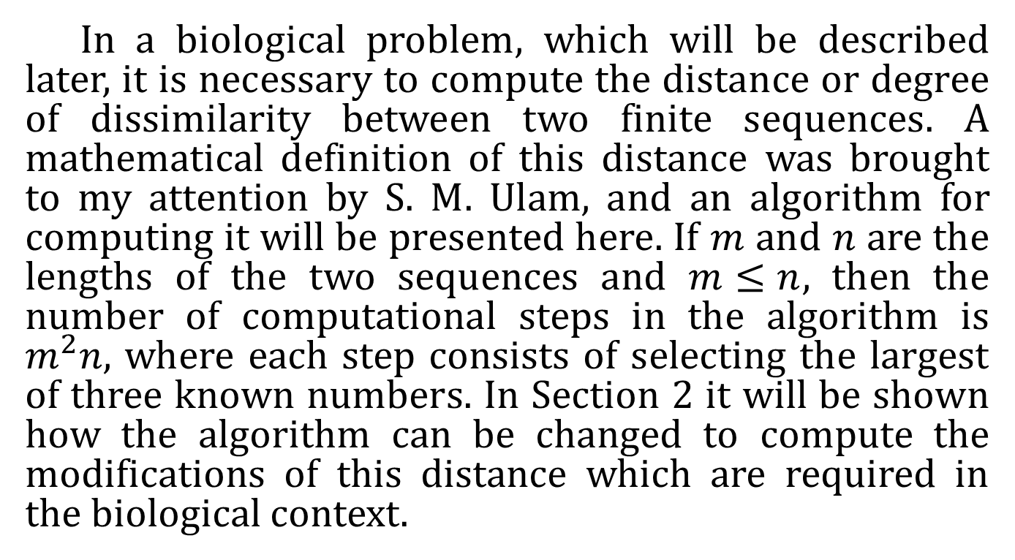
Abstract
In a biological problem, which will be described later, it is necessary to compute the distance or degree of dissimilarity between two finite sequences. A mathematical definition of this distance was brought to my attention by S. M. Ulam, and an algorithm for computing it will be presented here. If $m$ and $n$are the lengths of the two sequences and $m≤n$, then the number of computational steps in the algorithm is $m^{2}n$, where each step consists of selecting the largest of three known numbers. In Section 2 it will be shown how the algorithm can be changed to compute the modifications of this distance which are required in the biological context.

Slide 3
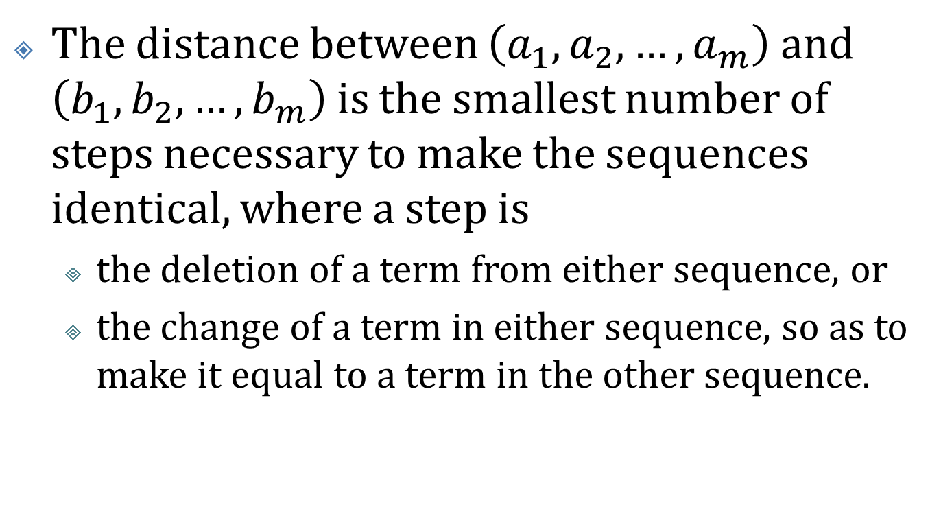
Definition (1/2)
The distance between $\left(a_{1}, a_{2}, …, a_{m}\right)$ and $\left(b_{1}, b_{2}, …, b_{m}\right)$ is the smallest number of steps necessary to make the sequences identical, where a step is
the deletion of a term from either sequence, or
the change of a term in either sequence, so as to make it equal to a term in the other sequence.

Slide 4
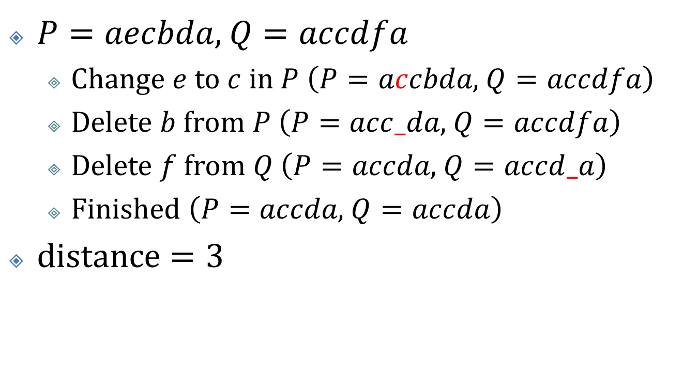
Definition (2/2)
$P=aecbda$, $Q=accdfa$
Change $e$ to $c$ in $P$$\left(P=accbda\text{, }Q=accdfa\right)$
Delete $b$ from $P$$\left(P=acc_da\text{, }Q=accdfa\right)$
Delete $f$ from $Q$$\left(P=accda\text{, }Q=accd_a\right)$
Finished $\left(P=accda\text{, }Q=accda\right)$
$\text{distance}=3$

Slide 5
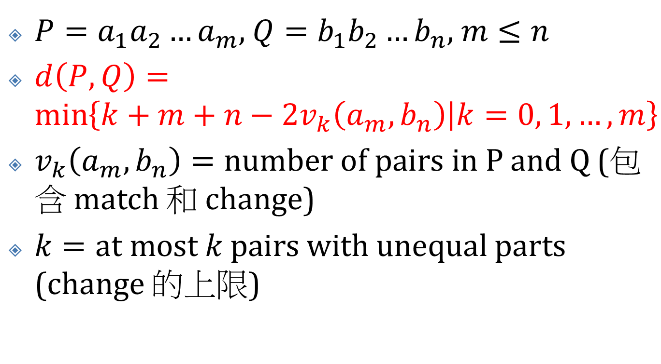
Algorithm
$P=a_{1}a_{2}…a_{m}$, $Q=b_{1}b_{2}…b_{n}$, $m≤n$
$d\left(P, Q\right)=\min\left\{k+m+n−2v_{k}\left(a_{m}, b_{n}\right) | k=0, 1, …, m\right\}$
$v_{k}\left(a_{m}, b_{n}\right)=\text{number} \text{of} \text{pairs} \text{in} \text{P} \text{and} \text{Q}$(包含 match 和 change)
$k=\text{at} \text{most} k \text{pairs} \text{with} \text{unequal} \text{parts}$(change 的上限)

Slide 6
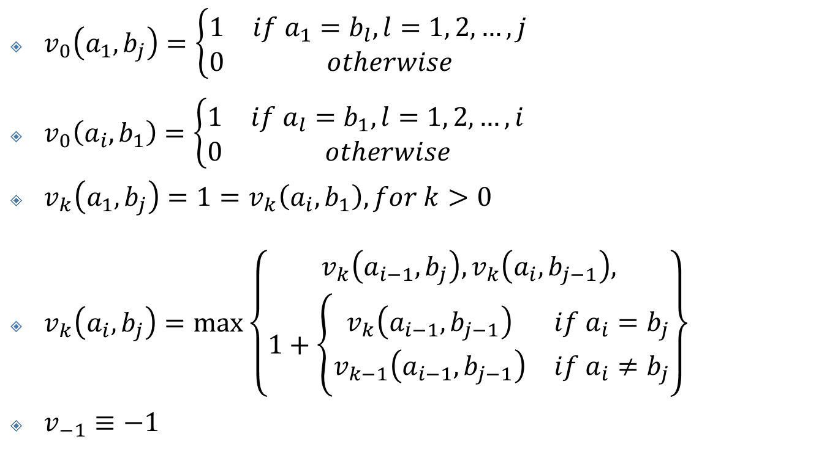

$$v_{k}\left(a_{m}, b_{n}\right)$$
$v_{0}\left(a_{1}, b_{j}\right)=\left\{\begin{matrix}1 & if a_{1}=b_{l}, l=1, 2, …, j \\ 0 & otherwise\end{matrix}\right.$
$v_{0}\left(a_{i}, b_{1}\right)=\left\{\begin{matrix}1 & if a_{l}=b_{1}, l=1, 2, …, i \\ 0 & otherwise\end{matrix}\right.$
$v_{k}\left(a_{1}, b_{j}\right)=1=v_{k}\left(a_{i}, b_{1}\right), for k>0$
$v_{k}\left(a_{i}, b_{j}\right)=\max\left\{\begin{aligned}v_{k}\left(a_{i−1}, b_{j}\right),v_{k}\left(a_{i}, b_{j−1}\right), \\ 1+\left\{\begin{matrix}v_{k}\left(a_{i−1}, b_{j−1}\right) & if a_{i}=b_{j} \\ v_{k−1}\left(a_{i−1}, b_{j−1}\right) & if a_{i}≠b_{j}\end{matrix}\right.\end{aligned}\right\}$
$v_{−1}≡−1$

Slide 7
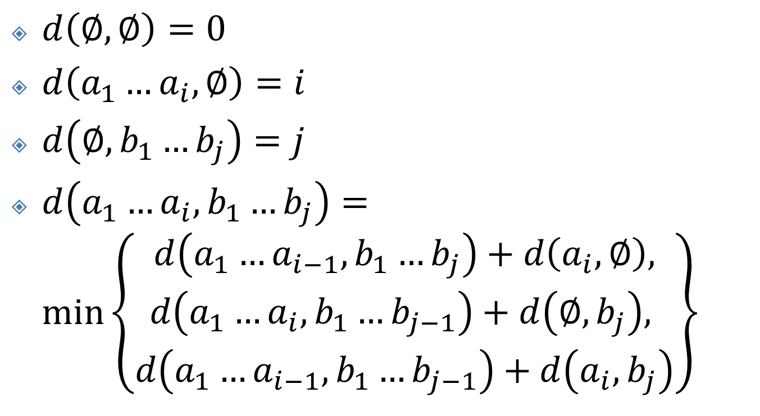

$$O\left(mn\right)$$
$d\left(∅, ∅\right)=0$
$d\left(a_{1}…a_{i}, ∅\right)=i$
$d\left(∅, b_{1}…b_{j}\right)=j$
$d\left(a_{1}…a_{i},b_{1}…b_{j}\right)=\min\left\{\begin{matrix}d\left(a_{1}…a_{i−1},b_{1}…b_{j}\right)+d\left(a_{i}, ∅\right), \\ d\left(a_{1}…a_{i},b_{1}…b_{j−1}\right)+d\left(∅, b_{j}\right), \\ d\left(a_{1}…a_{i−1},b_{1}…b_{j−1}\right)+d\left(a_{i}, b_{j}\right)\end{matrix}\right\}$

