Slide 1
Systolic Algorithms for the Longest Common Subsequence Problem
Chang-Biau Yang(楊昌彪), R.C.T. Lee(李家同)
Journal of the Chinese Institute of Engineers
Vol. 10, NO 6, pp.691-699(1987)
Date:2014/01/14
許竣傑

Slide 2
Abstract
The concept of systolic array processors is very suitable for VLSI implementation. In this paper, we propose two systolic algorithms to solve the longest common subsequence problem by dynamic programming approach and also prove that these two algorithms are correct. The order of the time-processor-product of our algorithms is equal to that of the corresponding sequential method.

Slide 3
Systolic Array
Cell
  Registers and ALU
Independent
Share information
Pipelining and multiprocessing

Slide 4



Dynamic Programming of LCS
L(i-1, j-1)
L(i-1, j)
L(i, j-1)
L(i, j)

Slide 5
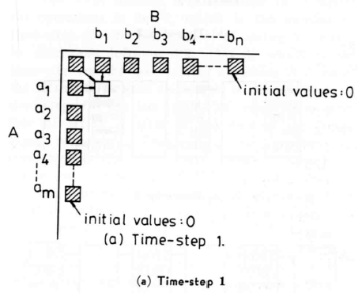
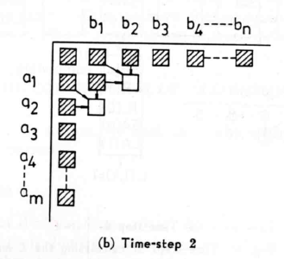
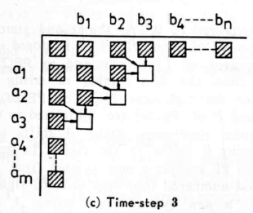
Systolic Algorithms

Slide 6
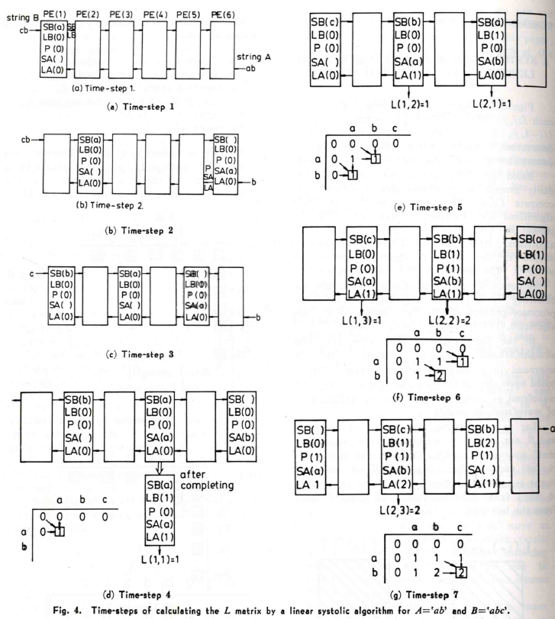
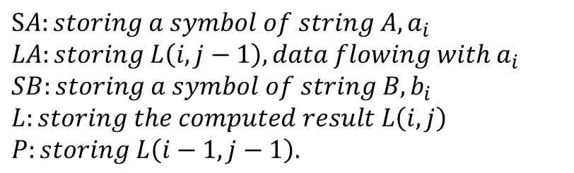
PE = 2n
String A: @a@b, m=2
String B: a@b@c@, n=3
P | LB
LA
B:
a
b
c
A
0 | 0 | 0 | 0
0 | 1 | 1 | 1
0 | 1 | 2 | 2
a
b

Slide 7













Systolic Algorithm A (Time-steps)
PE = 2n
1 | 2 | 3 | 4 | 5 | … | 2n-2 | 2n-1 | 2n
@
@
Time-steps = 2n-2
Plus 1
Plus m
S=2n-1
Total = 2n+m-1
Time-processor-product = (2n+m-1)2n

Slide 8
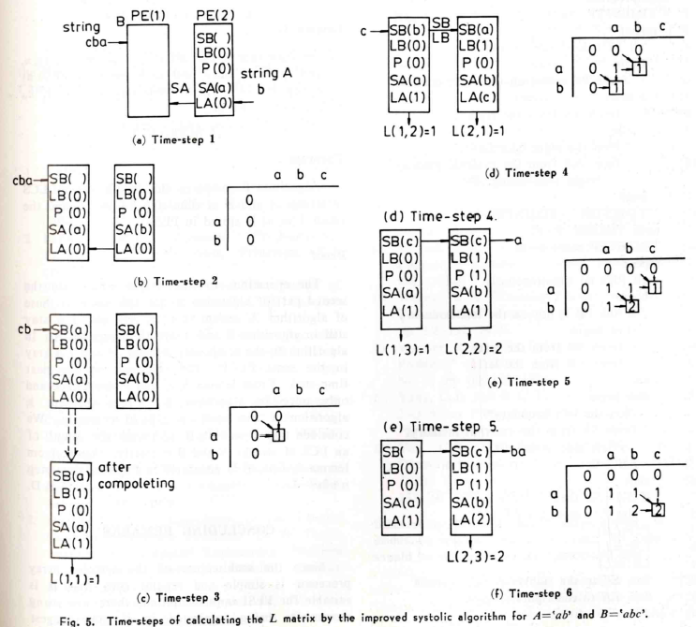


An Improved Systolic Algorithm (B)
PE = m
String A: ab
String B: abc
P | LB
LA

Slide 9
















Systolic Algorithm B (Time-steps)
PE = m
1 | 2 | 3 | 4 | 5 | … | m-2 | m-1 | m
…
Time-steps = m
Plus n
Plus m-1
Total : 2m+n-1
Time-processor-product = (2m+n-1)m

Slide 10
Thank you

