Slide 1
Efficient String Matching: An Aid to Bibliographic Search
Alfred V. Aho, Margaret J. Corasick Communications of the Association for Computing Machinery, vol. 18, issue 6, p.p. 333-340, June 1975
Presenter: Chun-Chieh Tai
Date: January 14, 2014

Slide 2
Abstract
This paper describes a simple, efficient algorithm to locate all occurrences of any of a finite number of keywords in a string of text. The algorithm consists of constructing a finite state pattern matching machine from the keywords and then using the pattern matching machine to process the text string in a single pass. Construction of the pattern matching machine takes time proportional to the sum of the lengths of the keywords. The number of state transitions made by the pattern matching machine in processing the text string is independent of the number of keywords. The algorithm has been used to improve the speed of a library bibliographic search program by a factor of 5 to 10.

Slide 3
Pattern Matching Machine
The behavior of the pattern matching machine is dictated by three functions:
a goto function g,
a failure function f,
and an output function output.

Slide 4
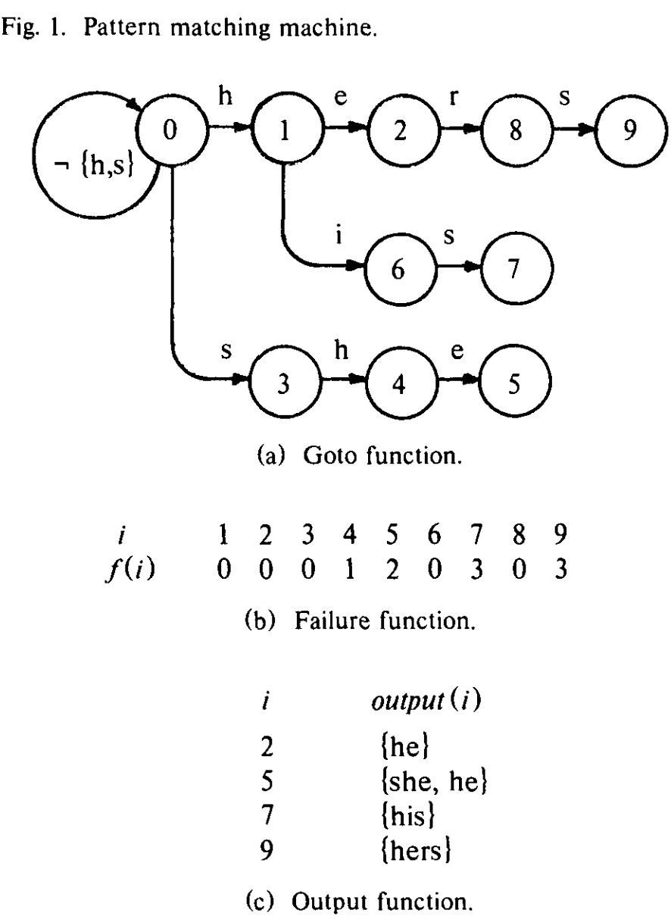
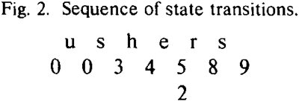

Slide 5
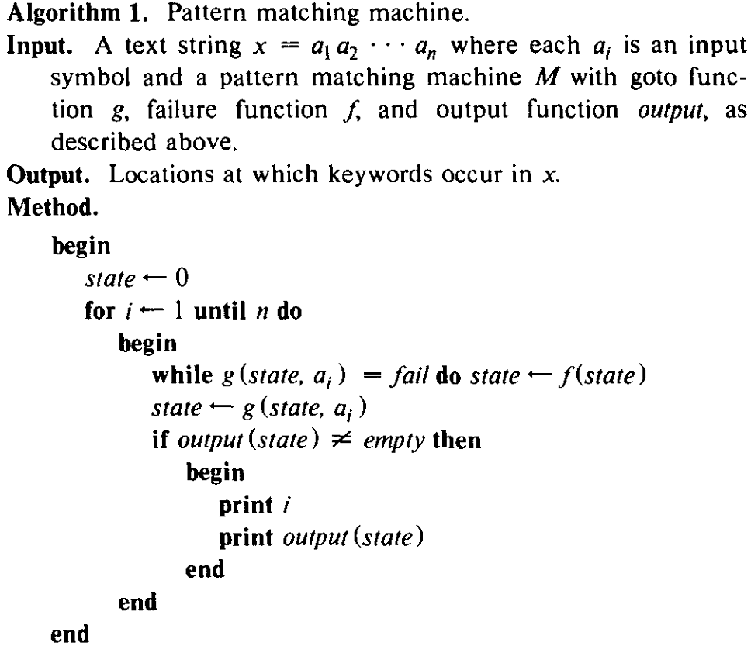

Slide 6
Construction of Goto, Failure, and Output Functions
To construct the goto function, we shall construct a goto graph.
We begin with a graph consisting of one vertex which represents the state 0.
We then enter each keyword y into the graph, by adding a directed path to the graph that begins at the start state.
We add new edges to the graph only when necessary.

Slide 7
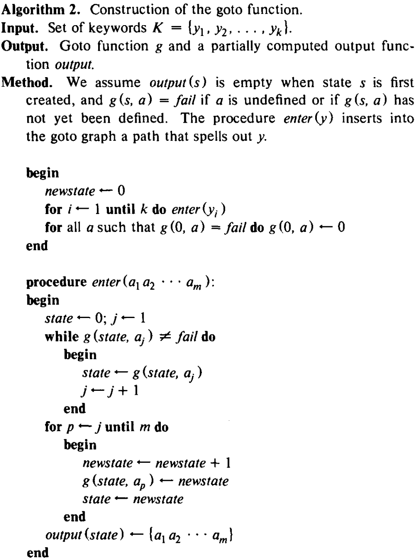

Slide 8
Ex: support {he, she, his, hers} is the set of keywords.
(1) Adding “he” to the graph.
Output “he” with state 2.
(2) Adding “she” to the graph.
Output “she” with state 5.
(3) Adding “his” to the graph.
Output “his” with state 7.
(4) Adding “hers” to the graph.
Output “hers” with state 9.
h
e
r
s
0
1
2
8
9
i
s
6
7
s
h
e
3
4
5

Slide 9
Construction of Goto, Failure, and Output Functions
The failure function is constructed from the goto function.
Let us define the depth of a state s in the goto graph as the length of the shortest path from the start state to s.
We shall compute the failure function for all states of depth 1, then for all states of depth 2, and so on, until the failure function has been computed for all states.

Slide 10
Construction of Goto, Failure, and Output Functions
We consider each state r of depth d-1 and perform the following actions.
1. lf g(r, a)=fail for all a, do nothing.
2. Otherwise, for each symbol a such that g(r, a)=s, do the following:
(a) Set state=f(r) .
(b) Execute the statement state←f (state) zero or more times, until a value for state is obtained such that g(state, a)≠fail . (Note that since g(0, a)=fail for all a, such a state will always be found.)
(c) Set f(s)=g(state, a).

Slide 11
Construction of Goto, Failure, and Output Functions
During the computation of the failure function we also update the output function.

Slide 12
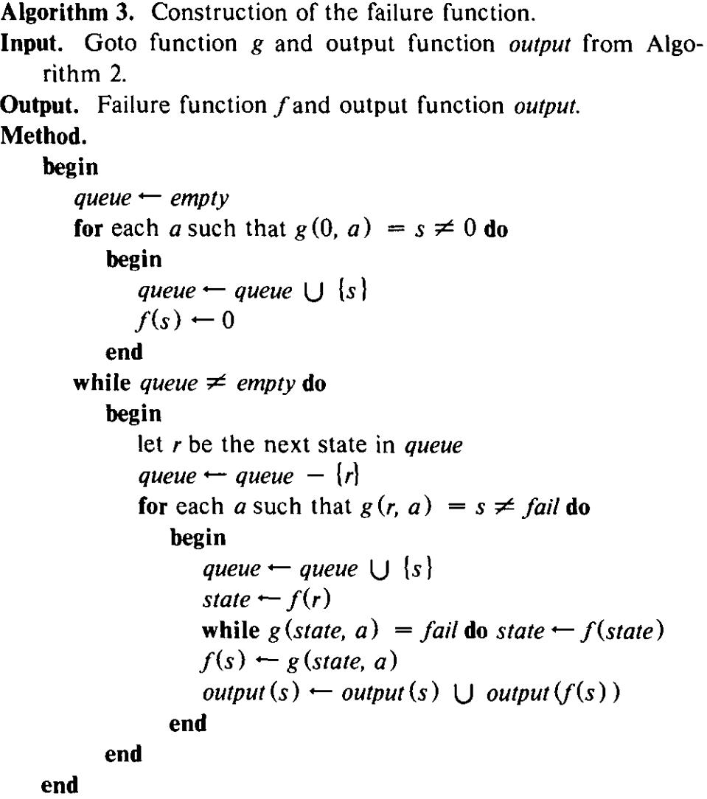

Slide 13
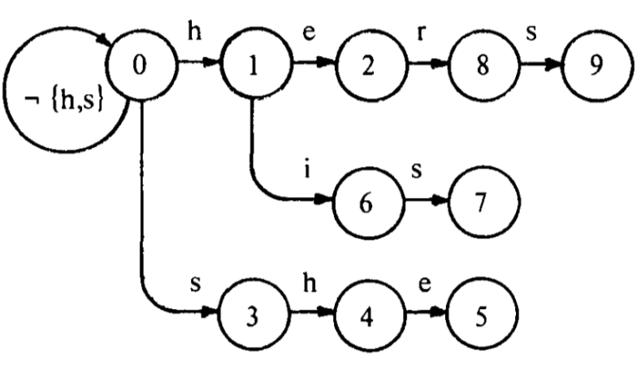
Goto function
depth 1 2 3 4
Output function
i | output(i)
2 | {he}
5 | {she, he}
7 | {his}
9 | {hers}
Failure function
depth-1 | 0 | 1 | 0 | 1 | 2 | 1 | 2 | 2 | 3
i | 1 | 2 | 3 | 4 | 5 | 6 | 7 | 8 | 9
f(i) | 0 | 0 | 0 | 1 | 2 | 0 | 3 | 0 | 3

Slide 14
Construction of Goto, Failure, and Output Functions
The failure function produced by Algorithm 3 is not optimal in the following sense.
To avoid making unnecessary failure transitions we can use f', a generalization of the next function from [13].
Using a deterministic finite automaton in Algorithm 1 can potentially reduce the number of state transitions by 50%.

Slide 15
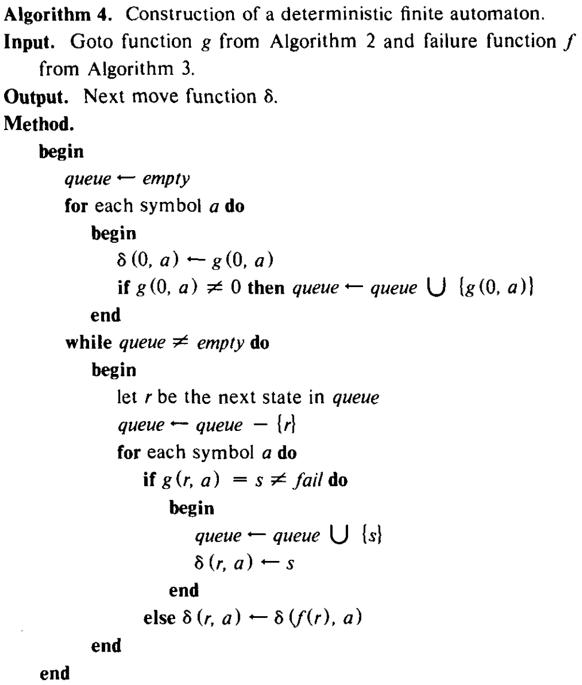

Slide 16
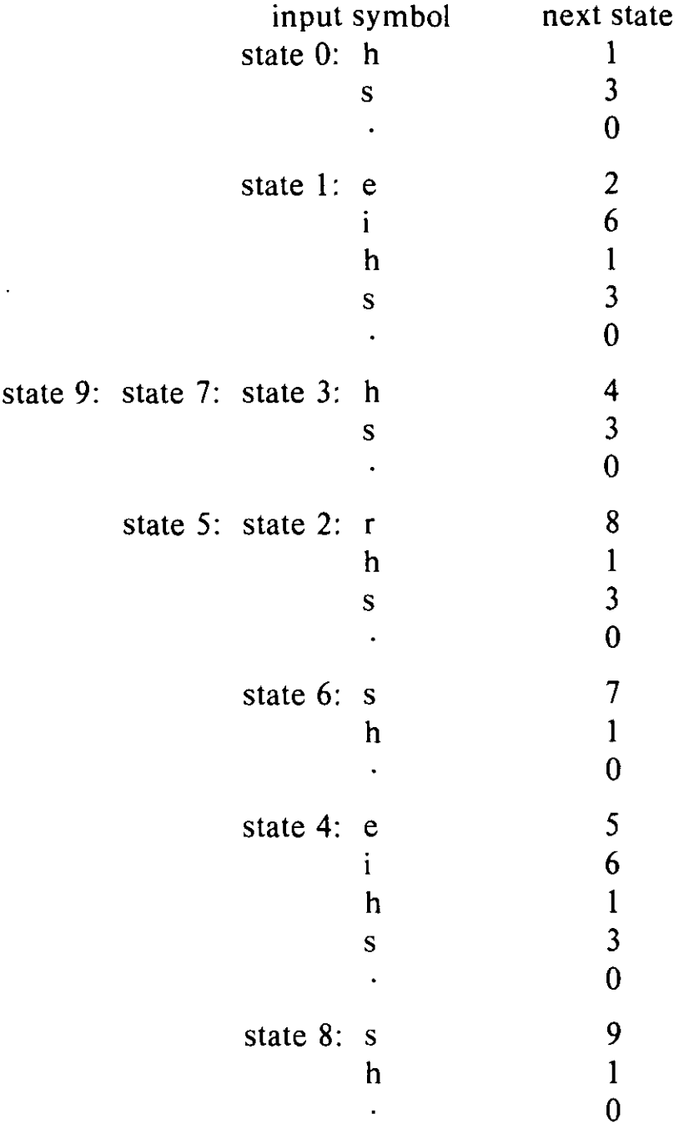
Next Move Function
i | 1 | 2 | 3 | 4 | 5 | 6 | 7 | 8 | 9
f(i) | 0 | 0 | 0 | 1 | 2 | 0 | 3 | 0 | 3

Slide 17
Thanks for your listening.

