Slide 1
An Algorithm for Differential File Comparison
Authors: J. W. Hunt, M. D. McIlroy Bell Laboratories Computing Science Technical Report #41(July 1976)

Slide 2
Abstract
The program diff reports differences between two files, expressed as a minimal list of line changes to bring either file into agreement with the other. Diff has been engineered to make efficient use of time and space on typical inputs that arise in vetting version-to-version changes in computer-maintained or computer-generated documents. Time and space usage are observed to vary about as the sum of the file lengths on real data, although they are known to vary as the product of the file lengths in the worst case.
The central algorithm of diff solves the ‘longest common subsequence problem’ to find the lines that do not change between files. Practical efficiency is gained by attending only to certain critical ‘candidate’ matches between the files, the breaking of which would shorten the longest subsequence common to some pair of initial segments of the two files. Various techniques of hashing, presorting into equivalence classes, merging by binary search, and dynamic storage allocation are used to obtain good performance.

Slide 3
Diff
分辨兩個檔案不同之處的UNIX程式
流程：
1. 將檔案中的每一行hash成一個computer word，並排序
2. 找出兩個檔案hash結果的LCS
3. 利用Append, Change, Delete三個操作完成
目標：若 A 與 B 為兩個檔案，透過 append, change, delete 將 A 以 B 表示，每次操作要先找到 LCS 的元素，再用合適的方法輸出。

Slide 4
Diff
A = a b c d e f g
B = w a b x y z e
將 A 以 B 表示
A 與 B 的 LCS 為 a b e 1. delete B 的 a 前面的 line 1，w A = a b c d e f g B = w a b x y z e → B = a b x y z e 2. change B 的 b 到 e 之間的 line 4 至 line 6，x y z 換成 A 的 b 到 e 之間的元素，c d A = a b c d e f g B = a b x y z e → B = a b c d e 3. append B 的 e ，接上 A 的 e 後面的元素，f g A = a b c d e f g B = a b c d e → B = a b c d e f g

Slide 5
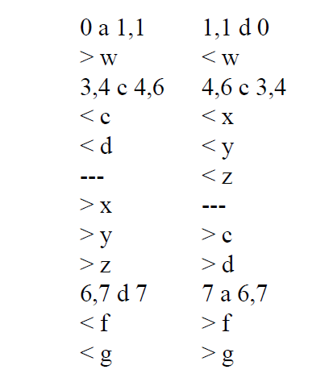
Diff
a = append
c = change
d = delete
< = original file content
> = derived file content
左為以 A 表 B
右為以 B 表 A

Slide 6
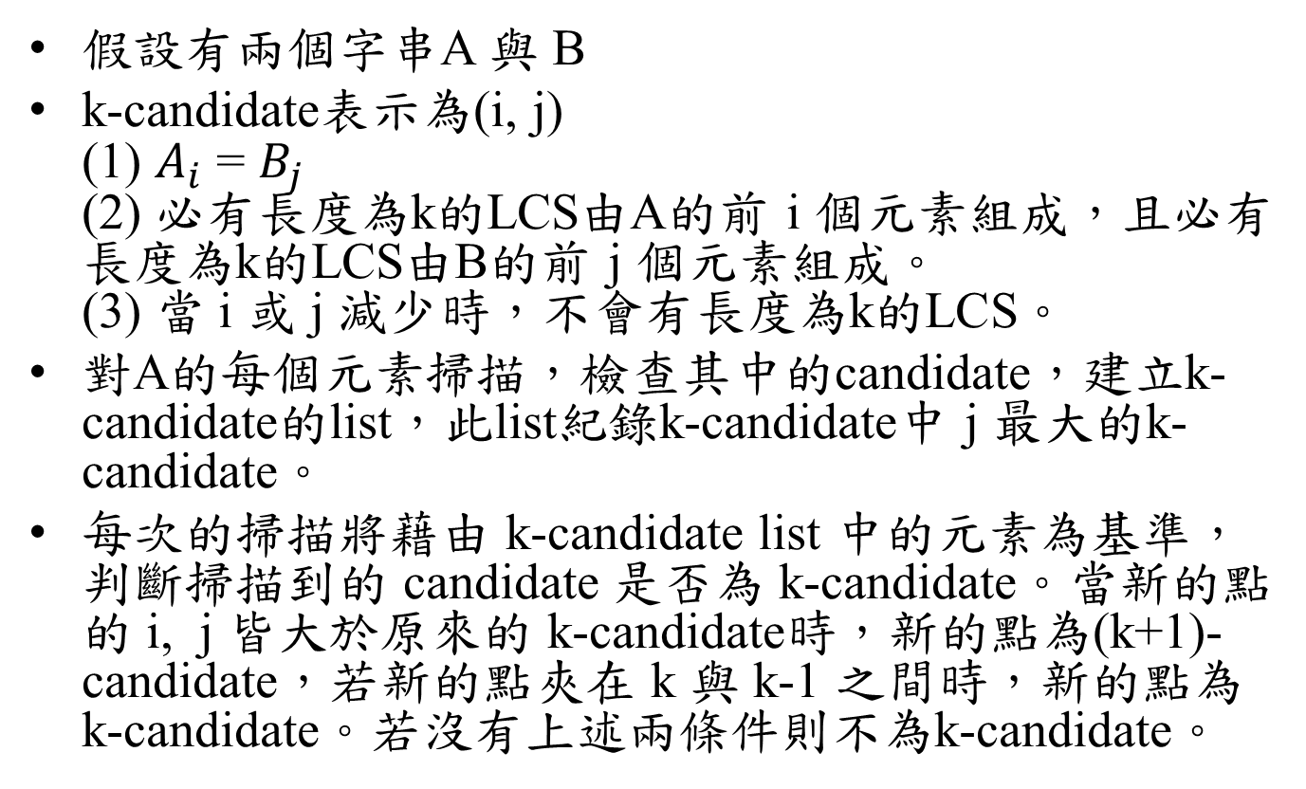
Diff Algorithm for LCS
假設有兩個字串A 與 B
k-candidate表示為(i, j) (1) $A_{i}$= $B_{j}$ (2)必有長度為k的LCS由A的前 i 個元素組成，且必有長度為k的LCS由B的前 j個元素組成。 (3) 當 i 或 j 減少時，不會有長度為k的LCS。
對A的每個元素掃描，檢查其中的candidate，建立k-candidate的list，此list紀錄k-candidate中 j 最大的k-candidate。
每次的掃描將藉由 k-candidate list 中的元素為基準，判斷掃描到的 candidate 是否為 k-candidate。當新的點的 i, j 皆大於原來的 k-candidate時，新的點為(k+1)-candidate，若新的點夾在 k 與 k-1 之間時，新的點為k-candidate。若沒有上述兩條件則不為k-candidate。

Slide 7
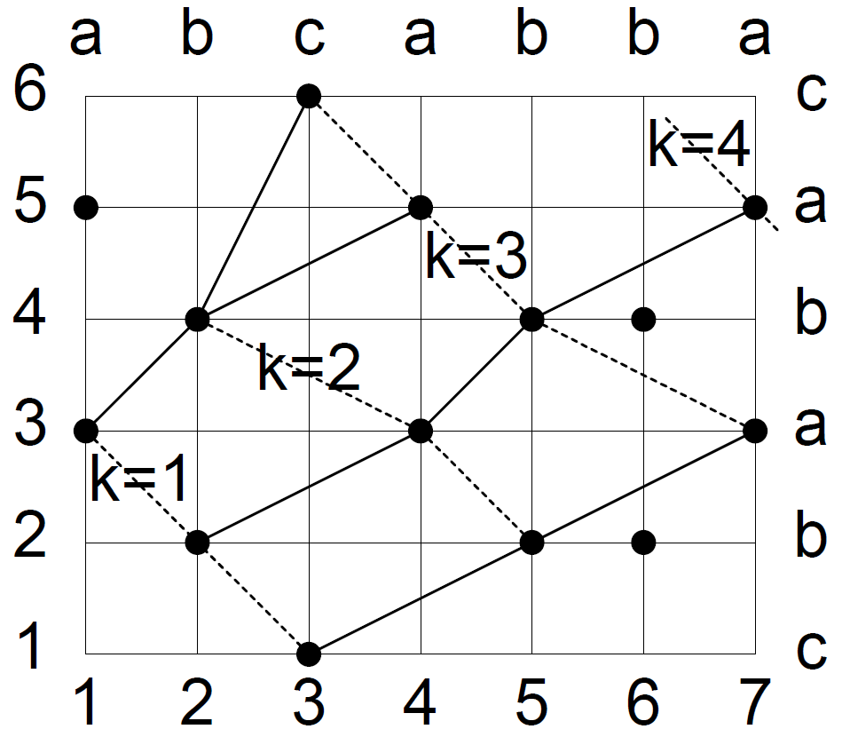
Diff Algorithm for LCS
A = abcabba B = cababc
Initial k-candidate list: (0, 0) , (8, 7) , (8, 7) , (8, 7), (8, 7) , (8, 7) , (8, 7)…
檢查垂直線1，更新list： (0, 0) , (1, 3) , (8, 7) , (8, 7), (8, 7) , (8, 7) , (8, 7)…

Slide 8
Diff Algorithm for LCS
A = abcabba B = cababc
Initial k-candidate list: (0, 0) , (8, 7) , (8, 7) , (8, 7), (8, 7) , (8, 7) , (8, 7)…
檢查垂直線2，更新list： (0, 0) , (2, 2) , (2, 4) , (8, 7), (8, 7) , (8, 7) , (8, 7)…

Slide 9
Diff Algorithm for LCS
A = abcabba B = cababc
Initial k-candidate list: (0, 0) , (8, 7) , (8, 7) , (8, 7), (8, 7) , (8, 7) , (8, 7)…
檢查垂直線3，更新list： (0, 0) , (3, 1) , (2, 4) , (3, 6), (8, 7) , (8, 7) , (8, 7)…

Slide 10
Diff Algorithm for LCS
A = abcabba B = cababc
Initial k-candidate list: (0, 0) , (8, 7) , (8, 7) , (8, 7), (8, 7) , (8, 7) , (8, 7)…
檢查垂直線4，更新list： (0, 0) , (3, 1) , (4, 3) , (4, 5), (8, 7) , (8, 7) , (8, 7)…

Slide 11
Diff Algorithm for LCS
A = abcabba B = cababc
Initial k-candidate list: (0, 0) , (8, 7) , (8, 7) , (8, 7), (8, 7) , (8, 7) , (8, 7)…
檢查垂直線5，更新list： (0, 0) , (3, 1) , (5, 2) , (5, 4), (8, 7) , (8, 7) , (8, 7)…

Slide 12
Diff Algorithm for LCS
A = abcabba B = cababc
Initial k-candidate list: (0, 0) , (8, 7) , (8, 7) , (8, 7), (8, 7) , (8, 7) , (8, 7)…
檢查垂直線6，更新list： (0, 0) , (3, 1) , (5, 2) , (5, 4), (8, 7) , (8, 7) , (8, 7)…

Slide 13
Diff Algorithm for LCS
A = abcabba B = cababc
Initial k-candidate list: (0, 0) , (8, 7) , (8, 7) , (8, 7), (8, 7) , (8, 7) , (8, 7)…
檢查垂直線7，更新list： (0, 0) , (3, 1) , (5, 2) , (7, 3), (7, 5) , (8, 7) , (8, 7)…
LCS為 baba，長度為4。

Slide 14
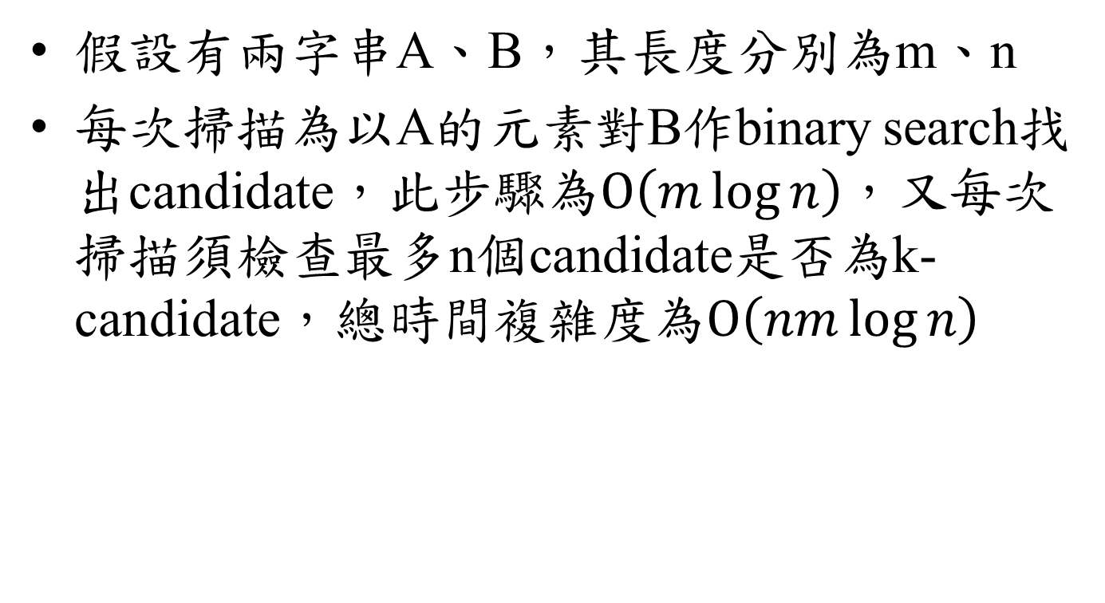
Time Complexity
假設有兩字串A、B，其長度分別為m、n
每次掃描為以A的元素對B作binary search找出candidate，此步驟為$O\left(m\log{n}\right)$，又每次掃描須檢查最多n個candidate是否為k-candidate，總時間複雜度為$O\left(nm\log{n}\right)$

