Slide 1
A Linear Space Algorithm for Computing Maximal Common Subsequences
Communications of the ACM
June 1975 Volume 18 Number 6
D.S. Hirschberg
Princeton University
Presenter : De-Sheng Jhan
2014/2/18

Slide 2
Abstract
The problem of finding a longest common subsequence of two strings has been solved in quadratic time and space. An algorithm is presented which will solve this problem in quadratic time and in linear space.

Slide 3
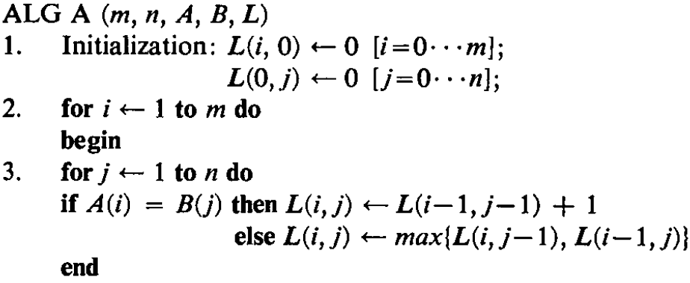
Algorithm A(1/2)

Slide 4
Algorithm A(2/2)
A = “ABCD” B = “ACDE”
 |  | A | C | D | E
 | 0 | 0 | 0 | 0 | 0
A | 0 | 1 | 1 | 1 | 1
B | 0 | 1 | 1 | 1 | 1
C | 0 | 1 | 2 | 2 | 2
D | 0 | 1 | 2 | 3 | 3
LCS = “ACD”

Slide 5
Time and Space Analysis of Algorithm A
Input and output arrays require :
m + n + (m + 1)*(n + 1) locations.
require O(mn) space
O(mn) time

Slide 6
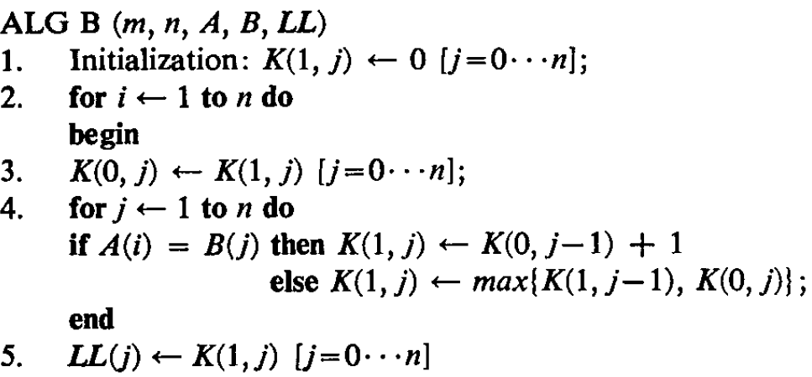
Algorithm B(1/5)

Slide 7
Algorithm B(2/5)
A = “ABCD” B = “ACDE”
 |  | A | C | D | E
 | 0 | 0 | 0 | 0 | 0
A | 0 | 1 | 1 | 1 | 1
B | 0 | 1 | 1 | 1 | 1
C | 0 | 1 | 2 | 2 | 2
D | 0 | 1 | 2 | 3 | 3
 |  | A | C | D | E
A | 0 | 0 | 0 | 0 | 0
 |  | A | C | D | E
 | 0 | 0 | 0 | 0 | 0
A | 0 | 1 | 1 | 1 | 1

Slide 8
Algorithm B(3/5)
 |  | A | C | D | E
 | 0 | 0 | 0 | 0 | 0
A | 0 | 1 | 1 | 1 | 1
B | 0 | 1 | 1 | 1 | 1
C | 0 | 1 | 2 | 2 | 2
D | 0 | 1 | 2 | 3 | 3
 |  | A | C | D | E
 | 0 | 1 | 1 | 1 | 1
B | 0 | 0 | 0 | 0 | 0
 |  | A | C | D | E
 | 0 | 1 | 1 | 1 | 1
B | 0 | 1 | 1 | 1 | 1

Slide 9
Algorithm B(4/5)
 |  | A | C | D | E
 | 0 | 0 | 0 | 0 | 0
A | 0 | 1 | 1 | 1 | 1
B | 0 | 1 | 1 | 1 | 1
C | 0 | 1 | 2 | 2 | 2
D | 0 | 1 | 2 | 3 | 3
 |  | A | C | D | E
 | 0 | 1 | 1 | 1 | 1
C | 0 | 0 | 0 | 0 | 0
 |  | A | C | D | E
 | 0 | 1 | 1 | 1 | 1
C | 0 | 1 | 2 | 2 | 2

Slide 10
Algorithm B(5/5)
 |  | A | C | D | E
 | 0 | 0 | 0 | 0 | 0
A | 0 | 1 | 1 | 1 | 1
B | 0 | 1 | 1 | 1 | 1
C | 0 | 1 | 2 | 2 | 2
D | 0 | 1 | 2 | 3 | 3
 |  | A | C | D | E
 | 0 | 1 | 2 | 2 | 2
D | 0 | 0 | 0 | 0 | 0
 |  | A | C | D | E
 | 0 | 1 | 2 | 2 | 2
D | 0 | 1 | 2 | 3 | 3

Slide 11
Time and Space Analysis of Algorithm B
Input and output arrays require :
m + n + (n + 1) locations.
O(m + n) space
O(mn) time

Slide 12
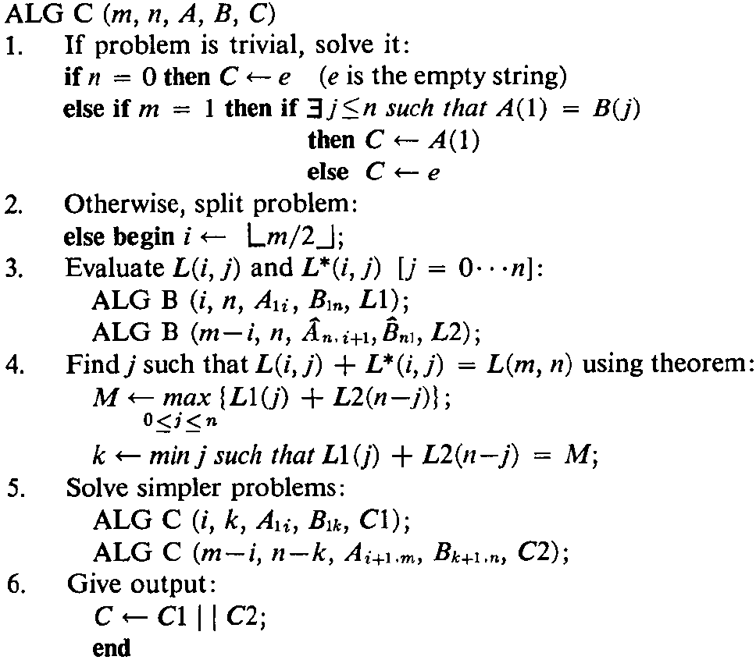
Algorithm C(1/6)

Slide 13
Algorithm C(2/6)
If problem is trivial, solve it:
1. A = “abcd” m = 4, B = “” n = 0,
=> NULL
2. A = “b” m = 1, B = “abcd” n = 4,
=> b
A = “e” m = 1, B = “abcd” n = 4,
=> NULL

Slide 14
Algorithm C(3/6)
AlgoC(4, 4, “ABCD”, “ACDE”)
AlgoB(2, 4, “AB”, “ACDE”)
AlgoB(2, 4, “DC”, “EDCA”)
 |  | A | C | D | E
 | 0 | 0 | 0 | 0 | 0
A | 0 | 1 | 1 | 1 | 1
 |  | E | D | C | A
 | 0 | 0 | 0 | 0 | 0
D | 0 | 0 | 1 | 1 | 1
 |  | A | C | D | E
 | 0 | 1 | 1 | 1 | 1
B | 0 | 1 | 1 | 1 | 1
 |  | E | D | C | A
 | 0 | 0 | 1 | 1 | 1
C | 0 | 0 | 1 | 2 | 2

Slide 15
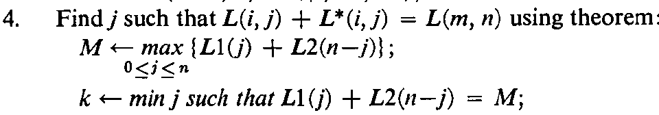
Algorithm C(4/6)
 |  | A | C | D | E
 | 0 | 1 | 1 | 1 | 1
B | 0 | 1 | 1 | 1 | 1
 |  | E | D | C | A
 | 0 | 0 | 1 | 1 | 1
C | 0 | 0 | 1 | 2 | 2
J = 0, 0 + 2 = 2
J = 1, 1 + 2 = 3
J = 2, 1 + 1 = 2
J = 3, 1 + 0 = 1
J = 4, 1 + 0 = 1
AlgoC(2, 1, “AB”, “A”)
AlgoC(2, 3, “CD”, “CDE”)

Slide 16
Algorithm C(5/6)
AlgoC(2, 1, “AB”, “A”)
AlgoC(2, 3, “CD”, “CDE”)
AlgoB(1, 1, “A”, “A”)
AlgoB(1, 3, “C”, “CDE”)
 |  | A
 | 0 | 0
A | 0 | 1
 |  | C | D | E
 | 0 | 0 | 0 | 0
C | 0 | 1 | 1 | 1
AlgoB(1, 1, “B”, “A”)
AlgoB(1, 3, “D”, “EDC”)
 |  | A
 | 0 | 0
B | 0 | 0
 |  | E | D | C
 | 0 | 0 | 0 | 0
D | 0 | 0 | 1 | 1

Slide 17
Algorithm C(6/6)
 |  | A
 | 0 | 0
A | 0 | 1
 |  | C | D | E
 | 0 | 0 | 0 | 0
C | 0 | 1 | 1 | 1
 |  | A
 | 0 | 0
B | 0 | 0
 |  | E | D | C
 | 0 | 0 | 0 | 0
D | 0 | 0 | 1 | 1
J = 0, 0 + 0 = 0
J = 1, 1 + 0 = 1
J = 0, 0 + 1 = 1
J = 1, 1 + 1 = 2
J = 2, 1 + 0 = 0
J = 3, 1 + 0 = 1
AlgoC(1, 1, “A”, “A”) => A
AlgoC(1, 0, “B”, null) = >null
AlgoC(1, 1, “C”, “C”) => C
AlgoC(1, 2, “D”, “DE”) => D
LCS : ACD

Slide 18
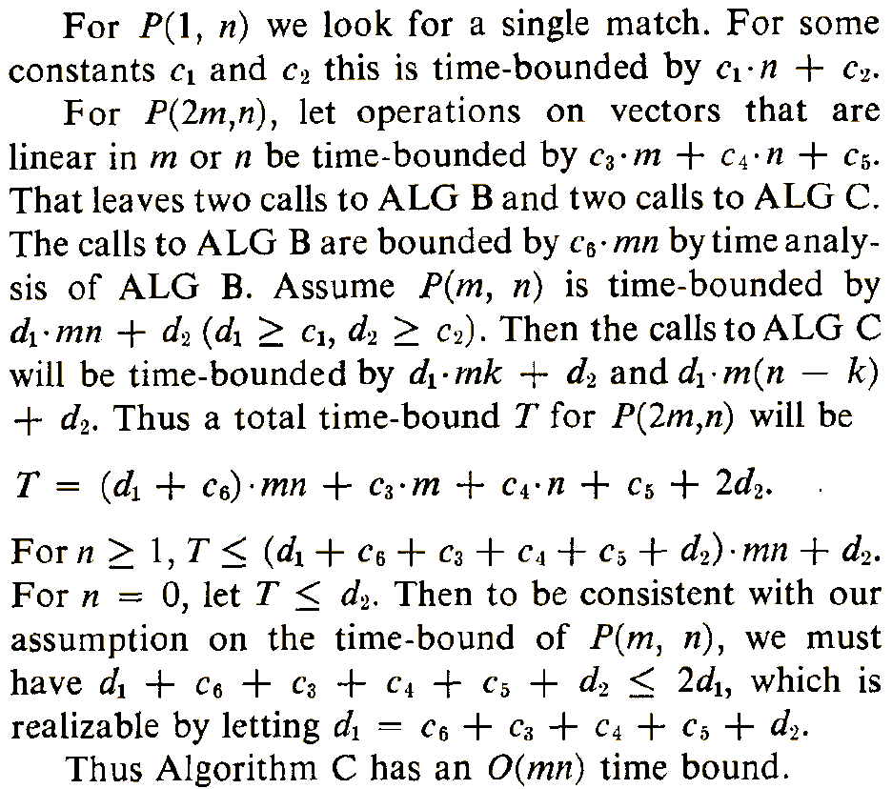
Time Analysis of Algorithm C

Slide 19
Space Analysis of Algorithm C
O(m + n)

Slide 20
Thank you for listening

