Slide 1
Optimal sequence alignments
WALTER M. FITCH
TEMPLE F. SMITH
Proc. Nati Acad. Sci. USA
Vol. 80, pp. 1382-1386, March 1983
Presenter: Chen-Yi Fang
Date: 2014/2/25

Slide 2
Abstract
Current theory is adequate to the task of finding an optimal alignment between two character strings such as nucleic acids(核酸).
Most algorithms currently in use must fail to find the homologous alignment between a set of codons for the chicken α- and β -hemoglobin (血紅蛋白) sequence when it is in fact discoverable by a more general treatment of gaps.
Fundamental reasons for this are discussed.
Notes:
Adequate nucleic hemoglobin(血紅蛋白)

Slide 3
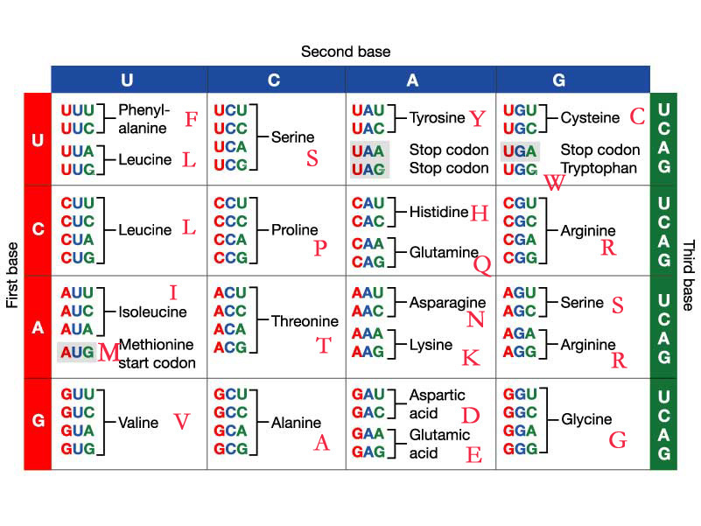
RNA Codon and Amino Acid
三個核苷酸(nucleotides)為一組的密碼子(codon).
Notes:
遺傳密碼是一組將DNA或mRNA序列以三個核苷酸(nucleotides)為一組的密碼子(codon)轉譯為蛋白質的胺基酸序列，以用於蛋白質合成。

Slide 4
Method
//Needleman_Wunsch(similarity mode)
for i=1 to length(A)
for j=1 to length(B)
{
Match ← F(i-1,j-1) + S(Ai, Bj)
Delete ← F(i-1, j) - d
Insert ← F(i, j-1) - d
F(i,j) ← max(Match, Insert, Delete)
}
//d is gap-weighting function. d = g + nr

Slide 5
Method.parameters
under above linear gap-weight assumption.
g: the weight for the presence of the gap per se.
n: the number of sequence elements in the gap.
r: the weight for each residue position in the gap.
  EX:
    A:2-0-1-4-2-1-5
    B: 1-1-4 G₂ 5
    G₂.d = g + 2+ 1
whether or not to weight end (terminal) gaps.

Slide 6
Method.sequence
codons 40-52 of the mRNA of chicken α hemoglobin and codons 39-57 of the mRNA of chicken β hemoglobin.
β:F-A-S-F-G-N-L-S-S-P-T-A-I-L-G-N-P-M-V
α:F-P-H-F D-L-S-H G-S-A-Q-I.
Above is the answer we believed from amino acid with two gaps.

Slide 7
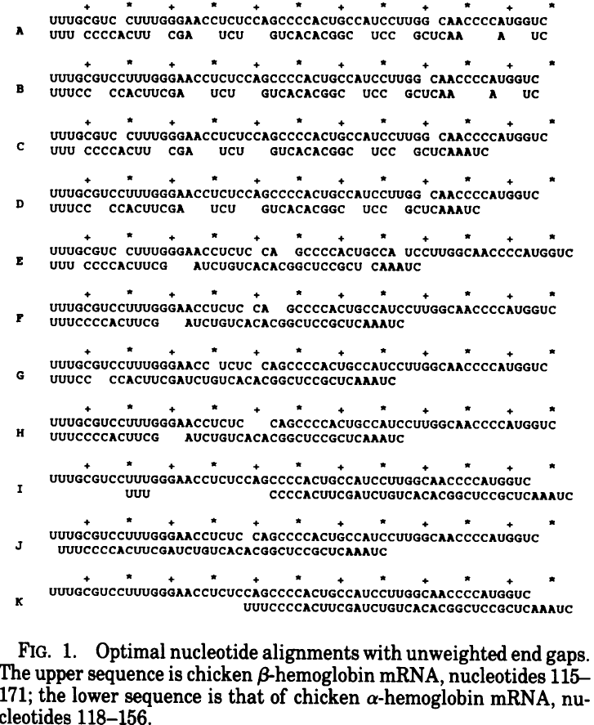
Unweighted terminal gaps

Slide 8
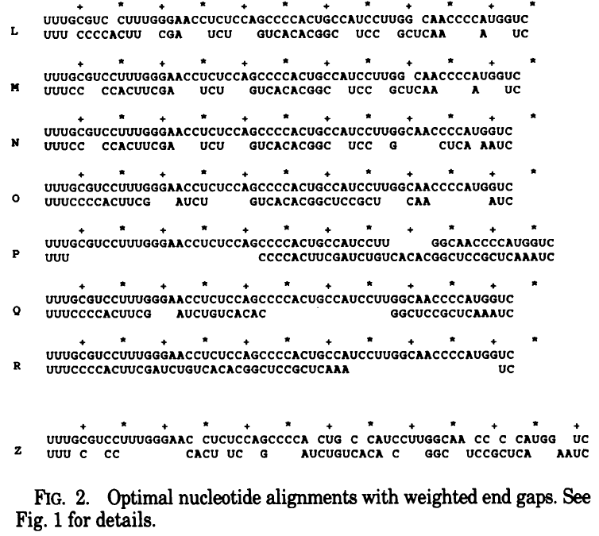
Weighted terminal gaps

Slide 9
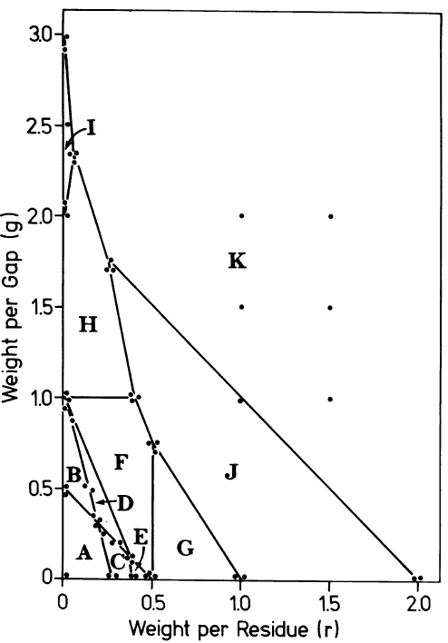
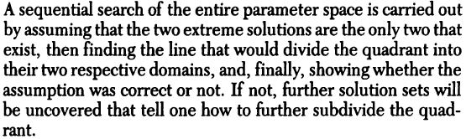
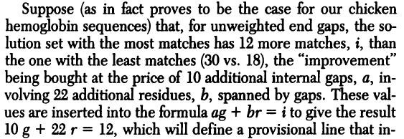

Slide 10
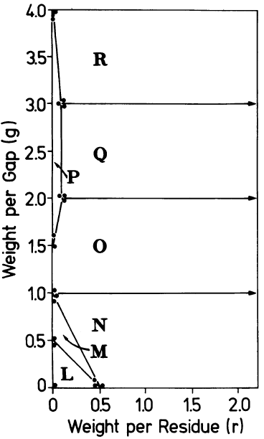

Slide 11
