Slide 1
Comparison of Biosequences
TEMPLE F. SMITH, Northern Michigan University
MICHAEL S. WATERMAN, Los Alamos Scientific Laboratory
Advances in Applied Mathematics, December 1981, p482-489
Presentator :許竣傑

Slide 2
Abstract
Homology and distance measures have been routinely used to compare two biological sequences, such as proteins or nucleic acids. The homology measure of Needleman and Wunsch is shown, under general conditions, to be equivalent to the distance measure of Sellers. A new algorithm is given to find similar pairs of segments, one segment from each sequence. The new algorithm, based on homology measures, is compared to an earlier one due to Sellers.

Slide 3




Similarity and Distance
$a=a_{1}a_{2}a_{3}a_{4}$
$b=b_{1}b_{2}b_{3}b_{4}b_{5}$
$A=\left(a_{1},b_{3}\right),(a_{2},b_{4})$, $(a_{4},b_{5})$

Slide 4
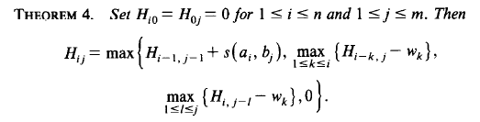
Maximum Similarity Segments

Slide 5
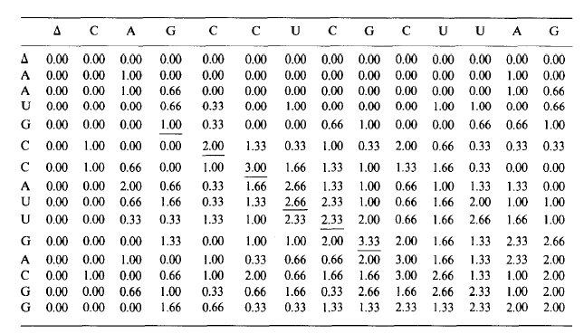

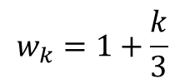
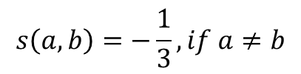
Maximum Similarity Segments
$$s\left(a,b\right)=1, if a=b$$
G C C A U U G
G C C ∆ U C G
$$s\left(a,b\right)=−\frac{1}{3}, if a≠b$$
$$w_{k}=1+\frac{k}{3}$$

Slide 6
Thank You

