Slide 1
An information theoretic lower bound for the longest common subsequence problem Information Processing Letters; vol. 7 pp. 40–41 (1978)
Daniel S. Hirschberg
Rice University
Presentor：Hsin-Chuan Yuan

Slide 2
Abstract
We shall prove that nlogn is a lower bound on the number of “less than-equal-greater than” comparisons required to solve the LCS problem, assuming unrestricted alphabet size.

Slide 3
The Longest Increasing Subsequence (LIS) Problem
Robinson-Schensted-Knuth Algorithm can solve the LIS problem in O(nlogn) time.
Number of comparison: (n-L)log L + O(n)
The worst value for L is roughly n / log n
Upper bound: nlogn – nloglogn + O(n)
Input
3
5
2
7
4
8
1
6
1
3
3
2
2
2
2
1
1
L
2
5
5
5
4
4
4
4
3
7
7
7
7
6
4
8
8
8

Slide 4
Decision rule
Let the comparison p1 : p2 be the ith on P*. If p1 and p2 are both positions in A (say, au, and av) then if u < v then return “less than”; otherwise, return “greater than”.
If p1 and p2 are not both positions in A then do the following. Let R be the set of relative orderings of the positions of strings A and B that are consistent with the results of all comparisons made along P(1) to P(i-1) that also have a1 < a2 < … <an, Let R1 be the subset of R that is consistent with p1 < p2 and let R2 be the subset of R consistent with p1 >p2. If I R1 I > I R2 I then return “less than”; otherwise return “greater than”.
root
p1:p2

Slide 5
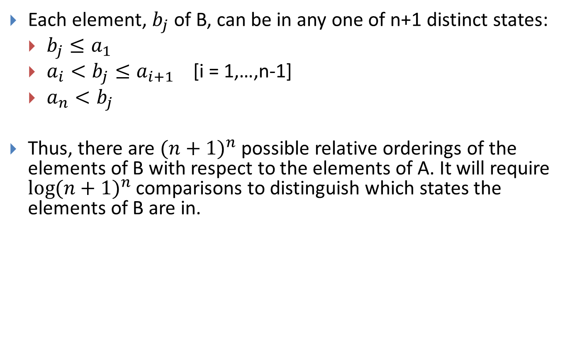
Decision rule
Each element, $b_{j}$ of B, can be in any one of n+1 distinct states:
$b_{j}≤a_{1}$
$a_{i}<b_{j}≤a_{i+1}$ [i = 1,…,n-1]
$a_{n}<b_{j}$
Thus, there are ${(n+1)}^{n}$ possible relative orderings of the elements of B with respect to the elements of A. It will require ${\log{(n+1)}}^{n}$ comparisons to distinguish which states the elements of B are in.

Slide 6
Conclusions
nlogn comparisons are required to make every element of B comparable to every element of A.

