Slide 1
YAP3: Improve Detection of Similarities in Computer Program and Other Texts
Author：Michael J. Wise
Source：SIGCSE Proceedings of the twenty-seventh SIGCSE technical symposium on Computer science education 1996 pp. 130-134
Presenter：Guan-Cheng Guo Date：2014/4/22

Slide 2
Abstract
In spite of years of effort, plagiarism in student assignment submissions still causes considerable difficulties for course designers; if students’ work is not their own, how can anyone be certain they have learnt anything? YAP is a system for detecting suspected plagiarism in computer programs and other texts submitted by students.

Slide 3
Abstract
The paper reviews YAP3, the third version of YAP, focusing on its novel underlying algorithm - Running-Karp-Rabin Greedy-String-Tiling (or RKR-GST), whose development arose from the observation with YAP and other systems that students shuffle independent code segments. YAP3 is able to detect transposed subsequences, and is less perturbed by spurious additional statements. The paper concludes with a discussion of recent extension of YAP to English texts, further illustrating the flexibility of the YAP approach.

Slide 4
YAP3
YAP3 主要分成兩個階段做:
首先，使用source text來產生 token sequences
移除註解和字串常數
將大寫字母轉換成小寫字母
相近意義的詞映射到相同的格式 e.g. strncmp 映射到 strcmp；function 映射到 procedure.
重新排序functions到呼叫使用的地方
移除非目標語言所產生之token

Slide 5
YAP3
第二階段，比較階段:
使用Running-Karp-Rabin Greedy-String-Tiling (RKR-GST) 演算法來作為YAP3的設計基礎。
RKR-GST改良Greedy-String-Tiling(GST)演算法而來。

Slide 6
Greedy String Tiling(GST)
給定兩字串： abcdefghijklmuvwxyz, ijkabclmdefghpq
假設設定最小match length為2

Slide 7
Greedy String Tiling(GST)
搜尋第一次： abcdefghijklmuvwxyz, ijkabclmdefghpq 找到 “abc”, length = 3, max match length = 3 abcdefghijklmuvwxyz, ijkabclmdefghpq 找到“defgh”, length = 5, max match length = 5 abcdefghijklmuvwxyz, ijkabclmdefghpq 找到 “ijk”, length = 3, max match length = 5 abcdefghijklmuvwxyz, ijkabclmdefghpq 找到 “lm”, length = 2, max match length = 5

Slide 8
Greedy String Tiling(GST)
將找到的最長match substring標記為已使用，重複搜尋子字串，不對已標記之子字串進行搜索，直到找到的max match length為設定的最小match length。

Slide 9
Running-Karp-Rabin Greedy-String-Tiling (RKR-GST)
將hash function引入GST，計算pattern string 及source text所有長度為m之子字串賦予一個hash值
Pattern 中所有hash值與text中的hash值進行比較，hash值相同的text與pattern在進行token的比較
Text中的所有的hash值建成hash表存放，使用查表的方法，減少搜索的時間

Slide 10
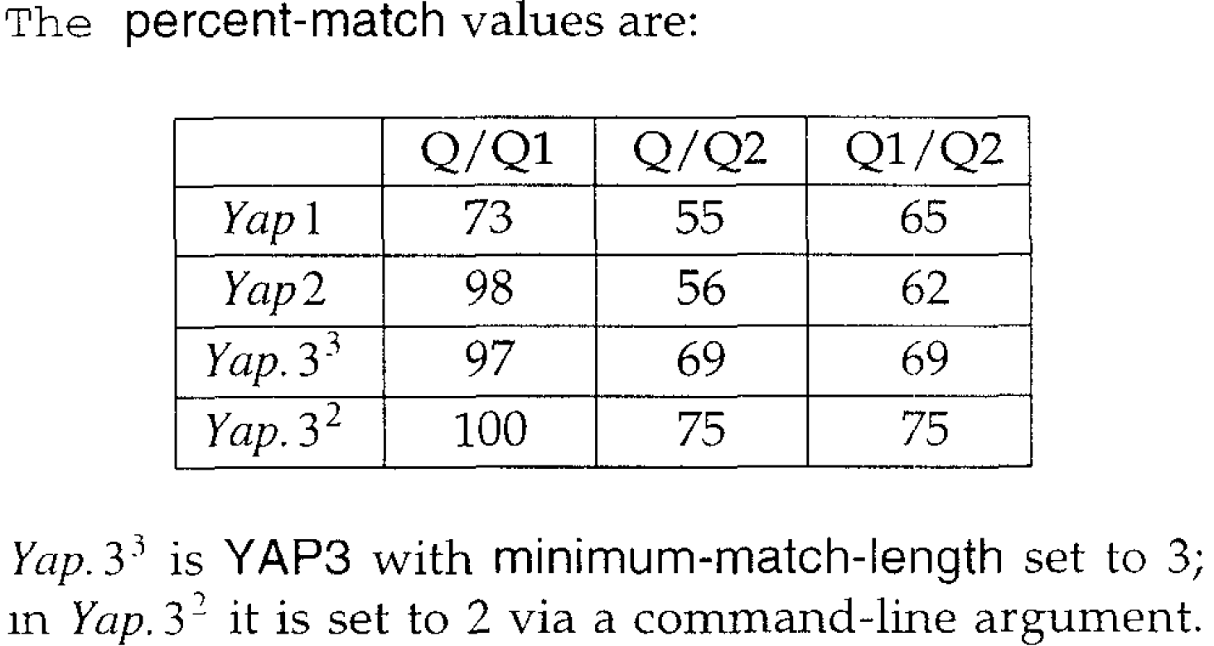
Comparing The YAP Versions

