Slide 1
Aligning Amino Acid Sequences: Comparison of Commonly Used Methods
D.F. Feng, M.S. Johnson, and R.F. Doolittle
Journal of Molecular Evolution(1985) 21:112-125
Presenter:Ding-Yao Huang
Date:2014/04/22

Slide 2
Abstract
We examined two extensive families of protein sequences using four different alignment schemes that employ various degrees of "weighting“ in order to determine which approach is most sensitive in establishing relationships.
All alignments used a similarity approach based on a general algorithm devised by Needleman and Wunsch. The approaches included a simple program, UM (unitary matrix), whereby only identities are scored; a scheme in which the genetic code is used as a basis for weighting (GC); another that employs a matrix based on structural similarity of amino acids taken together with the genetic basis of mutation (SG); and a fourth that uses the empirical log-odds matrix (LOM) developed by Dayhoff on the basis of observed amino acid replacements.

Slide 3
Abstract
The two sequence families examined were (a) nine different globins and (b) nine different tyrosine kinase-like proteins. It was assumed a priori that all members of a family share common ancestry.
In cases where two sequences were more than 30% identical, alignments by all four methods were almost always the same.
In cases where the percentage identity was less than 20%, however, there were often significant differences in the alignments.
On the average, the Dayhoff LOM approach was the most effective in verifying distant relationships, as judged by an empirical "jumbling test." This was not universally the case, however, and in some instances the simple UM was actually as good or better.

Slide 4
Abstract
Trees constructed on the basis of the various alignments differed with regard to their limb lengths, but had essentially the same branching orders.
We suggest some reasons for the different effectivenesses of the four approaches in the two different sequence settings, and offer some rules of thumb for assessing the significance of sequence relationships.

Slide 5
Introduction
Based on Needleman and Wunsch(1970)
 | M | P | R | C | L | C | G
P | 0 | 1 | 0 | 0 | 0 | 0 | 0
B | 0 | 0 | 1 | 1 | 1 | 1 | 1
R | 0 | 0 | 1 | 0 | 0 | 0 | 0
C | 0 | 0 | 0 | 1 | 0 | 1 | 0
K | 0 | 0 | 0 | 0 | 0 | 0 | 0
C | 0 | 0 | 0 | 1 | 0 | 1 | 0
G | 0 | 0 | 0 | 0 | 0 | 0 | 1
 | M | P | R | C | L | C | G
P | 0 | 1 | 0 | 0 | 0 | 0 | 0
B | 0 | 0 | 0 | 0 | 0 | 0 | 0
R | 0 | 0 | 1 | 0 | 0 | 0 | 0
C | 0 | 0 | 0 | 1 | 0 | 1 | 0
K | 0 | 0 | 0 | 0 | 0 | 0 | 0
C | 0 | 0 | 0 | 1 | 0 | 1 | 0
G | 0 | 0 | 0 | 0 | 0 | 0 | 1
 | M | P | R | C | L | C | G
P | 0 | 1 | 0 | 0 | 0 | 0 | 0
B | 0 | 0 | 1 | 1 | 1 | 1 | 1
R | 0 | 0 | 2 | 0 | 0 | 0 | 0
C | 0 | 0 | 0 | 1 | 0 | 1 | 0
K | 0 | 0 | 0 | 0 | 0 | 0 | 0
C | 0 | 0 | 0 | 1 | 0 | 1 | 0
G | 0 | 0 | 0 | 0 | 0 | 0 | 1

Slide 6
Introduction
Based on Needleman and Wunsch(1970)
 | M | P | R | C | L | C | G
P | 0 | 1 | 0 | 0 | 0 | 0 | 0
B | 0 | 0 | 1 | 1 | 1 | 1 | 1
R | 0 | 0 | 2 | 1 | 1 | 1 | 1
C | 0 | 0 | 1 | 3 | 2 | 3 | 2
K | 0 | 0 | 1 | 2 | 3 | 3 | 3
C | 0 | 0 | 1 | 3 | 3 | 4 | 3
G | 0 | 0 | 1 | 2 | 3 | 3 | 5

Slide 7
Introduction
Based on Needleman and Wunsch(1972)
F_{i-1,j-1}+S(A_{i},B_{j})
 |  | M | P | R | C | L | C | G
 | 0 | 0 | 0 | 0 | 0 | 0 | 0 | 0
P | 0 | 0 | 1 | 0 | 0 | 0 | 0 | 0
B | 0 | 0 | 1 | 1 | 1 | 1 | 1 | 1
R | 0 | 0 | 1 | 2 | 2 | 2 | 2 | 2
C | 0 | 0 | 1 | 2 | 3 | 3 | 3 | 3
K | 0 | 0 | 1 | 2 | 3 | 3 | 3 | 3
C | 0 | 0 | 1 | 2 | 3 | 3 | 4 | 4
G | 0 | 0 | 1 | 2 | 3 | 3 | 4 | 5
 |  | M | P | R | C | L | C | G
 | 0 | 0 | 0 | 0 | 0 | 0 | 0 | 0
P | 0 | 0 | 1 | 0 | 0 | 0 | 0 | 0
B | 0 | 0
R | 0 | 0
C | 0 | 0
K | 0 | 0
C | 0 | 0
G | 0 | 0
F_{ij}=max
F_{i,j-1}+d
F_{i-1,j}+d
Match =1
Mismatch= 0
Gap penalty d= 0

Slide 8
Introduction
 |  | M | P | R | C | L | C | G
 | 0 | 0 | 0 | 0 | 0 | 0 | 0 | 0
P | 0 | 0 | 1 | 0 | 0 | 0 | 0 | 0
B | 0 | 0 | 1 | 1 | 1 | 1 | 1 | 1
R | 0 | 0 | 1 | 2 | 2 | 2 | 2 | 2
C | 0 | 0 | 1 | 2 | 3 | 3 | 3 | 3
K | 0 | 0 | 1 | 2 | 3 | 3 | 3 | 3
C | 0 | 0 | 1 | 2 | 3 | 3 | 4 | 4
G | 0 | 0 | 1 | 2 | 3 | 3 | 4 | 5
F_{i-1,j-1}+S(A_{i},B_{j})
F_{ij}=max
F_{i,j-1}+d
F_{i-1,j}+d
Match =1
Mismatch= 0
Gap penalty d= 0
MP_ RCL_CG
_ PBRC_KCG

Slide 9
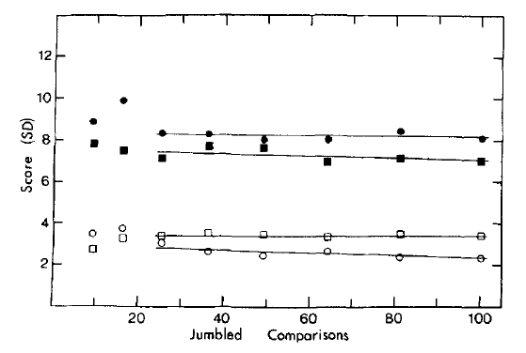
Jumbling Test
Globin sequences(球蛋白)
Tyrosine kinase-type sequences(酪氨酸激酶)
Notes:
排列組合

Slide 10
The Four Scoring Approaches
MP_RCL_CG
Unitary Matrix
Matching score : 1.0
Mismatching score : 0
Gap penalty: -2.5
Genetic Code Matrix (three-base-change)
Matching score : 3-2-1-0
Gap penalty: -3
_ PBRC_KCG
5+4*(-2.5)=-5
MP_ RC L _CG
_ PB RC _ KCG
1+2+2+2*(-3)+(-3)+(-3)=-7

Slide 11
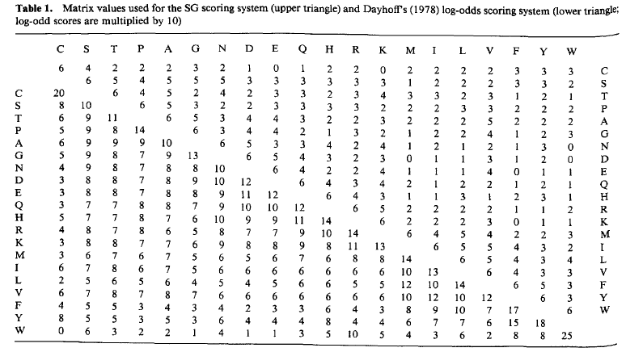
The Four Scoring Approaches
MP_RCL_CG
_ PBRC_KCG
4*(-5.5)+5*6=8
Structure-Genetic Matrix Gap penalty: -5.5
Log-odds Matrix Gap penalty: 0
(14+14+20+20+13)/10-0.8=7.3

Slide 12
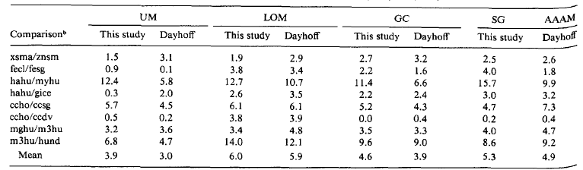
The Four Scoring Approaches

Slide 13
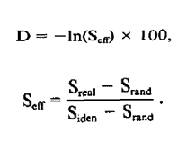
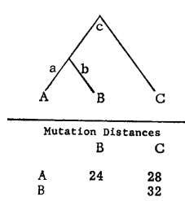
Construction of Phylogenetic Trees
Matrix from the limb length
+
Percentage Standard Deviation
a+b=24
b-a=4
a=10,b=14,c=18
Notes:
希望PSD 越小越好 ，因為PSD=minimal tree lengths

Slide 14
Sequences Used for Comparison

Slide 15
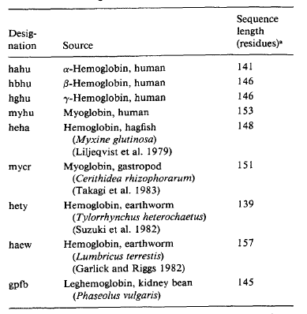
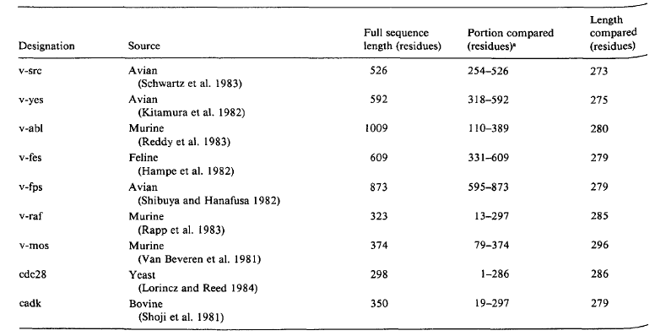
Sequences Used for Comparison
Globin(球蛋白)
Tyrosine kinase-type sequences(酪氨酸激酶)

Slide 16
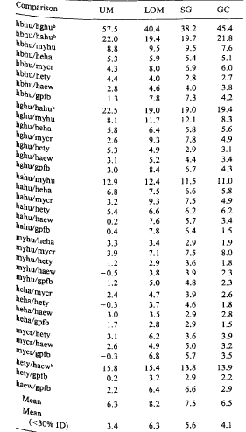
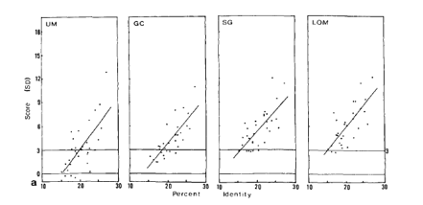
Results
Globin(球蛋白)

Slide 17
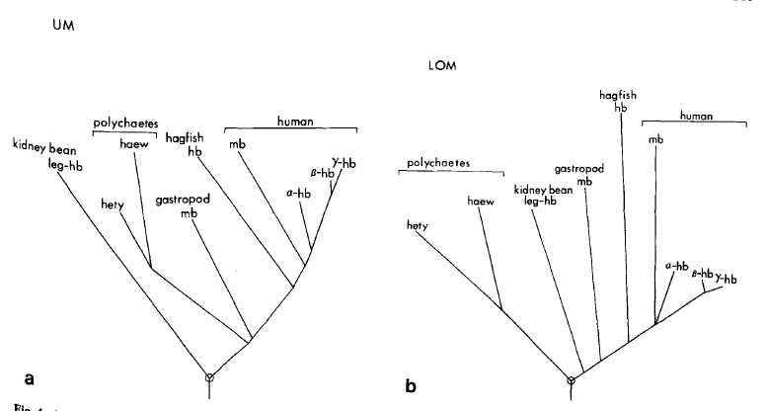
Results

Slide 18
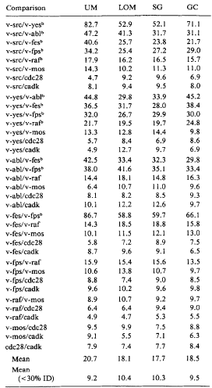
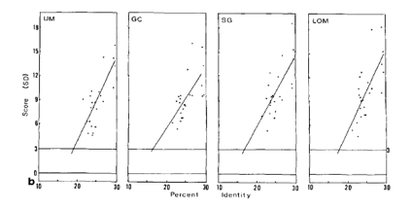
Results
Tyrosine kinase-type sequences(酪氨酸激酶)

Slide 19
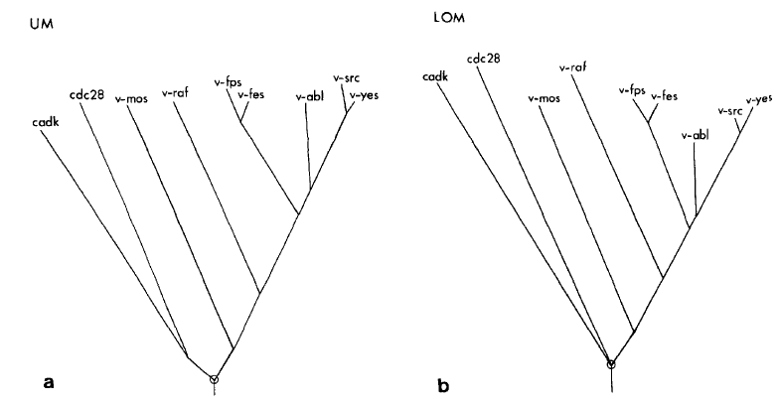
Results

Slide 20
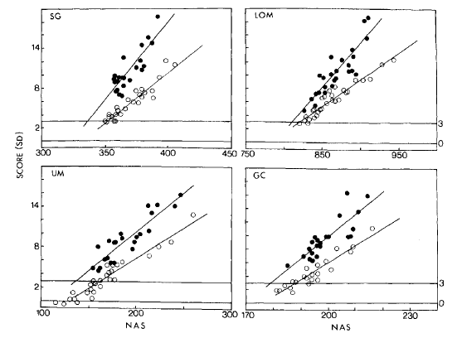
Results

Slide 21
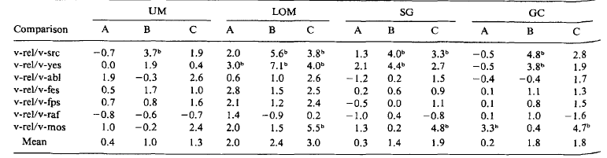
Results
A v-rel (129-400)
B v-rel (129-178)
C v-rel (279-400)

Slide 22
Conclusion
We don’t know what is the best way to align two amino acid sequence if they share common ancestry.
The answer may be to use a weight matrix.
The best weighting schemes take account of both genetic likelihood and structural similarities between amino acids.

