Slide 1
Alignment of the Amino Acid Sequences of Distantly Related Proteins Using Variable Gap Penalties
Arthur M. Lesk, Michael Levitt and Cyrus Chothia
Protein Engineering, Vol. 1 No.1 pp.77-78, 1986
Presenter: Chong-Xuan Lo
Date:2014/4/22

Slide 2
Abstract
An essential step in assessing and analysing the relationship between two or more proteins is the establishment of an alignment of their amino acid sequences. The prediction of an unknown protein structure by model building from the known structure of a homologue also requires the correct correspondence between the residues.
Using sequence information alone, the optimal alignment determined by the procedure of Needleman and Wunsch (1970) or equivalent modifications, with scoring parameters expressed in the mutation data matrix MD (Orcutt et al., 1984), gives correct results for closely related sequences.

Slide 3
Abstract
For distantly related proteins, however, this procedure gives results inconsistent with the alignments derived from superpositions of the 3-D structures; this has been observed in the globins (Lesk and Chothia,1980), the cytochromes c (Dickerson, 1980), the serine proteases (Delbaere et al., 1979; Greer, 1981; Read et al., 1984) and plastocyanin and azurin (Chothia and Lesk, 1982).

Slide 4
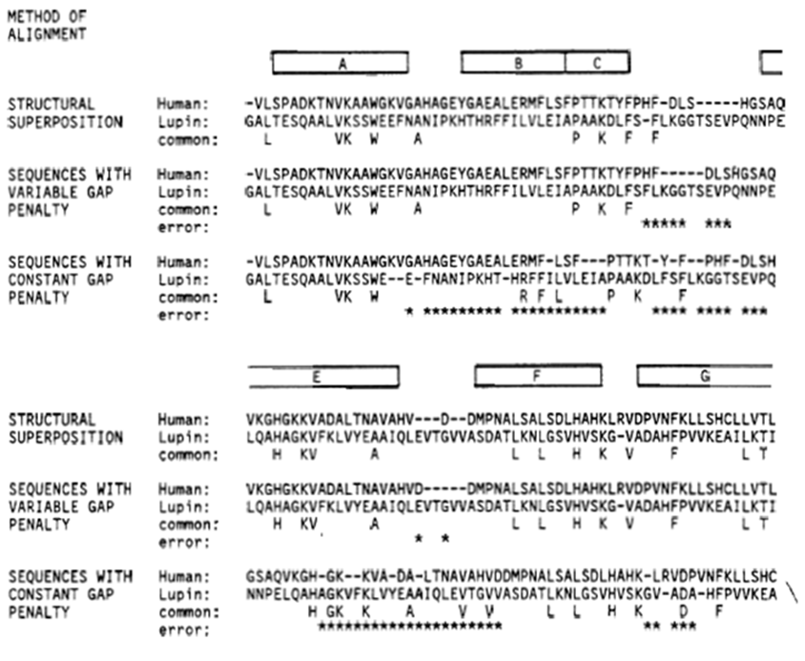
CONSTANT GAP
Needleman -Wunsch - Sellars algorithm in the PIR program ALIGN, using a matrix bias of 2, and a gap penalty of 10
Figure 1 also indicates the positions of the helices in the a-strand of human haemoglobin A.
It is clear that the algorithm has not hesitated to put insertions within helical regions.

Slide 5
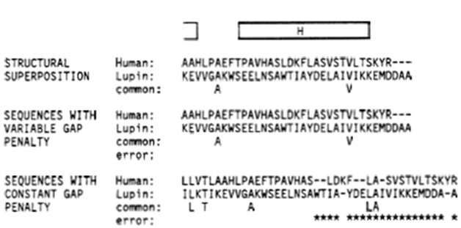
VARIABLE GAP
Because of the importance of the stability of the structures of the packing of helix - helix interfaces, insertions and deletions are not observed to occur in the interiors of helical regions of proteins. They would entirely change the pattern of residue, and destroy the complementarity of the occluding surfaces.
(Insertions and deletions can occur at the ends of helical regions.)

Slide 6
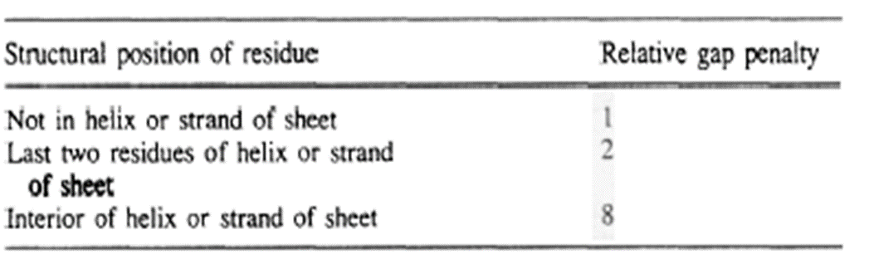
VARIABLE GAP
It is possible to apply this insight into the mechanism of protein evolution to the alignment of distantly related sequences by a modification of the Needleman - Wunsch procedure.
Instead of applying a gap penalty uniform throughout the sequence, we increase the gap penalty within helical regions.
Figure 1 uses variable gap penalties . The number of errors, relative to the alignment based on the 3-D structure, is reduced from 78 to 10.

Slide 7
Conclusion
The analysis of relationships among distantly related proteins depends on the availability of structural information. The use of variable gap weights can be a useful way to bring structural information to bear on the problem of alignment of distantly related sequences.

