Slide 1
On the Range Maximum-Sum Segment Query Problem
Kuan-Yu Chen and Kun-Mao Chao
Discrete Applied Mathematics, Vol. 155, No. 16,
pp. 2043-2052, 2007
Date: Jan. 02, 2008
Introducer: Hsing-Yen Ann

Slide 2
Abstract (1/2)
The range minimum query problem, RMQ for short, is to preprocess a sequence of real numbers A[1 ... n] for subsequent queries of the form: "Given indices i, j, what is the index of the minimum value of A[i ... j]?" This problem has been shown to be linearly equivalent to the LCA problem in which a tree is preprocessed for answering the lowest common ancestor of two nodes. It has also been shown that both the RMQ and LCA problems can be solved in linear preprocessing time and constant query time under the unit-cost RAM model.

Slide 3
Abstract (2/2)
This paper studies a new query problem arising from the analysis of biological sequences. Specifically, we wish to answer queries of the form: "Given indices i and j, what is the maximum-sum segment of A[i ... j]?" We establish the linear equivalence relation between RMQ and this new problem. As a consequence, we can solve the new query problem in linear preprocessing time and constant query time under the unit-cost RAM model. We then present alternative linear-time solutions for two other biological sequence analysis problems to demonstrate the utilities of the techniques developed in this paper.

Slide 4
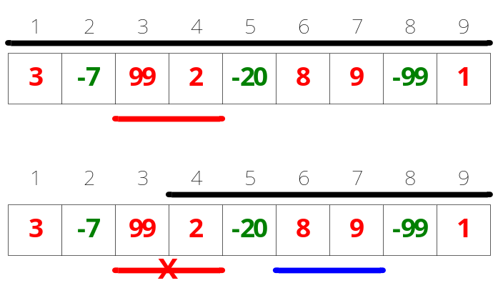
Maximum-Sum Segment v.s. RMSQ (Range Maximum-Sum Segment Query)
Maximum-sum segment
  Given an array A, find the maximum-sum segment of A
Range maximum-sum segment
  Given an array A and a range [i, j], find the maximum-sum segment in the range [i, j]

Slide 5
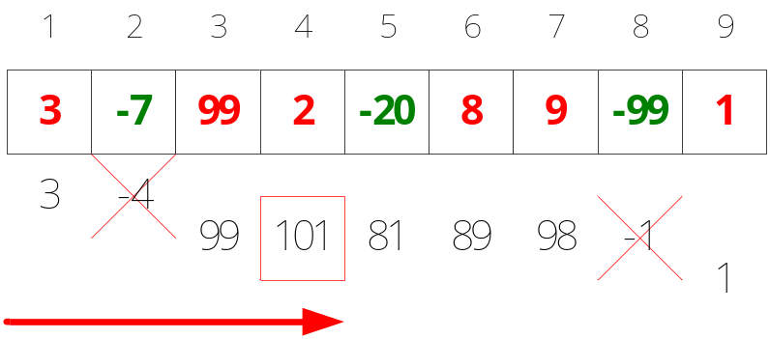
Bentley’s Linear-Time Algorithm for Maximum-Sum Segment
Bentley’s Algorithm [Programming Pearls, 1984]
maxSumOfSegment(a[], n) {
int curSum = maxSum = a[1];
for (i = 2 to n) {
curSum = max(curSum + a[i], 0);
maxSum = max(maxSum, curSum);
}
return maxSum;
}

Slide 6
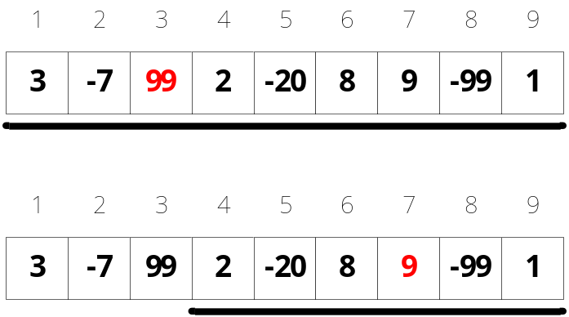
RMQ (Range Minimum / Maximum Query)
Range maximum query
  Given an array A and a range [i, j], find the maximum in the range [i, j]
  Can be solved in O(n) preprocessing time and O(1) query time.

Slide 7
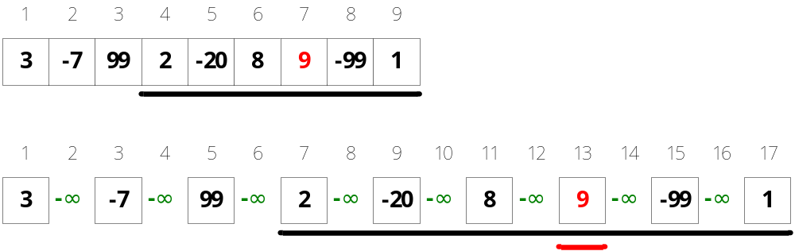
RMSQ Is Linearly Equivalent to RMQ
RMQ can be linearly transformed to RMSQ
How to solve RMSQ with RMQ?

Slide 8
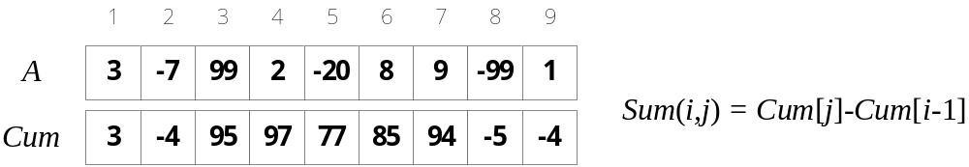
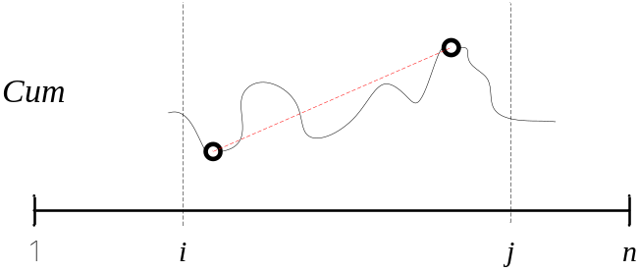
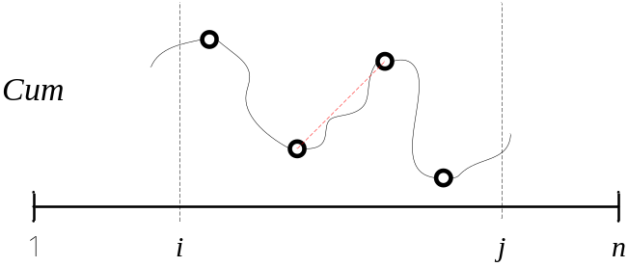
An Idea
Cumulative sum (prefix sum)
Finding the RMQ_{min}(C, i-1, j) and RMQ_{max}(C, i-1, j)
– not workable for all cases

Slide 9
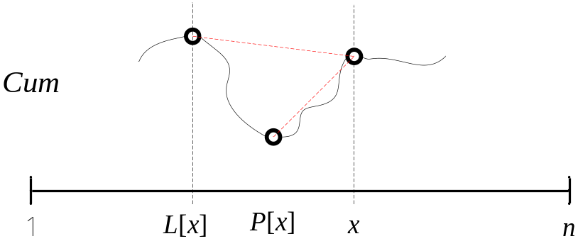
Good Partners
L[x]: left bound of index x, nearest higher one
P[x]: good partner of x, the lowest one between C[L[x]…x]
M[x]: Sum(P[x], x) the sum of good segment which is end with x

Slide 10
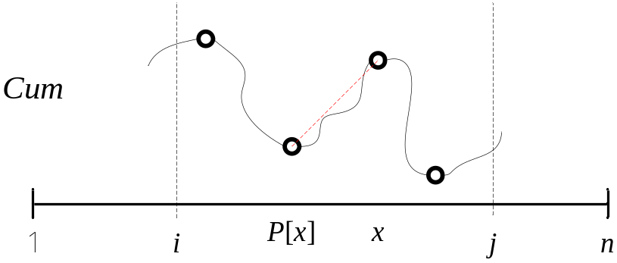
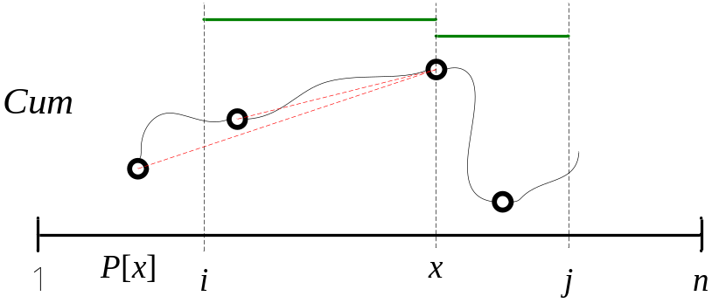
Solve RMSQ with RMQ (1/2)
Finding x = RMQ_{max}(M, i, j) and its good partner P[x]
If P[x] ≧ i, the RMSQ is solved
Else ??

Slide 11
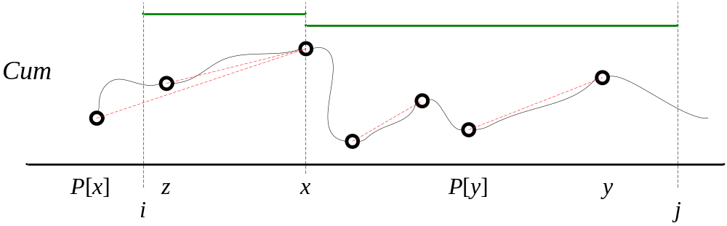
Solve RMSQ with RMQ (2/2)
If P[x] < i, there are only two possible candidate segments
  Finding y = RMQ_{max}(M, x+1, j), the candidate segment is [P[y]…y]
  Finding z = RMQ_{min}(C, i-1, x-1), the candidate segment is [z…x]
The better one is the solution

Slide 12
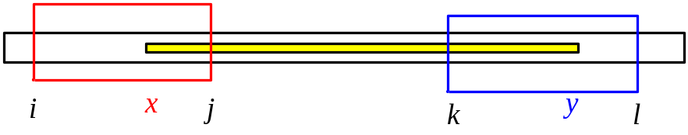
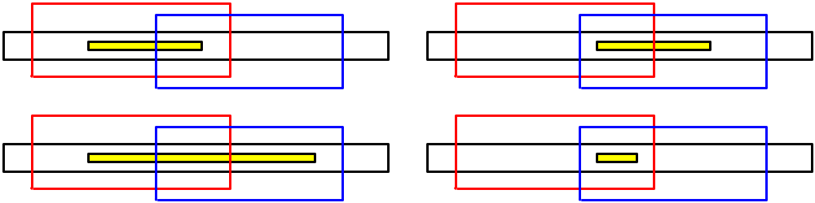
A Variant –
RMSQ with Two Query Intervals
To find the maximum-sum segments [x, y], where
i ≦ x ≦ j and k ≦ y ≦ l.
If j ≦ k, x = RMQ_{min}(C, i-1, j-1) and y = RMQ_{max}(C, k, l)
Else, there are four cases
  x = RMQ_{min}(C, i-1, k-1)+1 and y = RMQ_{max}(C, k, l)
  x = RMQ_{min}(C, k, j-1)+1 and y = RMQ_{max}(C, j, l)
  (x, y) = RMSQ (k, j)

