Slide 1
Finding a Longest Common Subsequence between a Run-Length-Encoded String and an Uncompressed String
J. J. Liu, Y. L. Wang and R. C. T. Lee
Journal of Complexity,
Vol. 24, pp. 173-184, 2008
Date: May 7, 2008
Introducer: Hsing-Yen Ann

Slide 2

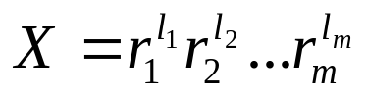
Abstract (1/2)
In this paper, we propose an O(min{mN, Mn}) time algorithm for finding a longest common subsequence of strings X and Y with lengths M and N, respectively, and run-length-encoded lengths m and n, respectively. We propose a new recursive formula for finding a longest common subsequence of Y and X which is in the run-length-encoded format. That is, and
, where r_{i} is the repeated character of run i and l_{i} is the number of its repetitions.

Slide 3
Abstract (2/2)
There are three cases in the proposed recursive formula in which two cases are for r_{i} matching y_{j}. The third case is for r_{i} mismatching y_{j}. We will look specifically at the prior two cases that r_{i} matches y_{j}. To determine which case will be used when r_{i} matches y_{j}, we have to find a specific value which can be obtained by using another of our proposed recursive formulas.

Slide 4
Problem Definition
Run-length encoding (RLE) compression
aaaaabbbccccdd ➔ a⁵b³c⁴d²
Input:
  RLE string X
  Uncompressed string Y
Output:
  LCS between X and Y.

Slide 5
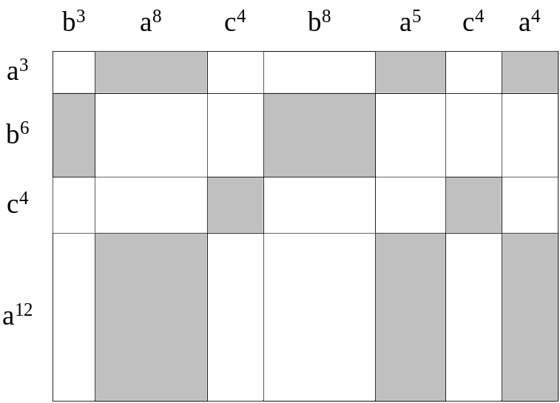
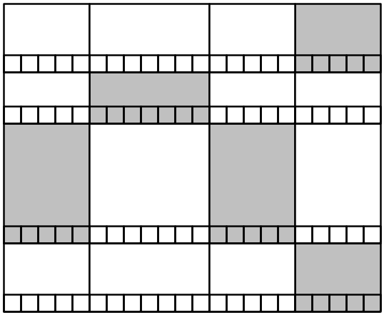

Dark Blocks & Light Blocks
Divide the DP lattice into k × l blocks.
Dark blocks: matched blocks
Light blocks: mismatched blocks

Slide 6
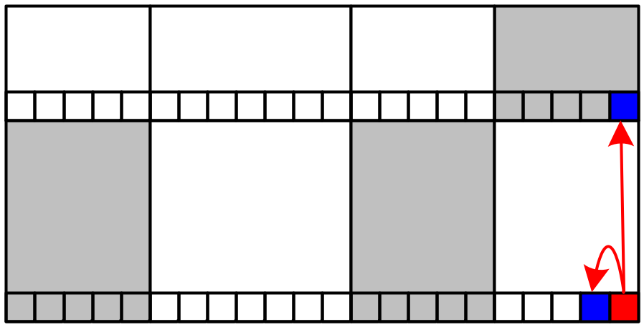
Lemma 1
For run i and y_{j}, if r_{i} mismatches y_{j}, then
LCS(lp(r_{i}), j) = max{LCS(lp(r_{i}), j-1), LCS(lp(r_{i}−1), j)}.

Slide 7
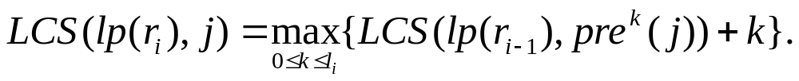
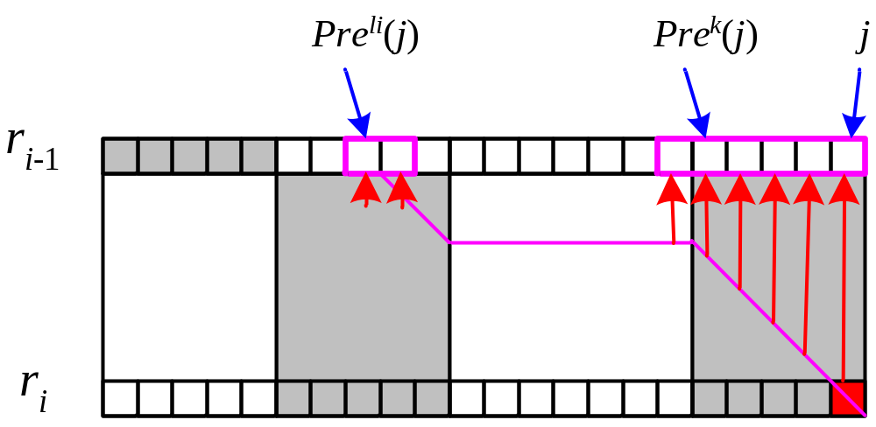
Lemma 2
For run i and y_{j}, if r_{i} matches y_{j}, then
The best k is called the originating value.

Slide 8
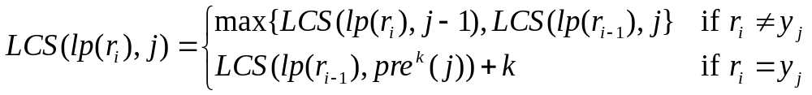
Modified Recursive Formula
If we know the originating value k, then
How to calculate k in constant time?

Slide 9
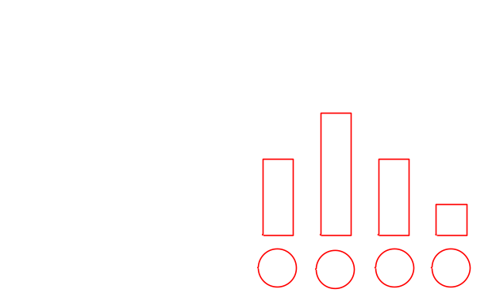
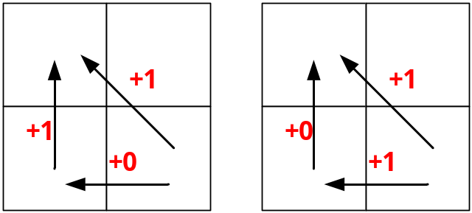
Lemma 3 & Lemma 4
Let S_{i,j} denote the number of critical elements of (lp(r_{i}),j)
For run i and y_{j}, if r_{i} matches y_{j} and S_{i,j-1}=0, then
LCS(lp(r_{i}), j) = LCS(lp(r_{i}), j-1).
For run i and y_{j}, if r_{i} matches y_{j} and S_{i,j-1}>0, then
LCS(lp(r_{i}), j) = LCS(lp(r_{i}), j-1) +1.

Slide 10
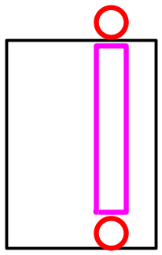
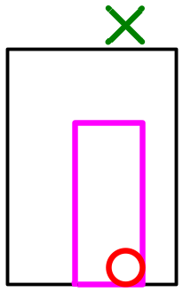
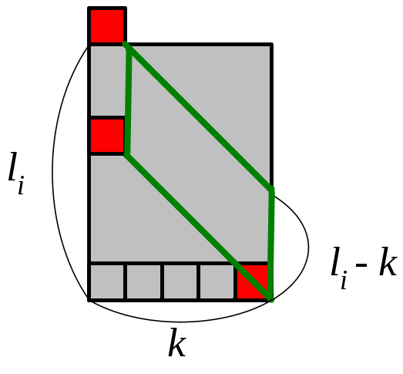
Computing S_{i,j} by Lemmas 5-7
For run i and y_{j},
if LCS(lp(r_{i}), j) = LCS(lp(r_{i-1}), j), then S_{i,j-1}=l_{i}.
For run i and y_{j},
if r_{i} mismatches y_{j} and
LCS(lp(r_{i}), j) > LCS(lp(r_{i-1}), j),
then S_{i,j}=S_{i,j-1}<l_{i}.
For run i and y_{j}, if r_{i} matches y_{j}, then S_{i,j}=l_{i}-k, where k is the nearest originating value of element (i, j) in the LCS table.

Slide 11
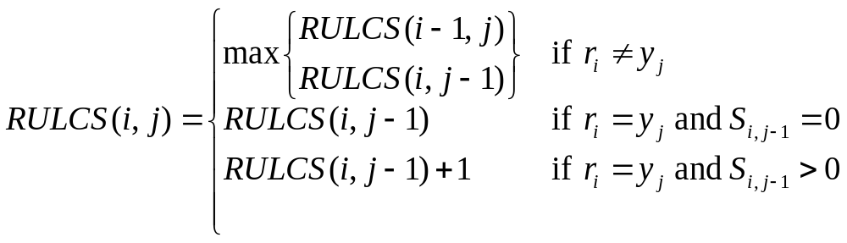
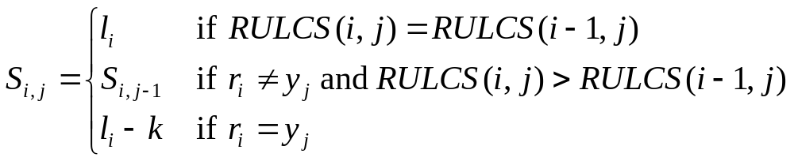
The Algorithm
If we know the nearest originating value k, then
(Lemma 3)
(Lemma 4)
(Lemma 5)
(Lemma 6)
(Lemma 7)

Slide 12


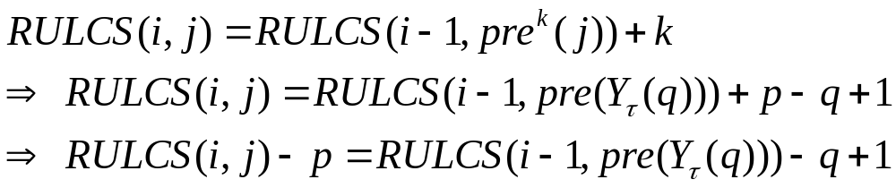
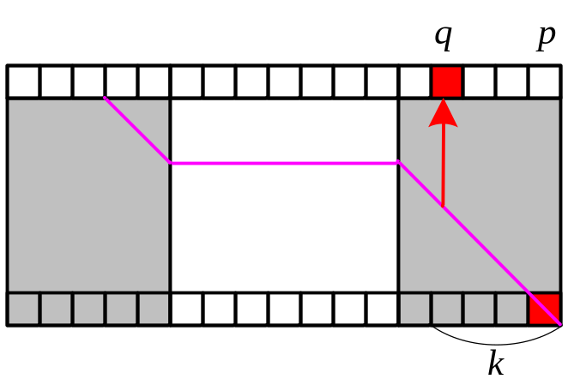
Computing k by Lemma 8
Let p and q denote the numbers of symbol .
(1) Element is an originating element.
(2) k = p - q+1 is an originating value.
(3)

Slide 13
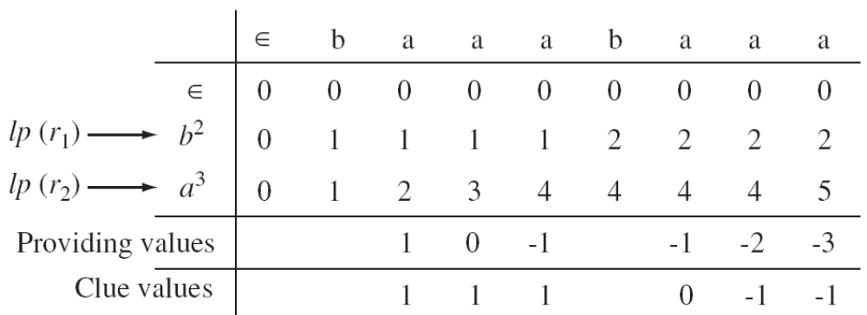
Computing k by Lemma 8
Using reverse rp table for finding the matched value in O(1) time.
Clue value
Providing value

Slide 14
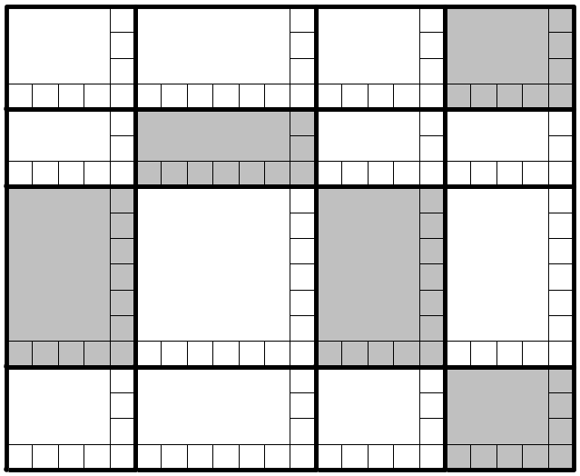
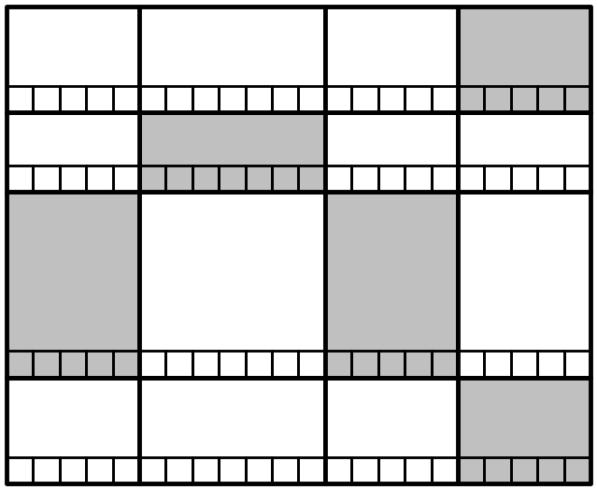


Conclusion
There is an O(min{mN, Mn}) time algorithm that computes the LCS.

