Slide 1
Design of Accurate Predictors for DNA-Binding Sites in Proteins Using Hybrid SVM-PSSM Method
Shinn-Ying Ho, Fu-Chieh Yu, Chia-Yun Chang, Hui-Ling Huang
Department of Biological Science and Technology, National Chiao Tung University, Hsinchu 300, Taiwan
Institute of Bioinformatics, National Chiao Tung University, Hsinchu 300, Taiwan
Department of Information Management, Jin Wen Institute of Technology, Hsin-Tien, Taipei, Taiwan
BioSystems 90 (2007) 234-241
Presenter : Yen, Hsin-Wei
Date : 2008.5.7

Slide 2
Abstract
In this paper, we investigate the design of accurate predictors for DNA-binding sites in proteins from amino acid sequences. As a result, we propose a hybrid method using support vector machine (SVM) in conjunction with evolutionary information of amino acid sequences in terms of their position-specific scoring matrices (PSSMs) for prediction of DNA-binding sites.

Slide 3
Abstract (cont’)
Considering the numbers of binding and non-binding residues in proteins are significantly unequal, two additional weights as well as SVM parameters are analyzed and adopted to maximize net prediction (NP, an average of sensitivity and specificity) accuracy. To evaluate the generalization ability of the proposed method SVM-PSSM, a DNA-binding dataset PDC-59 consisting of 59 protein chains with low sequence identity on each other is additionally established.

Slide 4
Abstract (cont’)
The SVM-based method using the same six-fold cross-validation procedure and PSSM features has NP=80.15% for the training dataset PDNA-62 and NP=69.54% for the test dataset PDC-59, which are much better than the existing neural network-based method by increasing the NP values for training and test accuracies up to 13.45% and 16.53%, respectively. Simulation results reveal that SVM-PSSM performs well in predicting DNA-binding sites of novel proteins from amino acid sequences.

Slide 5
Datasets
PDNA-62: 7967 non-binding and 1792 binding residues
PDNA-48: total 6431 and 1030 binding residues
PDC-59: for independent tests ,total 13041 and 1454 binding residues
All filtered by PISCES

Slide 6
SVM-PSSM
Use PSI-BLAST to generate PSSM profiles
PSSMs are in the from of 20N matrix
Each residue i will be represented by a_{i}=(a_{i,1}, … ,a_{i,20})
(each query residue is represented by a vector of 20 attributes)

Slide 7
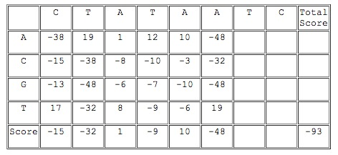
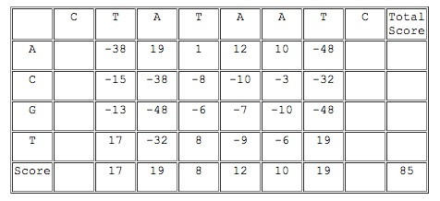
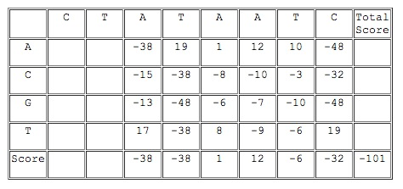
PSSM
position specific scoring matrix

Slide 8
Input Pattern
The input pattern for the residue i is
x_{i} = (a_{i-k}, … ,a_{i}, … ,a_{i+k})
k : the number of neighborhood residues on either side
Construct a window size s = 2k + 1

Slide 9
Four Criteria
Sensitivity = TP / (TP + FN)
Specificity = TN / (TN + FP)
Net prediction : NP, mean of sensitivity and specificity
Accuracy = (TP + TN) / ( TP + FN + TN +FP )

Slide 10
Determination of Parameter Values
s : window size
c : cost parameter
γ : kernel parameter
w₁/w₀ : # of non-binding / # of binding

Slide 11
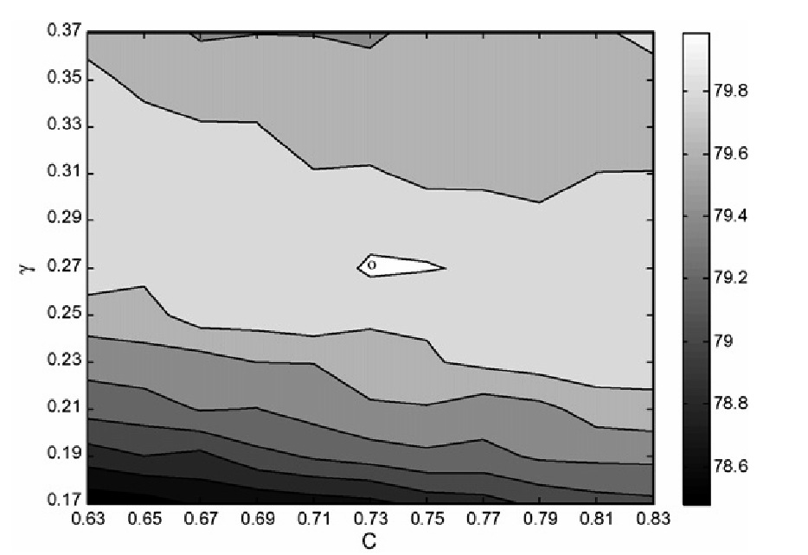
Example
PDNA-62

Slide 12
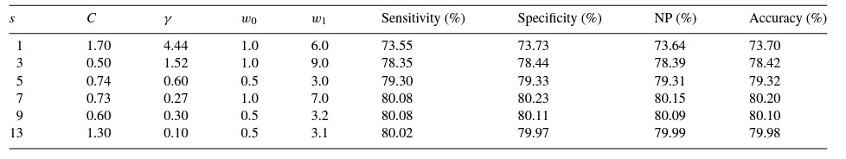
Example (cont’)

Slide 13
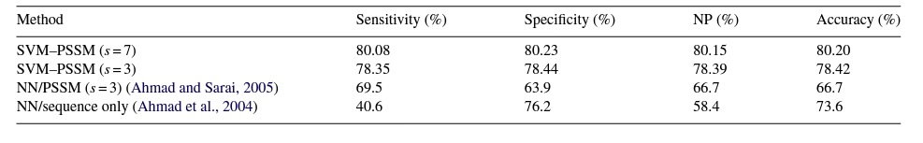
Results
Comparison with NN on PDNA-62

Slide 14
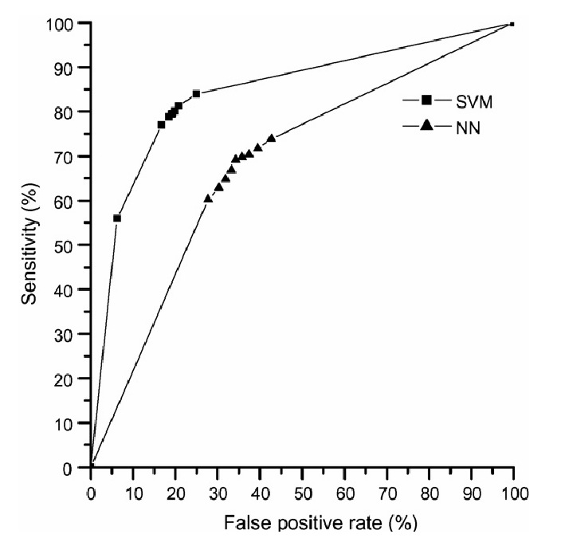
Result (cont’)

Slide 15
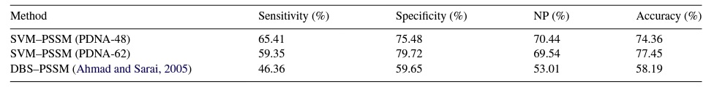
Result (cont’)
Independent Test
Using PDNA-62, PDNA-48 as the training dataset on PDC-59

