Slide 1
The optimization and improvement of bridge game system
Y. Song, H. Qiu, Y. Wang, X. Zheng,
33rd Chinese Control and Decision Conference, 2021
Presenter: Yu-Yen Chu
Date: June 27, 2023

Slide 2
Abstract
This article from the background of the bridge, improving the system analysis, experimental test three perspective, based on the idea of reinforcement learning, from two aspects of contract and scoring ability, through a large number of calculations and the original program and every time a new system of winning IMP value level to achieve the agreed order, accumulate experience, design a set of good rewards and punishment mechanism, greatly improve the efficiency of the bridge to play CARDS and intelligence, thus the bridge game system was optimized and improved.

Slide 3
Abstract (Cont.)
In addition, the traditional methods need to manually extract the features of poor expansibility, this paper combined with reinforcement learning algorithm, the ideas of game devised a new system, under the condition of different effective play the computer, the program has also reached a higher level of the game structure design, for the incomplete information game theory provides a reasonable method, application creates opportunities to people living in the future.

Slide 4
Problem Setup
Neural Network can only deal with accurate data (known information).
Reinforcement Learning can set “reward” and “punishment”.
Original program: Neural Network.
Improved program: Deep Reinforcement Learning (Neural Network + Reinforcement Learning).

Slide 5
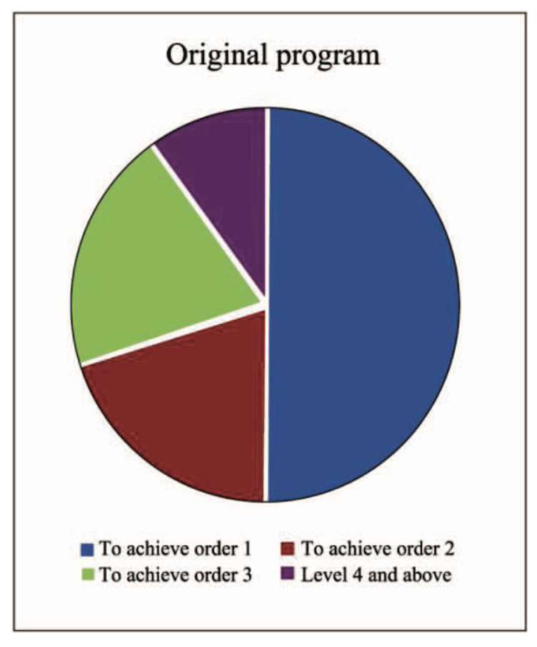
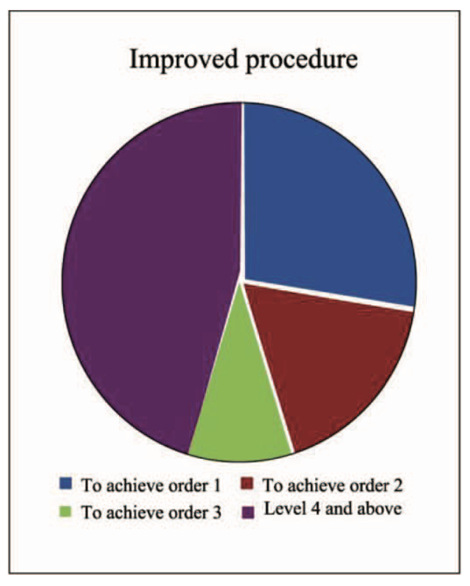
Experimental Result
the bidding level of original program and improved program

Slide 6
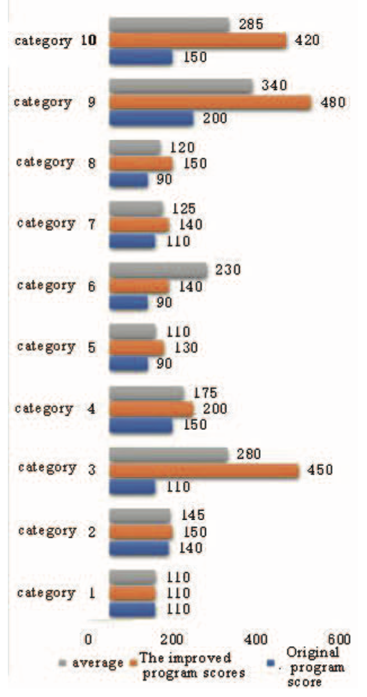
Experimental Result
the score of original program and improved program

