Slide 1
Order-Preserving Multiple Pattern Matching in Parallel
Somin Park, Jinhyeok Park, Youngho Kim and Jeong Seop Sim,
Applied Sciences. 2023, Vol. 13 Issue 8, pp. 5142-5151
Presenter: Wen-Wen Liao
Date: June 27, 2023

Slide 2
Abstract
The order-preserving multiple pattern matching problem is to find all substrings of T whose relative orders are the same for any pattern in a set of patterns. Various sequential algorithms have been studied for the order-preserving multiple pattern matching problems. In this paper, we propose two parallel algorithms, each of which uses Aho–Corasick automata and fingerprint tables, respectively. We also present experimental results of comparing the execution times of each parallel algorithm on various types of time-series data.

Slide 3
Order-Preserving Multiple Pattern Matching (OPMPM)
To find all substrings of T that are order-isomorphic to any Pa(1 ≤ a ≤ k) in P
𝑇 = (41, 36, 15, 8, 41, 23, 28, 16, 26, 22, 56, 29, 12, 61)
P = {(6, 3, 5, 1, 4, 2, 7), (1, 3, 2, 5)}

Slide 4
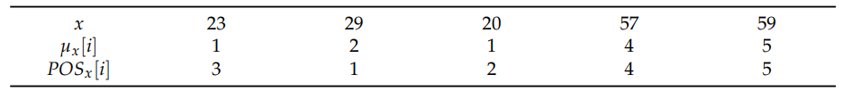

Order-Preserving Multiple Pattern Matching (OPMPM)
Prefix table: $μ_{x}$[i] represents the number of characters that are smaller than x[i] in x[1..i].
Position table: ${POS}_{x}$[i] is the index of the i-th smallest character in x.
x = (23, 29, 20, 57, 59)

Slide 5
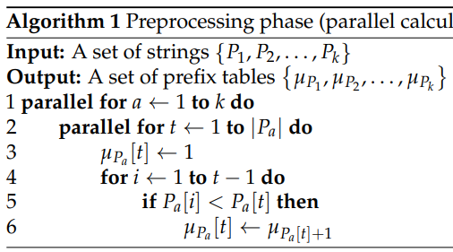
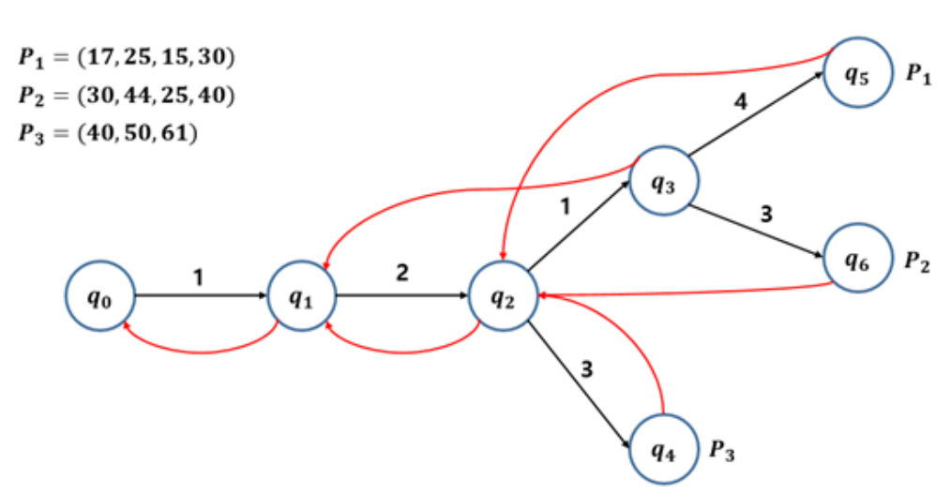

Parallel OPMPM Algorithm Using the Aho–Corasick Automaton
Preprocessing: create prefix tables using O(M) threads in O($\overline{m}$) time.

Slide 6
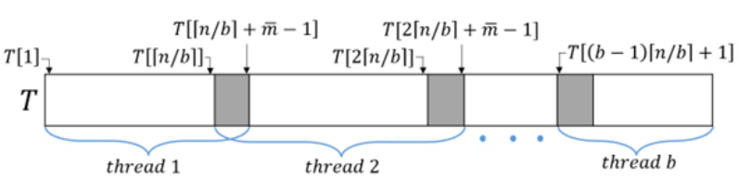

Parallel OPMPM Algorithm Using the Aho–Corasick Automaton
Searching: T is divided into b blocks and each block is searched in parallel using b threads
Block size: $\left\lceil n/b\right\rceil +\overline{m}−1$, and insertion, deletion, and rank in order-statistics tree need O(log $\overline{m}$) → O(($\left\lceil n/b\right\rceil +\overline{m})$log $\overline{m}$)→$∴b=\left\lceil n/\overline{m}\right\rceil$, ∵ O($\overline{m}$log $\overline{m}$)
order-isomorphic to $P_{a}$ can occur across two adjacent blocks

Slide 7
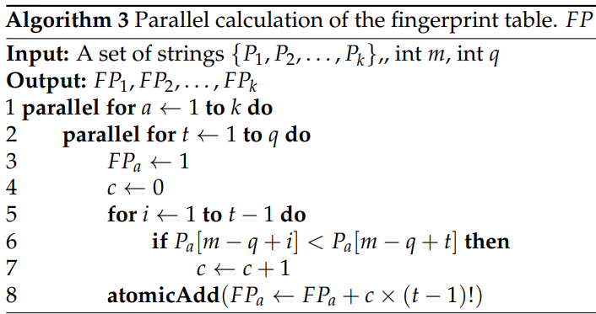

Parallel OPMPM Algorithm Using the Fingerprint Table
Preprocessing: create position tables using O(M) threads in O($\overline{m}$) time and the fingerprint table can be calculated in O(q) time using O(kq) threads.
→O(M) threads in O($\overline{m}$) time

Slide 8
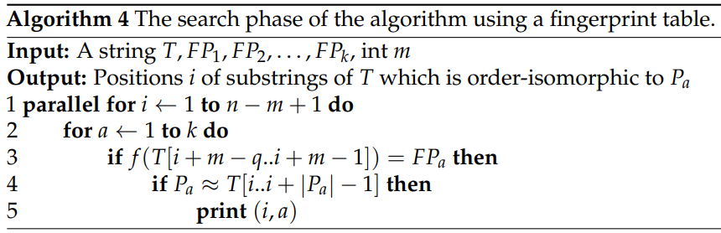
Parallel OPMPM Algorithm Using the Fingerprint Table
Searching : calculates f(T[i + m − q..i + m − 1]) and compare with FP
→O(M) time using O(n) threads

Slide 9
Experimental Results
Data
Randomly generated strings
Dow Jones Index
Electrocardiogram data

Slide 10
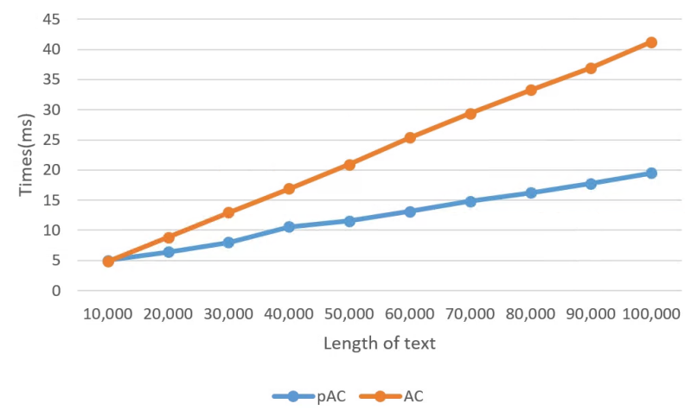
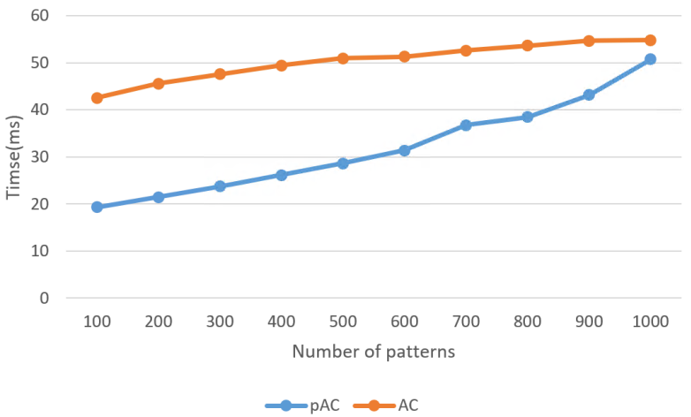
Experimental Results
Comparison of execution times of AC and pAC for randomly generated strings.
Comparison of execution times of AC and pAC varying n for randomly generated strings when m = 9 and k = 100.
Comparison of execution times of AC and pAC varying k for randomly generated strings when n = 100,000 and m = 9.

Slide 11
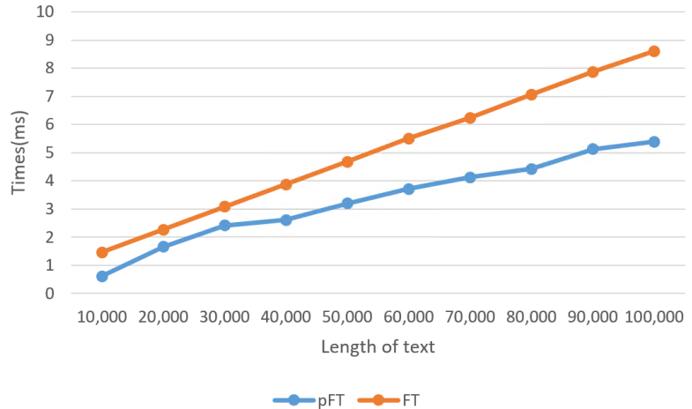
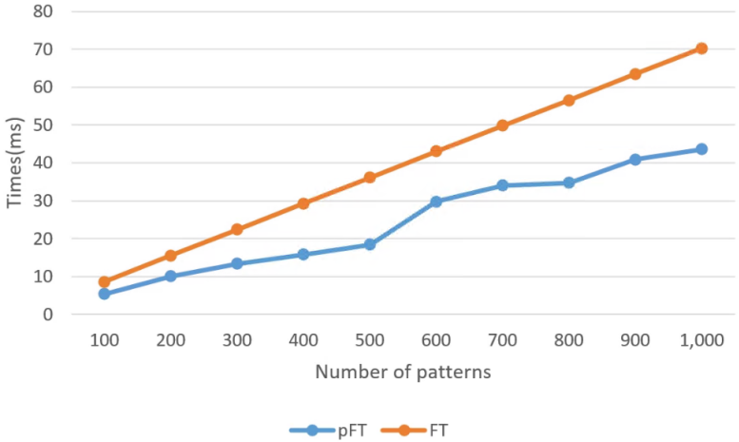
Experimental Results
Comparison of execution times of FT and pFT for randomly generated strings.
Comparison of execution times of FT and pFT according to n for randomly generated
strings when m = 9 and k = 100.
Comparison of execution times of FT and pFT according to k for randomly generated
strings when n = 100,000 and m = 9.

Slide 12
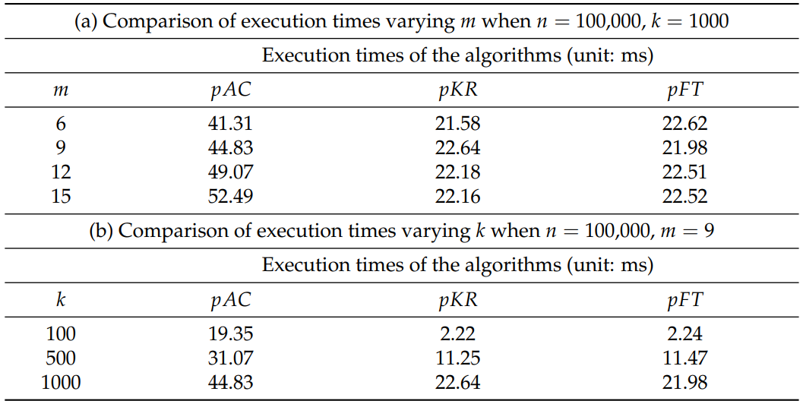
Experimental Results
Comparison of execution times of pKR, pAC, and pFT.
Comparison of execution times of pAC, pKR, and pFT for random strings.

Slide 13
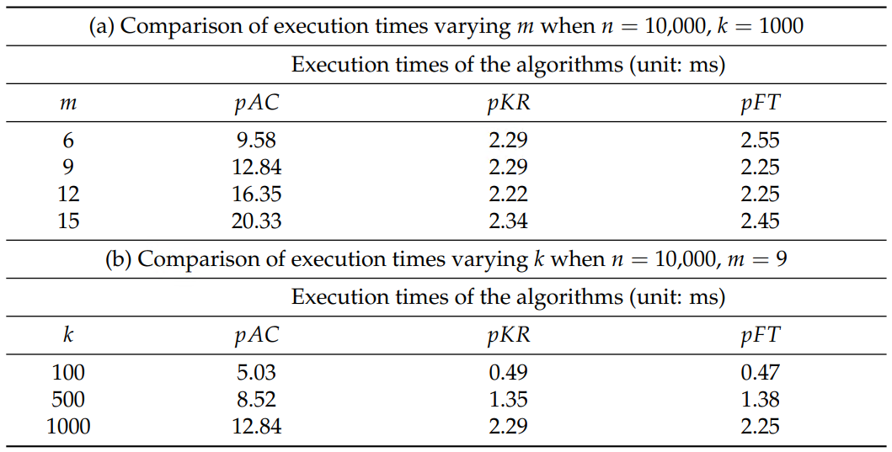
Experimental Results
Comparison of execution times of pKR, pAC, and pFT.
Comparison of execution times of pAC, pKR, and pFT for Dow Jones Index data.

Slide 14
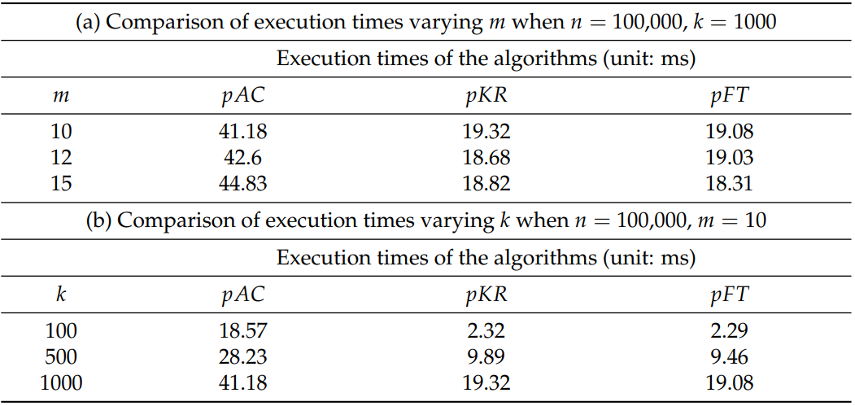
Experimental Results
Comparison of execution times of pKR, pAC, and pFT.
Comparison of execution times of pAC, pKR, and pFT for ECG data.

Slide 15
Conclusion
Parallel OPMPM Algorithm Using the Aho–Corasick Automaton
Approximately 2.12 times faster than the sequential algorithm
Parallel OPMPM Algorithm Using the Fingerprint Table
Approximately 1.6 times faster than the sequential algorithm

