Slide 1
A COVER-MERGING-BASED ALGORITHM FOR THE LONGEST INCREASING SUBSEQUENCE IN A SLIDING WINDOW PROBLEM
Sebastian Deorowicz
Computing and Informatics, Vol. 31, 2012, pp.1217–1233
Presenter: Zhi-Cheng Shen
Date: June 27, 2023

Slide 2
Abstract
A longest increasing subsequence problem (LIS) is a well-known combinatorial problem with applications mainly in bioinformatics, where it is used in various projects on DNA sequences. Recently, a number of generalisations of this problem were proposed. One of them is to find an LIS among all fixed-size windows of the input sequence (LISW). We propose an algorithm for the LISW problem based on cover representation of the sequence that outperforms the existing methods for some class of the input sequences.

Slide 3
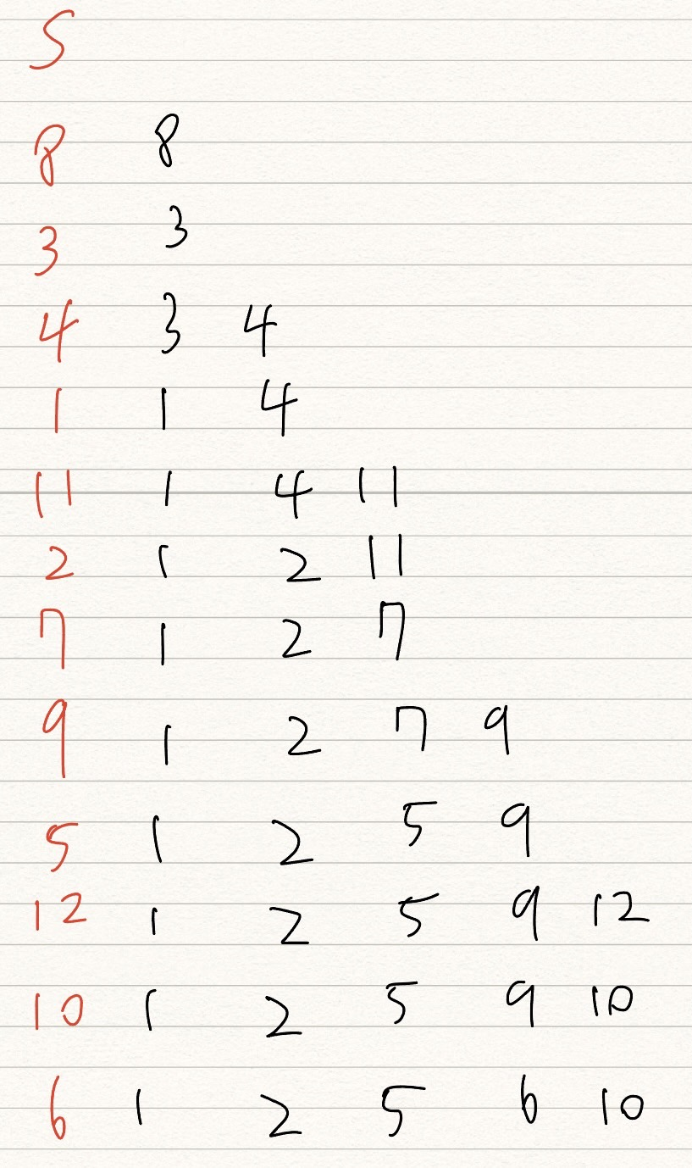

Longest Increasing subsequence
S = <8,3,4,1,11,2,7,9,5,12,10,6>
Lis(S₁) = 5

Slide 4
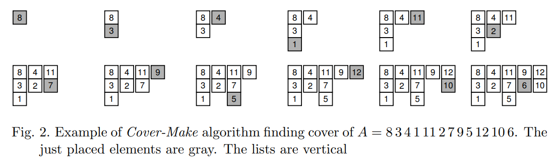

Cover Make

Slide 5
Time Complexity
Time: O(nlogl)，l is the length of LIS

Slide 6
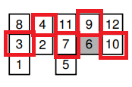
LIS Read
找上一列中小於自己的最大元素。要找“最大元素”是因為這樣才有辦法讓找尋中的LIS更能往前接

Slide 7
Time complexity
Time: O(n)

Slide 8
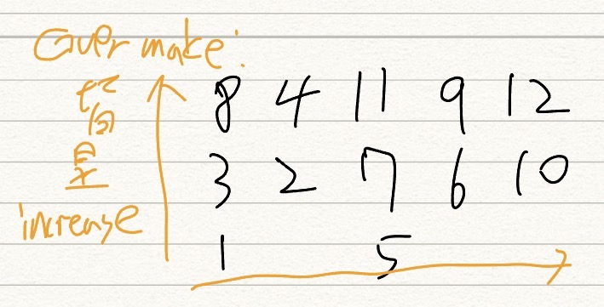

Slide 9
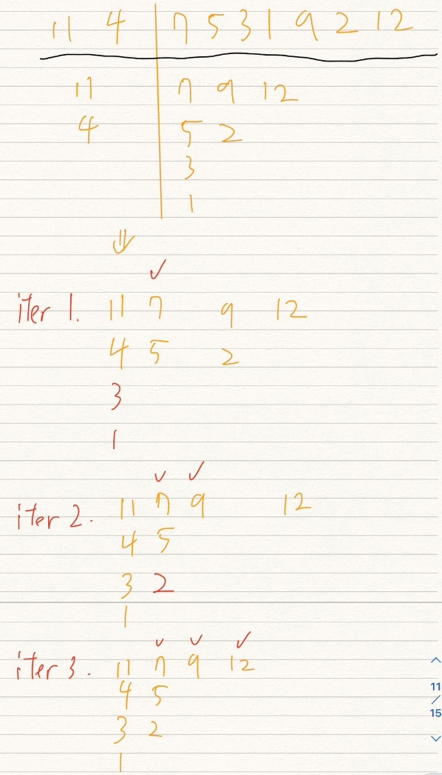
Cover Merge

Slide 10
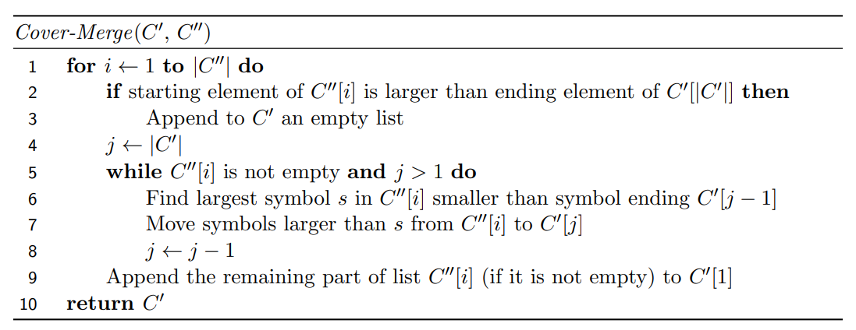
Cover Merge Algorithm

Slide 11
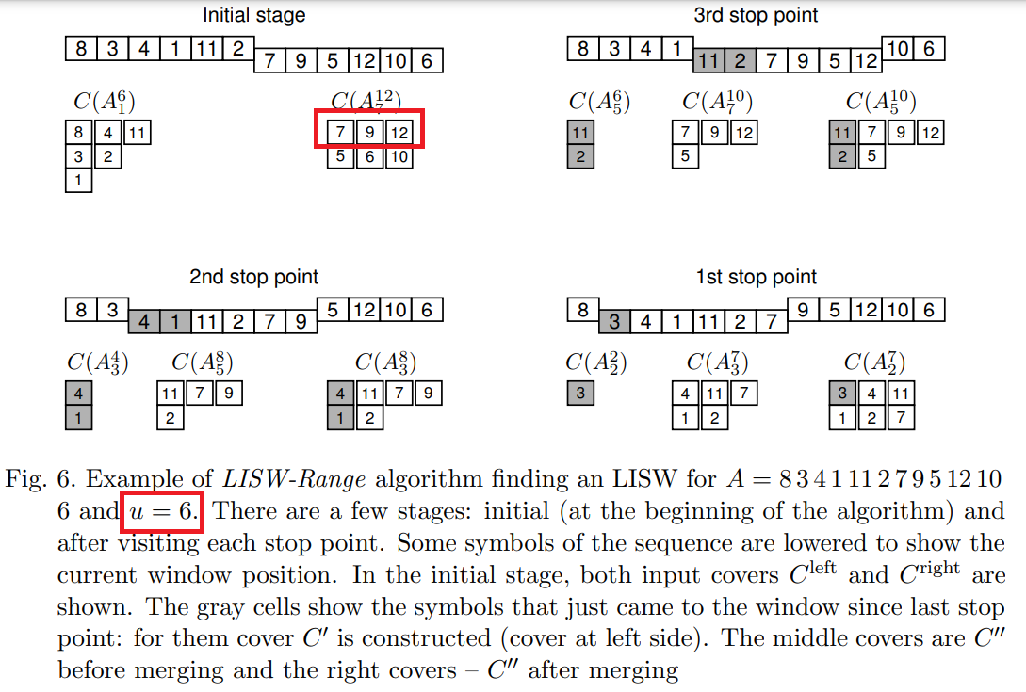
LISW

Slide 12


Stop Point
S: <1,4,11,2,7,9,5>
u = 6，9結尾
S: <1,4,11,2,7,9,5>
u = 6，5結尾
1 4 11 9
2 7
4 11 9
2 7
5
因為5沒有辦法新開一個list，所以用5結尾的LIS不會比用9還好

Slide 13
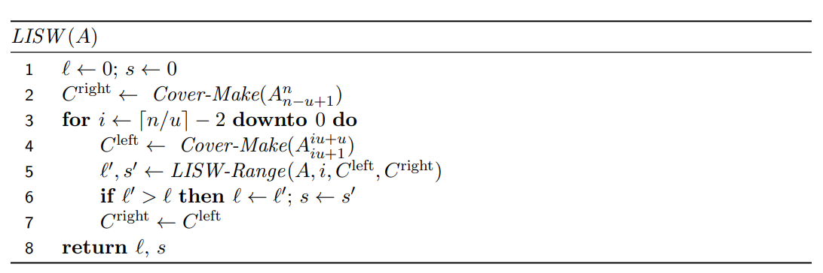
LISW

Slide 14
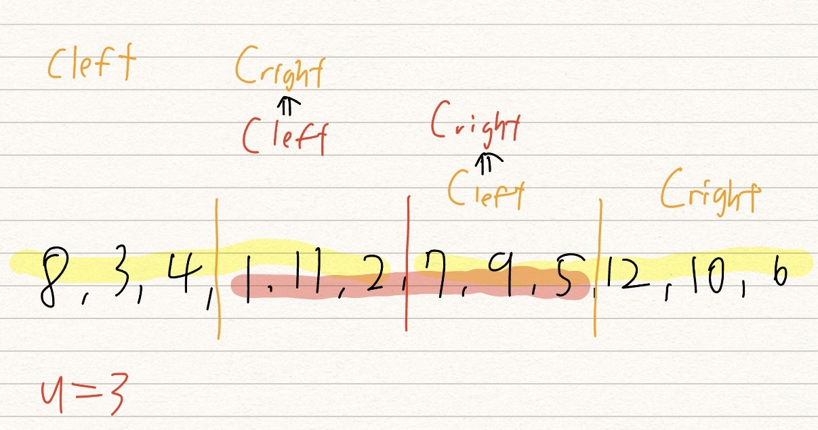


Slide 15
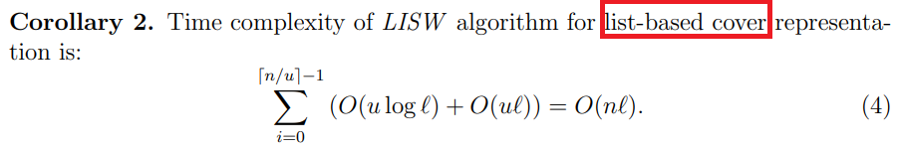
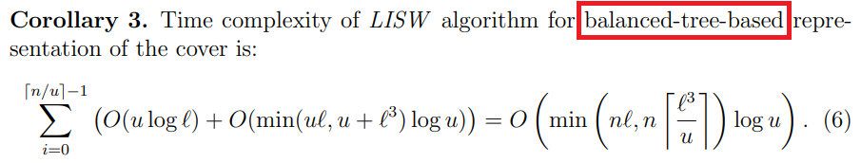
Time Complexity

Slide 16
Thanks~

