Slide 1
Longest Increasing and Decreasing Subsequences
C. Schensted
Canadian Journal of Mathematics, Volume 13, 1961, pp. 179 - 191
Presenter: Guan-Jie Chen
Date: July 18, 2023

Slide 2
Abstract
This paper deals with finite sequences of integers. Typical of the problems we shall treat is the determination of the number of sequences of length n, consisting of the integers 1, 2, … , m, which have a longest increasing subsequence of length α. Throughout the first part of the paper we will deal only with sequences in which no numbers are repeated. In the second part we will extend the results to include the possibility of repetition. Our results will be stated in terms of standard Young tableaux.

Slide 3

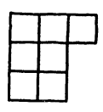
Standard Young Tableau
The numbers in each row / column form increasing sequences
order = 7

Slide 4
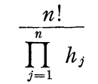
Standard Young Tableau (cont.)
The number of standard tableaux of a given shape containing the integers 1, 2, ..., n
Notes:
ｈ：ｈｏｏｋ ｌｅｎｇｔｈ

Slide 5
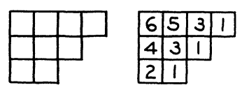

Standard Young Tableau (cont.)
Notes:
符合ＳＹＴ且ｓｈａｐｅ如上圖，ｏｒｄｅｒ＝９的
ａｒｒａｎｇｅｍｅｎｔ有１６８種

Slide 6
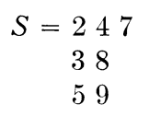
Standard Young Tableau (cont.)
S ← 6
Notes:
ｒｏｗ－ｍａｊｏｒ

Slide 7
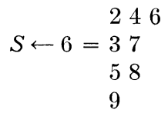
Standard Young Tableau (cont.)

Slide 8
Standard Young Tableau (cont.)
6 → S
Notes:
ｃｏｌｕｍｎ－ｍａｊｏｒ

Slide 9
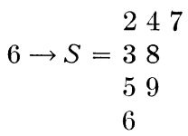
Standard Young Tableau (cont.)

Slide 10
Standard Young Tableau (cont.)
A = 3 5 4 9 8 2 7 B = 7 2 8 9 4 5 3
2 4 7 2 3 5
3 8 4 8 9
5 9 7
Notes:
ＬＩＳ長度＝３
ＬＤＳ長度＝３
ｃｏｌｕｍｎ數為ＬＩＳ長度
ｒｏｗ數為ＬＤＳ長度

Slide 11
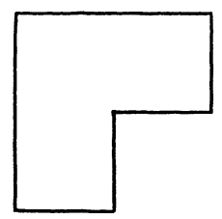
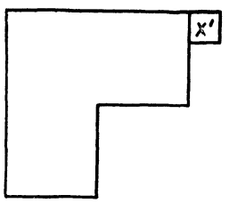
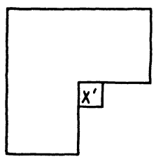
(x → S) ← y = x → (S ← y)
y is the largest
S
(1)
(2)
Notes:
目的：先證ｙ最大，ｘ最大，Ｎ最大（ｘ、ｙ皆不是最大），便涵蓋所有ｃａｓｅ
ｘ’是被推出來的ｐａｒｔ

Slide 12
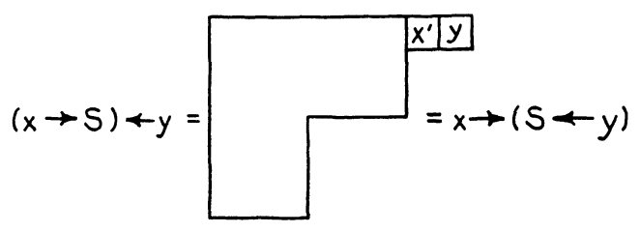
(x → S) ← y = x → (S ← y) (cont.)
y is the largest
(1)

Slide 13
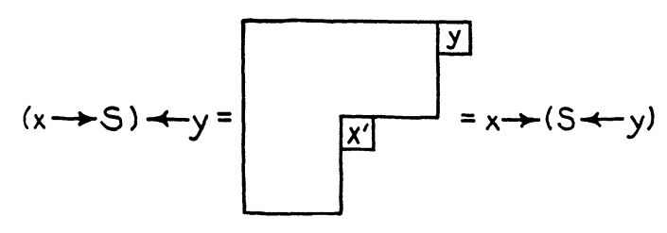
(x → S) ← y = x → (S ← y) (cont.)
y is the largest
(2)
Notes:
還有第３種ｃａｓｅ：ｘ在左下

Slide 14
(x → S) ← y = x → (S ← y) (cont.)
Step. 1: Equality is established when S is of order 0, 1, or 2
Step. 2: Assuming the lemma true for S of order n
Step. 3: Proving the lemma true for S of order n + 1
Notes:
ｘ最大略，證明方法同ｙ最大
此處用數學歸納法

Slide 15
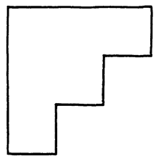
(x → S) ← y = x → (S ← y) (cont.)
N is the largest number in S
S is of order n + 1
S’ (remove N from S) is of order n
N
N
N
Notes:
Ｎ只會落在紅色部分（其ｒｏｗ＆ｃｏｌｕｍｎ的尾巴）
移除Ｎ不影響剩餘的ｓｈａｐｅ
也就是說
從Ｓ’到Ｓ（加入Ｎ）不會影響到原先ｓｈａｐｅ裡面元素的位置，也不會影響到ｘ’與ｙ’

Slide 16
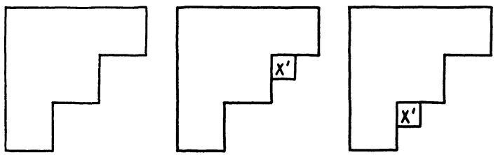
(x → S) ← y = x → (S ← y) (cont.)
If x’ and y’ do not fall into the same square
y’
S’ x → S’ S’ ← y
Notes:
ｂｙ ａｓｓｕｍｐｔｉｏｎ

Slide 17
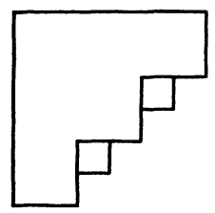
(x → S) ← y = x → (S ← y) (cont.)
If x’ and y’ do not fall into the same square
x’
(x → S’) ← y =
= x → (S’ ← y)
y’
Notes:
加入Ｎ成為Ｓ後，依然成立

Slide 18
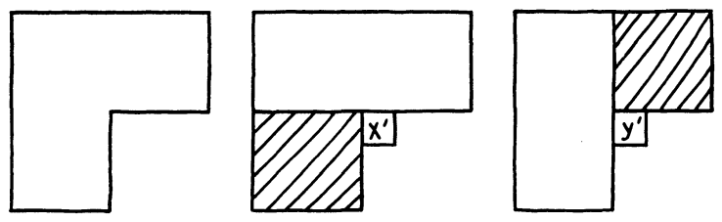
(x → S) ← y = x → (S ← y) (cont.)
If x’ and y’ fall into the same square
S’ x → S’ S’ ← y
Notes:
取代了陰影部分
ｘ在取代過程中會越來越往右上跑
ｙ在取代過程中會越來越往左下跑

Slide 19
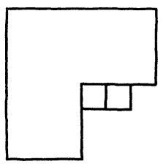
(x → S) ← y = x → (S ← y) (cont.)
If x’ and y’ fall into the same square
x’ < y’
(x → S’) ← y =
= x → (S’ ← y)
Notes:
ｘ’ ｙ’

Slide 20
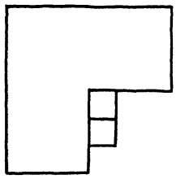
(x → S) ← y = x → (S ← y) (cont.)
If x’ and y’ fall into the same square
x’ > y’
(x → S’) ← y =
= x → (S’ ← y)
Notes:
ｙ’
ｘ’

Slide 21
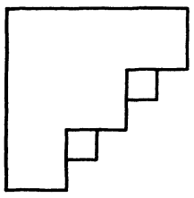
(x → S) ← y = x → (S ← y) (cont.)
If N does not coincide with either x’ or y’
y’
N
x’
Notes:
Ｓ部分

Slide 22
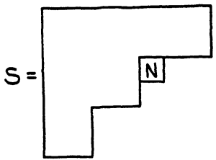
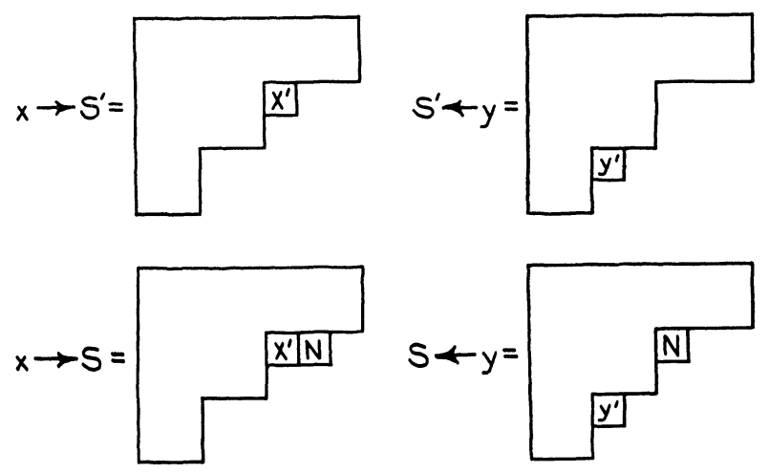
(x → S) ← y = x → (S ← y) (cont.)
If N coincides with x’ (at right side)

Slide 23
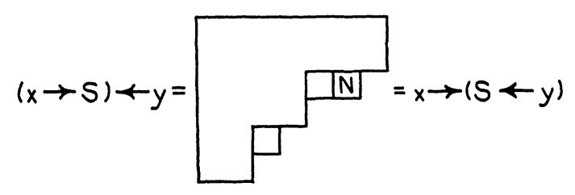
(x → S) ← y = x → (S ← y) (cont.)
If N coincides with x’ (at right side)
x’
y’

Slide 24
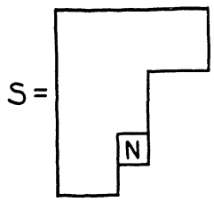
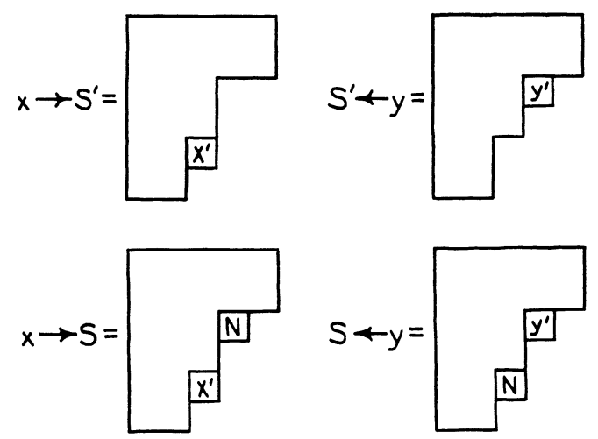
(x → S) ← y = x → (S ← y) (cont.)
If N coincides with x’ (at left side)

Slide 25
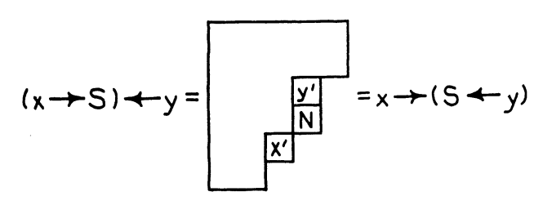
(x → S) ← y = x → (S ← y) (cont.)
If N coincides with x’ (at left side)

Slide 26
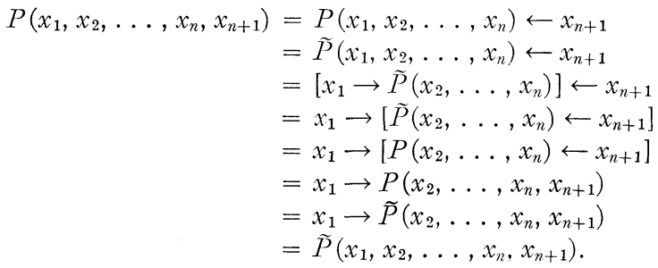
((x₁ ← x₂) ← x₃) ← … ← x_{n+1}
=
= x₁ → … → (x_{n-1} → (x_{n} → x_{n+1}))

Slide 27
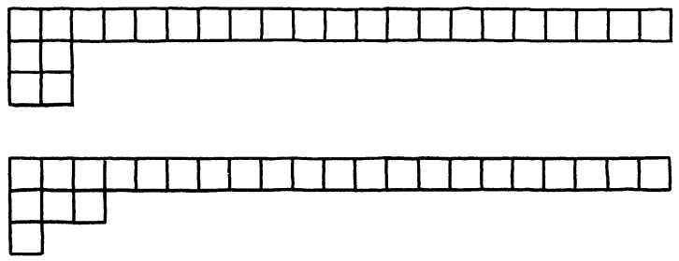
Example
To find the number of permutations of 1 to 25 having
LIS length = 21 and LDS length = 3
number of tableaux
21000
31350

Slide 28
Sequences with Repeated Numbers
A = 3 3 2 3 4 1
We replace 1 by 1, 2 by 2, the three 3's by 3, 4, 5, and 4 by 6
B = 3 4 2 5 6 1
tableau of B: 1 4 5 6
2
3

Slide 29
Sequences with Repeated Numbers (cont.)
B
LIS length = 4
LDS length = 3
A
Longest non-decreasing subsequence length = 4
LDS length = 3

Slide 30
Thanks for your patience

