Slide 1
Efficient Algorithms for the Order Preserving Pattern Matching Problem
Simone Faro and M. Oğuzhan Külekci,
Algorithmic Aspects in Information and Management, 2016, pp. 185–196
Presenter: Wen-Wen Liao
Date: July 18, 2023

Slide 2
Abstract
Given a pattern x of length m and a text y of length n, both over an ordered alphabet, the order-preserving pattern matching problem consists in finding all substrings of the text with the same relative order as the pattern. The OPPM, which might be viewed as an approximate variant of the well known exact pattern matching problem, has gained attention in recent years. This interesting problem finds applications in a lot of fields as from time series analysis, like share prices on stock markets or weather data analysis, to musical melody matching. In this paper we present two new filtering approaches which turn out to be much more effective in practice than the previously presented methods by reducing the number of false positives up to 99%. From our experimental results it turns out that our proposed solutions are up to 2 times faster than the previous solutions.

Slide 3
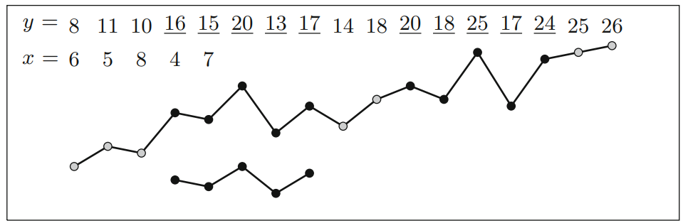

Order-Preserving Pattern Matching (OPPM)
$x$ x= <6, 5, 8, 4, 7>
$y$ = <8, 11, 10, 16, 15, 20, 13, 17, 14, 18, 20, 18, 25, 17, 20, 25, 26>
Relative order of the sequence $x$ = <3, 1, 0, 4, 2>

Slide 4

Order-isomorphism
$x$ = <6, 3, 8, 3, 10, 7, 10>
$y$ = <2, 1, 4, 1, 5, 3, 5>
$z$ = <6, 3, 8, 4, 9, 7, 10>
Rank function
${rk}_{x}$ = ${rk}_{y}$= ${rk}_{z}$= <2, 0, 4, 1, 5, 3, 6>
Equality function
${eq}_{x}$ = ${eq}_{y}$= <1, 0, 0, 0, 0, 1>, ${eq}_{z}$ = <0, 0, 0, 0, 0, 0>

Slide 5

Order-isomorphism
$x≈y$, if and only if ${rk}_{x}$ = ${rk}_{y}$and ${eq}_{x}$ = ${eq}_{y}$.
$x$ = <6, 3, 8, 3, 10, 7, 10>
$y$ = <2, 1, 4, 1, 5, 3, 5>
$z$ = <6, 3, 8, 4, 9, 7, 10>
${rk}_{x}$ = ${rk}_{y}$= ${rk}_{z}$= <2, 0, 4, 1, 5, 3, 6>
${eq}_{x}$ = ${eq}_{y}$= <1, 0, 0, 0, 0, 1>, ${eq}_{z}$ = <0, 0, 0, 0, 0, 0>
$x≈y, \text{but} x≉z$

Slide 6
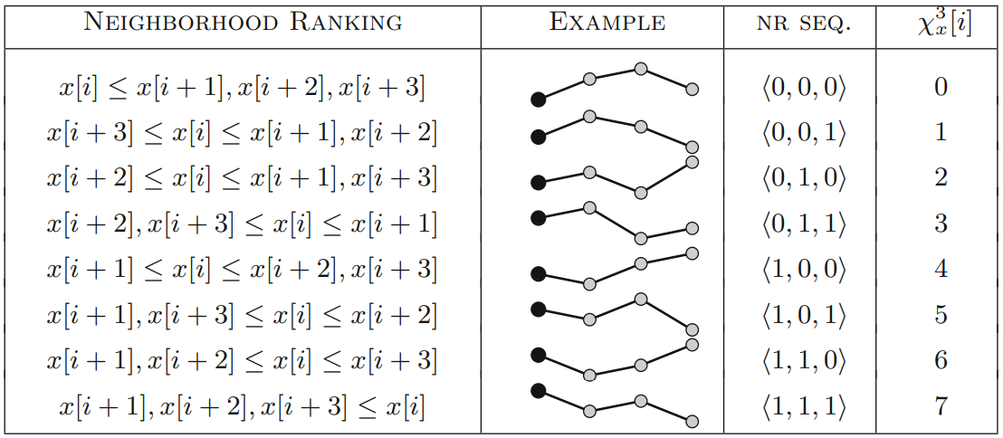


The Neighborhood Ranking Approach
q-neighborhood ranking sequences (table is 3-neighborhood)
$2^{q}$possible

Slide 7

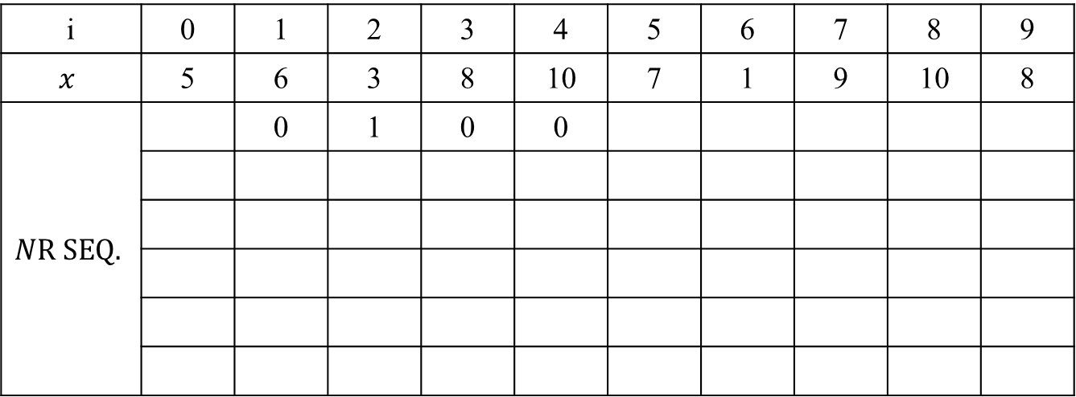
The Neighborhood Ranking Approach
$x$ = <5, 6, 3, 8, 10, 7, 1, 9, 10, 8>
4-neighborhood
i | 0 | 1 | 2 | 3 | 4 | 5 | 6 | 7 | 8 | 9
$$x$$ | 5 | 6 | 3 | 8 | 10 | 7 | 1 | 9 | 10 | 8
$$NR SEQ.$$ |  | 0 | 1 | 0 | 0
$β_{x}$(1, i)
$β_{x}$(2, i)
$β_{x}$(3, i)
$β_{x}$(4, i)
$β_{x}$(5, i)

Slide 8
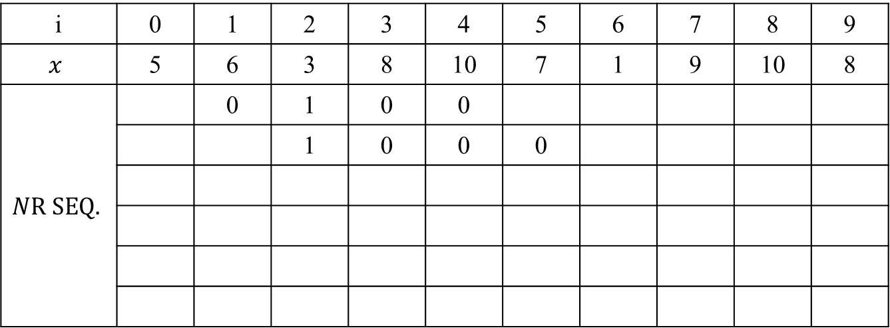
The Neighborhood Ranking Approach
$x$ = <5, 6, 3, 8, 10, 7, 1, 9, 10, 8>
4-neighborhood
i | 0 | 1 | 2 | 3 | 4 | 5 | 6 | 7 | 8 | 9
$$x$$ | 5 | 6 | 3 | 8 | 10 | 7 | 1 | 9 | 10 | 8
$$NR SEQ.$$ |  | 0 | 1 | 0 | 0
$β_{x}$(1, i) |  |  | 1 | 0 | 0 | 0
$β_{x}$(2, i)
$β_{x}$(3, i)
$β_{x}$(4, i)
$β_{x}$(5, i)

Slide 9
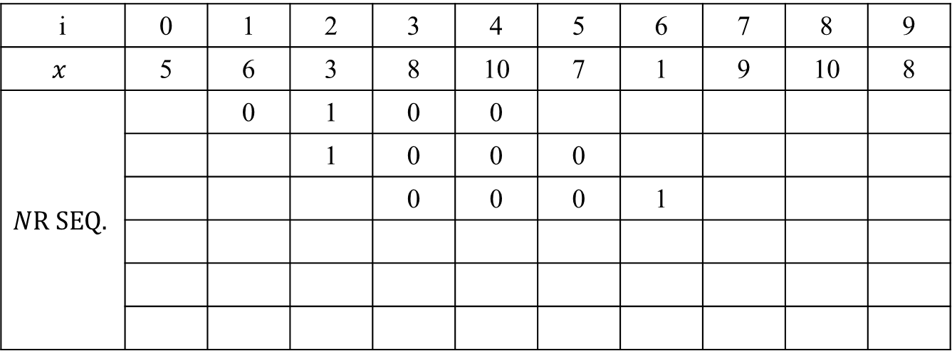
The Neighborhood Ranking Approach
$x$ = <5, 6, 3, 8, 10, 7, 1, 9, 10, 8>
4-neighborhood
i | 0 | 1 | 2 | 3 | 4 | 5 | 6 | 7 | 8 | 9
$$x$$ | 5 | 6 | 3 | 8 | 10 | 7 | 1 | 9 | 10 | 8
$$NR SEQ.$$ |  | 0 | 1 | 0 | 0
$β_{x}$(1, i) |  |  | 1 | 0 | 0 | 0
$β_{x}$(2, i) |  |  |  | 0 | 0 | 0 | 1
$β_{x}$(3, i)
$β_{x}$(4, i)
$β_{x}$(5, i)

Slide 10
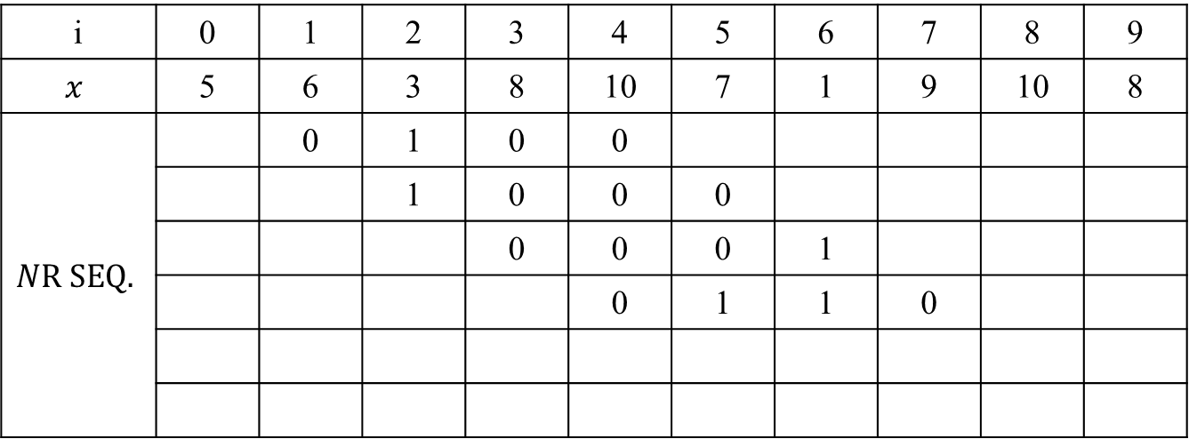
The Neighborhood Ranking Approach
$x$ = <5, 6, 3, 8, 10, 7, 1, 9, 10, 8>
4-neighborhood
i | 0 | 1 | 2 | 3 | 4 | 5 | 6 | 7 | 8 | 9
$$x$$ | 5 | 6 | 3 | 8 | 10 | 7 | 1 | 9 | 10 | 8
$$NR SEQ.$$ |  | 0 | 1 | 0 | 0
$β_{x}$(1, i) |  |  | 1 | 0 | 0 | 0
$β_{x}$(2, i) |  |  |  | 0 | 0 | 0 | 1
$β_{x}$(3, i) |  |  |  |  | 0 | 1 | 1 | 0
$β_{x}$(4, i)
$β_{x}$(5, i)

Slide 11
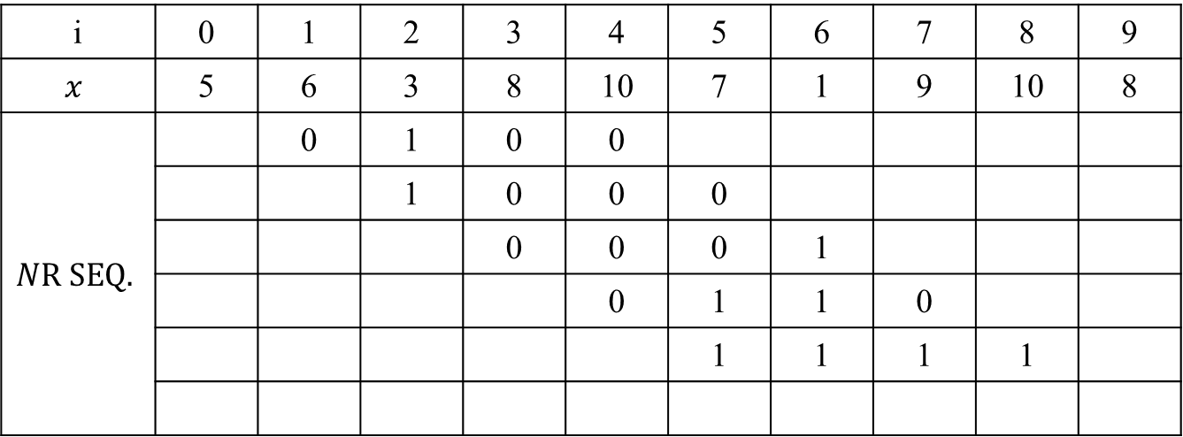
The Neighborhood Ranking Approach
$x$ = <5, 6, 3, 8, 10, 7, 1, 9, 10, 8>
4-neighborhood
i | 0 | 1 | 2 | 3 | 4 | 5 | 6 | 7 | 8 | 9
$$x$$ | 5 | 6 | 3 | 8 | 10 | 7 | 1 | 9 | 10 | 8
$$NR SEQ.$$ |  | 0 | 1 | 0 | 0
$β_{x}$(1, i) |  |  | 1 | 0 | 0 | 0
$β_{x}$(2, i) |  |  |  | 0 | 0 | 0 | 1
$β_{x}$(3, i) |  |  |  |  | 0 | 1 | 1 | 0
$β_{x}$(4, i) |  |  |  |  |  | 1 | 1 | 1 | 1
$β_{x}$(5, i)

Slide 12

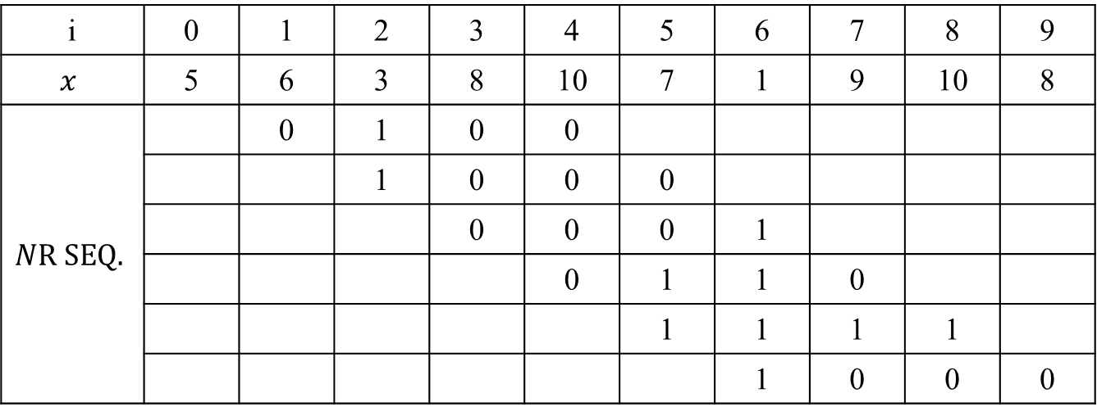
The Neighborhood Ranking Approach
$x$ = <5, 6, 3, 8, 10, 7, 1, 9, 10, 8>
4-neighborhood
$χ_{x}^{4}$ = <4, 8, 1, 6, 15, 8>
i | 0 | 1 | 2 | 3 | 4 | 5 | 6 | 7 | 8 | 9
$$x$$ | 5 | 6 | 3 | 8 | 10 | 7 | 1 | 9 | 10 | 8
$$NR SEQ.$$ |  | 0 | 1 | 0 | 0
$β_{x}$(1, i) |  |  | 1 | 0 | 0 | 0
$β_{x}$(2, i) |  |  |  | 0 | 0 | 0 | 1
$β_{x}$(3, i) |  |  |  |  | 0 | 1 | 1 | 0
$β_{x}$(4, i) |  |  |  |  |  | 1 | 1 | 1 | 1
$β_{x}$(5, i) |  |  |  |  |  |  | 1 | 0 | 0 | 0

Slide 13
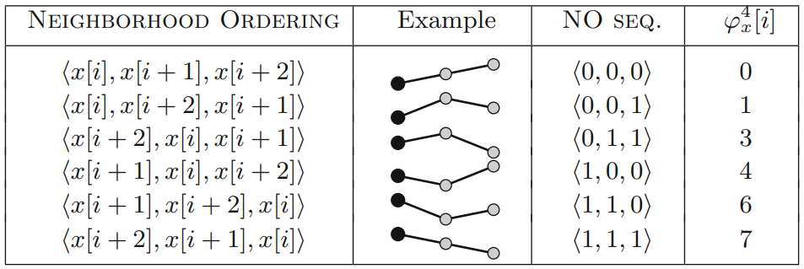

The Neighborhood Ordering Approach
q-neighborhood ordering sequences (table is 2-neighborhood)
$\left(q+1\right)!$ possible

Slide 14

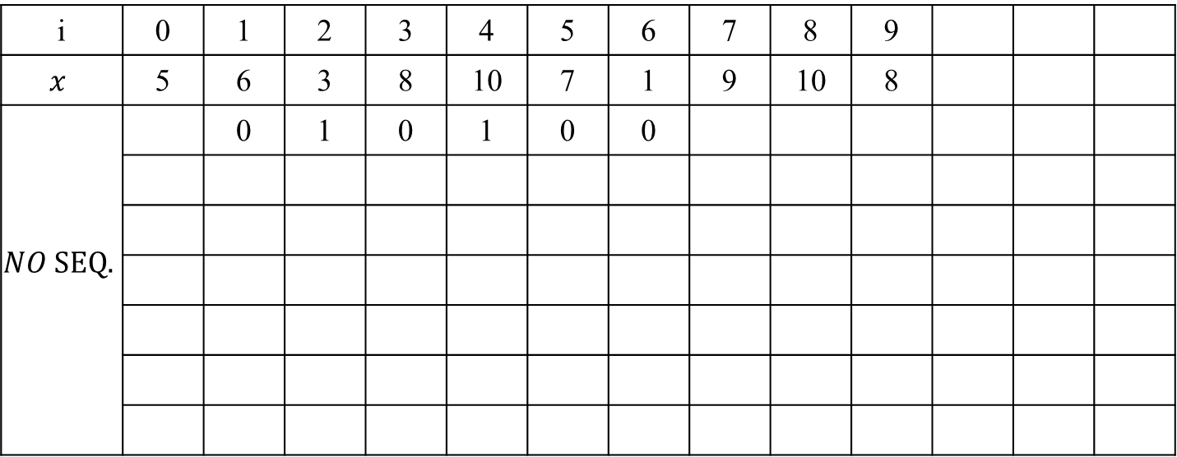
The Neighborhood Ordering Approach
$x$ = <5, 6, 3, 8, 10, 7, 1, 9, 10, 8>
3-neighborhood
i | 0 | 1 | 2 | 3 | 4 | 5 | 6 | 7 | 8 | 9
$$x$$ | 5 | 6 | 3 | 8 | 10 | 7 | 1 | 9 | 10 | 8
$$NO SEQ.$$ |  | 0 | 1 | 0 | 1 | 0 | 0

Slide 15
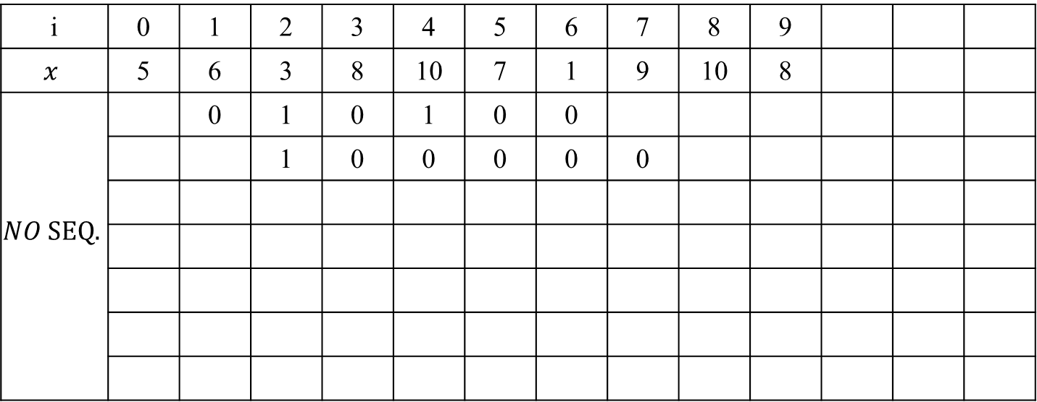
The Neighborhood Ordering Approach
$x$ = <5, 6, 3, 8, 10, 7, 1, 9, 10, 8>
3-neighborhood
i | 0 | 1 | 2 | 3 | 4 | 5 | 6 | 7 | 8 | 9
$$x$$ | 5 | 6 | 3 | 8 | 10 | 7 | 1 | 9 | 10 | 8
$$NO SEQ.$$ |  | 0 | 1 | 0 | 1 | 0 | 0
 |  |  | 1 | 0 | 0 | 0 | 0 | 0

Slide 16
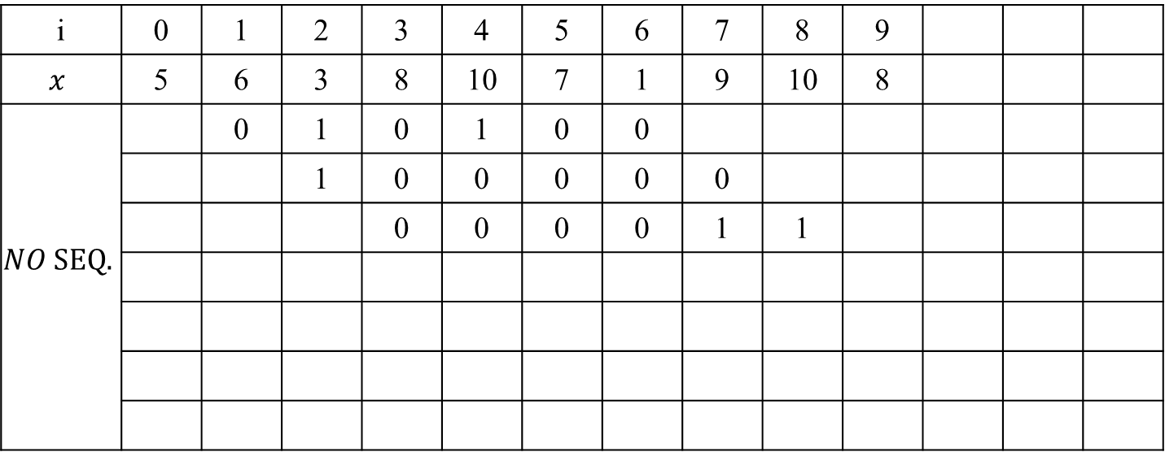
The Neighborhood Ordering Approach
$x$ = <5, 6, 3, 8, 10, 7, 1, 9, 10, 8>
3-neighborhood
i | 0 | 1 | 2 | 3 | 4 | 5 | 6 | 7 | 8 | 9
$$x$$ | 5 | 6 | 3 | 8 | 10 | 7 | 1 | 9 | 10 | 8
$$NO SEQ.$$ |  | 0 | 1 | 0 | 1 | 0 | 0
 |  |  | 1 | 0 | 0 | 0 | 0 | 0
 |  |  |  | 0 | 0 | 0 | 0 | 1 | 1

Slide 17
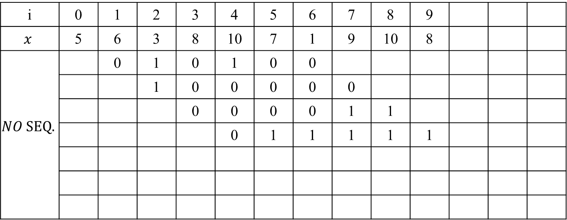
The Neighborhood Ordering Approach
$x$ = <5, 6, 3, 8, 10, 7, 1, 9, 10, 8>
3-neighborhood
i | 0 | 1 | 2 | 3 | 4 | 5 | 6 | 7 | 8 | 9
$$x$$ | 5 | 6 | 3 | 8 | 10 | 7 | 1 | 9 | 10 | 8
$$NO SEQ.$$ |  | 0 | 1 | 0 | 1 | 0 | 0
 |  |  | 1 | 0 | 0 | 0 | 0 | 0
 |  |  |  | 0 | 0 | 0 | 0 | 1 | 1
 |  |  |  |  | 0 | 1 | 1 | 1 | 1 | 1

Slide 18
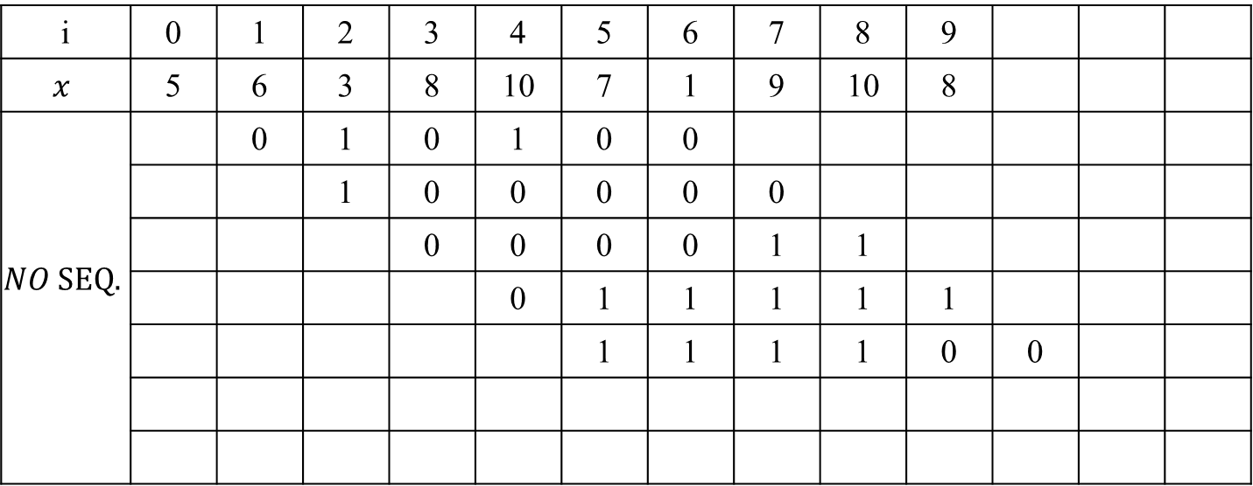
The Neighborhood Ordering Approach
$x$ = <5, 6, 3, 8, 10, 7, 1, 9, 10, 8>
3-neighborhood
i | 0 | 1 | 2 | 3 | 4 | 5 | 6 | 7 | 8 | 9
$$x$$ | 5 | 6 | 3 | 8 | 10 | 7 | 1 | 9 | 10 | 8
$$NO SEQ.$$ |  | 0 | 1 | 0 | 1 | 0 | 0
 |  |  | 1 | 0 | 0 | 0 | 0 | 0
 |  |  |  | 0 | 0 | 0 | 0 | 1 | 1
 |  |  |  |  | 0 | 1 | 1 | 1 | 1 | 1
 |  |  |  |  |  | 1 | 1 | 1 | 1 | 0 | 0

Slide 19
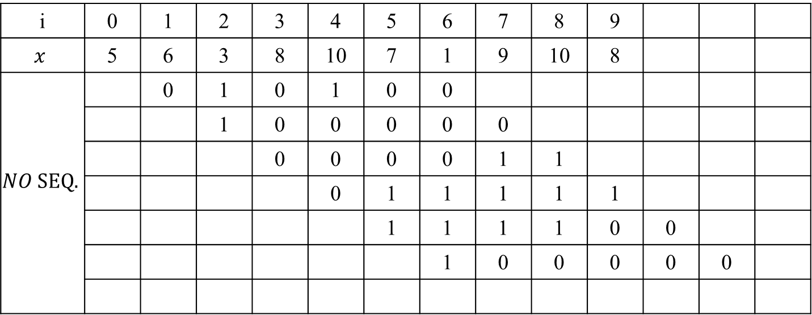
The Neighborhood Ordering Approach
$x$ = <5, 6, 3, 8, 10, 7, 1, 9, 10, 8>
3-neighborhood
i | 0 | 1 | 2 | 3 | 4 | 5 | 6 | 7 | 8 | 9
$$x$$ | 5 | 6 | 3 | 8 | 10 | 7 | 1 | 9 | 10 | 8
$$NO SEQ.$$ |  | 0 | 1 | 0 | 1 | 0 | 0
 |  |  | 1 | 0 | 0 | 0 | 0 | 0
 |  |  |  | 0 | 0 | 0 | 0 | 1 | 1
 |  |  |  |  | 0 | 1 | 1 | 1 | 1 | 1
 |  |  |  |  |  | 1 | 1 | 1 | 1 | 0 | 0
 |  |  |  |  |  |  | 1 | 0 | 0 | 0 | 0 | 0

Slide 20

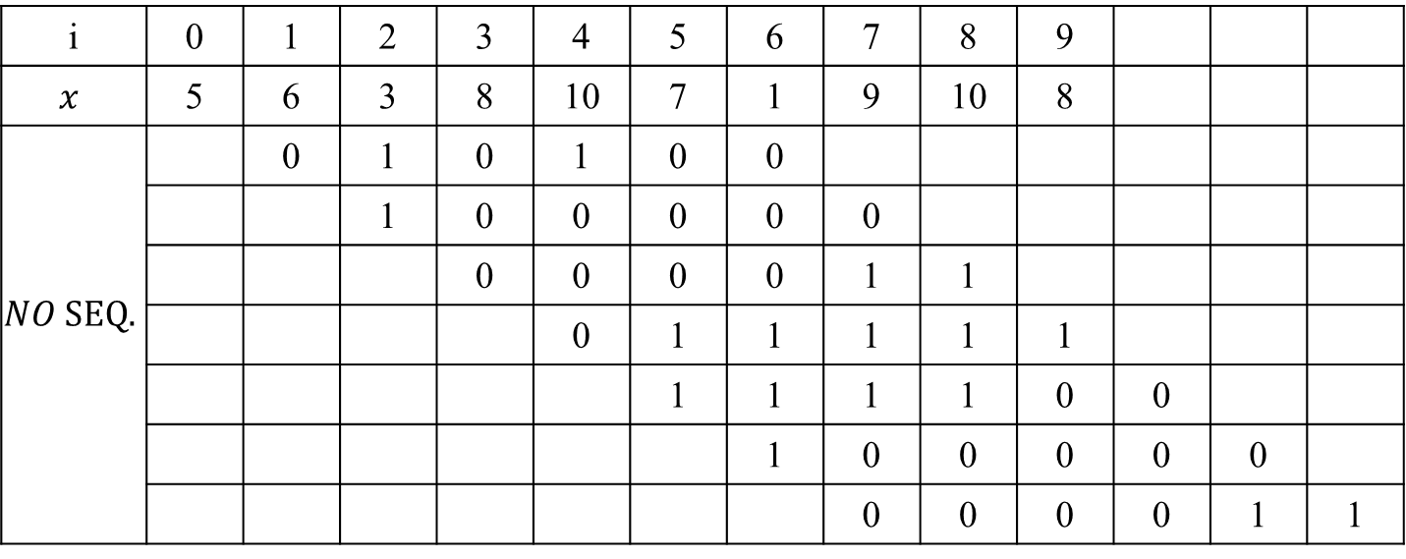
The Neighborhood Ordering Approach
$x$ = <5, 6, 3, 8, 10, 7, 1, 9, 10, 8>
3-neighborhood
$φ_{x}^{4}$ = <20, 32, 3, 31, 60, 32, 3>
i | 0 | 1 | 2 | 3 | 4 | 5 | 6 | 7 | 8 | 9
$$x$$ | 5 | 6 | 3 | 8 | 10 | 7 | 1 | 9 | 10 | 8
$$NO SEQ.$$ |  | 0 | 1 | 0 | 1 | 0 | 0
 |  |  | 1 | 0 | 0 | 0 | 0 | 0
 |  |  |  | 0 | 0 | 0 | 0 | 1 | 1
 |  |  |  |  | 0 | 1 | 1 | 1 | 1 | 1
 |  |  |  |  |  | 1 | 1 | 1 | 1 | 0 | 0
 |  |  |  |  |  |  | 1 | 0 | 0 | 0 | 0 | 0
 |  |  |  |  |  |  |  | 0 | 0 | 0 | 0 | 1 | 1

Slide 21
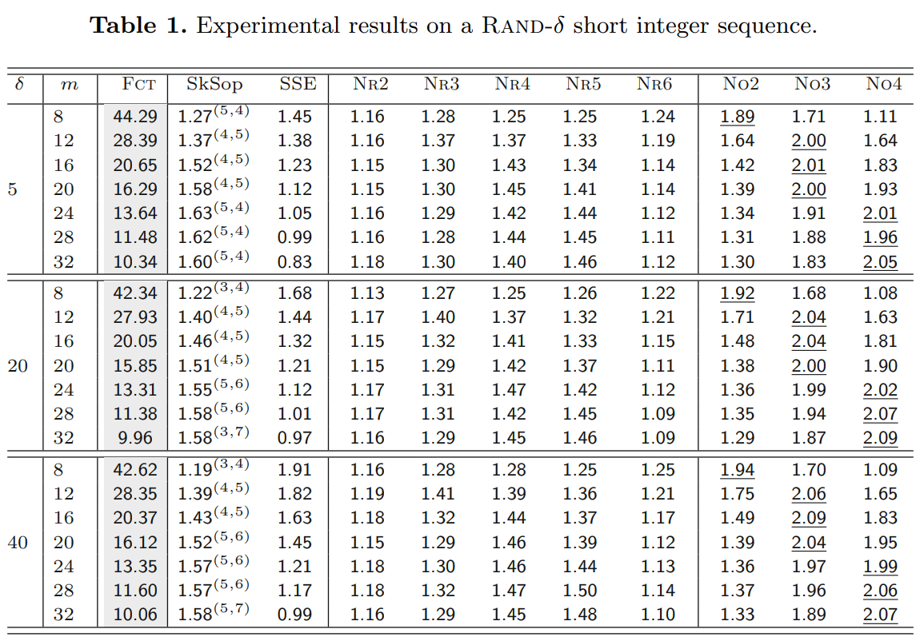
Experimental Evaluations

Slide 22
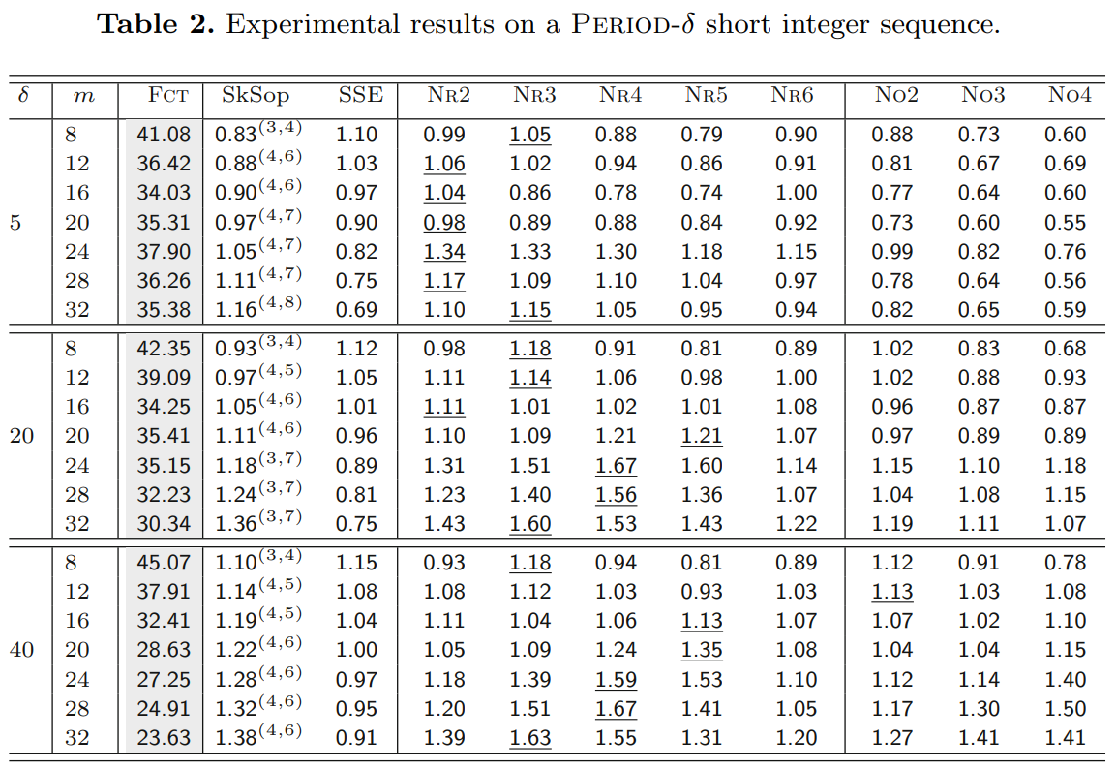
Experimental Evaluations

