Slide 1
Robotic Indoor Path Planning Using Dijkstra's Algorithm with Multi-Layer Dictionaries
Syed Abdullah Fadzli, Sani Iyal Abdulkadir, Mokhairi Makhtar, Azrul Amri Jamal, 2015 2nd International Conference on Information Science and Security (ICISS), Seoul, Korea.
Presenter: Yu-Chen Lin
Date: July 18, 2023

Slide 2
Abstract
Dijkstra's algorithm is a classic algorithm for finding the shortest path between two points due to its optimization capability. The adjacency matrix is the naive storage structure of the algorithm. This storage structure has limited the use of the algorithm as it expands large storage space. A multi-layer dictionary is proposed in this work to enhance the storage structure. Previously, the algorithm was used to optimize single parameter (such as distance, time and fuel) for movement between two places. The path computed using the classic Dijkstra's algorithm is the shortest; however, it may not be the most feasible. The algorithm needs to optimize other factors such as energy consumption and the degree of turns a robot need to take. Junction degree of difficulty function is introduced to further improve the output. It is defined as the degree of difficulty of the path between two points in an open environment. The experimental result shows that the proposed path planning method produced the most optimal path between two points when applied to a map of any indoor terrain.

Slide 3
Dijkstra
Dijkstra is a breadth-first-search (BFS) algorithm for finding the shortest paths from a single source vertex to all other vertices.
Dijkstra's algorithm is suitable for graphs with non-negative edge weights.

Slide 4
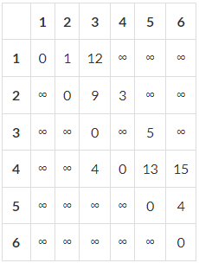
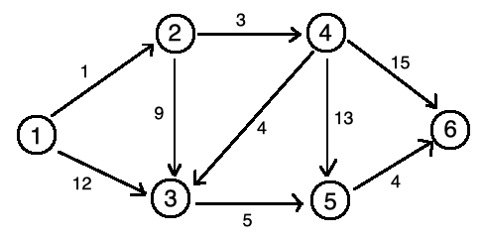

Dijkstra

Slide 5

Multi-Layer Dictionary
The multi-layer dictionary consists of two dictionaries and a list of data structure organized in hierarchical order.
The first dictionary maps each and every node to its neighboring nodes.
The second dictionary stores the path information of each neighboring pathway.

Slide 6
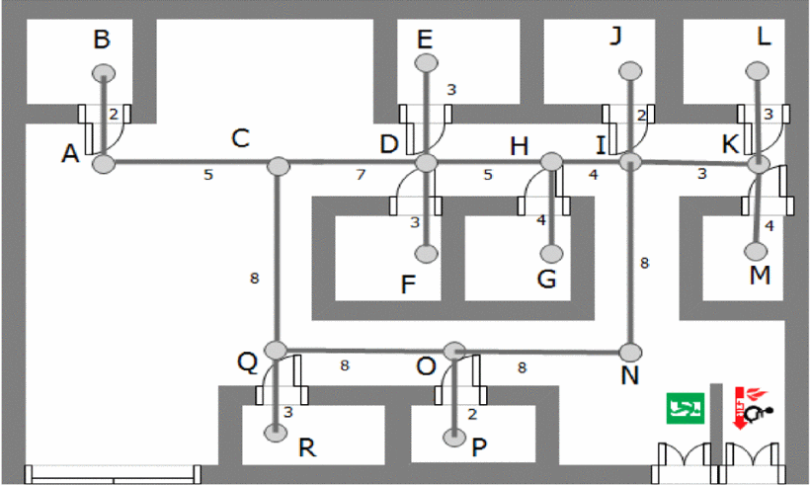
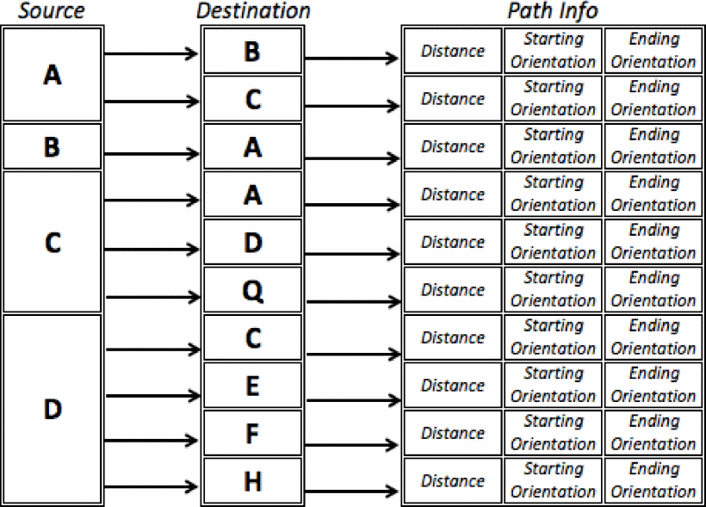

Slide 7
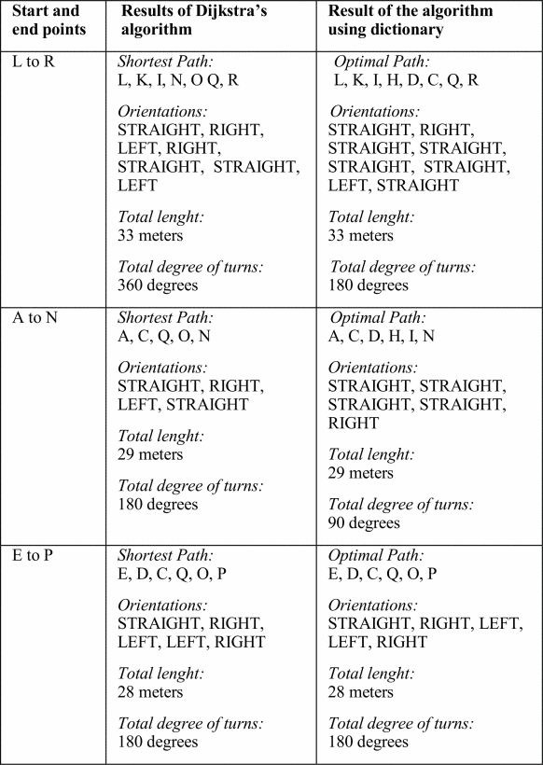
Experiment

Slide 8
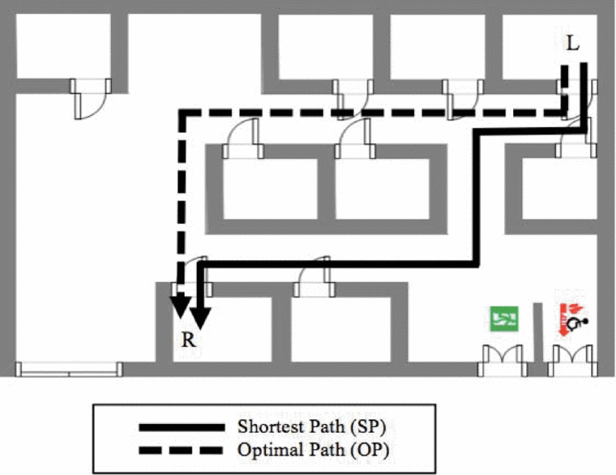









Slide 9
Conclusion
Different with the traditional algorithm, the proposed method considered both the length and the degree of difficulty of the path.

Slide 10
Multi-Robot Path Planning using Dijkstra’s Algorithm with Multi-layer Dictionaries
Saif Allah M. Abgenah, Azrul Amri Jamal, Syed Abdullah Fadzli. International Journal of Advanced Research in Computer and Communication Engineering Vol. 10, Issue 1.(January 2021). Malaysia.

Slide 11
Navigating Multi-Robots on The Floor Map
A function “coll” has been added in the single Robot algorithm to prevent collision.
If two Robots have the same optimal path then one Robot is assigned the optimal path while the other Robot is assigned the shortest path according to their priority.

Slide 12
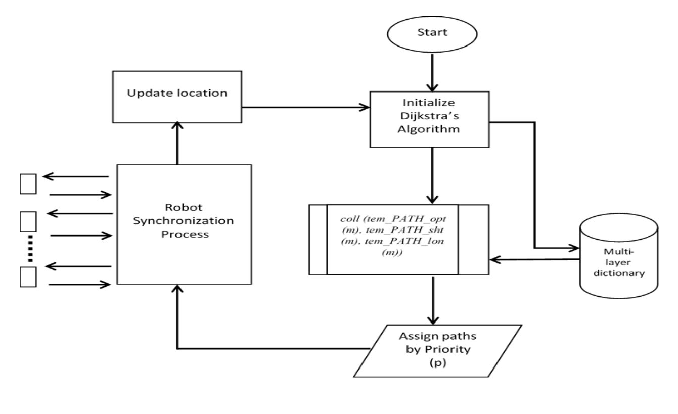

Slide 13
Conclusion
For multi-Robots, the navigation for each robot was priorities in the proposed method, therefore assigning each robot to path where it is clear to navigate which eliminates the chance of collision between robots while navigating from source to destination.

