Slide 1
Order-preserving matching
Jinil Kim, Peter Eades, Rudolf Fleischer, Seok-Hee Hong,
Costas S. Iliopoulos, Kunsoo Park, Simon J. Puglisi, Takeshi Tokuyama
Theoretical Computer Science 525(2014) 68–79
Presenter: Wen-Yu Chang
Date: Aug. 1, 2023

Slide 2
Abstract(1/2)
We introduce a new string matching problem called order-preserving matching on numeric strings, where a pattern matches a text if the text contains a substring of values whose relative orders coincide with those of the pattern. Order-preserving matching is applicable to many scenarios such as stock price analysis and musical melody matching in which the order relations should be matched instead of the strings themselves. Solving order-preserving matching is closely related to the representation of order relations of a numeric string.

Slide 3
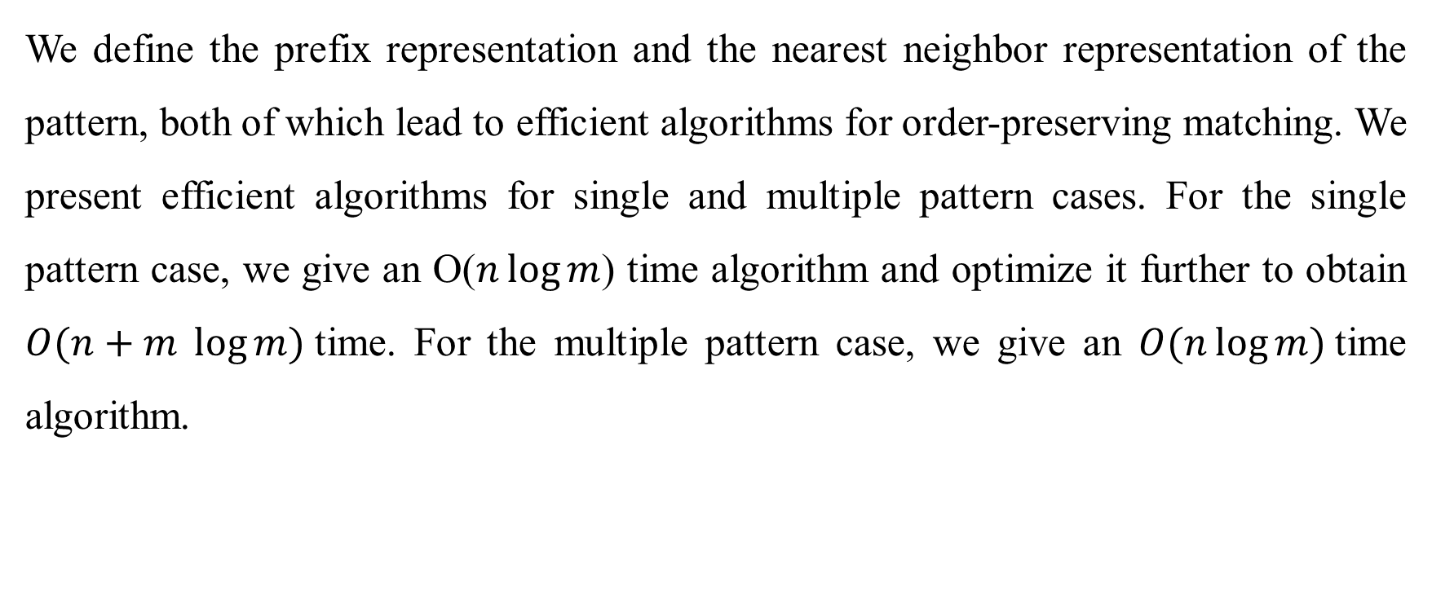
Abstract(2/2)
We define the prefix representation and the nearest neighbor representation of the pattern, both of which lead to efficient algorithms for order-preserving matching. We present efficient algorithms for single and multiple pattern cases. For the single pattern case, we give an O($n\log{m}$) time algorithm and optimize it further to obtain $O(n+m \log{m})$time. For the multiple pattern case, we give an $O(n\log{m})$time algorithm.

Slide 4
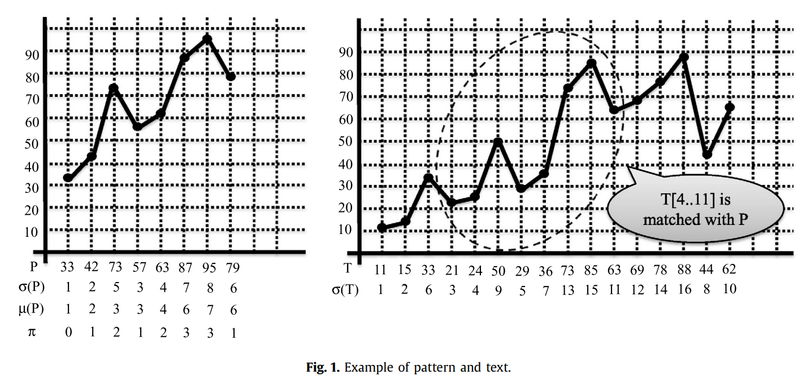

Order-Preserving Matching
$$σ\left(T\left[4..11\right]\right)=(1, 2, 5, 3, 4, 7, 8, 6)$$

Slide 5
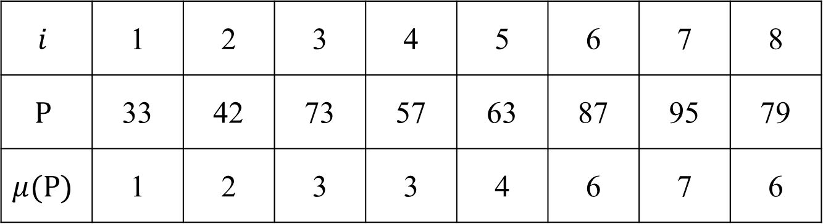
Prefix Representation
An alternative way of representing order relations is to use the rank of each character in the prefix by using the order-statistic tree.
$$i$$ | 1 | 2 | 3 | 4 | 5 | 6 | 7 | 8
$$P$$ | 33 | 42 | 73 | 57 | 63 | 87 | 95 | 79
$$μ(P)$$ | 1 | 2 | 3 | 3 | 4 | 6 | 7 | 6

Slide 6
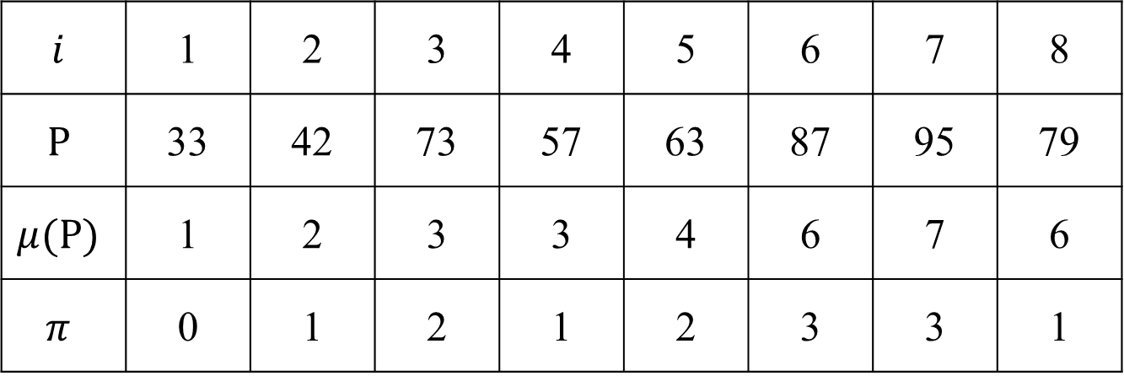
Failure Function
Based on the KMP algorithm
$$i$$ | 1 | 2 | 3 | 4 | 5 | 6 | 7 | 8
$$P$$ | 33 | 42 | 73 | 57 | 63 | 87 | 95 | 79
$$μ(P)$$ | 1 | 2 | 3 | 3 | 4 | 6 | 7 | 6
$$π$$ | 0 | 1 | 2 | 1 | 2 | 3 | 3 | 1

Slide 7
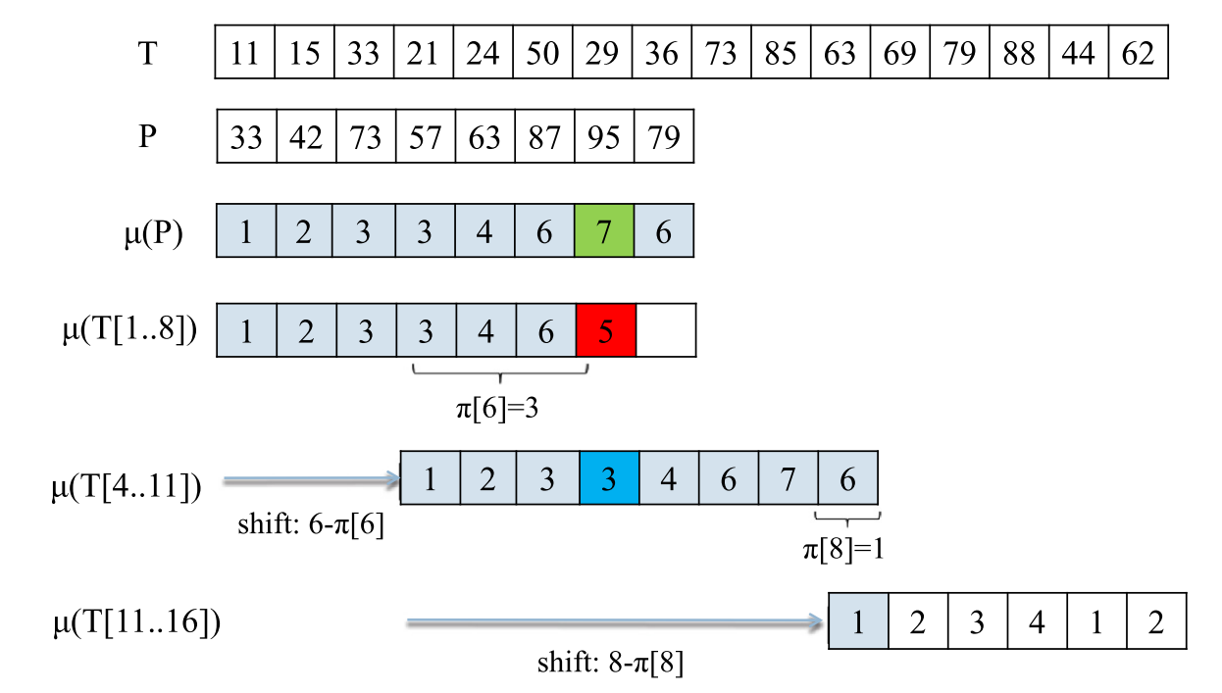
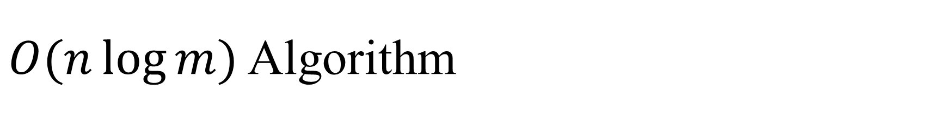


$O(n\log{m})$ Algorithm
$$i$$
1 | 2 | 3 | 4 | 5 | 6 | 7 | 8
0 | 1 | 2 | 1 | 2 | 3 | 3 | 1
$$π$$

Slide 8
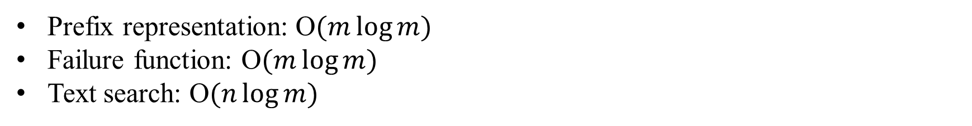
Time Complexity
Prefix representation: O$(m\log{m})$
Failure function: O$(m\log{m})$
Text search: O$(n\log{m})$

Slide 9
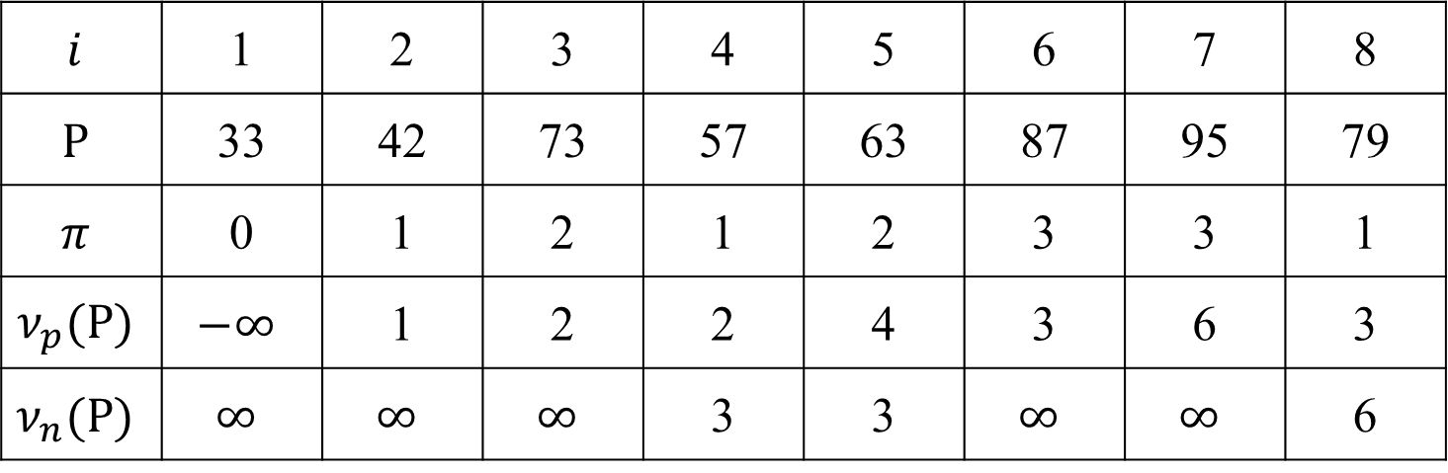
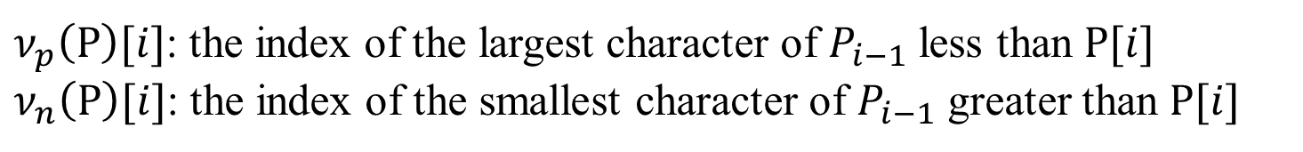
The Nearest Neighbor Representation
$$i$$ | 1 | 2 | 3 | 4 | 5 | 6 | 7 | 8
$$P$$ | 33 | 42 | 73 | 57 | 63 | 87 | 95 | 79
$$π$$ | 0 | 1 | 2 | 1 | 2 | 3 | 3 | 1
$$ν_{p}(P)$$ | $$−∞$$ | 1 | 2 | 2 | 4 | 3 | 6 | 3
$$ν_{n}(P)$$ | $$∞$$ | $$∞$$ | $$∞$$ | 3 | 3 | $$∞$$ | $$∞$$ | 6
$ν_{p}\left(P\right)[i]$: the index of the largest character of $P_{i−1}$ less than $P[i]$
$ν_{n}\left(P\right)[i]$: the index of the smallest character of $P_{i−1}$ greater than $P[i]$

Slide 10
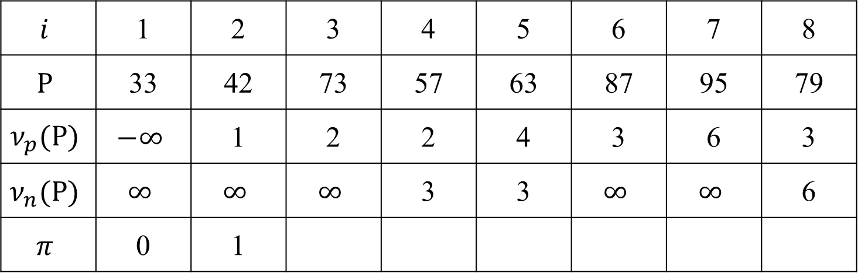
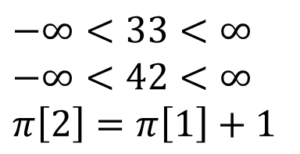
Failure Function
$$i$$ | 1 | 2 | 3 | 4 | 5 | 6 | 7 | 8
$$P$$ | 33 | 42 | 73 | 57 | 63 | 87 | 95 | 79
$$ν_{p}(P)$$ | $$−∞$$ | 1 | 2 | 2 | 4 | 3 | 6 | 3
$$ν_{n}(P)$$ | $$∞$$ | $$∞$$ | $$∞$$ | 3 | 3 | $$∞$$ | $$∞$$ | 6
$$π$$ | 0 | 1
$$−∞<33<∞$$
$$−∞<42<∞$$
$$π\left[2\right]=π\left[1\right]+1$$

Slide 11
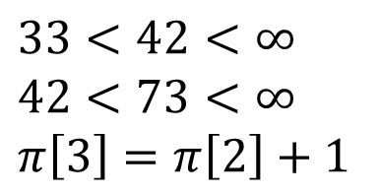
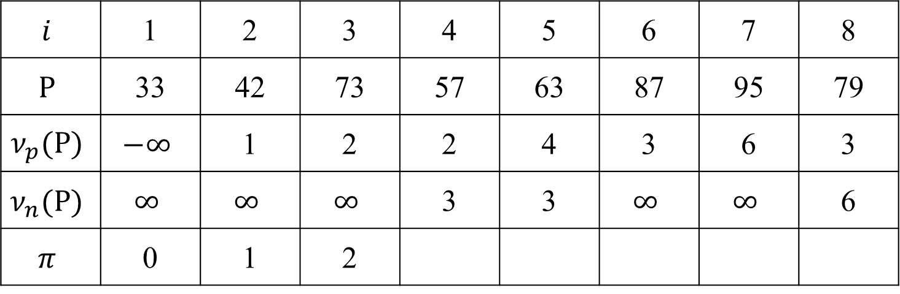
Failure Function
$$i$$ | 1 | 2 | 3 | 4 | 5 | 6 | 7 | 8
$$P$$ | 33 | 42 | 73 | 57 | 63 | 87 | 95 | 79
$$ν_{p}(P)$$ | $$−∞$$ | 1 | 2 | 2 | 4 | 3 | 6 | 3
$$ν_{n}(P)$$ | $$∞$$ | $$∞$$ | $$∞$$ | 3 | 3 | $$∞$$ | $$∞$$ | 6
$$π$$ | 0 | 1 | 2
$$33<42<∞$$
$$42<73<∞$$
$$π\left[3\right]=π\left[2\right]+1$$

Slide 12
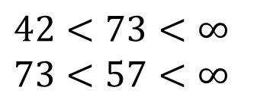
Failure Function
$$i$$ | 1 | 2 | 3 | 4 | 5 | 6 | 7 | 8
$$P$$ | 33 | 42 | 73 | 57 | 63 | 87 | 95 | 79
$$ν_{p}(P)$$ | $$−∞$$ | 1 | 2 | 2 | 4 | 3 | 6 | 3
$$ν_{n}(P)$$ | $$∞$$ | $$∞$$ | $$∞$$ | 3 | 3 | $$∞$$ | $$∞$$ | 6
$$π$$ | 0 | 1 | 2
$$42<73<∞$$
$$73<57<∞$$

Slide 13
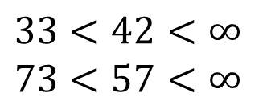
Failure Function
$$i$$ | 1 | 2 | 3 | 4 | 5 | 6 | 7 | 8
$$P$$ | 33 | 42 | 73 | 57 | 63 | 87 | 95 | 79
$$ν_{p}(P)$$ | $$−∞$$ | 1 | 2 | 2 | 4 | 3 | 6 | 3
$$ν_{n}(P)$$ | $$∞$$ | $$∞$$ | $$∞$$ | 3 | 3 | $$∞$$ | $$∞$$ | 6
$$π$$ | 0 | 1 | 2
$$33<42<∞$$
$$73<57<∞$$

Slide 14
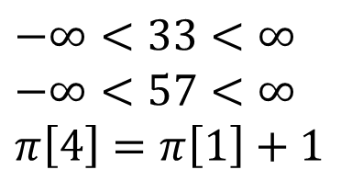

Failure Function
$$i$$ | 1 | 2 | 3 | 4 | 5 | 6 | 7 | 8
$$P$$ | 33 | 42 | 73 | 57 | 63 | 87 | 95 | 79
$$ν_{p}(P)$$ | $$−∞$$ | 1 | 2 | 2 | 4 | 3 | 6 | 3
$$ν_{n}(P)$$ | $$∞$$ | $$∞$$ | $$∞$$ | 3 | 3 | $$∞$$ | $$∞$$ | 6
$$π$$ | 0 | 1 | 2 | 1
$$−∞<33<∞$$
$$−∞<57<∞$$
$$π\left[4\right]=π\left[1\right]+1$$

Slide 15

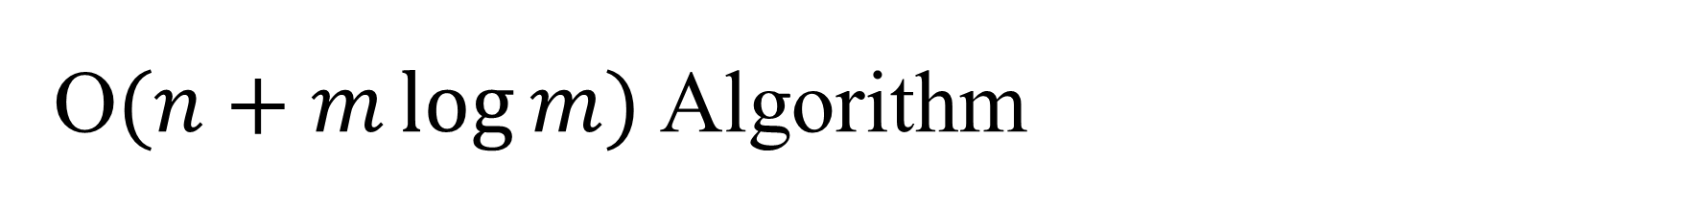





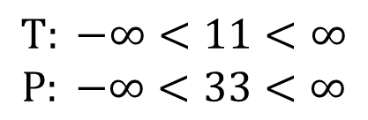
O$(n+m\log{m})$Algorithm
$$i$$
1 | 2 | 3 | 4 | 5 | 6 | 7 | 8
$$T[1..8]$$
$$ν_{p}(P)$$
$$−∞$$ | 1 | 2 | 2 | 4 | 3 | 6 | 3
$$∞$$ | $$∞$$ | $$∞$$ | 3 | 3 | $$∞$$ | $$∞$$ | 6
0 | 1 | 2 | 1 | 2 | 3 | 3 | 1
$$ν_{n}(P)$$
$$π$$
$$T: −∞<11<∞$$
$$P: −∞<33<∞$$

Slide 16





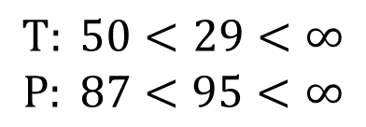
O$(n+m\log{m})$Algorithm
$$i$$
1 | 2 | 3 | 4 | 5 | 6 | 7 | 8
$$T[1..8]$$
$$ν_{p}(\text{P})$$
$$−∞$$ | 1 | 2 | 2 | 4 | 3 | 6 | 3
$$∞$$ | $$∞$$ | $$∞$$ | 3 | 3 | $$∞$$ | $$∞$$ | 6
0 | 1 | 2 | 1 | 2 | 3 | 3 | 1
$$ν_{n}(\text{P})$$
$$π$$
$$\text{T}: 50<29<∞$$
$$\text{P}: 87<95<∞$$

Slide 17
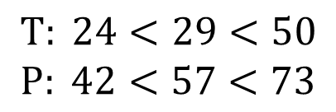




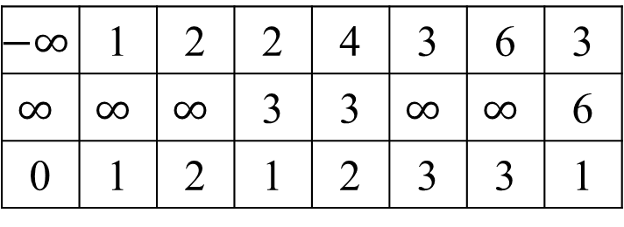
O$(n+m\log{m})$Algorithm
$$i$$
1 | 2 | 3 | 4 | 5 | 6 | 7 | 8
$$T[4..11]$$
$$ν_{p}(\text{P})$$
$$−∞$$ | 1 | 2 | 2 | 4 | 3 | 6 | 3
$$∞$$ | $$∞$$ | $$∞$$ | 3 | 3 | $$∞$$ | $$∞$$ | 6
0 | 1 | 2 | 1 | 2 | 3 | 3 | 1
$$ν_{n}(\text{P})$$
$$π$$
$$\text{T}: 24<29<50$$
$$\text{P}: 42<57<73$$

Slide 18
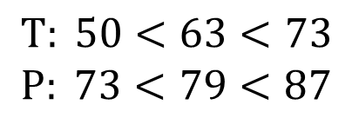



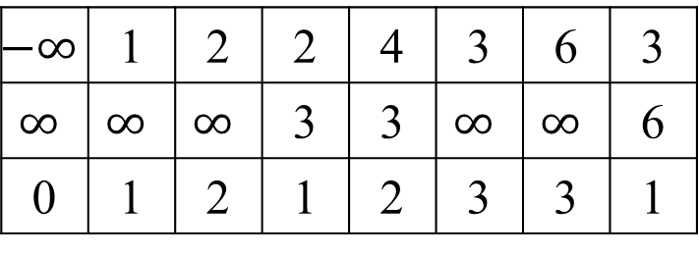
O$(n+m\log{m})$Algorithm
$$i$$
1 | 2 | 3 | 4 | 5 | 6 | 7 | 8
$$T[4..11]$$
$$ν_{p}(\text{P})$$
$$−∞$$ | 1 | 2 | 2 | 4 | 3 | 6 | 3
$$∞$$ | $$∞$$ | $$∞$$ | 3 | 3 | $$∞$$ | $$∞$$ | 6
0 | 1 | 2 | 1 | 2 | 3 | 3 | 1
$$ν_{n}(\text{P})$$
$$π$$
$$\text{T}: 50<63<73$$
$$\text{P}: 73<79<87$$

Slide 19
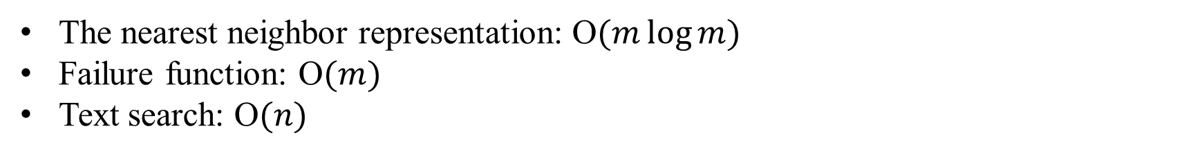
Time Complexity
The nearest neighbor representation: O$(m\log{m})$
Failure function: O$(m)$
Text search: O$(n)$

Slide 20
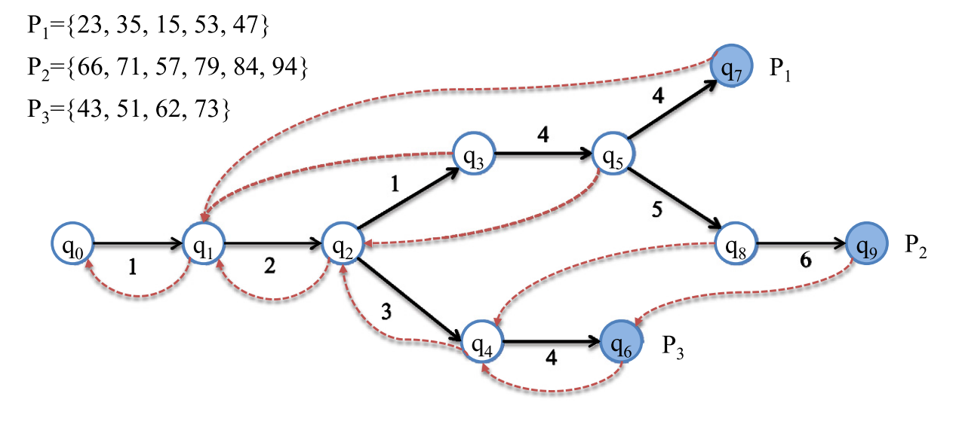
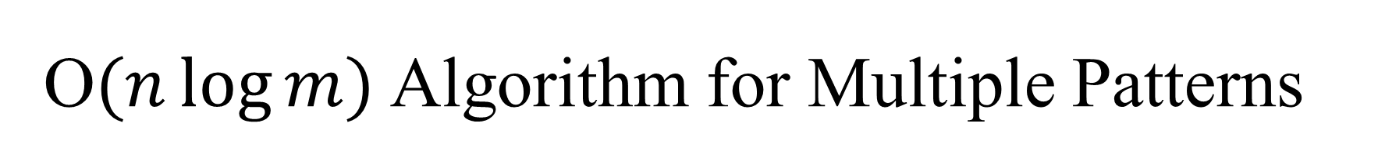

O$(n\log{m})$Algorithm for Multiple Patterns
Based on the Aho–Corasick algorithm
$$μ\left(P_{1}\right)=\left(1, 2, 1, 4, 4\right)$$
$$μ\left(P_{2}\right)=\left(1, 2, 1, 4, 5, 6\right)$$
$$μ\left(P_{3}\right)=\left(1, 2, 3, 4\right)$$

Slide 21

Failure Function
Find the longest proper suffix which is a proper prefix of some pattern.
$$μ\left(P\left[q_{2}\right]\right)\left[1..2\right]=\left(1, 2\right)$$
$$μ\left(P_{1}\left[3..4\right]\right)=(1, 2)$$
$$π\left[{\text{q}}_{5}\right]={\text{q}}_{2}$$

Slide 22

Failure Function
Find the longest proper suffix which is a proper prefix of some pattern.
$$μ\left(P\left[q_{4}\right]\right)\left[1..3\right]=\left(1, 2, 3\right)$$
$$μ\left(P_{2}\left[3..5\right]\right)=(1, 2, 3)$$
$$π\left[{\text{q}}_{8}\right]={\text{q}}_{4}$$

Slide 23


O$(n\log{m})$Algorithm for Multiple Patterns
$$T=\{12, 47, 11, 15, 10, 32, 41, 46\}$$
$$μ\left(P_{1}\right)=\left(1, 2, 1, 4, 4\right)$$
$$μ\left(P_{2}\right)=\left(1, 2, 1, 4, 5, 6\right)$$
$$μ\left(P_{3}\right)=\left(1, 2, 3, 4\right)$$

Slide 24
Time Complexity
Prefix representation: O$(m\log{m})$
Failure function: O$(m\log{m})$
Text search: O$(n\log{m})$

