Slide 1
A Fast and Practical Bit-vector Algorithm for the Longest Common Subsequence Problem
Maxime Crochemore, Costas S. Iliopoulos, Yoan J. Pinzon, James F. Reid
Information Processing Letters, Volume 80, Issue 6, 31 December 2001, Pages 279-285
Presenter: Guan-Jie Chen
Date: Aug. 1, 2023

Slide 2
Abstract
This paper presents a new practical bit-vector algorithm for solving the well-known Longest Common Subsequence (LCS) problem. Given two strings of length m and n, n⩾m, we present an algorithm which determines the length p of an LCS in O(nm/w) time and O(m/w) space, where w is the number of bits in a machine word. This algorithm can be thought of as column-wise “parallelization” of the classical dynamic programming approach.

Slide 3
Abstract (cont.)
Our algorithm is very efficient in practice, where computing the length of an LCS of two strings can be done in linear time and constant (additional/working) space by assuming that m⩽w.

Slide 4
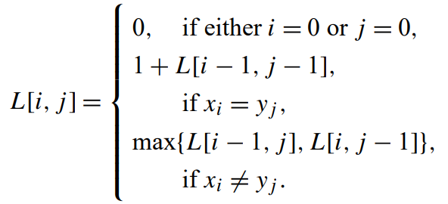
LLCS

Slide 5
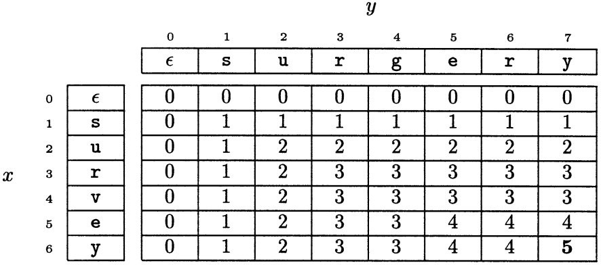
LLCS (cont.)
x = “survey”, y = “surgery”

Slide 6
Time / Space Complexity
O(nm)

Slide 7
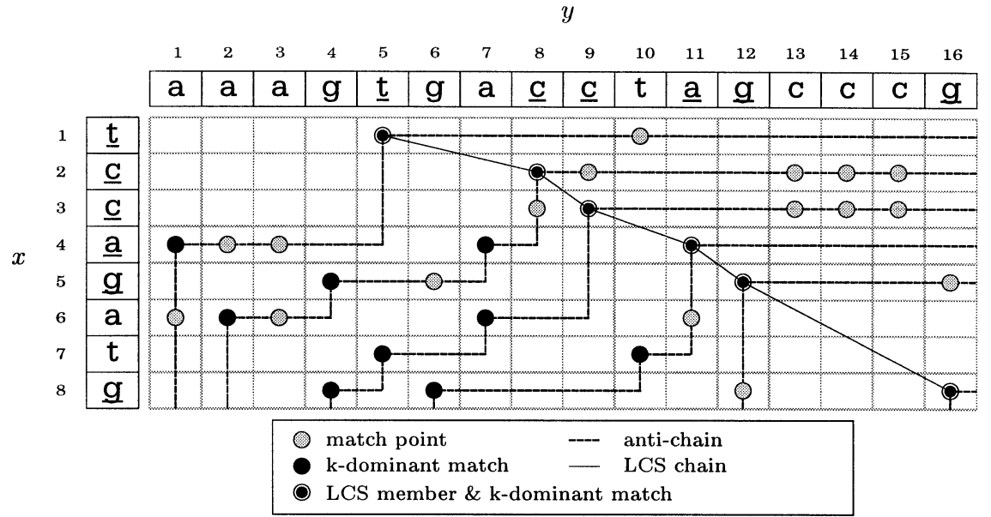
K-dominant
1
2
3
4
5
6
Notes:
ＬＣＳ可以轉換成找最長鏈的問題
前篇論文給予關係Ｒ（偏序關係）
兩組ｍａｔｃｈ［ｉ，ｊ］Ｒ［ｉ’，ｊ’］等價於ｉ＜ｉ’且ｊ＜ｊ’，可以形成一條鏈
圖中的虛線為反鏈（一個ｓｅｔ中的ｍａｔｃｈｅｓ無法互相產生Ｒ關係的話，便形成反鏈）
黑點為在ｋ－ｄｏｍｉｎａｎｔ時可以延伸出最佳解的ｍａｔｃｈ
灰點的發展性一定比黑點差

Slide 8
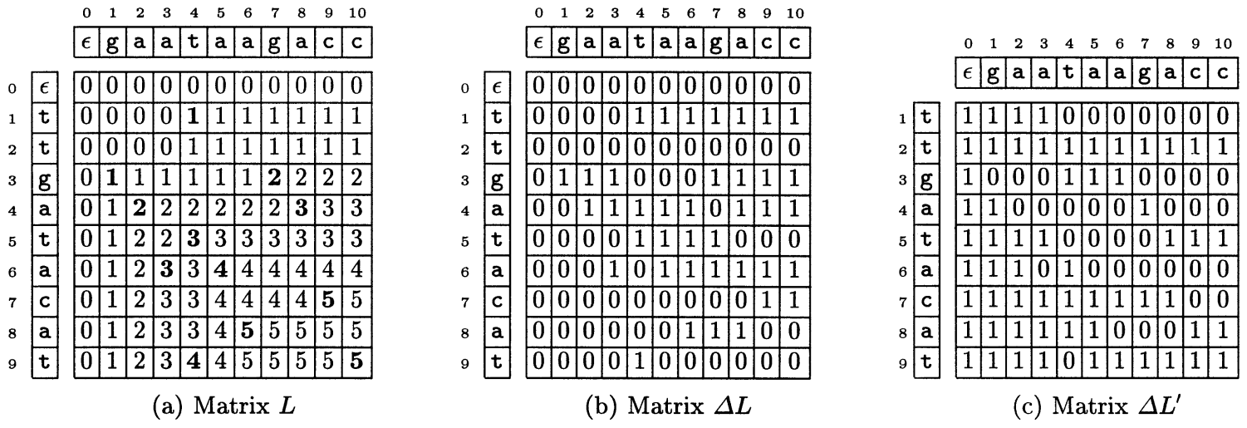
K-dominant (cont.)
Notes:
∆Ｌ：與上一個ｒｏｗ元素的差值
看某ｃｏｌｕｍｎ有幾個１，就知道ＬＬＣＳ是多少

Slide 9
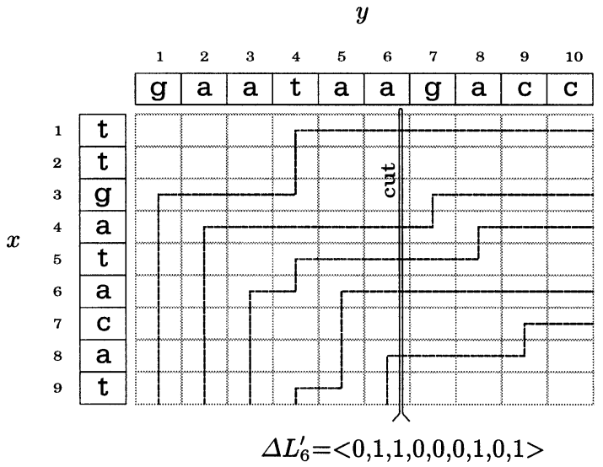
K-dominant (cont.)
0
1
1
0
0
0
1
0
1
Notes:
０表示ｋ－ｄｏｍｉｎａｎｔ的邊界通過此位置
反之為１
為何最後一格是１但有邊界通過
這邊紀錄的０應該是有＂新＂的ｋ－ｄｏｍｉｎａｎｔ經過（即代表ＬＬＣＳ＋１）
因為倒數兩格同為５－ｄｏｍｉｎａｎｔ，ＬＬＣＳ沒有增加

Slide 10
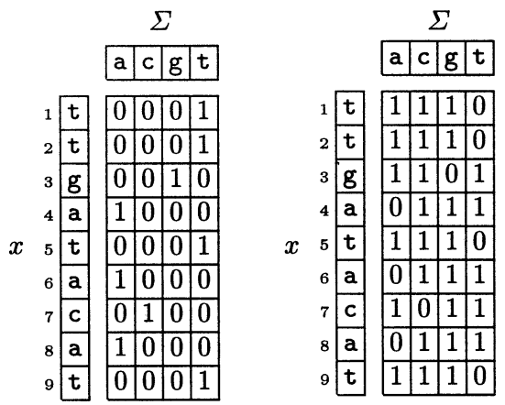
CIPR
Preprocessing

Slide 11
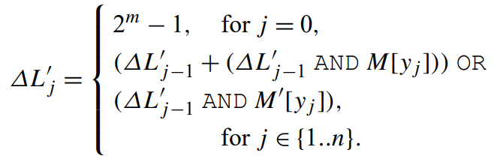
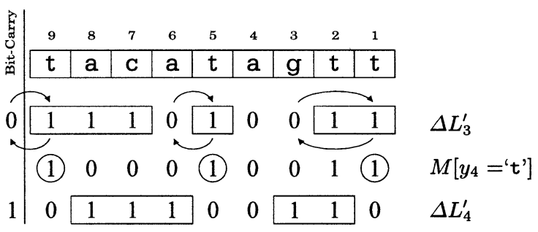
CIPR (cont.)

Slide 12
 | ∆L’₀ | M[y₁=’g’] | ∆L’₁ | M[y₂=’a’] | ∆L’₂ | M[y₃=’a’] | ∆L’₃
1 | 1 | 0 | 1 | 0 | 1 | 0 | 1
2 | 1 | 0 | 1 | 0 | 1 | 0 | 1
3 | 1 | 1 | 0 | 0 | 0 | 0 | 0
4 | 1 | 0 | 1 | 1 | 0 | 1 | 0
5 | 1 | 0 | 1 | 0 | 1 | 0 | 1
6 | 1 | 0 | 1 | 1 | 1 | 1 | 0
7 | 1 | 0 | 1 | 0 | 1 | 0 | 1
8 | 1 | 0 | 1 | 1 | 1 | 1 | 1
9 | 1 | 0 | 1 | 0 | 1 | 0 | 1
carry

Slide 13
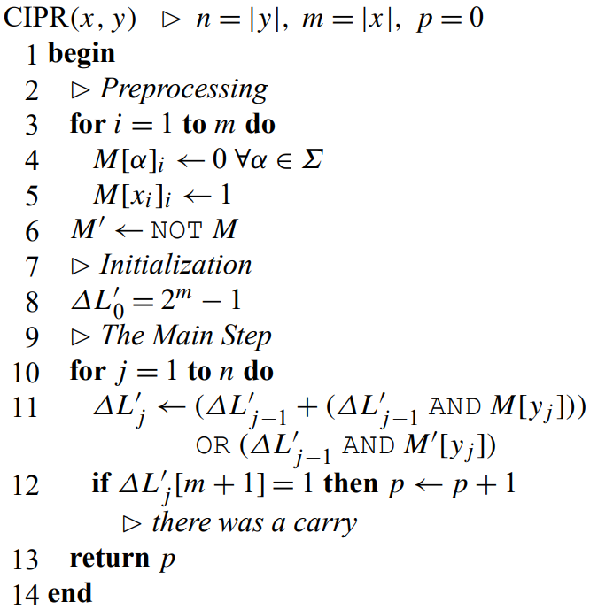

Slide 14
CIPR (cont.)
LLCS =
number of carries
number of ‘0’ in ∆L’_{n}

Slide 15
Time Complexity
O(nm/w) in general case
O(m/w) per column

Slide 16
Time Complexity (cont.)
O(n) if using a bit-parallel formula under the assumption that m⩽w
O(1) per column

Slide 17
Thanks for your patience

