Slide 1
A Hybrid A* Path Planning Algorithm Based on Multi-objective Constraints
Yu Zhao, Yongqiang Zhu, Pingxia Zhang, Qi Gao, Xue Han
(August 2022). 2022 Asia Conference on Advanced Robotics, Automation, and Control Engineering (ARACE). Qingdao, China.
Presenter: Yu-Chen Lin
Date: August 1, 2023

Slide 2
Abstract
To provide a safe, smooth and efficient global planning path for nonholonomic mobile robots. Aiming at the problems of traditional hybrid A∗ algorithm in path planning, such as approaching obstacles, unnecessary reversing and redundant turning, a multi-objective constraint method based on hybrid A∗ algorithm is proposed. To speed up the path planning, the heuristic function is dynamically weighted and the overall path cost function is designed. The path planning experiments are carried out in ROS (Robot Operation System) simulation environment and actual environment respectively, and the results show that. The hybrid A∗ algorithm with multi-objective constraints increases the minimum distance between the robot and obstacles by more than 50%, reduces the unnecessary times of reversing and turning, and reduces the total running time by 14.2% on average, thus improving the navigation efficiency of the mobile robot.

Slide 3

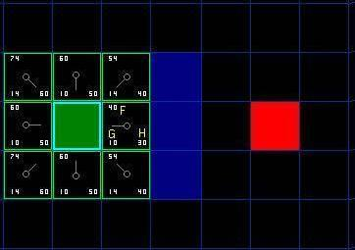
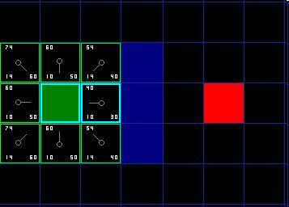
A* Algorithm
Search towards the most promising states
Notes:
A Star 算法是一種在遊戲開發過程中很常用的自動尋路算法。它有較好的性能和準確度。A * 搜索算法（A* search algorithm）是一種在圖形平面上，有多個節點的路徑，求出最低通過成本的算法。常用於遊戲中的 NPC 的移動計算，或網絡遊戲的 BOT 的移動計算上。該算法綜合了最佳優先搜索和 Dijkstra 算法的優點：在進行啓發式搜索提高算法效率的同時，可以保證找到一條基於啓發函數的最優路徑

Slide 4
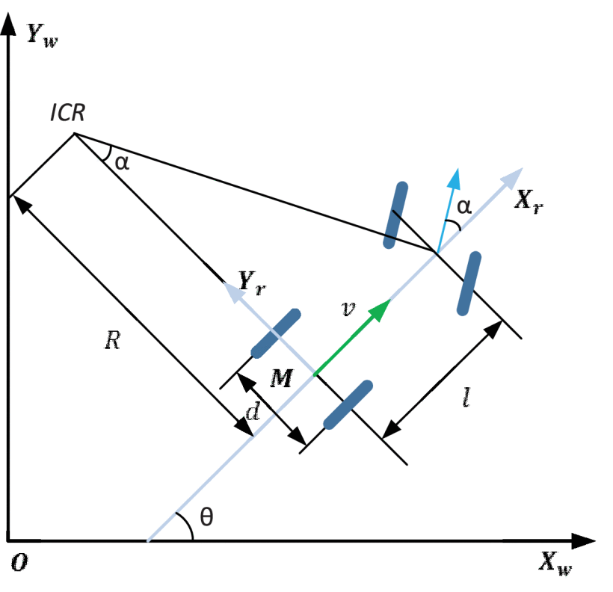


Ackermann's Principle

Slide 5
Reeds-Shepp Curve
Shortest path
Motion constraints
Composite motions
Notes:
機器人或車輛在二維平面上從一個點到達另一個點的最短轉向路徑。
沒有障礙物的最短路徑 最短路徑：Reeds-Shepp曲線是從起點到目標點的最短轉向路徑。這意味著在滿足特定運動約束的前提下，機器人或車輛需要轉彎的次數和角度總和最小化。

Slide 6
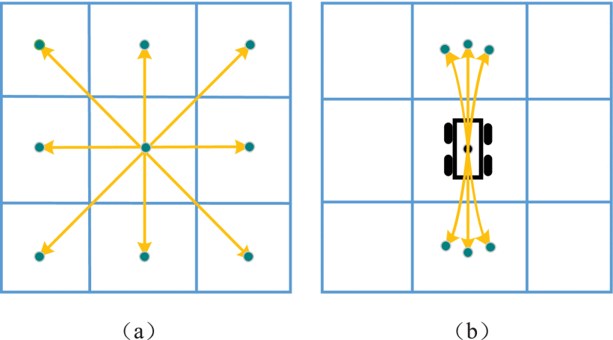
Hybrid A* Algorithm

Slide 7
Improved Hybrid A∗ Algorithm
Multi-objective Constraints
Heuristic Function
Path Optimization Post-processing

Slide 8
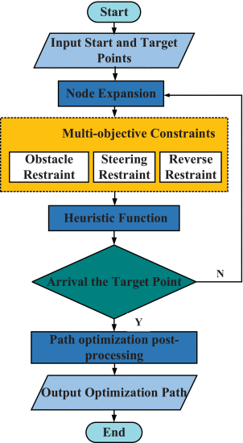





Notes:
d ₁為當前節點到目標節點的距離，d ₂為起始節點到目標節點的距離 一開始，機器人位於起點，此時對機器人的姿勢要求較低，演算法以最快的速度展開節點的擴展，犧牲了最佳路徑的搜索來獲得更快的搜索速度 接近終點時，演算法傾向於選擇最佳路徑，雖然這會導致搜索速度減慢。 X _{i}是路徑節點的坐標，0 _{i}是最近障礙物的坐標 ki是任意節點的曲率 Xi=Xi−Xi−1兩個相鄰節點組成的方向向量，通過路徑中所有節點的方向向量變化進行懲罰，從而減少轉向，提高路徑的平滑度。

Slide 9
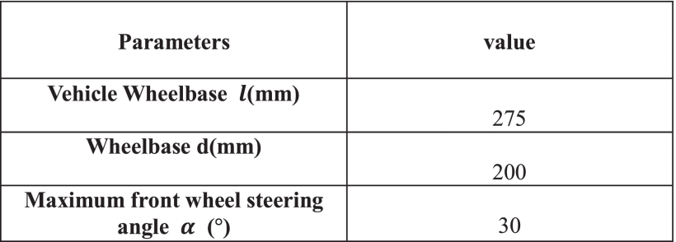
Experiment

Slide 10
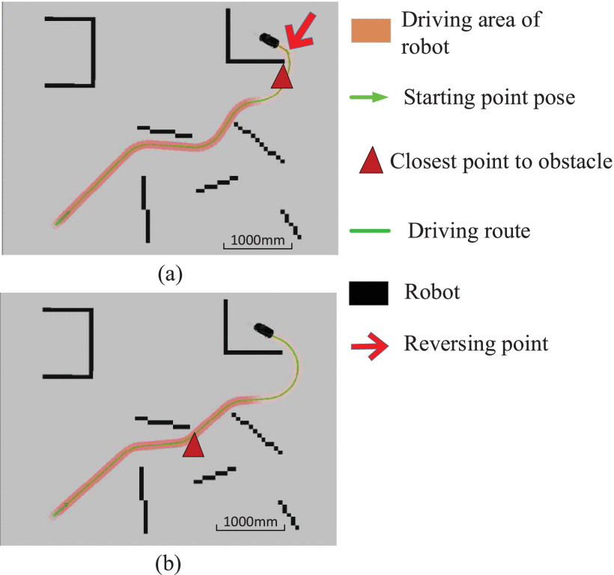
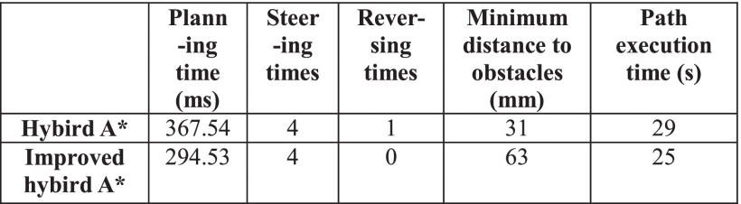

Slide 11
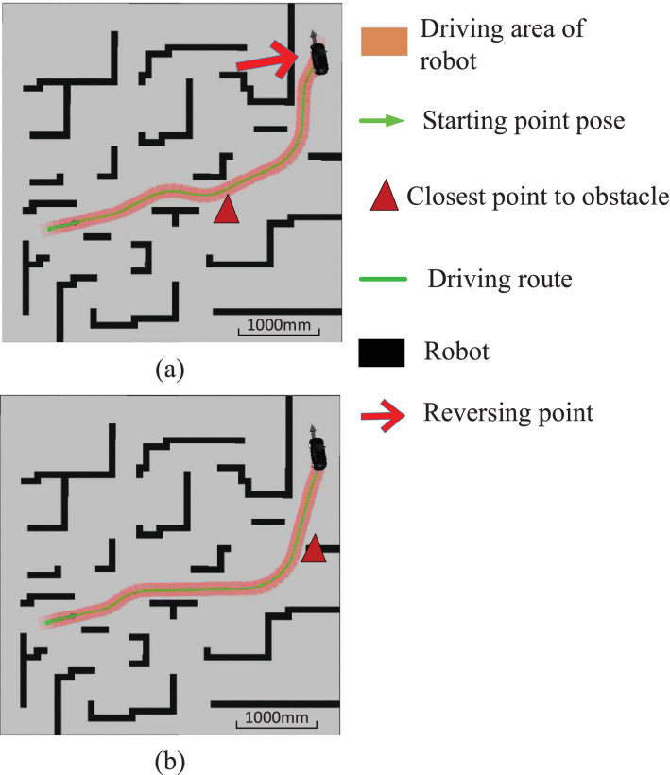
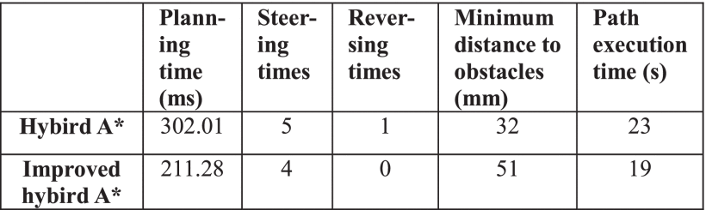

Slide 12
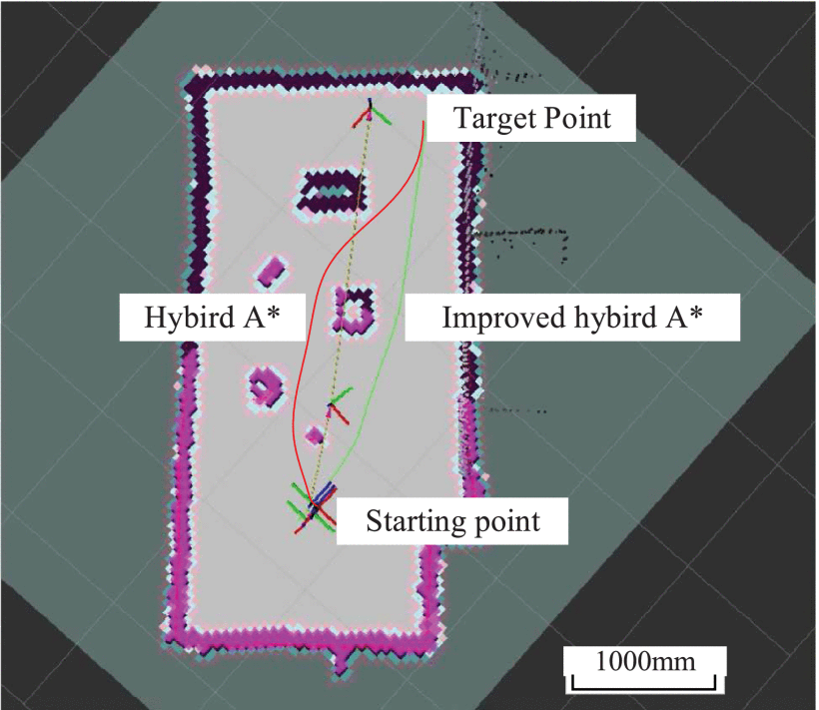

Slide 13
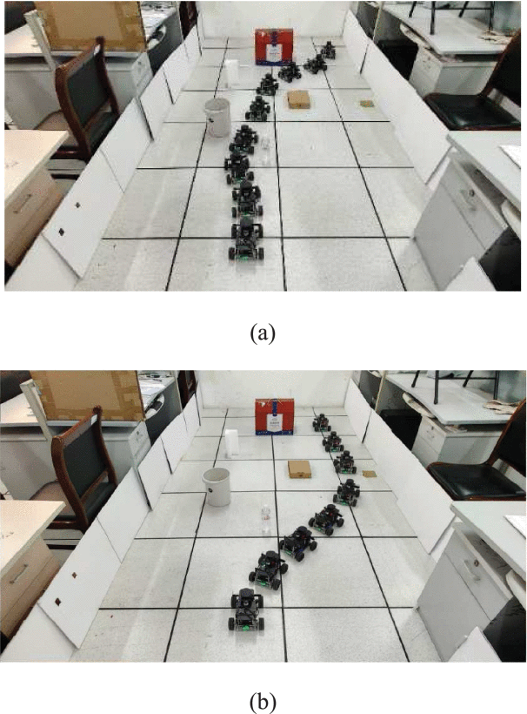
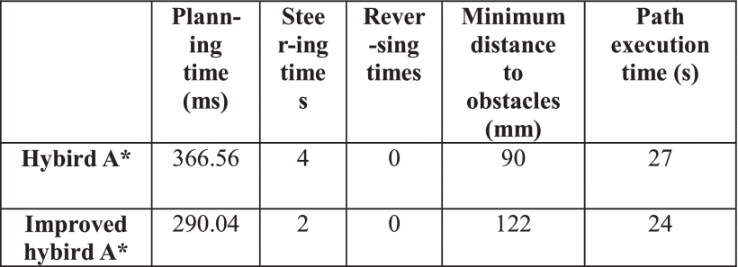

Slide 14
Conclusion
The improved hybrid A∗ algorithm tends to be smoother, reduces the number of non-essential turns and reversals, and maintains a suitable distance from obstacles.
Reduces the total running time by 14.2% in three scenarios and improves the efficiency of mobile robot navigation.

