Slide 1
N-queens problem by efficient non-backtracking algorithm using local search, heuristics and Tabu search elements
Noam Brown, Tuomas Sandholm
The 10th International Conference on Digital Technologies 2014,
July 2014, Zilina, Slovakia
Presenter: Yen-Yu Chen
Date: Aug. 29, 2023
Notes:
2014 年第十屆數字技術國際會議
斯洛伐克 日利納

Slide 2
Abstract
This paper presents an efficient algorithm using Local search, various heuristics and Tabu search elements, which is capable to find solution for huge instances of the n-queens (hundreds of millions n). The algorithm returns random solutions in short time even on an ordinary personal computer. There is no other faster algorithm in n-Queens bibliography as our presented algorithm so far.

Slide 3


N-queens problem
Notes:
N-queens 問題就是在nxn的棋盤上擺上n個皇后，每個皇后所在的行列對角線都不能有其他皇后
N-queens問題可能有不只一種擺法，這篇論文的目標是找到任一個解

Slide 4
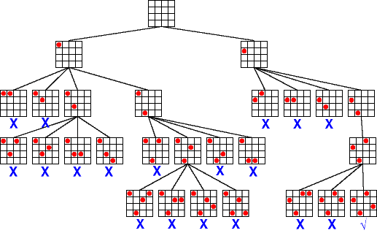
Backtracking
Time: O(n!)
Notes:
N-queens的經典方法是靠backracking來做
一行一行慢慢把皇后擺上棋盤，如果皇后跟原本棋盤上的皇后衝突，就會在這一行上換個位置擺，如果全部都試過，那就會回到上一步
這個方法的時間複雜度是n!

Slide 5
Representation of Queen Placement
Q = <2, 4, 1, 3>
 | ⚫
 |  |  | ⚫
⚫
 |  | ⚫
Notes:
這個演算法用一個一維陣列Q表示整個棋盤的布局，棋盤上永遠都有n個皇后
Q的第k的元素代表棋盤第k個row的皇后在哪一個位置
如果Q的長度是n裡面的內容一定是1到n的排列，不會有重複的，因為如果兩個row的皇后在同一個位置，那一定違反N-queen的規則
用這種表示方法一個row只會有一個皇后一個column也只會有一個皇后，所以只要看對角線有沒有衝突

Slide 6
Conflict
C = 4
⚫
 |  |  | ⚫
 |  | ⚫
 | ⚫
Notes:
heuristic
Conflict去判斷
有多少組會互相衝突的皇后

Slide 7
Row Exchange
C = 4
C = 1
⚫
 |  |  | ⚫
 |  | ⚫
 | ⚫
 |  |  | ⚫
⚫
 |  | ⚫
 | ⚫
Notes:
論文想用local search的方式解決問題，每一步都只會做一點小變動，定義走一步就是做row exchange
好處:維持表示法

Slide 8
Empty Diagonal
⚫
 |  |  | ⚫
 |  | ⚫
 | ⚫

Slide 9
Algorithm Step
Pre-Shaking : only one time
Shaking : loop until find solution
Notes:
Pre-Shaking 只做一次 用簡單的步驟把衝突數量降到一定程度
Shaking 一直循環

Slide 10

Pre-Shaking(1/2)
Q = <1, 2, 3, … , n>
Q = shuffle(Q)
conflicts among the queens after this step of the algorithm is $\frac{2}{3}n$ approximatel

Slide 11
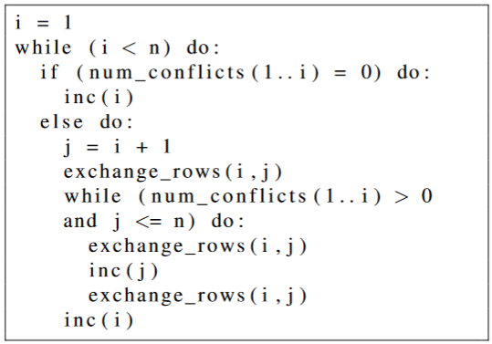
Pre-Shaking(2/2)
Notes:
檢查1到n有沒有衝突

Slide 12
Pre-Shaking(2/2)
 | ⚫
⚫
 |  |  | ⚫
 |  | ⚫
C = 0
Notes:
只會往左上跟右上的對角線看
(只考慮那一行跟換完的那一行)

Slide 13
Pre-Shaking(2/2)
 | ⚫
⚫
 |  |  | ⚫
 |  | ⚫
C = 1

Slide 14
Pre-Shaking(2/2)
 | ⚫
⚫
 |  |  | ⚫
 |  | ⚫
C = 1

Slide 15
Pre-Shaking(2/2)
 | ⚫
 |  |  | ⚫
⚫
 |  | ⚫
C = 0

Slide 16
Pre-Shaking(2/2)
 | ⚫
 |  |  | ⚫
⚫
 |  | ⚫
C = 0

Slide 17
Pre-Shaking(2/2)
 | ⚫
 |  |  | ⚫
⚫
 |  | ⚫
C = 0

Slide 18
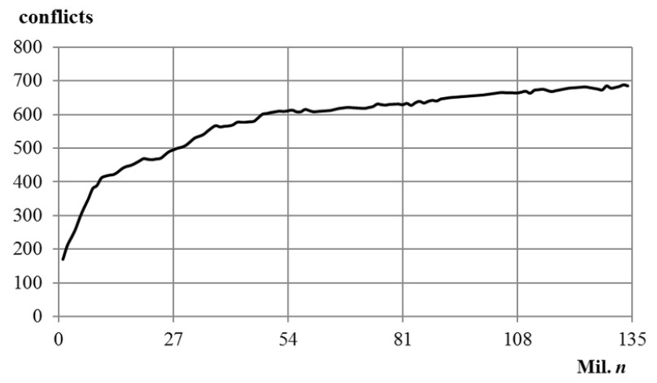
Conflicts after Pre-shaking
Notes:
Conflicts縮減為常數
1億3500萬

Slide 19
Shaking (1/5)
 | ⚫
 |  |  |  |  | ⚫
 |  |  | ⚫
⚫
 |  |  |  |  |  |  | ⚫
 |  | ⚫
 |  |  |  |  |  | ⚫
 |  |  |  | ⚫
1
m = <8, 4, 6, 1, 3, 5>
0
1
2
1
2
0
3
Notes:
把每一個row的Conflict數量都算出來，然後排序

Slide 20
Shaking (2/5)
 | ⚫
 |  |  |  |  | ⚫
 |  |  | ⚫
⚫
 |  |  |  |  |  |  | ⚫
 |  | ⚫
 |  |  |  |  |  | ⚫
 |  |  |  | ⚫
1
m = <8, 4, 6, 1, 3, 5>
0
1
2
1
2
0
3
Notes:
隨機 找一行，如果是empty diagonal那就可以row_exchange
會找完全部

Slide 21
Shaking (2/5)
 | ⚫
 |  |  |  |  | ⚫
 |  |  | ⚫
⚫
 |  |  |  |  |  |  | ⚫
 |  | ⚫
 |  |  |  | ⚫
 |  |  |  |  |  | ⚫
1
m = <8, 4, 6, 1, 3, 5>
0
1
2
1
2
0
0

Slide 22
Shaking (2/5)
 | ⚫
 |  |  |  |  | ⚫
 |  |  | ⚫
⚫
 |  |  |  |  |  |  | ⚫
 |  | ⚫
 |  |  |  | ⚫
 |  |  |  |  |  | ⚫
1
m = <8, 4, 6, 1, 3, 5>
0
1
1
0
1
0
0

Slide 23
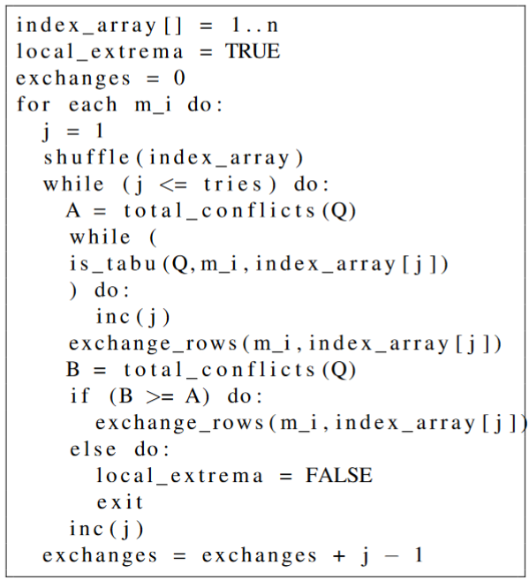
Shaking (3/5)
Notes:
已經找不到empty_diagonal
設定一個數量，每行可以隨機找tries數量的其他行，如果total conflict減少，就可以交換
B>=A 新的衝突較多

Slide 24
Shaking (3/5)
 | ⚫
 |  |  |  |  | ⚫
 |  |  | ⚫
⚫
 |  |  |  |  |  |  | ⚫
 |  | ⚫
 |  |  |  | ⚫
 |  |  |  |  |  | ⚫
1
m = <1, 3, 4, 6>
0
tries = 3
1
1
0
1
0
0

Slide 25
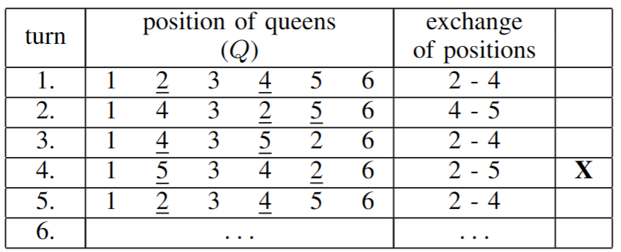
Tabu list

Slide 26
Shaking (4/5)
If the algorithm was unable to perform the exchange, which would decrease the number of total conflicts among the queens (in previous two steps), we suppose we got stuck in local extrema. Subsequently we accept such exchange of already performed exchanges (also in previous two steps), which ensures the lowest increase of total conflicts. That is the way the algorithm uses to escape from the extrema.

Slide 27
Shaking (1/5)
Continue with step 1.

Slide 28
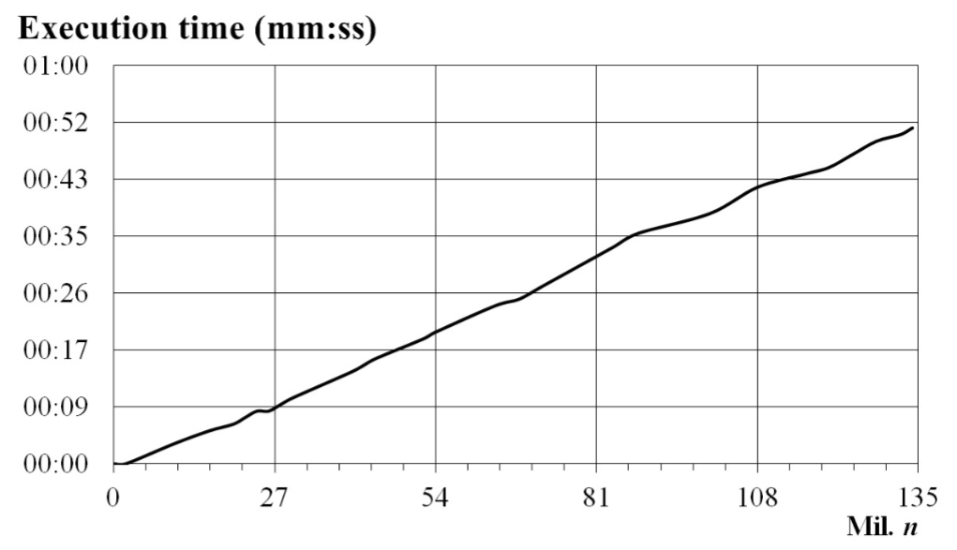
Conclusion

