Slide 1
Quantitative Comparison of Flood Fill and Modified Flood Fill Algorithms
George Law
International Journal of Computer Theory and Engineering,
Vol. 5, No. 3, June 2013
Presenter: Guan-Jie Chen
Date: Aug. 29, 2023

Slide 2
Abstract
Flood fill algorithm has won first places in the international micromouse competitions. To save computation time, the modified flood fill algorithm is often coded. Yet, the literature search reveals the scarcity of the quantitative details of the two algorithms. This article attempts to discuss their differences and uses Maze-solver simulator to collect and tabulate the maze-run statistics for various popular mazes. It will discuss these statistics and various aspects of the flood fill algorithm modifications.

Slide 3
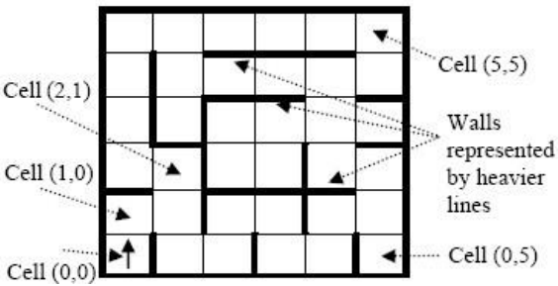
IEEE Micromouse Competition
The maze always has the east wall at the starting cell (0, 0)
The first move is always upward (north)

Slide 4
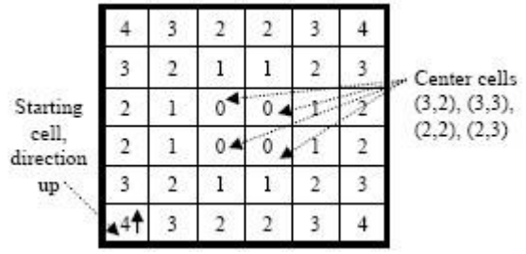
Flood Fill Algorithm
Notes:
數字為這個格子到終點的距離

Slide 5
Flood Fill Algorithm (cont.)
 |  | 0 | 0
 |  | 0 | 0

Slide 6
Flood Fill Algorithm (cont.)
 |  | 1 | 1
 | 1 | 0 | 0 | 1
 |  | 0 | 0 | 1
 |  | 1 | 1

Slide 7
Flood Fill Algorithm (cont.)
 |  | 2 | 2
 | 2 | 1 | 1 | 2
 | 1 | 0 | 0 | 1 | 2
 |  | 0 | 0 | 1 | 2
 |  | 1 | 1 | 2
 |  | 2 | 2

Slide 8
Flood Fill Algorithm (cont.)
 | 3 | 2 | 2 | 3
 | 2 | 1 | 1 | 2 | 3
 | 1 | 0 | 0 | 1 | 2
 |  | 0 | 0 | 1 | 2
 |  | 1 | 1 | 2 | 3
 | 3 | 2 | 2 | 3

Slide 9
Flood Fill Algorithm (cont.)
4 | 3 | 2 | 2 | 3 | 4
 | 2 | 1 | 1 | 2 | 3
 | 1 | 0 | 0 | 1 | 2
 |  | 0 | 0 | 1 | 2
 | 4 | 1 | 1 | 2 | 3
 | 3 | 2 | 2 | 3 | 4

Slide 10
Flood Fill Algorithm (cont.)
4 | 3 | 2 | 2 | 3 | 4
5 | 2 | 1 | 1 | 2 | 3
 | 1 | 0 | 0 | 1 | 2
 | 5 | 0 | 0 | 1 | 2
5 | 4 | 1 | 1 | 2 | 3
 | 3 | 2 | 2 | 3 | 4

Slide 11
Flood Fill Algorithm (cont.)
4 | 3 | 2 | 2 | 3 | 4
5 | 2 | 1 | 1 | 2 | 3
6 | 1 | 0 | 0 | 1 | 2
6 | 5 | 0 | 0 | 1 | 2
5 | 4 | 1 | 1 | 2 | 3
6 | 3 | 2 | 2 | 3 | 4

Slide 12
Flood Fill Algorithm (cont.)
Notes:
數字為這個格子到終點的距離

Slide 13
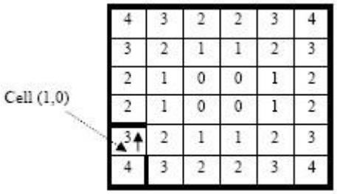
Flood Fill Algorithm (cont.)

Slide 14
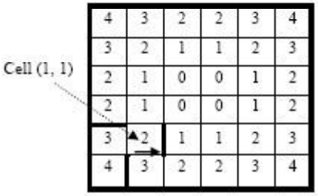
Flood Fill Algorithm (cont.)

Slide 15
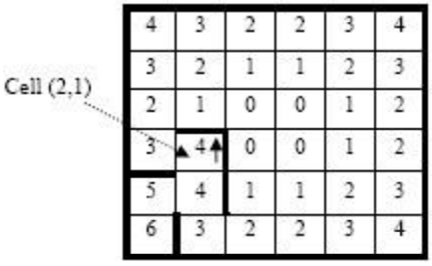
Flood Fill Algorithm (cont.)

Slide 16
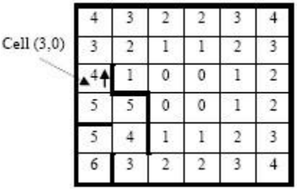
Flood Fill Algorithm (cont.)

Slide 17
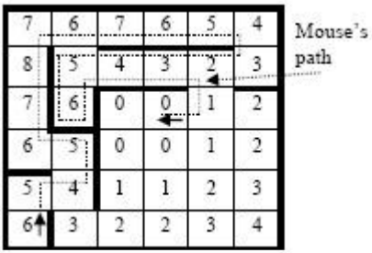
Flood Fill Algorithm (cont.)
36 * 24 = 864 cell distances updated

Slide 18
Flood Fill Algorithm (cont.)
4 | 3 | 2 | 2 | 3 | 4
5 | 2 | 1 | 1 | 2 | 3
6 | 1 | 0 | 0 | 1 | 2
6 | 5 | 0 | 0 | 1 | 2
5 | 4 | 1 | 1 | 2 | 3
6 | 3 | 2 | 2 | 3 | 4
Notes:
轉向愈少愈好
轉向花時間

Slide 19
Flood Fill Algorithm (cont.)
4 | 3 | 4 | 5 | 5 | 4
5 | 2 | 1 | 1 | 2 | 3
6 | 1 | 0 | 0 | 1 | 2
6 | 5 | 0 | 0 | 1 | 2
5 | 4 | 1 | 1 | 2 | 3
6 | 3 | 2 | 2 | 3 | 4
Notes:
轉向愈少愈好
轉向花時間

Slide 20
Modified Flood Fill Algorithm
The algorithm does not flood the maze each time a new cell is reached
Step1. Push the current cell location (x, y) onto the stack
Step2. Repeat this step while the stack is not empty
Pull the cell location (x, y)from the stack
If the minimum distance of the neighboring open cells, md, is not equal to the present cell’s distance - 1, replace the present cell’s distance with md + 1, and push all neighbor locations onto the stack

Slide 21
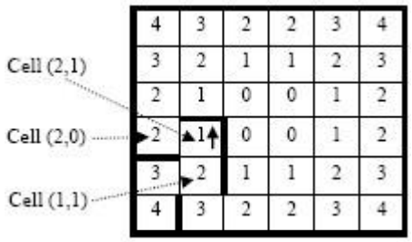
Modified Flood Fill Algorithm (cont.)
stack
(2, 1)

Slide 22
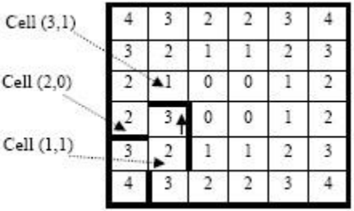
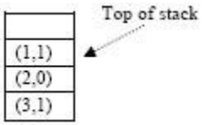
Modified Flood Fill Algorithm (cont.)

Slide 23
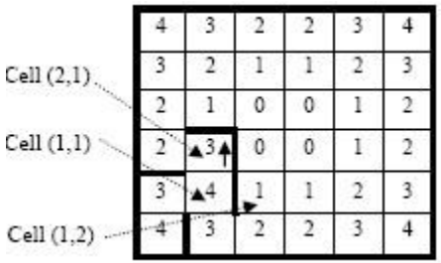
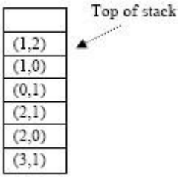
Modified Flood Fill Algorithm (cont.)

Slide 24
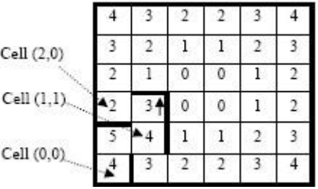
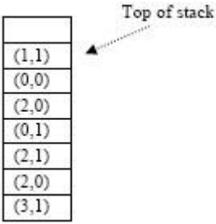
Modified Flood Fill Algorithm (cont.)

Slide 25
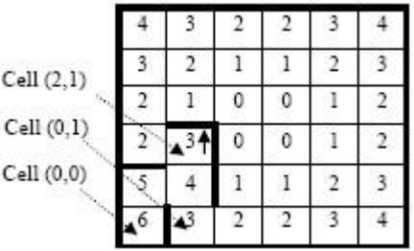
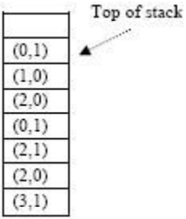
Modified Flood Fill Algorithm (cont.)

Slide 26
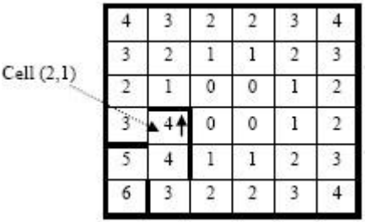
Modified Flood Fill Algorithm (cont.)

Slide 27
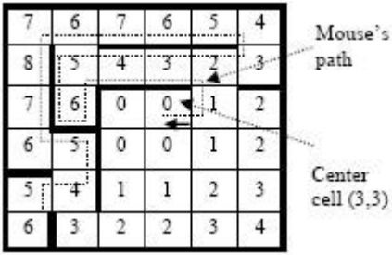
Modified Flood Fill Algorithm (cont.)

Slide 28
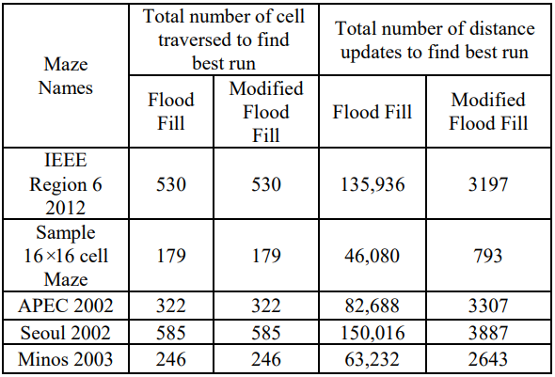
Results

Slide 29
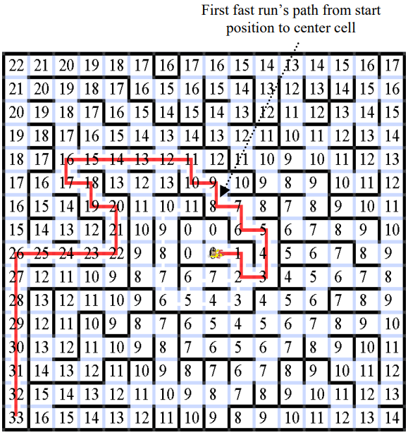
1st

Slide 30
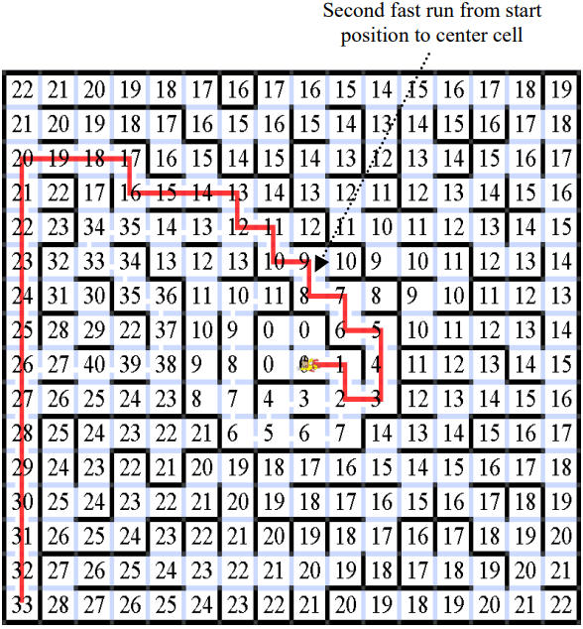
2nd

Slide 31
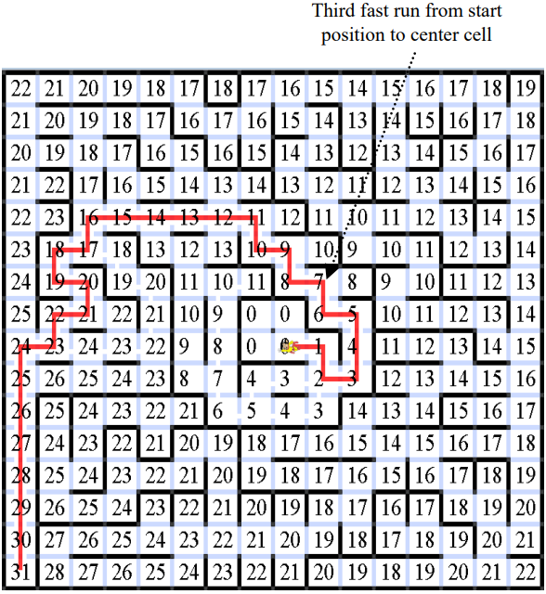
3rd
Notes:
４ｔｈ路徑相同 表明已經找到最佳路徑

Slide 32
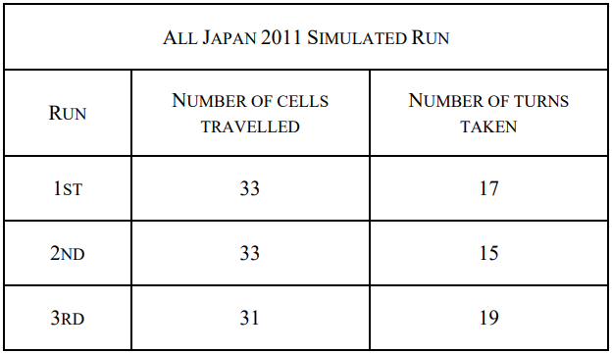
Results

Slide 33
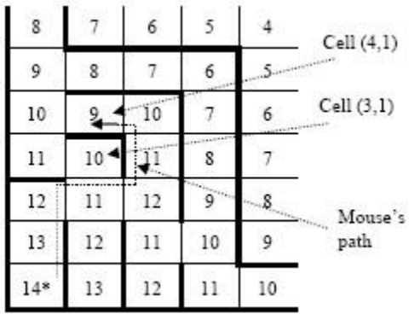
Appendix

Slide 34
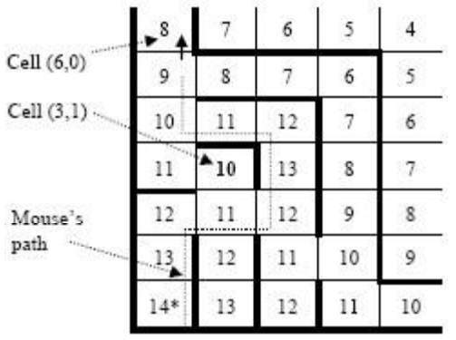
Appendix (cont.)
stack
(4, 0)
(4, 2)
S. Benkovic’s distance update algorithm x

Slide 35
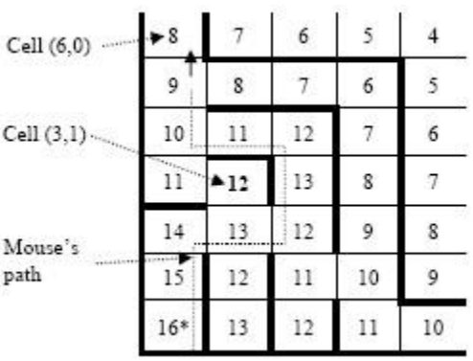
Appendix (cont.)
stack
(5, 1)
(3, 1)
(4, 0)
(4, 2)

Slide 36
Thanks for your patience

