Slide 1
The Game of Bridge: A Challenge for ILP
Legras, S., Rouveirol, C., & Ventos, V.
28th International Conference on Inductive Logic Programming,
Ferrara, Italy, September 2–4, 2018.
Presenter: Yun-An Chen
Date: Aug. 29, 2023

Slide 2
Abstract
Designs of champion-level systems dedicated to a game have been considered as milestones for Artificial Intelligence. Such a success has not yet happened for the game of Bridge because (i) Bridge is a partially observable game (ii) a Bridge player must be able to explain at some point the meaning of his actions to his opponents. This paper presents a simple supervised learning problem in Bridge: given a ‘limit hand’, should a player bid or not, only considering his hand and the context of his decision. We describe this problem and some of its candidate modelisations.

Slide 3
Abstract(cont.)
We then experiment state of the art propositional machine learning and ILP systems on this problem. Results of these preliminary experiments show that ILP systems are competitive or even outperform propositional Machine Learning systems. ILP systems are moreover able to build explicit models that have been validated by expert Bridge players.

Slide 4
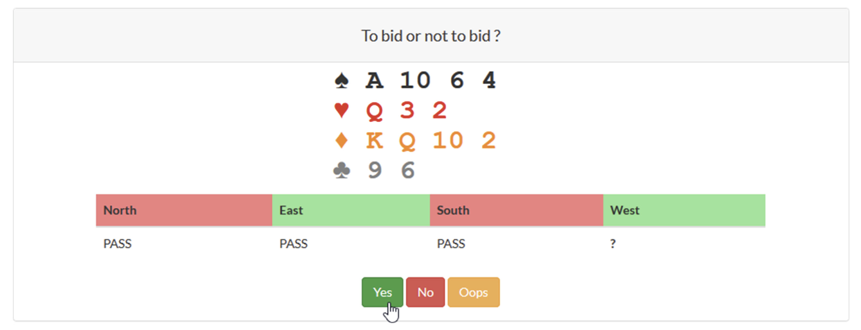
Opening bid problem

Slide 5
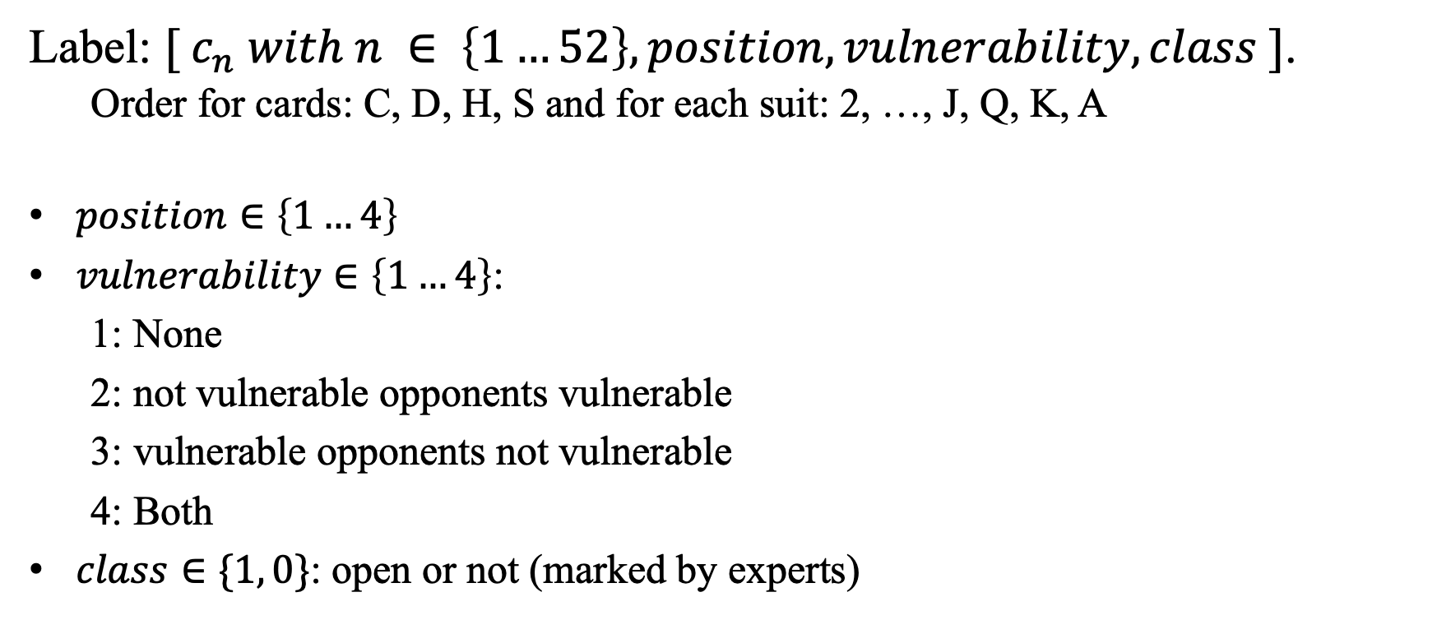
Representation of examples
Label: $[ c_{n} with n ∈ \left\{1…52\right\}, position, vulnerability, class ]$.
Order for cards: C, D, H, S and for each suit: 2, …, J, Q, K, A
$position∈\left\{1…4\right\}$
$vulnerability∈\left\{1…4\right\}$:
1: None
2: not vulnerable opponents vulnerable
3: vulnerable opponents not vulnerable
4: Both
$class∈\{1, 0\}$: open or not (marked by experts)

Slide 6

Background knowledges
$BK_{0}$:
Open(E, Class)
Has hand(E, H)
Has card(E, C)
Position(E, P)
Vuln(E, V1, V2)
Open(e, pos)
Has hand(e, [c6,c9,d2,dT,dQ,dK,h2,h3,hQ,s4,s6,sT,sA])
Has card(e, c6), Has card(e, c9) … Has card(e, sA)
Position(e, 4)
Vuln(e, not vulnerable, vulnerable)

Slide 7
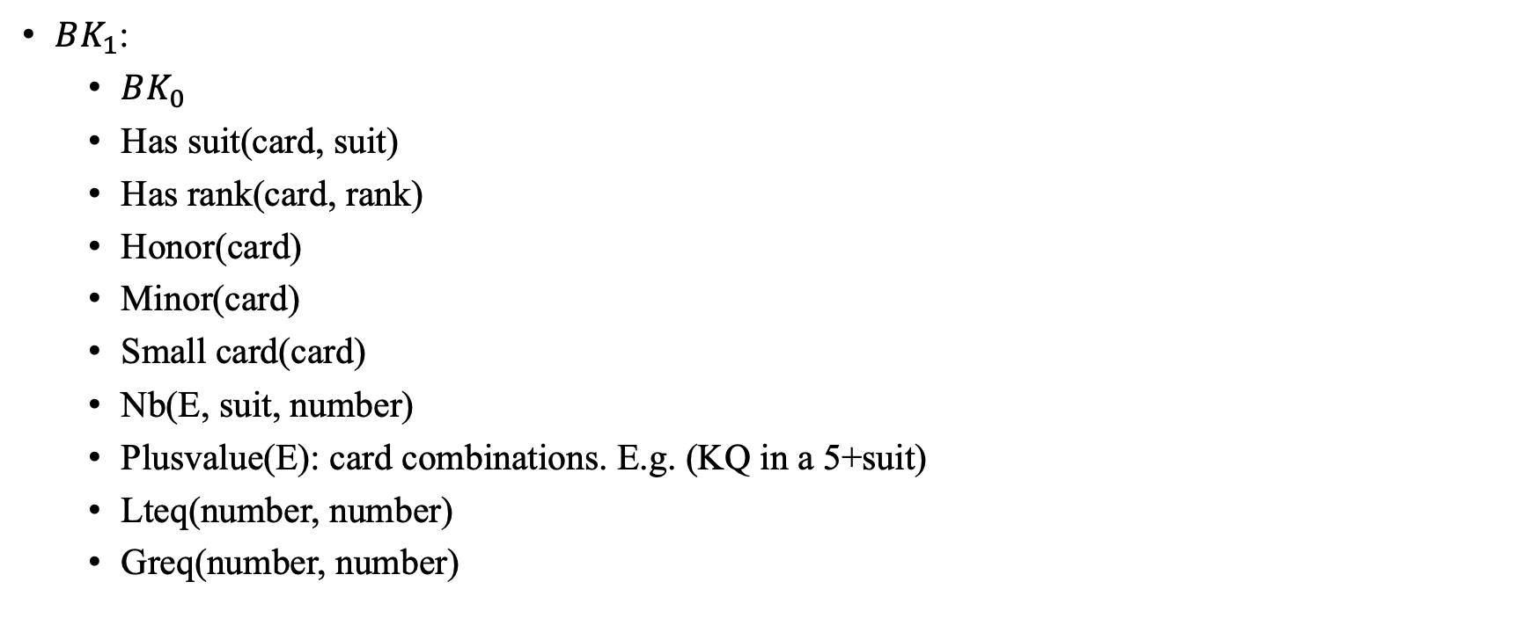
Background knowledges
$BK_{1}$:
$BK_{0}$
Has suit(card, suit)
Has rank(card, rank)
Honor(card)
Minor(card)
Small card(card)
Nb(E, suit, number)
Plusvalue(E): card combinations. E.g. (KQ in a 5+suit)
Lteq(number, number)
Greq(number, number)

Slide 8

Background knowledges
$BK_{2}$:
$BK_{1}$
List honor(E, Suit, ListH)

Slide 9
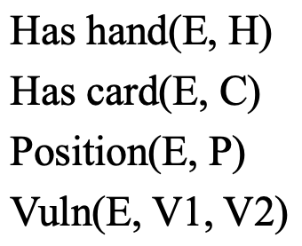
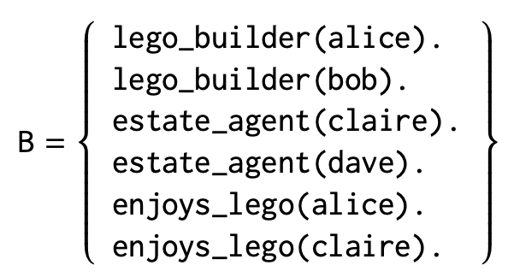

Methods
SVM
Building rule sets with Inductive Logic Programming(ILP) system
Aleph
Tilde
$$E^{+} , E^{−}$$
https://arxiv.org/pdf/2008.07912.pdf

Slide 10
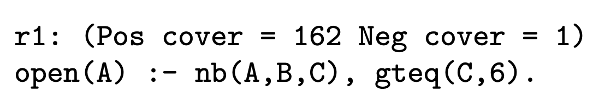
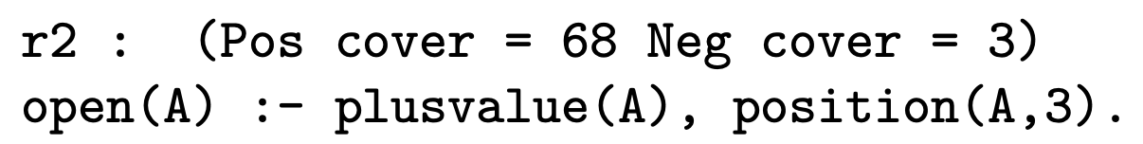
ILP system
Aleph (A Learning Engine for Proposing Hypotheses)
Step 1. Select example
Step 2. Build most-specific-clause
Step 3. Search
Step 4. Remove redundant
Tilde (Top-down Induction of Logical DEcision trees): learns a relational decision tree from interpretations.
Srinivasan, A.: The aleph manual (1999). http://www.comlab.ox.ac.uk/oucl/research/areas/machlearn/Aleph/

Slide 11
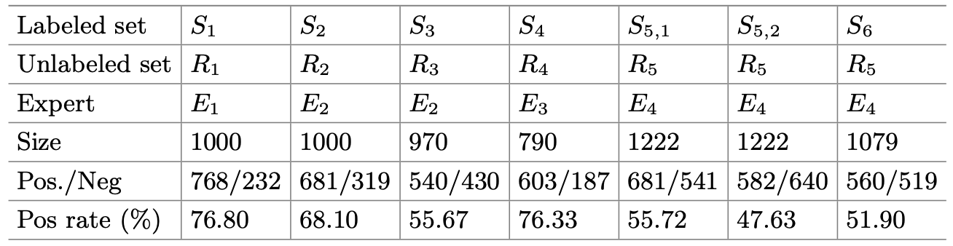
Datasets

Slide 12
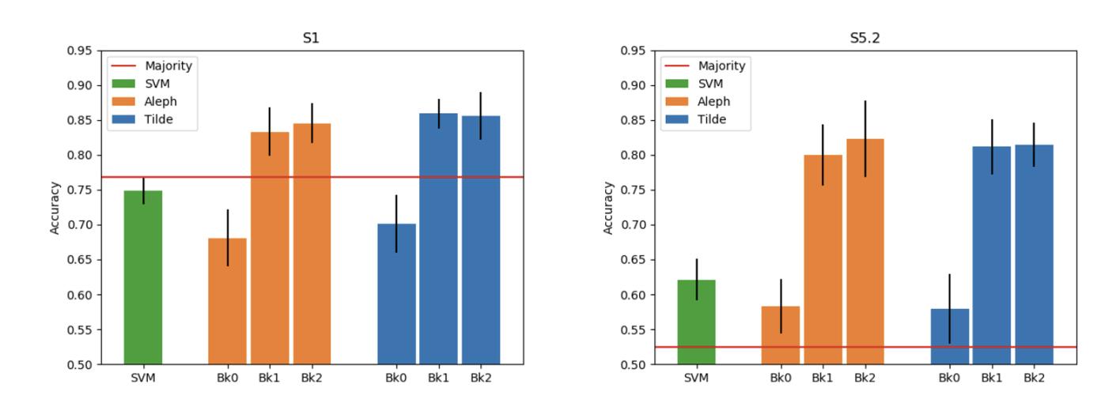
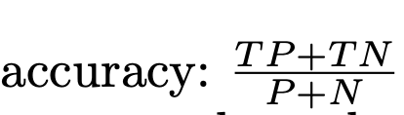
Experiments - accuracy

Slide 13
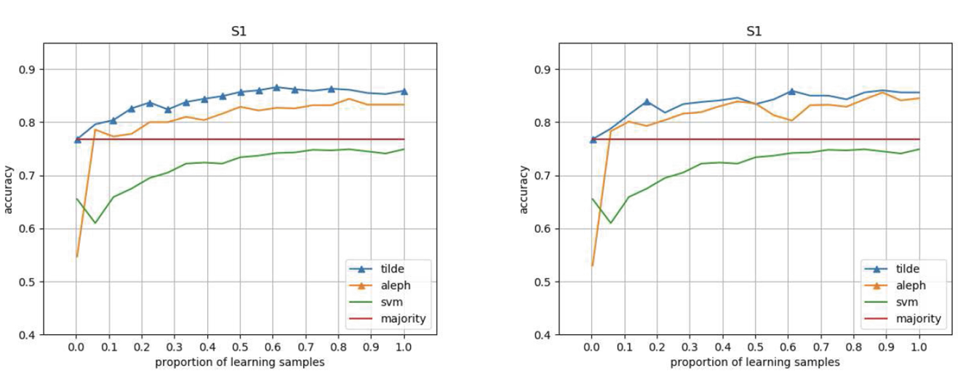


Experiments - training data size
$$BK_{1}$$
$$BK_{2}$$

Slide 14
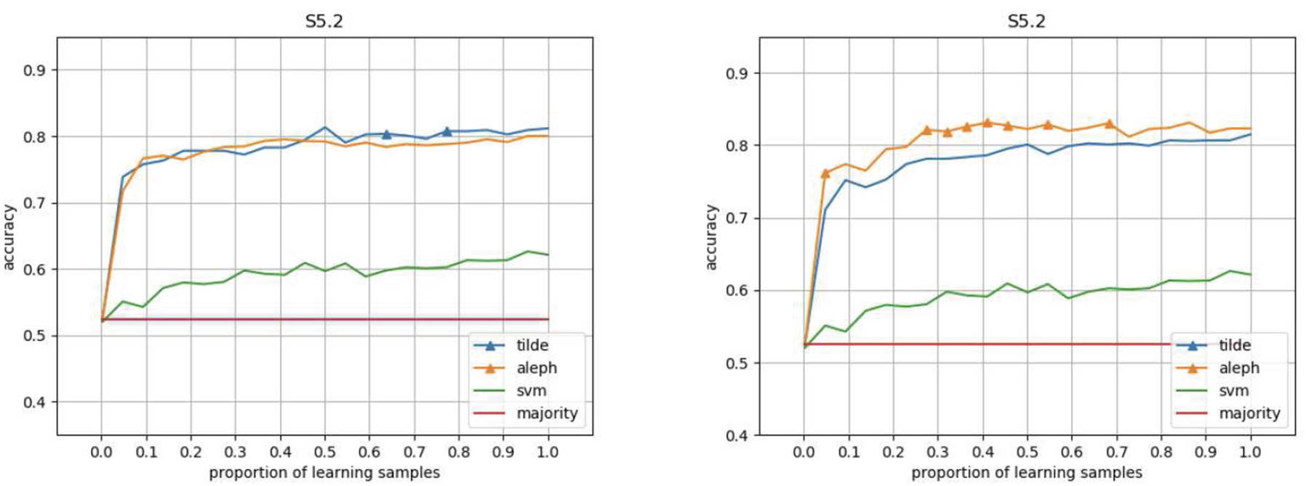
Experiments - training data size
$$BK_{1}$$
$$BK_{2}$$

Slide 15
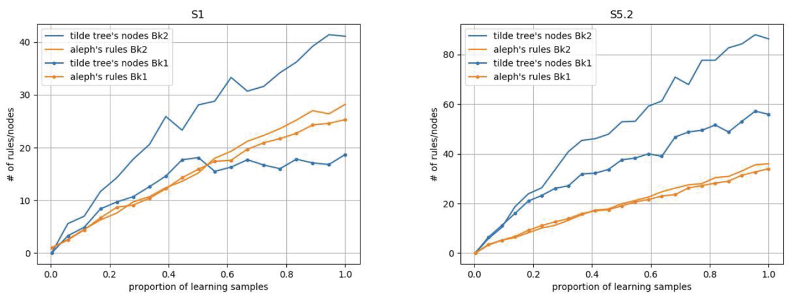
Experiments - complexity
Complexity: # of rules or nodes

Slide 16
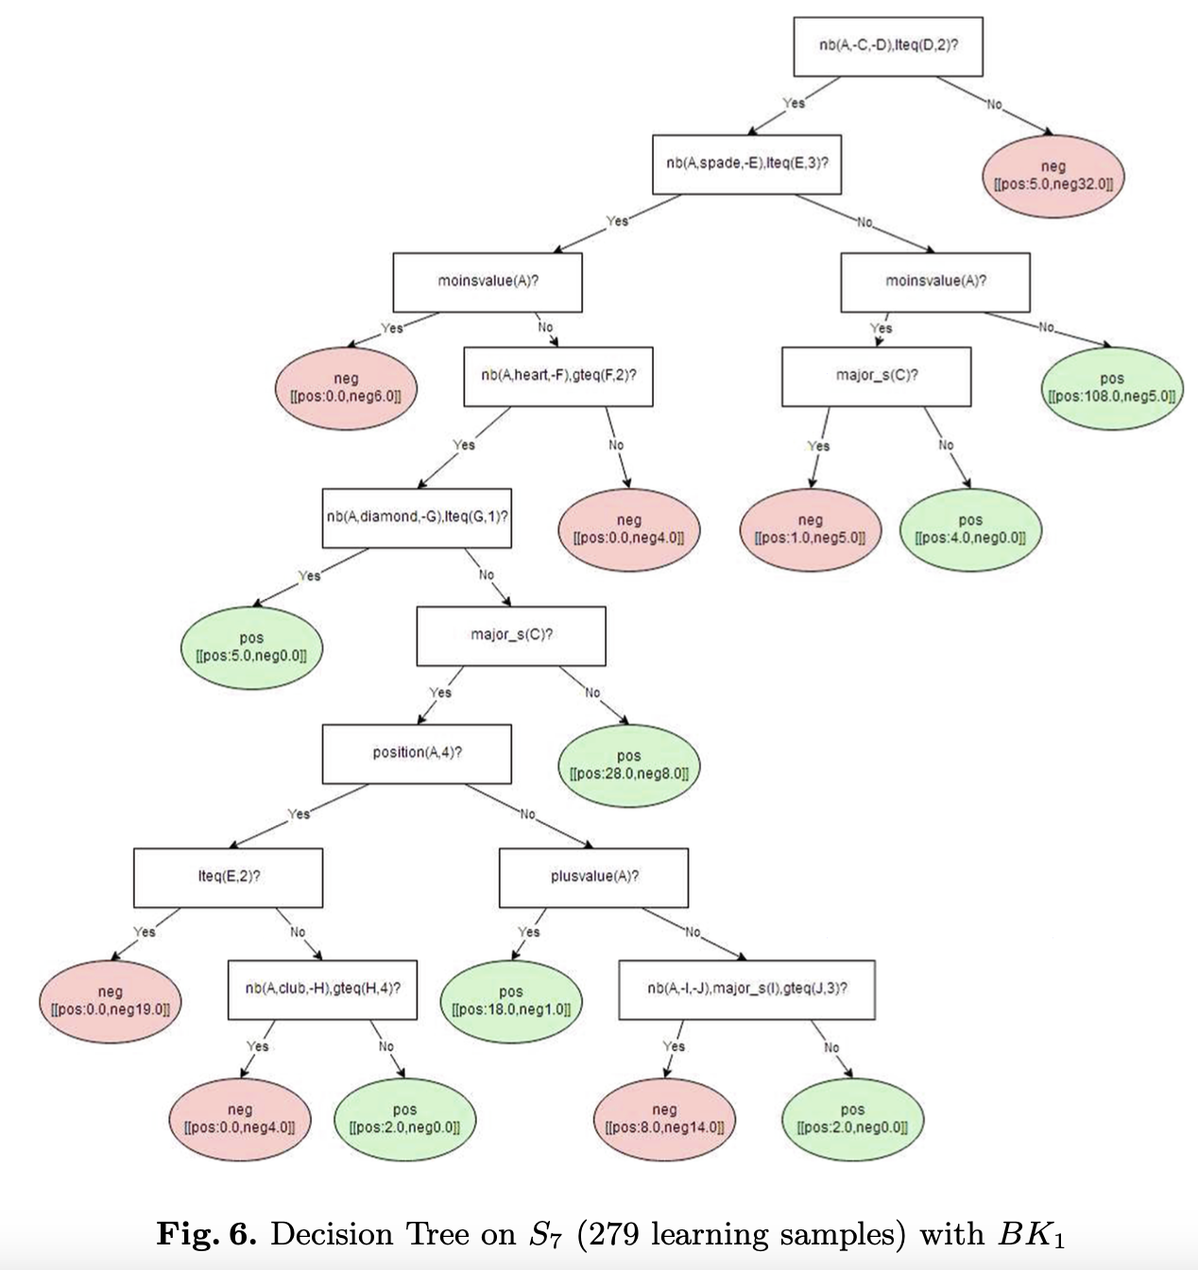
Experiments for E1
Number of data: 279 samples
Constraints:
No more than 5 card in a suit
Position cannot be 3

