Slide 1
A non-negative matrix factorization based method for predicting disease-associated miRNAs in miRNA-disease bilayer network
Yingli Zhong, Ping Xuan, Xiao Wang, Tiangang Zhang, Jianzhong Li, Yong Liu, Weixiong Zhang
Bioinformatics, Volume 34, Pages 267–277, 2017
Speaker: Jheng-Yan Lyu
Date: Aug. 27, 2019

Slide 2
Abstract (1/2)
Motivation: Identification of disease-associated miRNAs (disease miRNAs) is critical for understanding disease etiology and pathogenesis. Since miRNAs exert their functions by regulating the expression of their target mRNAs, several methods based on the target genes were proposed to predict disease miRNA candidates. They achieved only limited success as they all suffered from the high false-positive rate of target prediction results. Alternatively, other prediction methods were based on the observation that miRNAs with similar functions tend to be associated with similar diseases and vice versa. The methods exploited the information about miRNAs and diseases, including the functional similarities between miRNAs, the similarities between diseases, and the associations between miRNAs and diseases. However, how to integrate the multiple kinds of information completely and consider the biological characteristic of disease miRNAs is a challenging problem. Results: We constructed a bilayer network to represent the complex relationships among miRNAs, among diseases and between miRNAs and diseases. We proposed a non-negative matrix factorization based method to rank, so as to predict, the disease miRNA candidates.

Slide 3
Abstract (2/2)
The method integrated the miRNA functional similarity, the disease similarity and the miRNA-disease associations seamlessly, which exploited the complex relationships within the bilayer network and the consensus relationship between multiple kinds of information. Considering the correlation between the candidates related to various diseases, it predicted their respective candidates for all the diseases simultaneously. In addition, the sparseness characteristic of disease miRNAs was introduced to generate more reliable prediction model that excludes those noisy candidates. The results on 15 common diseases showed a superior performance of the new method for not only well-characterized diseases but also new ones. A detailed case study on breast neoplasms, colorectal neoplasms, lung neoplasms and 32 other diseases demonstrated the ability of the method for discovering potential disease miRNAs.

Slide 4




Disease similarity measurement

Slide 5
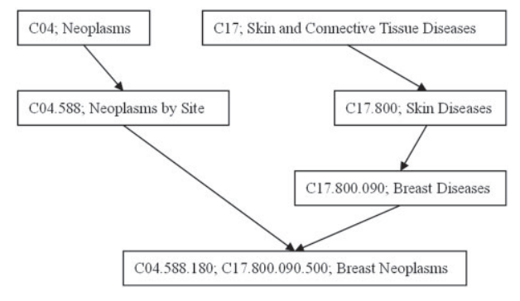
Disease similarity measurement
The DV value of ‘breast neoplasms’ is 1.0 (breast neoplasms) + 0.5 (breast diseases) + 0.5 (neoplasms by site) + 0.5 × 0.5 (neoplasms) + 0.5 × 0.5 (skin diseases) + 0.5 × 0.5 × 0.5 (skin and connective tissue diseases) = 2.6250

Slide 6


MiRNA similarity measurement
MiRNA ma is associated with diseases d1, d2, d3, d4 and d8
MiRNA mb is associated with d1, d2, d5 and d8.
DTa={d1,d2,d3,d4,d8}
DTb={d1,d2,d5,d8}

Slide 7

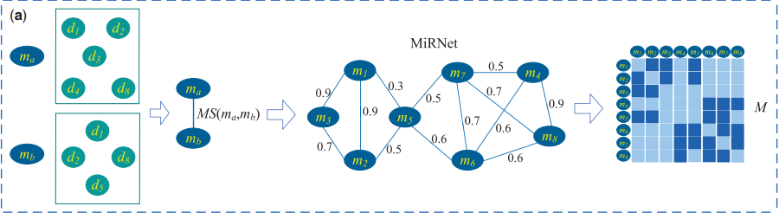
Construction of miRNA-disease bilayer network
Construction of MiRNet.

Slide 8
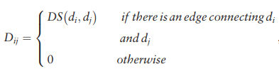
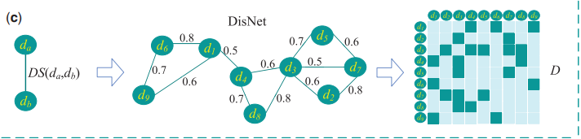
Construction of miRNA-disease bilayer network
Construction of DisNet.

Slide 9
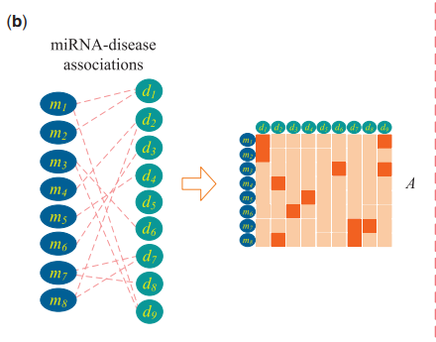
Construction of miRNA-disease bilayer network
Edges between MiRNet and DisNet.

Slide 10
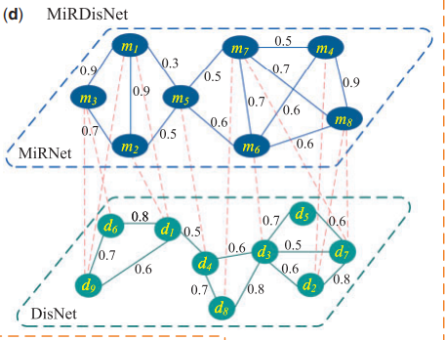

Construction of miRNA-disease bilayer network
miRNA-disease bilayer network

Slide 11



Modelling the edges between MiRNet and DisNet
||⋅||F is the Frobenius norm of a matrix and ⊙ is the Hadamard product.

Slide 12
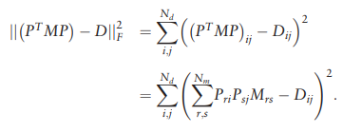

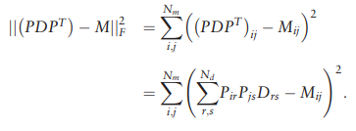

Non-negative matrix factorization

Slide 13
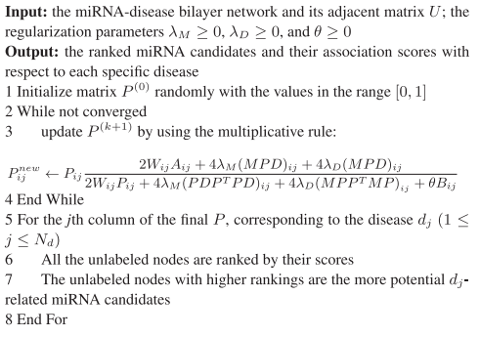
Algorithm for predicting the miRNA candidates associated with diseases

Slide 14
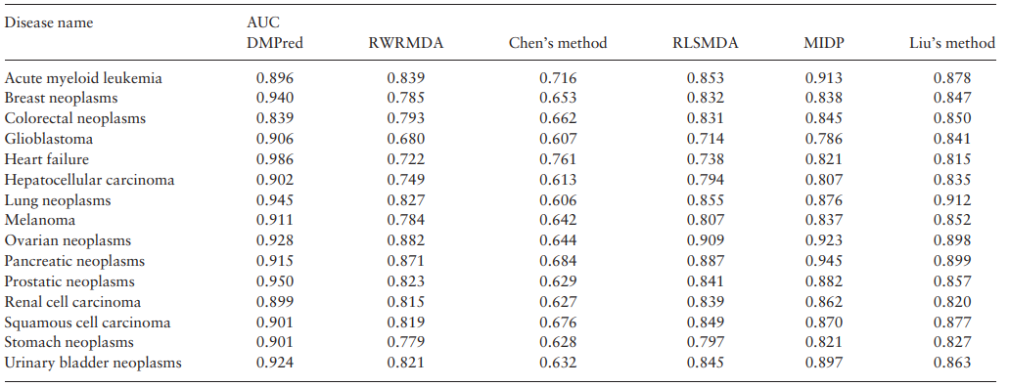
Results
The area under the ROC curve (AUC) is used to measure the global performance of a prediction method.

Slide 15
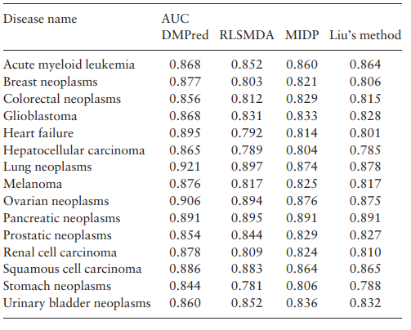
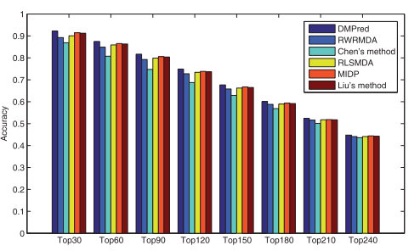
Results
Prediction results of DMPred and the other methods for the diseases whose respective associations were removed
The average accuracies across all the tested diseases at different top k

