Slide 1
Fast and Simple Algorithms for Computing both LCSk and LCSk+
Filip Pavetic, Ivan Katanic, Gustav Matula, Goran Zuzic, and Mile Sikic
Proceedings of the Prague Stringology Conference 50-62
August 27–28, 2018, Czech Technical University, Prague
Presenter: KeXin Zhu
Date: 2019/09/03
Notes:
https://zh.wikipedia.org/zh-tw/%E5%B8%83%E6%8B%89%E6%A0%BC
https://www.google.com.tw/maps/place/%E6%8D%B7%E5%85%8B%E5%B8%83%E6%8B%89%E6%A0%BC/@50.0598058,14.3255419,11z/data=!3m1!4b1!4m5!3m4!1s0x470b939c0970798b:0x400af0f66164090!8m2!3d50.0755381!4d14.4378005?hl=zh-TW
https://zh.wikipedia.org/zh-tw/%E5%B8%83%E6%8B%89%E6%A0%BC%E4%B9%8B%E6%98%A5
https://open.spotify.com/album/4xa5fzCtL1F2XBflafatXp?si=mCdNieahQUibMs3mBxvgoQ

Slide 2
Abstract(1/2)
Longest Common Subsequence (LCS) deals with the problem of measuring similarity of two strings. While this problem has been analyzed for decades, the recent interest stems from a practical observation that considering single characters is often too simplistic. Therefore, recent works introduce the variants of LCS based on shared substrings of length exactly or at least k (LCSk and LCSk+ respectively). The main drawback of the state-of-the-art algorithms for computing LCSk and LCSk+ is that they work well only in a limited setting: they either solve the average case well while being suboptimal in the pathological situations or they achieve a good worst-case performance, but fail to exploit the input data properties to speed up the computation.

Slide 3
Abstract(2/2)
Furthermore, these algorithms are based on non-trivial data structures which is not ideal from a practitioner’s point of view. We present a single algorithm to compute both LCSk and LCSk+ which outperforms the state-of-the art algorithms in terms of runtime complexity and requires only basic data structures. In addition, we implement an algorithm to reconstruct the solution which offers significant improvement in terms of memory consumption. Our empirical validation shows that we save several orders of magnitude of memory on human genome data. The C++ implementation of our algorithms is made available at: https://github.com/google/fast-simple-lcsk.

Slide 4
1 Introduction
Longest Common subsequence(LCS)：
X = “TGCGTGTGT”,
Y = “GTTGTGCCT”.
LCS of X and Y:
LCS = “GTGTGT”.
|LCS| = 6.

Slide 5
1 Introduction
The LCS in k Length Substrings Problem (LCSk)：
X = “TGCGTGTGT”,
Y = “GTTGTGCCT”.
LCSk of X and Y :
LCS1 = “G T G T G T” = LCS.
LCS2 = “GT TG” .
LCS3 = “GTG”.

Slide 6
1 Introduction
The LCS in at least k Length Substrings Problem (LCSk+)：
X = “TGCGTGTGT”,
Y = “GTTGTGCCT”.
LCSk+ of X and Y :
LCS = “GTGTGT”.
LCS2 = “GT TG”.
LCS2+ = “GT GTG”

Slide 7


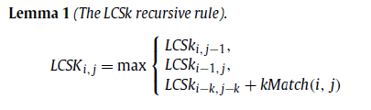
2 Benson’s LCSk/k+ algorithm
Notes:
Benson, G., et al. (2016). "LCSk: a refined similarity measure." Theoretical Computer Science 638: 11-26.

Slide 8
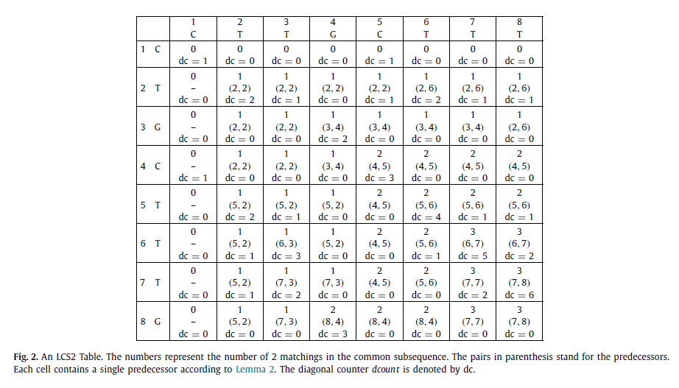
2 Benson’s LCSk/k+ algorithm

Slide 9
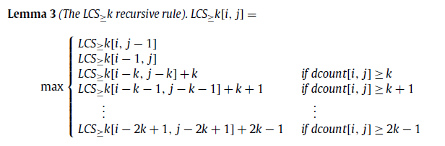
2 Benson’s LCSk/k+ algorithm
Complexity:
O(n^2)time and O(kn)space.
O(kn^2)time and O(kn)space.

Slide 10
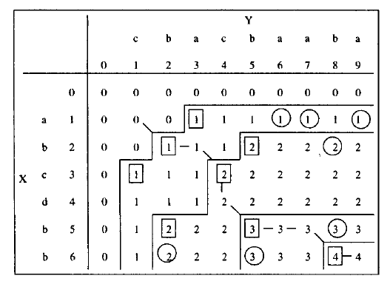
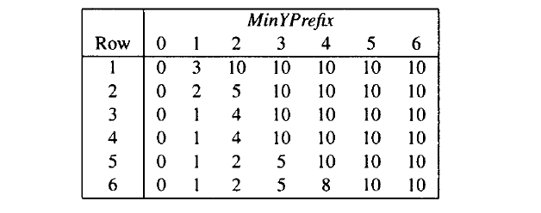
3 Processing the Table Row by Row
Sample:
Notes:
Bergroth, L., et al. (2000). A survey of longest common subsequence algorithms. Proceedings Seventh International Symposium on String Processing and Information Retrieval. SPIRE 2000, IEEE.
J. W. Hunt and T. G. Szymanski: A fast algorithm for computing longest common subsequences. Commun. ACM, 20(5) May 1977, pp. 350–353.

Slide 11
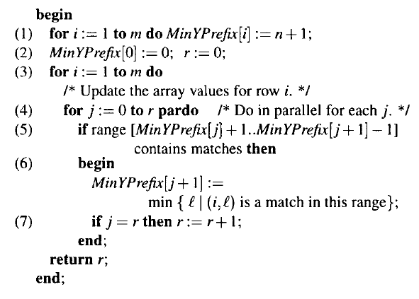
3 Processing the Table Row by Row
Algorithm:
Time complexity: O(|M|*logn).
Notes:
Bergroth, L., et al. (2000). A survey of longest common subsequence algorithms. Proceedings Seventh International Symposium on String Processing and Information Retrieval. SPIRE 2000, IEEE.
J. W. Hunt and T. G. Szymanski: A fast algorithm for computing longest common subsequences. Commun. ACM, 20(5) May 1977, pp. 350–353.

Slide 12
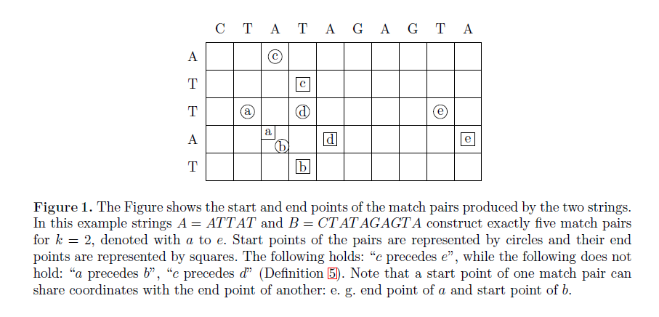
4 LCSk by decoupling start and end points
X = “ATTAT”,
Y = “CTATAGAGTA”.
Match Pair of X and Y if k=2:
(3, 2), (4, 3), (1, 3), (3, 4), (3, 9).
Start points of b(4,3): (4,3).
End points of b(4,3): (5,4).
c precedes e.

Slide 13
4 LCSk by decoupling start and end points

Slide 14

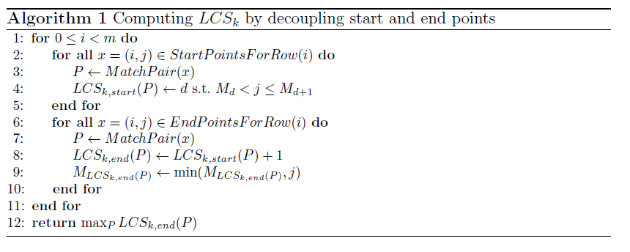
4 LCSk by decoupling start and end points

Slide 15
4 LCSk by decoupling start and end points
Complexity: O(m+n+r+min(rlogl,r+ml)) time, O(l+m+n)space.
M\d | 0 | 1 | 2
0 | 0 | Inf | Inf
1 | 0 | 4 | Inf
2 | 0 | 4 | Inf
3 | 0 | 3 | 7
4 | 0 | 3 | 7
5 | 0 | 3 | 7
 | C | T | A | T | A | T | A
A |  |  | c1(0)
T |  |  |  | c2(1)
T |  | a1(0) |  | d1(0) |  | e1(1)
A |  |  | a2(1)/b1(0) |  | d2(1) |  | e2(2)
T |  |  |  | b2(1)

Slide 16
5 Algorithm to compute LCSk+
X = “ATTAT”,
Y = “CTATAGAGTA”.
P continues G if i_{P} = i_{G} + 1 and j_{P} = j_{G} + 1.
b continues a.

Slide 17
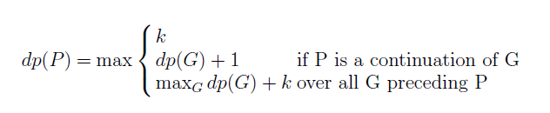
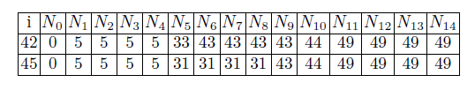
5 Algorithm to compute LCSk+

Slide 18
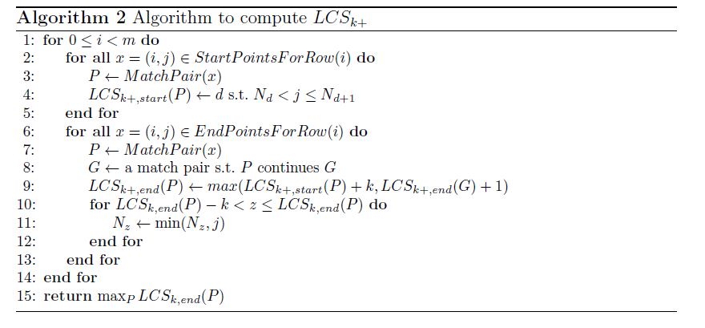
5 Algorithm to compute LCSk+
Complexity: O(m+n+r+min(r(logl+k),r+ml)) time, O(l+m+n)space.

