Slide 1
Prediction of microRNAs involved in immune system diseases through network based features
Archana Prabahar, Jeyakumar Natarajan
Journal of Biomedical Informatics, Volume 65, Pages 34–45, 2017
Speaker: Jheng-Yan Lyu
Date: Sept. 25, 2019

Slide 2
Abstract (1/2)
MicroRNAs are a class of small non-coding regulatory RNA molecules that modulate the expression of several genes at post-transcriptional level and play a vital role in disease pathogenesis. Recent research shows that a range of miRNAs are involved in the regulation of immunity and its deregulation results in immune mediated diseases such as cancer, inflammation and autoimmune diseases. Computational discovery of these immune miRNAs using a set of specific features is highly desirable. In the current investigation, we present a SVM based classification system which uses a set of novel network based topological and motif features in addition to the baseline sequential and structural features to predict immune specific miRNAs from other non-immune miRNAs. The classifier was trained and tested on a balanced set of equal number of positive and negative examples to show the discriminative power of our network features. Experimental results show that our approach achieves an accuracy of 90.2% and outperforms the classification accuracy of 63.2% reported using the traditional miRNA sequential and structural features. The proposed classifier was further validated with two immune disease sub-class datasets related to multiple sclerosis microarray data and psoriasis RNA-seq data with higher accuracy.

Slide 3
Abstract (2/2)
These results indicate that our classifier which uses network and motif features along with sequential and structural features will lead to significant improvement in classifying immune miRNAs and hence can be applied to identify other specific classes of miRNAs as an extensible miRNA classification system.

Slide 4
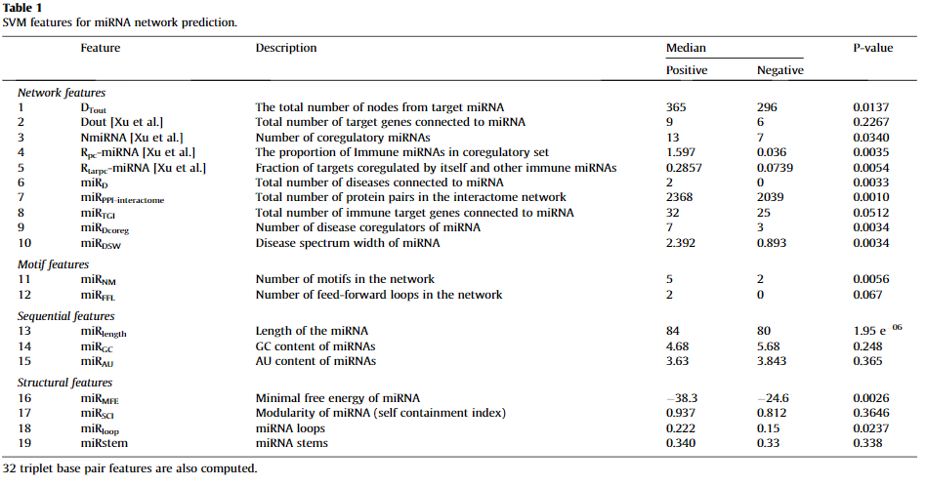
Features set
Use 51 features for the classification task

Slide 5
Network features
MiRNA target gene extraction
MiRNA target gene – disease association extraction
MiRNA – disease association extraction
MiRNA target gene – protein association extraction

Slide 6
MiRNA target gene extraction
MiRNA target genes were acquired from eight miRNA target databases: miRanda , PicTar , TargetScan , DIANA-microT , RNA22 , RNAhybrid , miRDB and PITA .
We extracted the regulatory associations between miRNAs and target genes that were found to appear in at least four of these databases
Total contains 101,426 miRNA-gene associations involving 245 miRNAs and 11,130 genes.
Notes:
我們提取了miRNA和靶基因之間的調節關聯，這些靶基因至少出現在這些數據庫中的四個中

Slide 7
MiRNA target gene – disease association extraction
Gene disease associations were obtained from curated entries of CTD database for all the MeSH(Medical Subject Headings) diseases.
A total of 6537 gene-disease associations were obtained.
MiRNA – disease association extraction
MiRNA – disease association were obtained from Human MiRNA associated Disease Database (HMDD) and miR2Disease.
Notes:
MeSH(Medical Subject Headings)一套生物醫學領域的主題詞表，是一種索引典，每個主題詞代表特定的主題範疇。

Slide 8
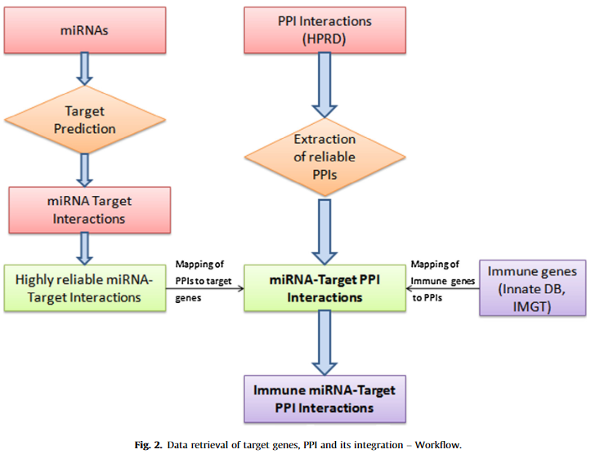
MiRNA target gene – protein association extraction
The current release of HPRD contains 145,134 human PPI interactions. The miRNA target genes were mapped to the HPRD and the corresponding PPI were extracted.
The extracted PPI network contains 18,753 genes and 570,870 interactions.
Notes:
The target genes which were related to immune diseases and their PPI were found using two databases IMGT and InnateDB. (使用兩個數據庫IMGT和InnateDB查找與免疫疾病及其PPI相關的靶基因。)
The Immune functional gene network contains 8230 immune genes which are involved in 22,683 immune target gene interactions and 73,046 immune target gene protein interactions.

Slide 9
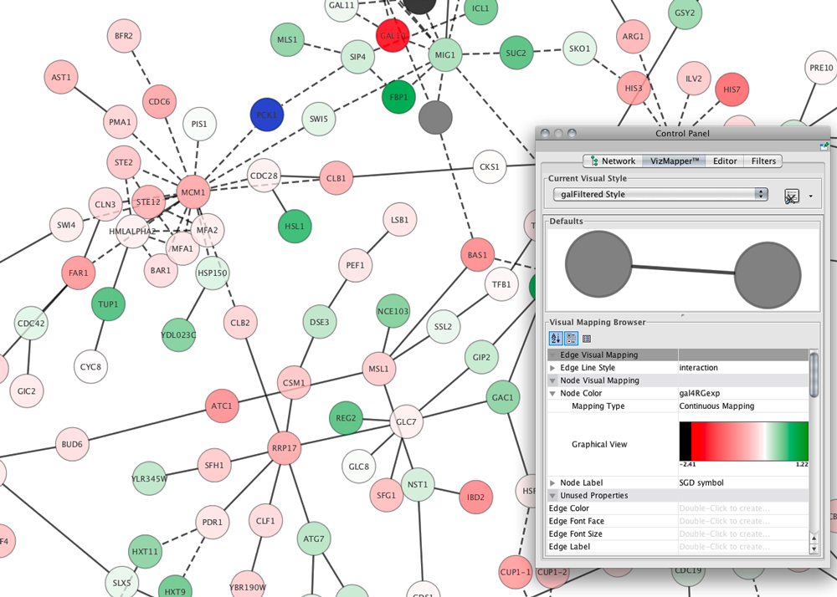
Network features
Nodes represent biomedical entities (i.e. miRNA, disease, or gene).
edges between nodes represent associations between two nodes (i.e. association between miRNA and genes, miRNA and disease, gene and gene, etc.).
For each miRNA in the network
Defined 10 measures:
DTout
Dout
NmiRNA
RpcmiRNA
RtarpcmiRNA
miRD
miRPPI-interactome
miRTGI
miRDcoreg
miRDSW

Slide 10
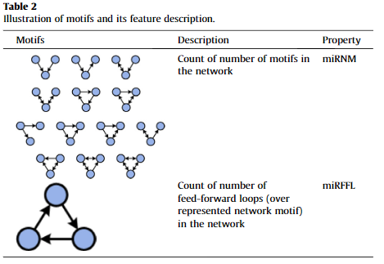
Motif and sequential features
Three node network motifs were identified from miRNA–disease–gene-protein network.
Sequential features were computed using RNAfold.

Slide 11
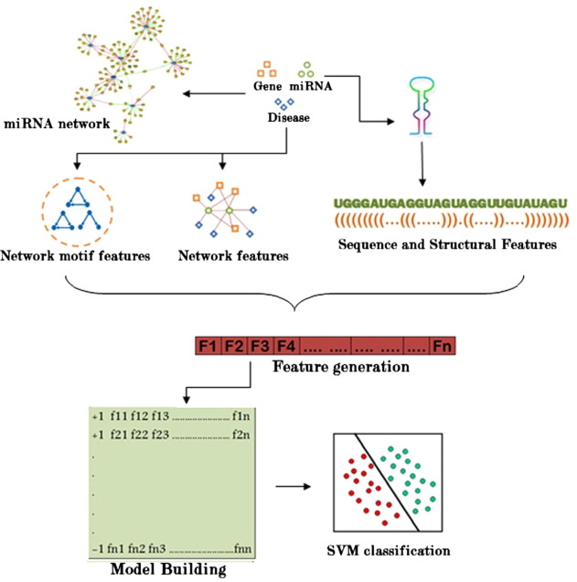
Support vector machine (SVM)
Used SVM classifier to classify immune miRNAs from other non-immune miRNAs.
SVM can process classification and prediction through different kernel functions and suitable parameters.

Slide 12
Principal component analysis (PCA)
PCA is a powerful tool for dimension reduction and feature extraction in data analysis.
The main advantage of PCA is that when data compression is performed, i.e. by reducing the number of dimensions, loss of information is much limited.
PCA involves the following steps:
subtraction of mean from the feature vectors
calculation of covariance matrix
calculation of eigenvectors and eigenvalues of the covariance matrix
choosing the components from feature vector
derivation of new dataset.
Notes:
1.從特徵向量中減去均值
2.協方差矩陣的計算
3.協方差矩陣的特徵向量和特徵值的計算
4.從特徵向量中選擇分量
5.新數據集的派生。

Slide 13
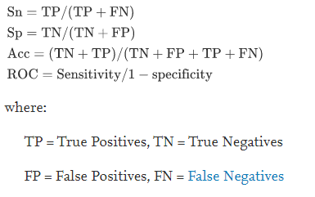
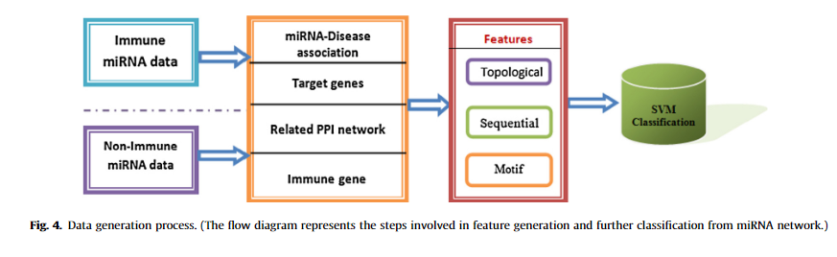
Results
Performance evaluation:
Accuracy (Ac)
Sensitivity (Sn)
Specificity (Sp)
Receiver Operating Characteristic (ROC)

Slide 14
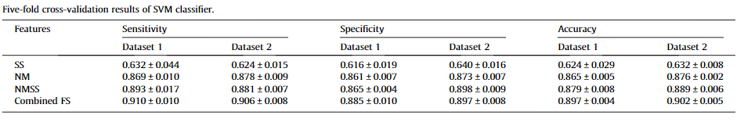
Results
Dataset 1: 245 positive data and 245 negative data from miRNA disease associations databases HMDD and miR2Disease
Dataset 2: 245 positive data (dataset1) and 245 negative data from microarray gene expression
Four different evaluations were performed using the following feature sets:
(i) Sequential + Structural features (SS) (3 + 36 features)
(ii) Network + Motif features (NM) (10 + 2 features)
(iii) Network + Motif + Sequential + Structural features (NMSS) (10 + 2 + 3 + 36 features)
(iv) Combined features + feature selection using principal component analysis (NMSSFs)

Slide 15
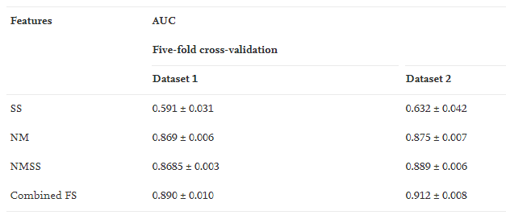
Results

