Slide 1
Indexed Dynamic Programming to Boost Edit Distance and LCSS Computation
Jérémy Barbay, Andrés Olivares
Proceedings of International Symposium on String
Processing and Information Retrieval
Lima, Peru, 9-11 October 2018, pp. 61-73
Presenter: Yuan-Hsiu Tsai
Date: Sept. 25, 2019

Slide 2
Abstract(1/2)
There are efficient dynamic programming solutions to the computation of the Edit Distance from to , for many natural subsets of edit operations, typically in time within O(nm) in the worst-case over strings of respective lengths n and m (which is likely to be optimal), and in time within O(n+m)O(n+m) in some special cases (e.g., disjoint alphabets). We describe how indexing the strings (in linear time), and using such an index to refine the recurrence formulas underlying the dynamic programs, yield faster algorithms in a variety of models, on a continuum of classes of instances of intermediate difficulty between the worst and the best case, thus refining the analysis beyond the worst case analysis.

Slide 3
Abstract(2/2)
As a side result, we describe similar properties for the computation of the Longest Common Sub Sequence LCSS(S,T)LCSS(S,T) between S and T, since it is a particular case of Edit Distance, and we discuss the application of similar algorithmic and analysis techniques for other dynamic programming solutions. More formally, we propose a parameterized analysis of the computational complexity of the Edit Distance for various sets of operators and of the Longest Common Sub Sequence in function of the area of the dynamic program matrix relevant to the computation..

Slide 4
Introduction
Edit Distance :
Edit Distance is the minimum number of such operations required to transform the string S into the string T.
即 將可執行的指令以最少的次數，將字串S 轉換成 字串T

Slide 5
Introduction
Traditional Edit Distance
<INSERT DELETE Edit Distance > :
S = aattcc
T = attagg
LCS= att
對齊後： S=a a t t c c _ _
T=a _ t t _ _ g g
=>Edit Distance d= 5

Slide 6
Introduction
Standard Edit Distance
<INSERT DELETE REPLACEMENT Edit Distance >
S = aattcc
T = attaggk
LCS= att
對齊後： S=a a t t c c _
T=a _ t t g g k
=>Edit Distance d= 4

Slide 7
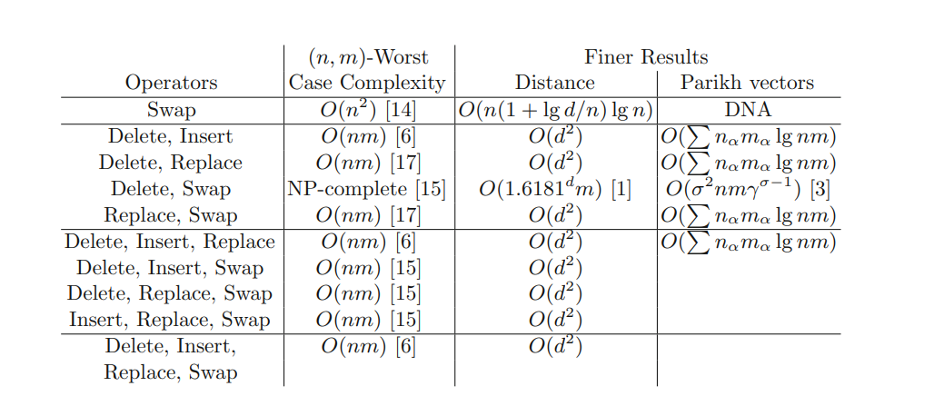
Summary of result for various combinations of operators from the basic set {Insert,Delete,Replace,Swap}

Slide 8
Introduction
Parikh Vector Given positive integers σ and n, a string S ∈ , and the integers such that denotes the number of occurrences of the letter in the string S, the Parikh vector of S is defined as p(S)=( ).
Example S = abbbcc [1.. σ]=[a,b,c]
➔p(S)=( 1,3,2)

Slide 9
Introduction
New operators：{Rank , Selection}
Suppose X[1..i] is a string
rank (X , i , α)： the number of occurrences of the symbol α in the substring X[1..i]
select(X , k , α)：the value j ∈ [1..|X|] such that the k-th occurrence of α in X is precisely at position j, if j exists. If j does not exist, then select(X, k, α) is null.

Slide 10
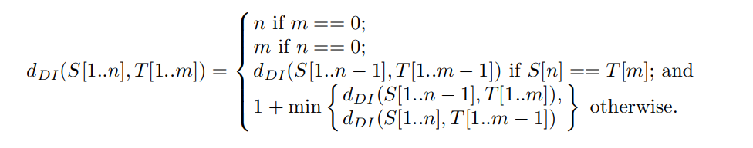
Algorithm- Classical

Slide 11
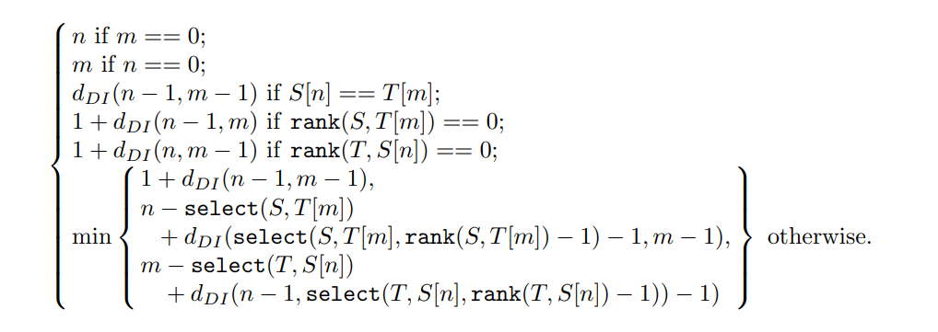
Algorithm-Adaptive

Slide 12
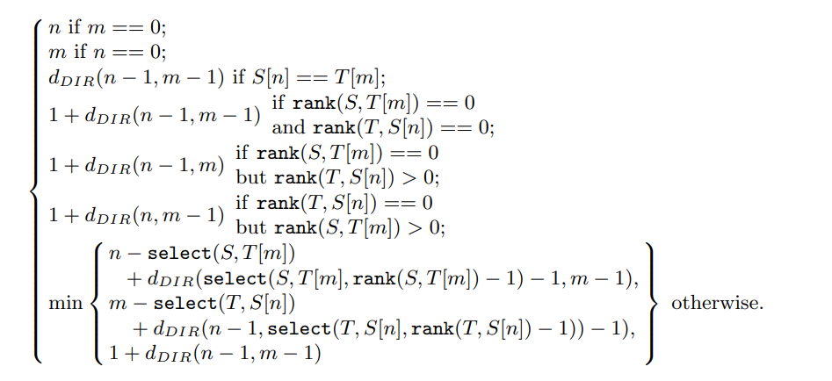
Algorithm- Levenshtein Distance <Delete Insert Replacement Edit Distance>

Slide 13
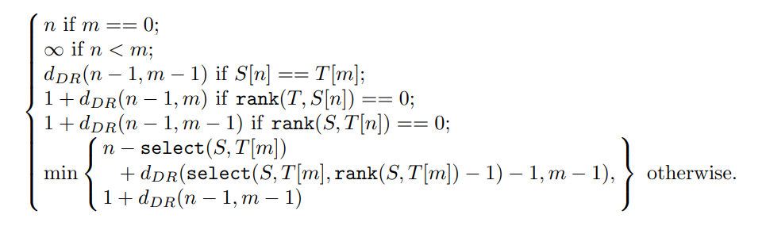
Algorithm- Delete Replacement Edit Disatance

Slide 14
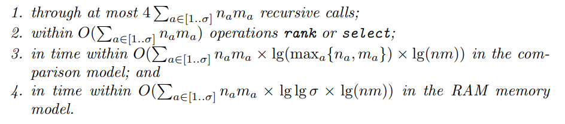
Delete Insert Edit Distance Levenshtein Edit Distance Delete Replace Edit Distance

Slide 15
Experiments
Hamlet <哈姆雷特>
The hound of the Baskervilles < 巴斯克維爾的獵犬 >
The war of the worlds <星際戰爭(世界大戰)>
Romeo & Juliet <羅密歐與茱麗葉>

Slide 16
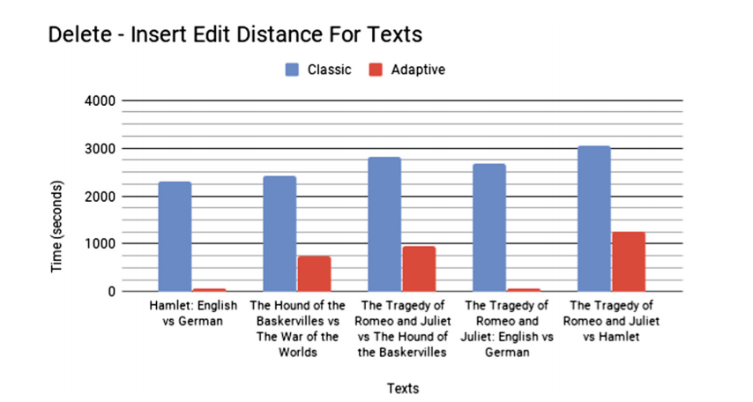
Experiments

Slide 17
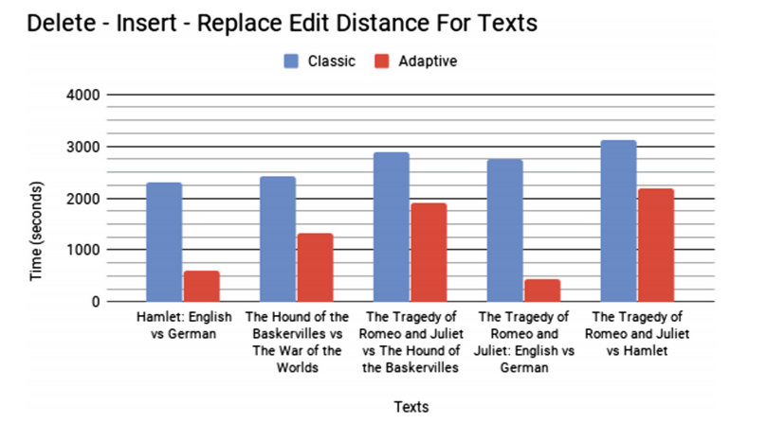
Experiments

Slide 18
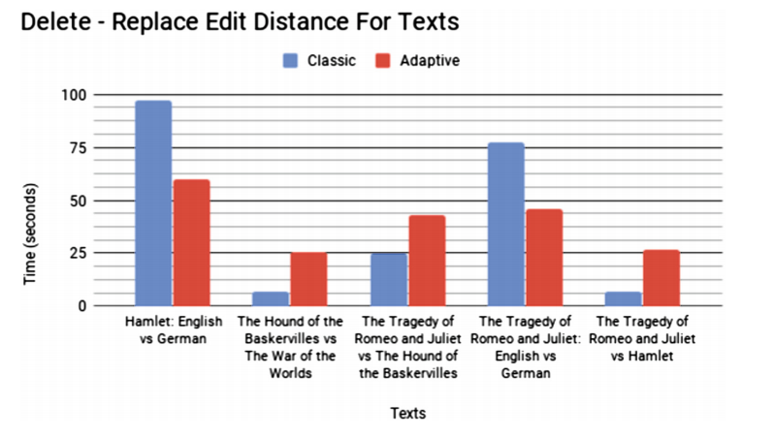
Experiments

