Slide 1
Optimal Suffix Tree Construction with Large Alphabets
Martin Farach
Rutgers University and Bell Labs
Proceedings 38th Annual Symposium on Foundations of Computer Science, 1997, IEEE. Miami Beach, FL, USA.
Presenter: KeXin Zhu
Date: 2019/09/25
Notes:
FOCS: http://cse.nsysu.edu.tw/files/11-1091-15069.php
Location：https://zh.wikipedia.org/wiki/%E8%BF%88%E9%98%BF%E5%AF%86%E6%B5%B7%E6%BB%A9
Bell Labs：https://zh.wikipedia.org/zh-tw/%E8%B4%9D%E5%B0%94%E5%AE%9E%E9%AA%8C%E5%AE%A4
Rutgers University ：https://zh.wikipedia.org/zh-tw/%E7%BD%97%E6%A0%BC%E6%96%AF%E5%A4%A7%E5%AD%A6

Slide 2
Abstract(1/2)
The suffix tree of a string is the fundamental data structure of combinatorial pattern matching. Weiner [Wei73], who introduced the data structure, gave an O(n)-time algorithm for building the suffix tree of an n-character string drawn from a constant size alphabet. In this comparison model, there is a trivial Ω(nlogn)-time lower bound based on sorting, and Weiner's algorithm matches this bound trivially. For integer alphabets, a substantial gap remains between the known upper and lower bounds, and closing this gap is the main open question in the construction of suffix trees.

Slide 3
Abstract(2/2)
There is no super-linear lower bound, and the fastest known algorithm was the O(nlogn) time comparison based algorithm. We settle this open problem by closing the gap: we build suffix trees in linear time for integer alphabet.

Slide 4
1 Introduction
Key of LCSk computation：
Quick test of A_{i−k+1...i} = B_{j−k+1...j}
Solution:
Longest common extension (LCE) by suffix array/tree

Slide 5
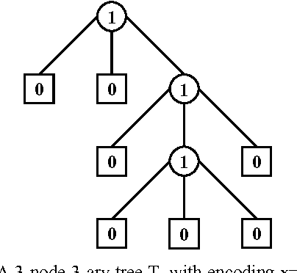
1 Introduction
T-ary tree：
Notes:
Ahrabian, H. and Abbas Nowzari-Dalini. “Parallel Generation of tary Trees.” (2005).

Slide 6
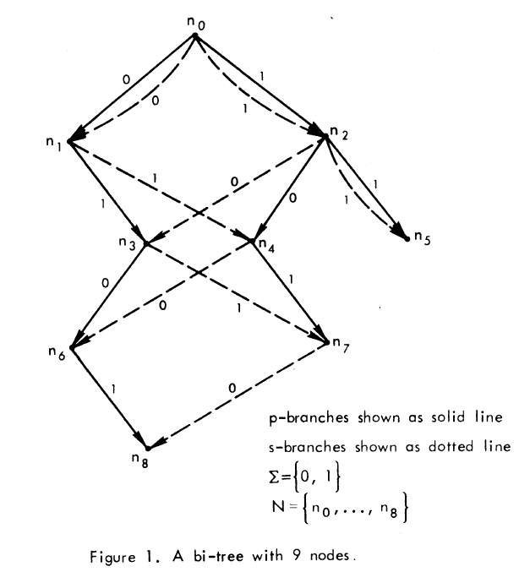
1 Introduction
Bi-tree ：
Notes:
Weiner, P. (1973). Linear pattern matching algorithms. 14th Annual Symposium on Switching and Automata Theory (swat 1973), IEEE.

Slide 7
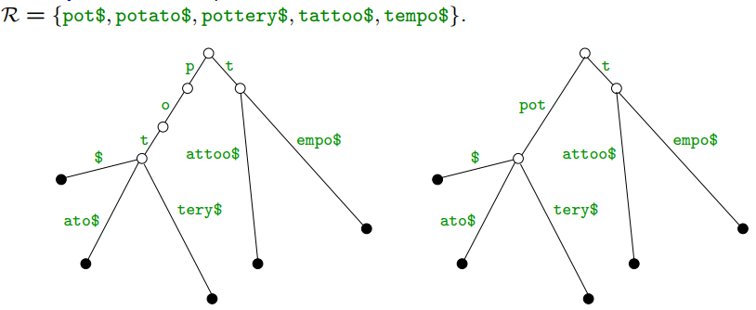
1 Introduction
Compact tries ：
Notes:
Weiner, P. (1973). Linear pattern matching algorithms. 14th Annual Symposium on Switching and Automata Theory (swat 1973), IEEE.

Slide 8
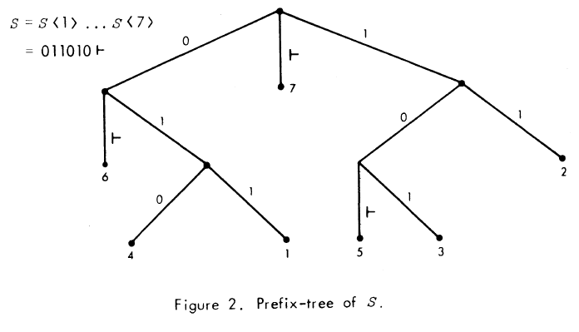
2 Wei73’s prefix tree
Prefix-tree of S = 011010￥ ：
Notes:
Weiner, P. (1973). Linear pattern matching algorithms. 14th Annual Symposium on Switching and Automata Theory (swat 1973), IEEE.

Slide 9
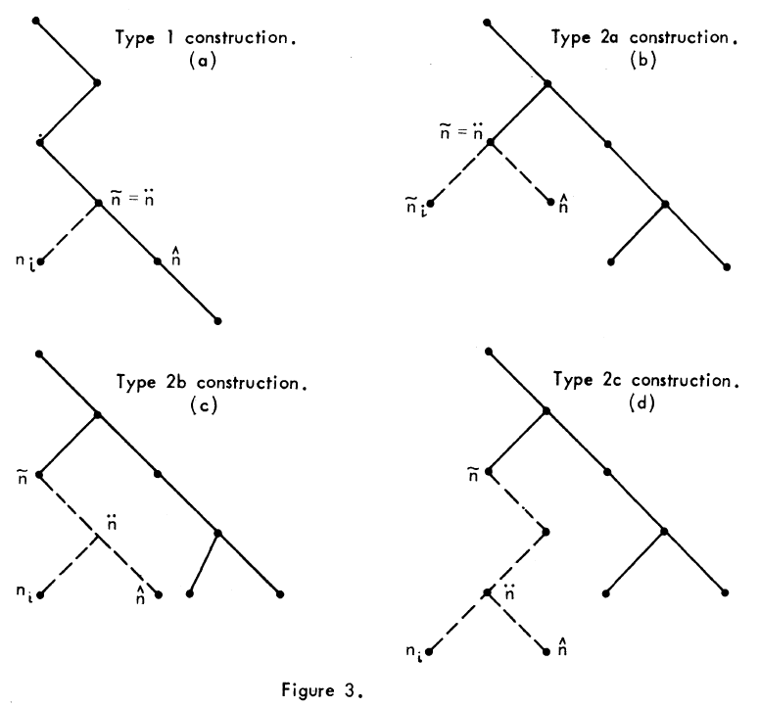
2 Wei73’s prefix tree
Different construction cases ：
Notes:
Weiner, P. (1973). Linear pattern matching algorithms. 14th Annual Symposium on Switching and Automata Theory (swat 1973), IEEE.

Slide 10
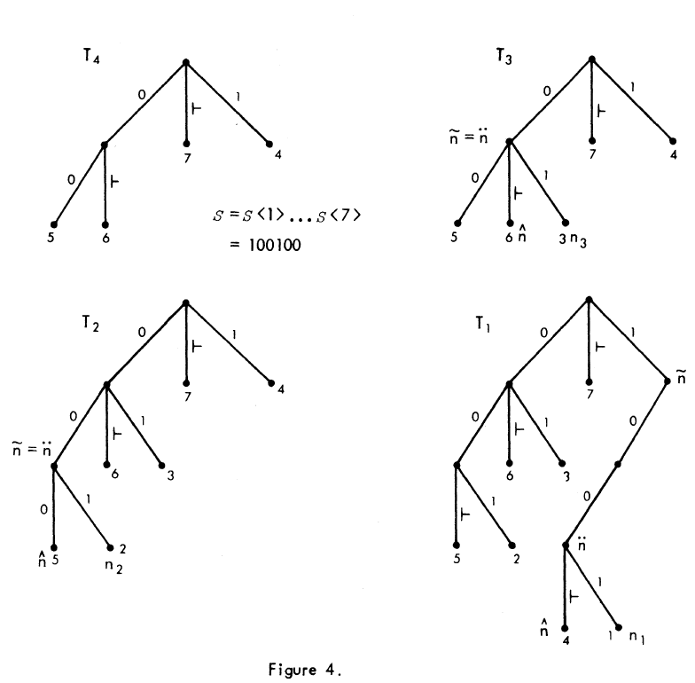
2 Wei73’s prefix tree
Direct construction：
Time complexity:
O(mlogm) at best.
Notes:
Weiner, P. (1973). Linear pattern matching algorithms. 14th Annual Symposium on Switching and Automata Theory (swat 1973), IEEE.

Slide 11
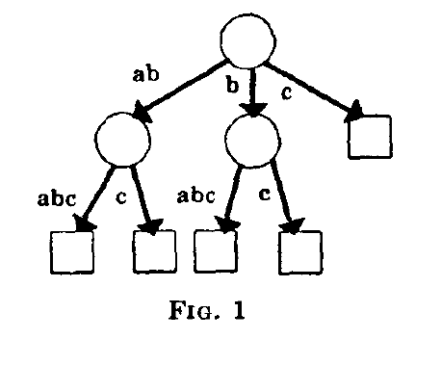
3 McC76’s prefix tree
Suffix tree of S = ababc￥ ：
Notes:
McCreight, E. M. (1976). "A space-economical suffix tree construction algorithm." Journal of the ACM (JACM) 23(2): 262-272.

Slide 12
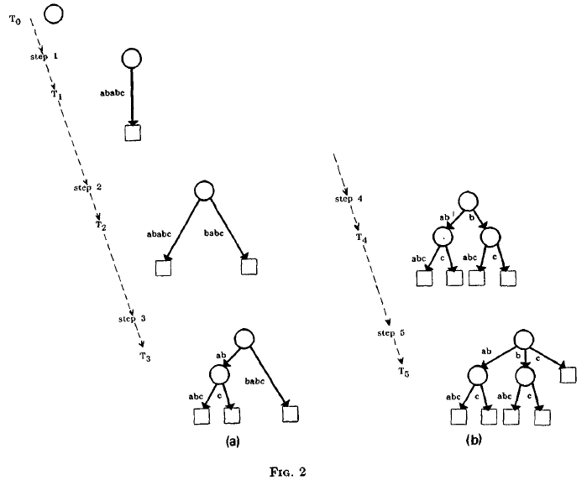
3 McC76’s prefix tree
Suffix tree construction steps of S = ababc￥：
For constant alphabet:
O(m).
For general alphabet:
O(mlogm).
Notes:
McCreight, E. M. (1976). "A space-economical suffix tree construction algorithm." Journal of the ACM (JACM) 23(2): 262-272.

Slide 13
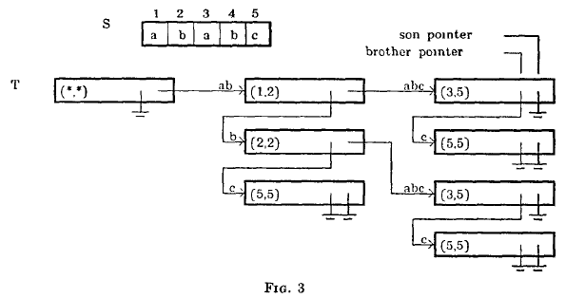
3 McC76’s prefix tree
The actual internal form of the tree：
Notes:
McCreight, E. M. (1976). "A space-economical suffix tree construction algorithm." Journal of the ACM (JACM) 23(2): 262-272.

Slide 14
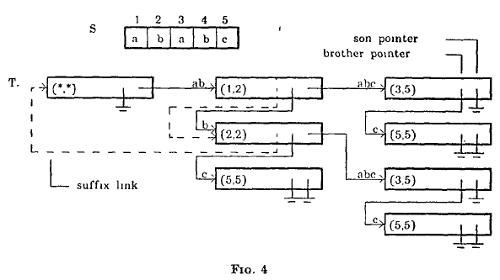
3 McC76’s prefix tree
Adding suffix links by dashed lines：
Notes:
McCreight, E. M. (1976). "A space-economical suffix tree construction algorithm." Journal of the ACM (JACM) 23(2): 262-272.

Slide 15
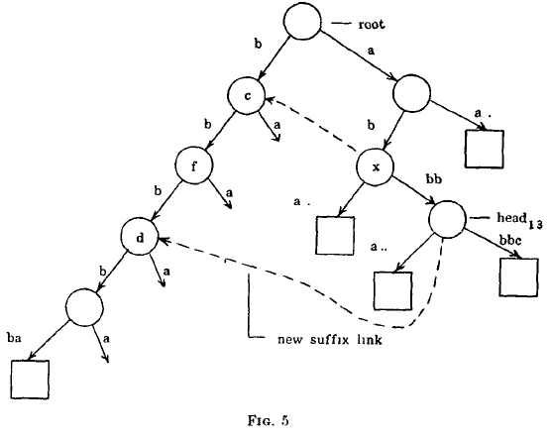
3 McC76’s prefix tree
Construction of S = b⁵abab³a²b⁵c￥ in step 14：
Notes:
McCreight, E. M. (1976). "A space-economical suffix tree construction algorithm." Journal of the ACM (JACM) 23(2): 262-272.

Slide 16
4 Suffix tree construction with integer alphabet
Construction steps：
(1) Building the odd tree T_{o};
(2) Building the even tree T_{e};
(3) Merging the trees T_{o} and T_{e}.

Slide 17
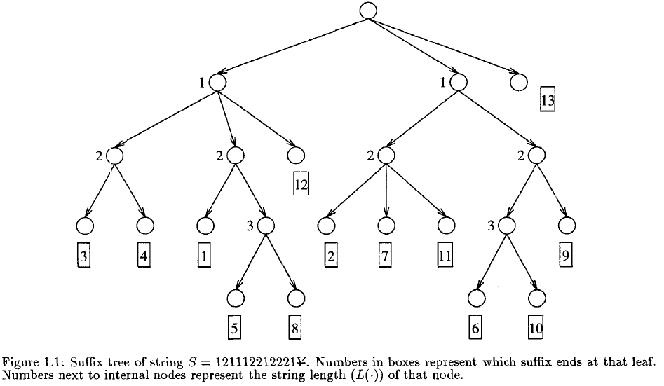
4 Suffix tree construction with integer alphabet
Suffix tree of string S = 121112212221￥：

Slide 18
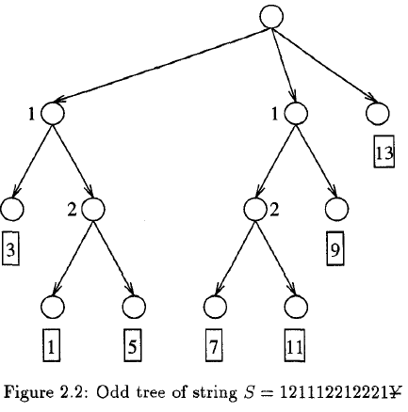
4 Suffix tree construction with integer alphabet
4.1 Building the odd tree：

Slide 19
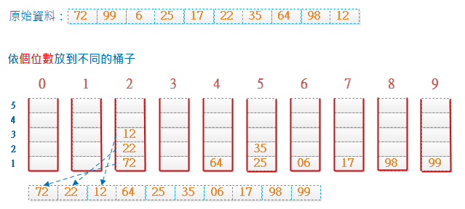
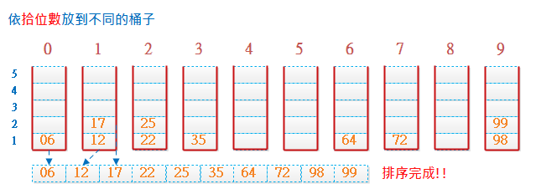
4 Suffix tree construction with integer alphabet
4.2 Building the even tree：
Radix sort:
Notes:
http://notepad.yehyeh.net/Content/Algorithm/Sort/Radix/Radix.php

Slide 20
4 Suffix tree construction with integer alphabet
4.2 Building the even tree：
Stable sort:
Stable sorting:
Before: 3,5,19,1,3*,10
After: 1,3,3*,5,10,19
Unstable sorting:
Before: 3,5,19,1,3*,10
After: 1,3*,3,5,10,19
Notes:
http://spaces.isu.edu.tw/upload/18833/3/web/sorting.htm

Slide 21

4 Suffix tree construction with integer alphabet
4.2 Building the even tree：
Steps:
(1) Order of the T_{o}: [3,1,5,7,11,9,13].
(2) Pair <S[2i], T_{o}[2i+1]> : [<2,3>, <1,5>, <2,7>, <2,11>, <1,9>, <1,13>].
(3) Stable radix sort: [<I,5>, <1,9>, <1,13>, <2,3>, <2,7>, <2,11>].
(4) Subtracting even order from second index: [4,8,12,2,6,10].
(5) Calculating Icp(l_{2i}, I_{2j}):

Slide 22
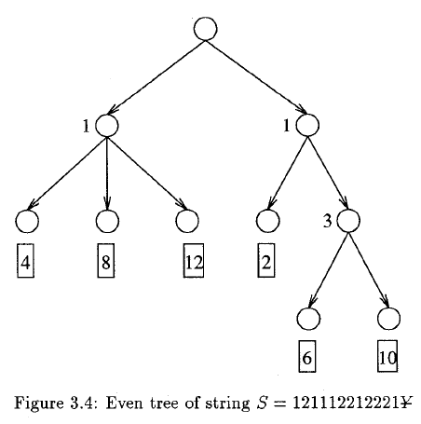
4 Suffix tree construction with integer alphabet
4.2 Building the even tree：

Slide 23
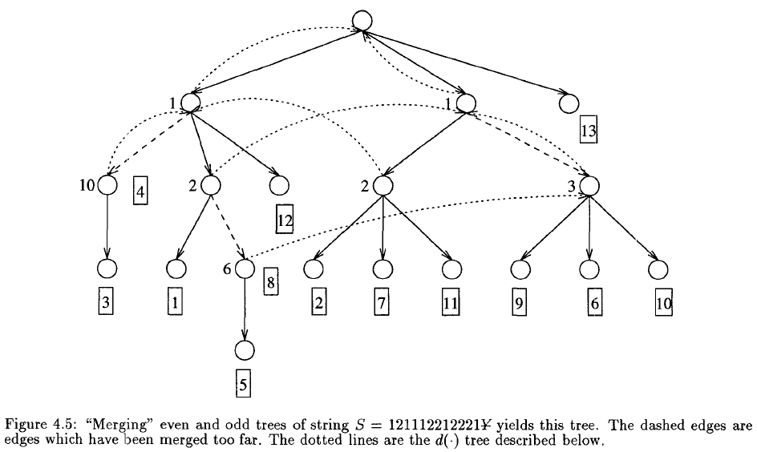
4 Suffix tree construction with integer alphabet
4.3 Merging the trees：
Coupled DFS:
For general alphabet:
O(m).

