Slide 1
A Decision-Theoretic
Generalization of On-Line Learning
and an Application to Boosting
Yoav Freund and Robert Elias Schapire
Journal of computer and system sciences Vol.55, pp.119-139 (1997)
Presenter : Chia-Lin Chen
Oct. 8th, 2019
Notes:
第一位作者是以色列人，第二位是美國人。當時他們在AT&T LAB工作
目前第二位作者在微軟工作。

Slide 2
Abstract(1/2)
In the first part of the paper we consider the problem of dynamically apportioning resources among a set of options in a worst-case on-line framework. The model we study can be interpreted as a broad, abstract extension of the well-studied on-line prediction model to a general decision-theoretic setting. We show that the multiplicative weight-update Littlestone Warmuth rule can be adapted to this model, yielding bounds that are slightly weaker in some cases, but applicable to a considerably more general class of learning problems.

Slide 3

Abstract(2/2)
We show how the resulting learning algorithm can be applied to a variety of problems, including gambling, multiple-outcome prediction, repeated games, and prediction of points in . In the second part of the paper we apply the multiplicative weight-update technique to derive a new boosting algorithm. This boosting algorithm does not require any prior knowledge about the performance of the weak learning algorithm. We also study generalizations of the new boosting algorithm to the problem of learning functions whose range, rather than being binary, is an arbitrary finite set or a bounded segment of the real line.

Slide 4
Introduction
“a weak learning algorithm that performs
just slightly better than random guessing into one with arbitrarily high accuracy.”
Adaptive Boosting
自適應增強

Slide 5
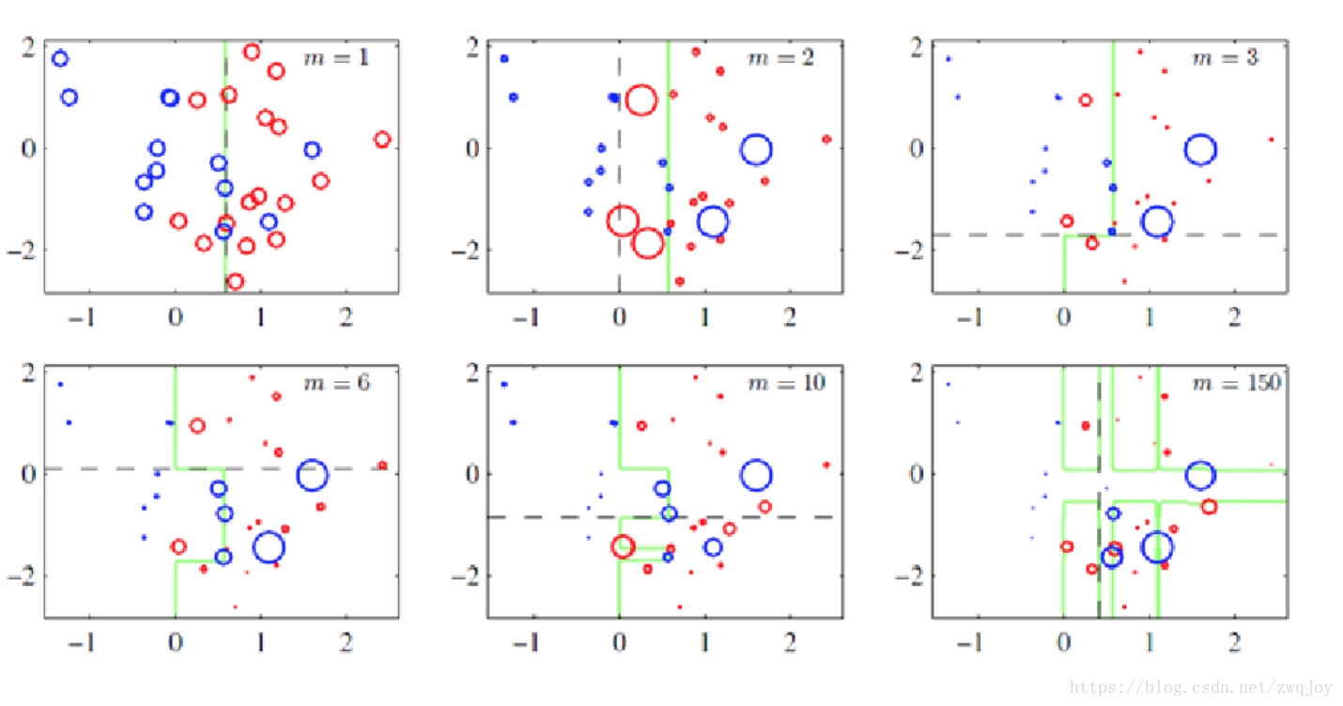
Each time step: boost itself

Slide 6
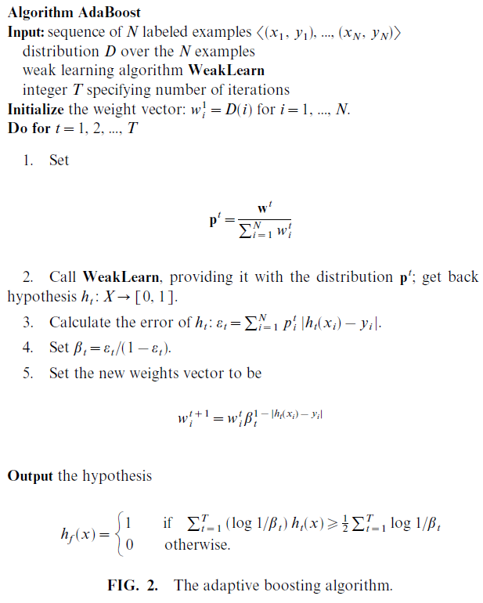
AdaBoost:
Adaptive Boosting

Slide 7
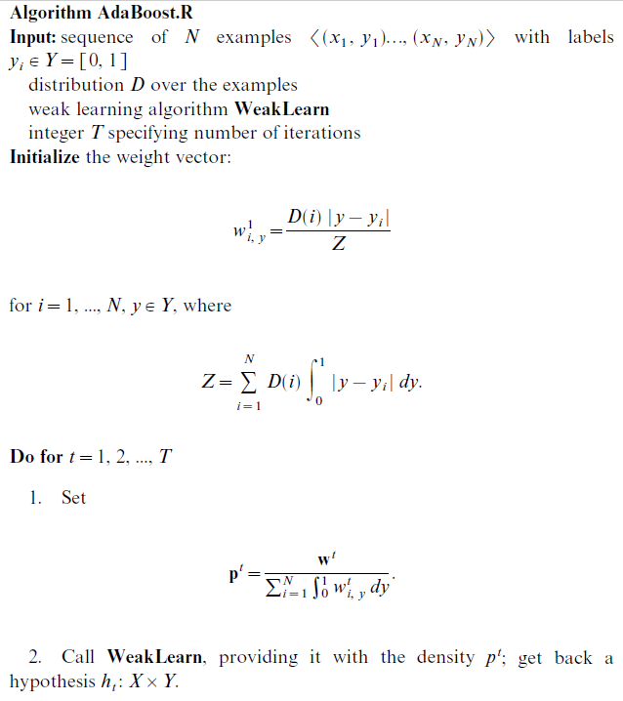

Slide 8
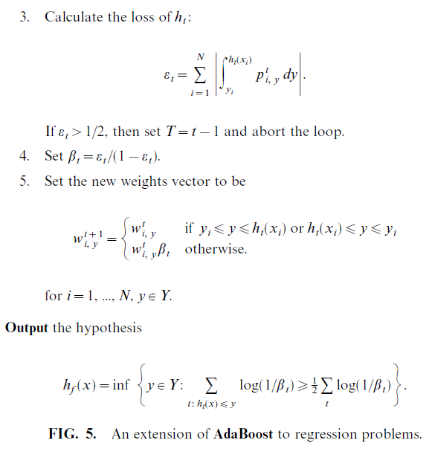

Slide 9
Thank You!

