Slide 1
Longest Common Subsequence in k Length Substrings
Gary Benson, Avivit Levy, and B. Riva Shalom
SISAP 2013, pp. 257–265
Presenter: Shao-Xuan Lee
Date: Oct. 8, 2019

Slide 2
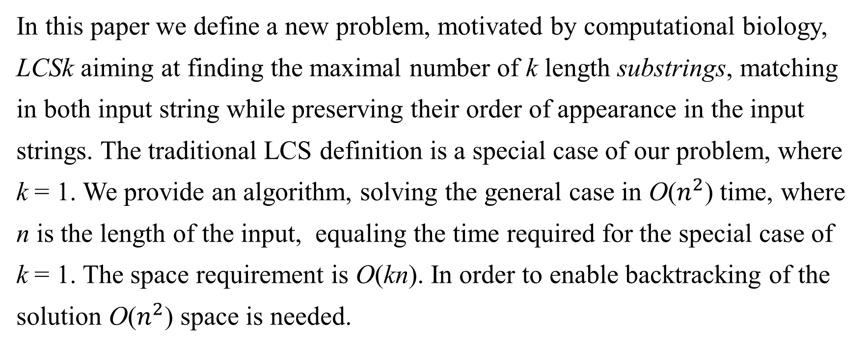
Abstract
In this paper we define a new problem, motivated by computational biology, LCSk aiming at finding the maximal number of k length substrings, matching in both input string while preserving their order of appearance in the input strings. The traditional LCS definition is a special case of our problem, where k = 1. We provide an algorithm, solving the general case in O($n^{2}$) time, where n is the length of the input, equaling the time required for the special case of k = 1. The space requirement is O(kn). In order to enable backtracking of the solution O($n^{2}$) space is needed.

Slide 3
LCSK(1/2)
12345678
A= CTTCCTTT
B= CTGCTTTG
LCS2 = CTCTTT

Slide 4
LCSK(2/2)
12345678
A= CTTCCTTT
B= CTGCTTTG
LCS3 = CTT,TTT

Slide 5
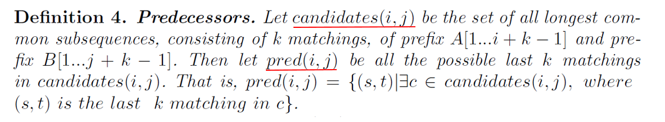
1 2 3 4 5 6 7 8
A = T G C G T G T G
B = G T T G T G C C
candidates(5,3) contains{TG, GT}, TG can be obtained in two ways:
a₁a₂ matched to b₃b₄, or a₅a₆ matched to b₃b₄, and GT by a₄a₅ matched to b₁b₂
pred(5,3) = {(1,3), (5,3), (4,1)}

Slide 6
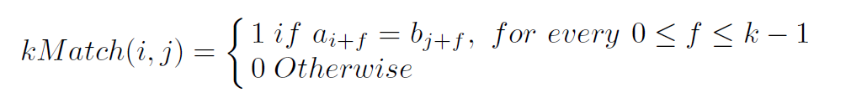
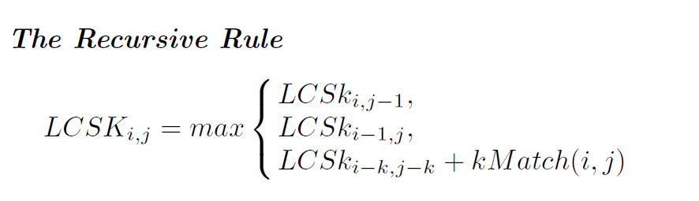

Slide 7
 | 1 C | 2 T | 3 G | 4 T | 5 C | 6 T | 7 T | 8 T
1 C | 1 (1,1)
2 T
3 G
4 C
5 T
6 T
7 T
8 G

Slide 8
 | 1 C | 2 T | 3 G | 4 T | 5 C | 6 T | 7 T | 8 T
1 C | 1 (1,1) | 1 (1,1) | 1 (1,1) | 1 (1,1) | 1 (1,1)(1,5)
2 T
3 G
4 C
5 T
6 T
7 T
8 G

Slide 9
 | 1 C | 2 T | 3 G | 4 T | 5 C | 6 T | 7 T | 8 T
1 C | 1 (1,1) | 1 (1,1) | 1 (1,1) | 1 (1,1) | 1 (1,1)(1,5) | 1 (1,5) | 1 (1,5)
2 T
3 G
4 C
5 T
6 T
7 T
8 G

Slide 10
 | 1 C | 2 T | 3 G | 4 T | 5 C | 6 T | 7 T | 8 T
1 C | 1 (1,1) | 1 (1,1) | 1 (1,1) | 1 (1,1) | 1 (1,1)(1,5) | 1 (1,5) | 1 (1,5)
2 T | 1 (1,1) | 1 (1,1) (2,2)
3 G
4 C
5 T
6 T
7 T
8 G

Slide 11
 | 1 C | 2 T | 3 G | 4 T | 5 C | 6 T | 7 T | 8 T
1 C | 1 (1,1) | 1 (1,1) | 1 (1,1) | 1 (1,1) | 1 (1,1)(1,5) | 1 (1,5) | 1 (1,5)
2 T | 1 (1,1) | 1 (1,1)(2,2) | 1 (1,1) | 1 (1,1) | 1 (1,1)(1,5) | 1 (1,5) | 1 (1,5)
3 G | 1 (1,1) | 1 (1,1) | 1 (1,1) | 1 (1,1) | 1 (1,1)(1,5) | 1 (1,5) | 1 (1,5)
4 C | 1 (4,1) | 1 (4,1) | 1 (1,1)(4,1) | 1 (4,1) | 2 (4,5)
5 T
6 T
7 T
8 G

Slide 12
 | 1 C | 2 T | 3 G | 4 T | 5 C | 6 T | 7 T | 8 T
1 C | 1 (1,1) | 1 (1,1) | 1 (1,1) | 1 (1,1) | 1 (1,1)(1,5) | 1 (1,5) | 1 (1,5)
2 T | 1 (1,1) | 1 (1,1)(2,2) | 1 (1,1) | 1 (1,1) | 1 (1,1)(1,5) | 1 (1,5) | 1 (1,5)
3 G | 1 (1,1) | 1 (1,1) | 1 (1,1) | 1 (1,1) | 1 (1,1)(1,5) | 1 (1,5) | 1 (1,5)
4 C | 1 (4,1) | 1 (4,1) | 1 (1,1)(4,1) | 1 (4,1) | 2 (4,5) | 2 (4,5) | 2 (4,5)
5 T | 1 (4,1) | 1 (4,1) | 1 (4,1) | 1 (4,1) | 2 (4,5) | 2 (4,5)(5,6) | 2 (4,5)(5,7)
6 T | 1 (4,1) | 1 (4,1) | 1 (4,1) | 1 (4,1) | 1 (4,5) | 2 (4,5)(6,6) | 3 (6,7)
7 T
8 G

Slide 13
 | 1 C | 2 T | 3 G | 4 T | 5 C | 6 T | 7 T | 8 T
1 C | 1 (1,1) | 1 (1,1) | 1 (1,1) | 1 (1,1) | 1 (1,1)(1,5) | 1 (1,5) | 1 (1,5)
2 T | 1 (1,1) | 1 (1,1)(2,2) | 1 (1,1) | 1 (1,1) | 1 (1,1)(1,5) | 1 (1,5) | 1 (1,5)
3 G | 1 (1,1) | 1 (1,1) | 1 (1,1) | 1 (1,1) | 1 (1,1)(1,5) | 1 (1,5) | 1 (1,5)
4 C | 1 (4,1) | 1 (4,1) | 1 (1,1)(4,1) | 1 (4,1) | 2 (4,5) | 2 (4,5) | 2 (4,5)
5 T | 1 (4,1) | 1 (4,1) | 1 (4,1) | 1 (4,1) | 2 (4,5) | 2 (4,5)(5,6) | 2 (4,5)(5,7)
6 T | 1 (4,1) | 1 (4,1) | 1 (4,1) | 1 (4,1) | 2 (4,5) | 2 (4,5)(6,6) | 3 (6,7)
7 T | 1 (4,1) | 1 (4,1)(7,2) | 1 (4,1) | 1 (4,1) | 2 (4,5) | 2 (4,5) | 3 (6,7)
8 G

Slide 14
 | 1 C | 2 T | 3 G | 4 T | 5 C | 6 T | 7 T | 8 T
1 C | 1 (1,1) | 1 (1,1) | 1 (1,1) | 1 (1,1) | 1 (1,1)(1,5) | 1 (1,5) | 1 (1,5)
2 T | 1 (1,1) | 1 (1,1)(2,2) | 1 (1,1) | 1 (1,1) | 1 (1,1)(1,5) | 1 (1,5) | 1 (1,5)
3 G | 1 (1,1) | 1 (1,1) | 1 (1,1) | 1 (1,1) | 1 (1,1)(1,5) | 1 (1,5) | 1 (1,5)
4 C | 1 (4,1) | 1 (4,1) | 1 (1,1)(4,1) | 1 (4,1) | 2 (4,5) | 2 (4,5) | 2 (4,5)
5 T | 1 (4,1) | 1 (4,1) | 1 (4,1) | 1 (4,1) | 2 (4,5) | 2 (4,5)(5,6) | 2 (4,5)(5,7)
6 T | 1 (4,1) | 1 (4,1) | 1 (4,1) | 1 (4,1) | 2 (4,5) | 2 (4,5)(6,6) | 3 (6,7)
7 T | 1 (4,1) | 1 (4,1)(7,2) | 1 (4,1) | 1 (4,1) | 2 (4,5) | 2 (4,5) | 3 (6,7)
8 G

Slide 15
LCSK time complexity
Time complexity: O(n²)
Space complexity: O(kn)
Backtracking time complexity: O(m)
where m is the number of k matching in the solution
Backtracking space complexity: O(n²)

