Slide 1
A Neural Network Primer
H. Abdi
Journal of Biological Systems, Vol. 2(3), pp. 247-283, (1994)
Presenter: Jen-Hui, Wang
Date: Dec. 28, 2006

Slide 2
Abstract
Neural networks are composed of basic units somewhat analogous to neurons. These units are linked to each other by connections whose strength is modifiable as a result of a learning process or algorithm. Each of these units integrates independently (in parallel) the information provided by its synapses in order to evaluate its state of activation. The unit response is then a linear or nonlinear function of its activation. Linear algebra concepts are used, in general, to analyze linear units, with eigenvectors and eigenvalues being the core concepts involved. This analysis makes clear the strong similarity between linear neural networks and the general linear model developed by statisticians. The linear models presented here are the perceptron, and the linear associator.

Slide 3
Abstract (cont.)
The behavior of nonlinear networks can be described within the framework of optimization and approximation techniques with dynamical systems (e.g., like those used to model spin glasses). One of the main notions used with nonlinear unit networks is the notion of attractor. When the task of the network is to associate a response with some specific input patterns, the most popular nonlinear technique consists of using hidden layers of neurons trained with back-propagation of error. The nonlinear models presented are the Hopfield network, the Boltzmann machine, the back-propagation network, and the radial basis function network.

Slide 4
The Perceptron
The perceptron can be considered as the first important implementation of artificial neural networks It was created in the fifties by Rosenblatt, the perceptron was designed to mimic or to model perceptual activities.
The main goal was to associate binary configurations patterns (i.e., patterns of [0,1] values) presented as inputs on a (artificial) retina with specific binary outputs

Slide 5
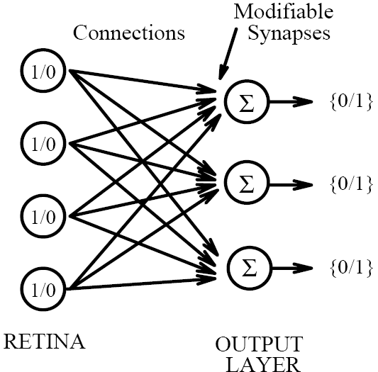
The Perceptron (cont.)
the perceptron is made of two layers: the input layer (i.e., the “retina” ) and the output layer (the “association layer”)
The activation of the cells of the input layer is transmitted to the cells of the output layer through connections (“synapses”) which can change the intensity of the signal

Slide 6
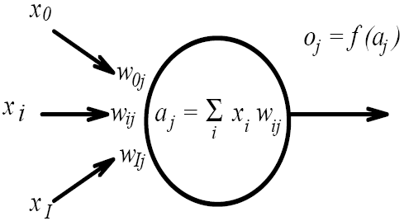
The Perceptron (cont.)
The output cell of a perceptron. The inputs are noted x_{i}, the synaptic weights are noted w_{i,j}, the total activation of the cell is noted a_{j}, its response or output, noted o_{j}

Slide 7
The Perceptron (cont.)
The cells of the output layer compute their state of activation as a function of the stimulation they receive through the synapses, and then give a (binary) response as a function of their state of activation.
The response is then obtained by thresholding the activation (i.e., the cell will be in the active state only if its activation level is larger than a given threshold)

Slide 8
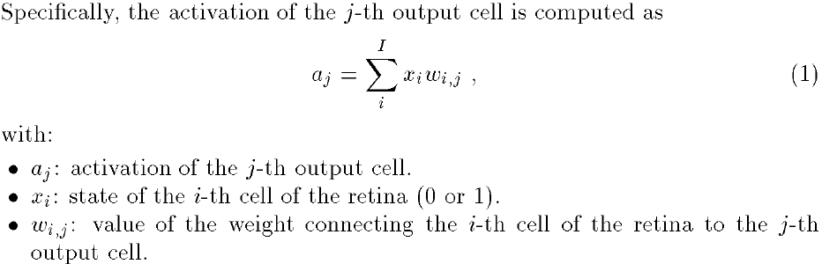
The Perceptron (cont.)

Slide 9


The Perceptron (cont.)
The output cells will then take either the active state (1) or the inactive state (0) if their level of activation is greater or less than their threshold noted θ_{j} (quite often θ_{j} is set to 0)
The threshold is modifiable by learning (like the weights). Actually, thresholding is often implemented by setting an input cell always active (the 0-th input cell) so that the weight w_{0,j} is equal to –θ_{j} (response bias)

Slide 10
Learning rule
The main problem for the perceptron is to learn how to adjust the synaptic weights in order to give the desired response for a given stimulus
The famous learning rule
  Widrow-Hoff learning rule, Delta rule
Widrow-Hoff learning rule
  This type of learning is referred to as supervised learning
  The output cells must be provided with the correct response so that they can compute an error signal
The output cells must know the state of the input cells, however, do not need to know the response of the other output cells

Slide 11

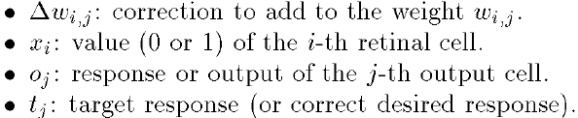

Widrow-Hoff learning rule
A cell will learn only if it makes a mistake (i.e., error signal is not zero)
The weights are adjusted and the learning procedure terminates as soon as the perceptron makes no error

Slide 12
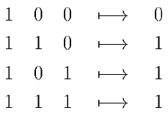
An example: learning the logical function OR
This perceptron is composed of three input cells two cells for the values of the argument of the logical function plus one cell (x₀) to implement threshold, and one output cell

Slide 13
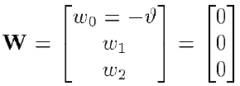

An example: learning the logical function OR
Supposing the synaptic weights are initialized to zero
The first randomly chosen association is [1,1,1]
The incorrect response of the perceptron is 0

Slide 14
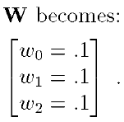
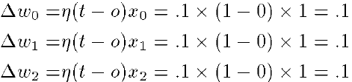
An example: learning the logical function OR
The error is the difference between the target value and the response of the output cell
Suppose that the learning constant η is set to the valueη= 0.1, and Widrow-Hoff learning rule is used

Slide 15

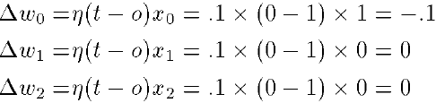
An example: learning the logical function OR
Suppose, now, that the first stimulus [1,0,0] is presented to the perceptron
The response of the output cell is 1, the correction to apply to the synaptic weights

Slide 16
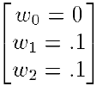
An example: learning the logical function OR
When the error correction rule is applied, W becomes:
With this set of weights, the perceptron is now able to give perfect answers for the OR problem

Slide 17
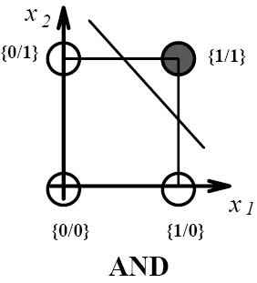
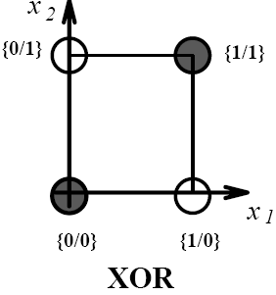
Evaluation of the perceptron
Because the activation of the output cell is a linear combination of the retinal input cells, the perceptron can learn only to discriminate linearly separable categories
If the categories are linearly separable, then if the learning constant η is small enough, convergence is guaranteed
Example of nonlinearly separable function: XOR

Slide 18
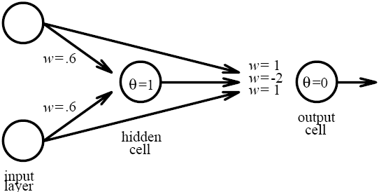

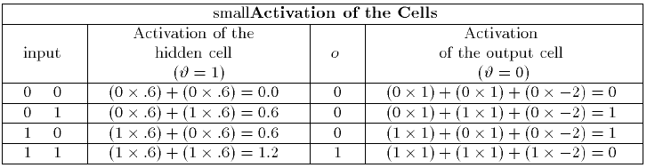
Evaluation of the perceptron
Several algorithms (the most popular of which is back propagation) make it possible for a perceptron with at least one hidden layer to implement the XOR logical function

Slide 19
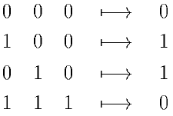
Evaluation of the perceptron
Another way of coping with a nonlinearly separable problem is to recode it in order to make it linearly separable
  For example, a third input cell is added and provided with the product of the two remaining cells
The following set of weights will then solve the XOR problem

Slide 20
Linear associators
They come in two forms
  Hetero-associator
  Auto-associators
The hetero-associators can be used to learn associations between input and output patterns
The auto-associator is a special case of the hetero-associator in which the association between an input pattern and itself is learned, it is used widely as a pattern recognition and pattern completion devices

Slide 21
Linear associators - Notation
f_{k}: Stimuli are represented by I × 1vector, k indicates the stimulus number, in general, input vectors are normalized so that f_{k}^{T}f_{k} = 1
g_{k}: The responses of the network are given by J × 1vector
F: The complete set of K stimuli is represented by a K × I matrix, in which the k-th row is f_{k}^{T}
G: The set of the K responses is represented by a K × J matrix, in which the k-th row is g_{k}^{T}
W: The J × I synaptic weight matrix
w_{i,j}: the weight corresponding to the connection between the i-th and the j-th output cell

Slide 22



Linear associators
The Hebbian learning rule in linear associators sets the change in the synaptic weights to be proportional to the product of the input and the output
If the proportionality constant is set to 1, the association between the k-th stimulus and the k-th response leads to the creation of the weight matrix.
The response of the associator is denoted , with just one association stored, it is easy to show that the associator estimates g_{k} perfectly

Slide 23


Linear associators
To implement several associations, the W_{k} matrices are summed in order to give W:
The estimation of the k-th response by the associator is obtained as:
In general, the quality of the associator estimation is evaluated by comparing and g_{k}
If the stimuli are pairwise orthogonal
  cos(f_{k}, f_{k’}) = 0 and = g_{k}, the responses perfectly
cross-talk

Slide 24
Linear associators – back to the general case
In order to improve the performance of linear associators, several learning rules have been proposed, the most popular one is clearly the Widrow-Hoff learning rule
Widrow-Hoff learning rule is an iterative procedure correcting the error between the target response and the actual response of the network
In matrix notation, the Widrow-Hoff rule is:
W_{(t)} being the weight matrix at step t, ηbeing a (small) positive constant, and k being randomly chosen

Slide 25
Non-linear systems (auto-associator)
As with the perceptron, several nonlinear extensions of auto-associator have been developed. These models include the Hopfield net , Brain-State-in-a-Box
Acting as content-addressable memories, these nonlinear auto-associators try to find, among the patterns stored, the one closest to the stimulus

Slide 26


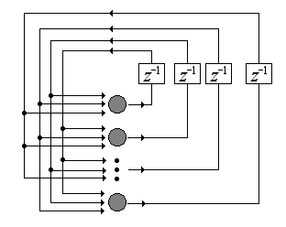

Hopfield Nets
It is an asynchronous nonlinear auto-associator
f_{k}: the k-th stimulus to be stored is represented by an I × 1 binary vector, taking values 0 or 1
: the set of thresholds for the I units is denoted
From the f_{k} vectors, new recoded vector denoted h_{k} :
The weight matrix is obtained as

Slide 27
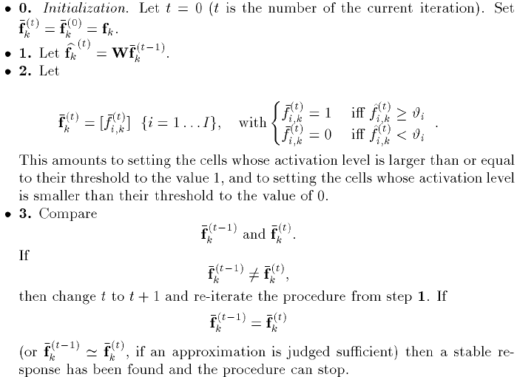
A stimulus is “recall” by presenting a “cue”, when f_{k} is used as a cue, recall from the memory is obtained through the following step

